Slide 1
SRI INDU COLLEGE OF ENGINEERING AND TECHNOLOGY
MAJOR PROJECT SEMINAR
CSE DEPARTMENT
SEMI-SUPERVISED MACHINE LEARNING APPROACH FOR DDOS ATTACKS
PRESENTED BY:
U.AISHWARYA (18D41A05J8)
Y.AKSHAYA (18D41A05L1)
P.BHARAT (18D41A05M4)
SANDEEP (18D41A05N4)
GUIDED BY:
NAVEEN CHAKRAVARTHI

Slide 2
Introduction What is Machine Learning?
Machine learning is an application of artificial intelligence (AI) that provides systems the ability to automatically learn and improve from experience without being explicitly programmed.
Machine learning algorithms:
Supervised
Un-supervised
Semi-supervised
Reinforcement

Slide 3
Supervised machine learning algorithms can apply what has been learned in the past to new data using labeled examples to predict future events.
In contrast, unsupervised machine learning algorithms are used when the information used to train is neither classified nor labeled.
Semi-supervised machine learning algorithms fall somewhere in between supervised and unsupervised learning, since they use both labeled and unlabeled data for training – typically a small amount of labeled data and a large amount of unlabeled data.
Reinforcement machine learning algorithms is a learning method that interacts with its environment by producing actions and discovers errors or rewards.

Slide 4
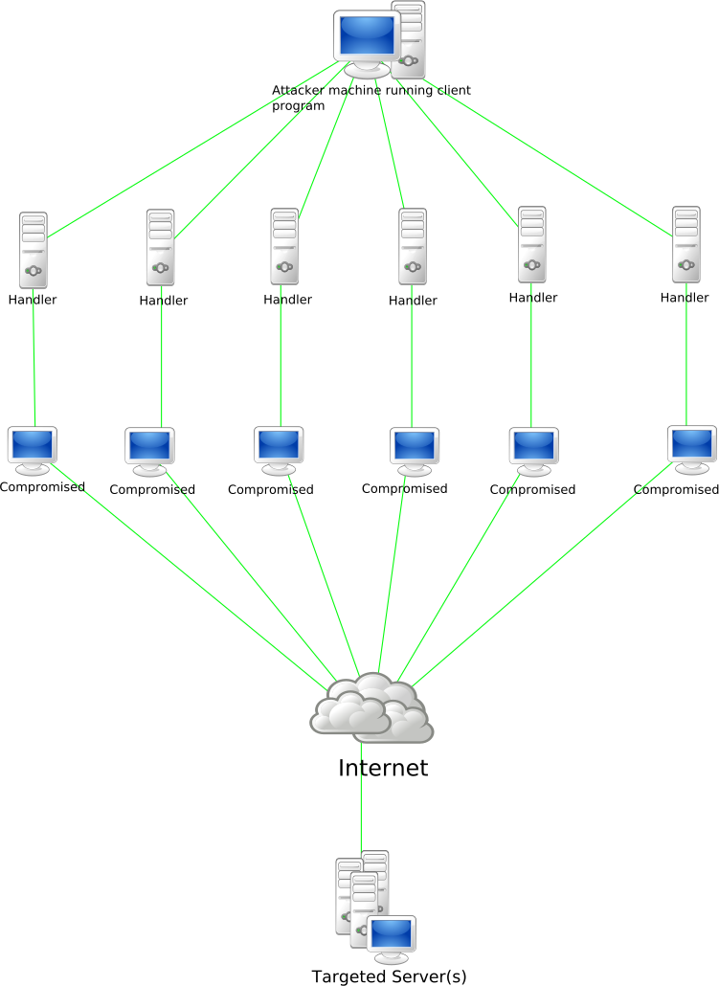
What is DDOS Attack?
In computing, a denial-of-service attack is a cyber-attack in which the perpetrator seeks to make a machine or network resource unavailable to its intended users by temporarily distributing services of a host connected to internet.
Fig. Denial Of Service

Slide 5
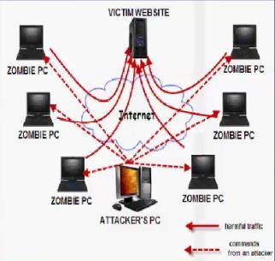
Distributed Denial -Of -Service Attack
A distributed denial-of-service (DDoS) attack occurs when multiple systems flood the bandwidth or resources of a targeted system, usually one or more web servers.Such an attack is often the result of multiple compromised systems (for example, a botnet) flooding the targeted system with traffic.

Slide 6
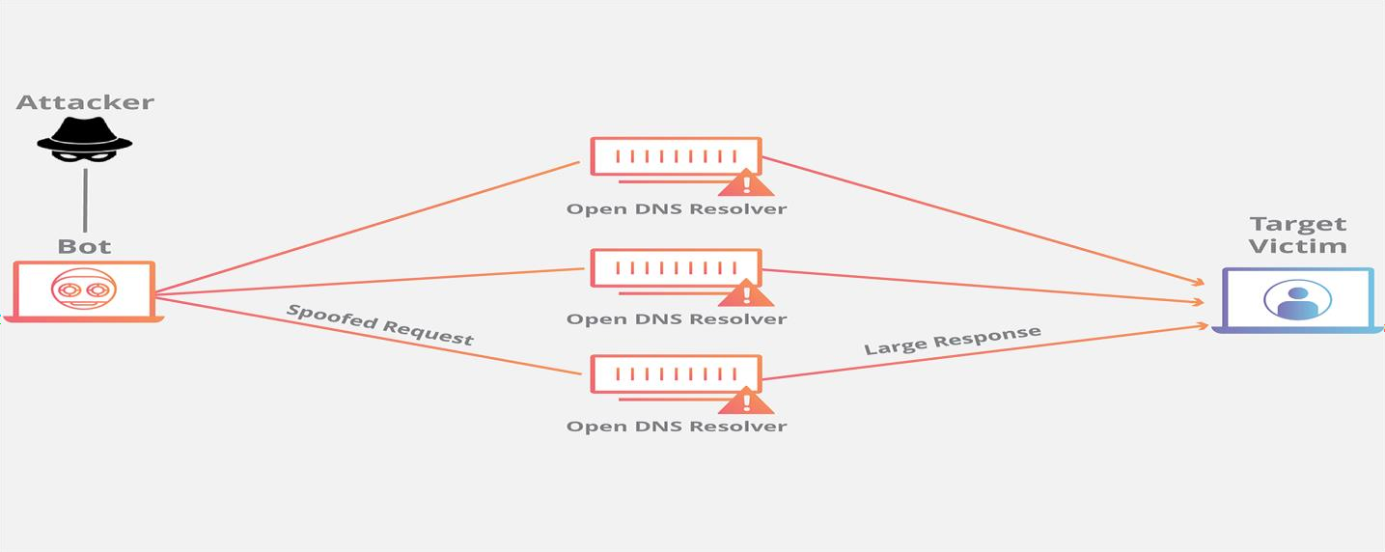
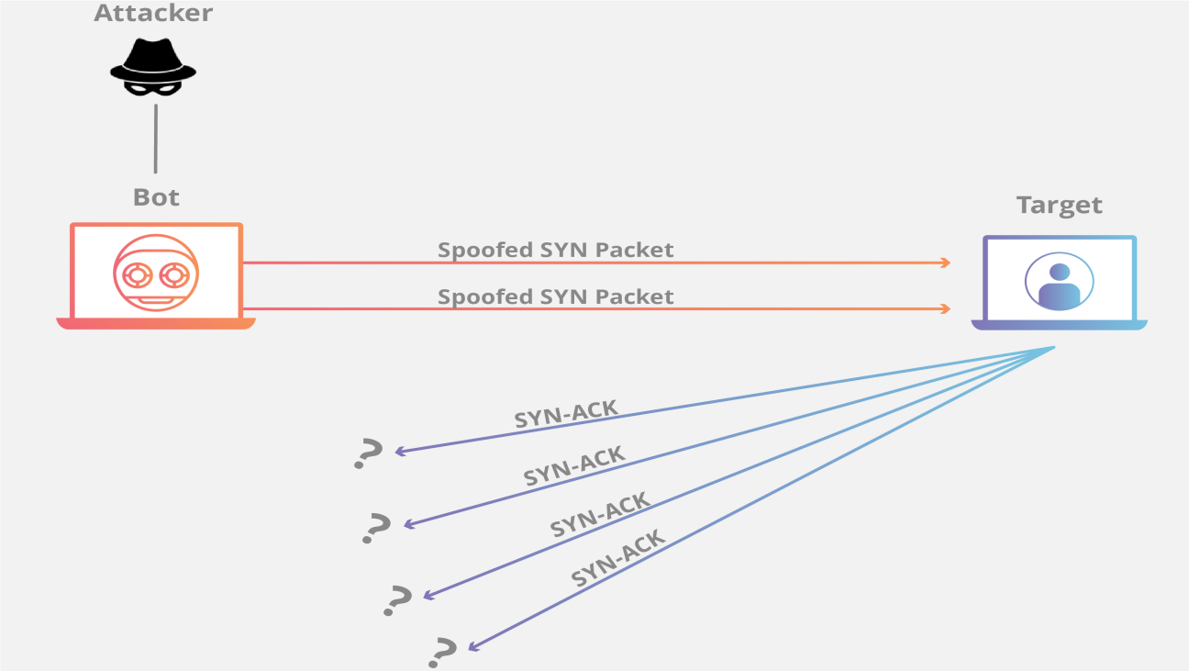
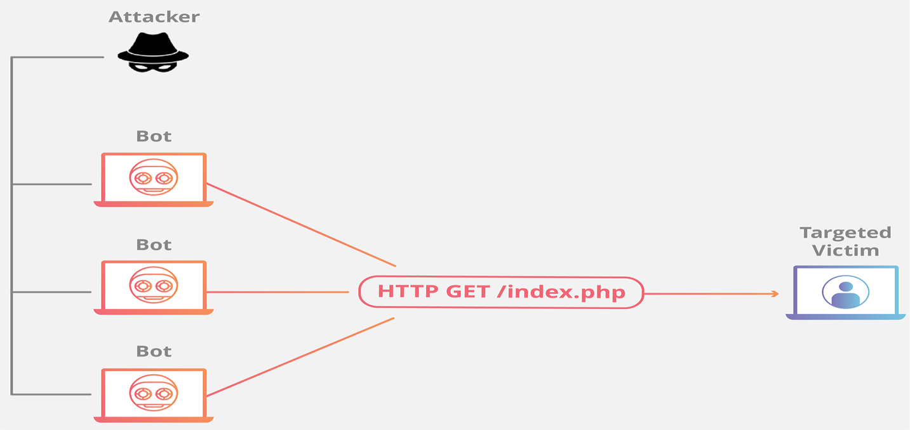
Types of DDOS Attacks
Volume based Attacks
Protocol Attacks
Application layer Attacks
Volume Based Attack
Protocol Based Attack
Application Layer Attack

Slide 7
Impact of ddos attack
DoS doesn’t usually try to steal information or lead to a security breach, but the loss of
reputation for the affected company can still cost a large amount of time and money. Often customers also decide to switch to an alternative provider, as they fear future security issues, or simply can’t afford to have an unavailable service. A DoS attack lends itself to activists andblackmailers – not really the best situation for companies to find themselves in.

Slide 8
Real time examples of DDOS attacks
January 2016: The latest target of a sophisticated DDos attack saw some of the HSBC customers losing access to their online banking accounts two days before the tax payment deadline in the UnitedKingdom.
Spring 2015: UK-based phone carrier Carphone Warehouse gets targeted by a DDos attack – while hackers steal millions of customers’data.
Summer 2014: A massive 300 Gbps DDoS attack exploited flaws of 100,000 unpatched servers, joined together as a botnet. An unidentified data centre was faced with the extremely huge scale of a DDoSattack.
In 2013: 39 attacks above 100 Gbps (Gigabits per second), which have steadily increased overtime.

Slide 9
Existing system
Supervised approach
Supervised ML approaches that use generated labeled network traffic datasets to build the detection model.
Disadvantages of supervised approach
The Generation of labelled network traffic data sets is costly in terms of computational cost andtime.
Without a continuous update of their detection models, the supervised machine learning approaches are unable to predict the new legitimate and attack behaviours.
The presence of large amount of irrelevant normal data is incoming network traffic is noisy and reduces the performance of supervised MLclassifiers.

Slide 10
Unsupervised approach
The unsupervised approaches no labeled dataset is needed to build the detection model. The DDoS and the normal traffics are distinguished based on the analysis of their underlying distribution characteristics.
Disadvantages of supervised approach:
The main drawback of the unsupervised approaches is the high false positiverates.
In the high dimensional network traffic data, the distance between points becomes meaningless and tends to homogenize. This problem, known as the curse of dimensionality prevents unsupervised approaches to accurately detectattacks

Slide 11
Semi supervised approach
The semi-supervised ML approaches are taking advantages of both supervised and unsupervised approaches by the ability to work on labeled and unlabeled datasets. Also, the combination of supervised and unsupervised approaches allows to increase accuracy and decreases the false positive rates. However, semi-supervised approaches are also challenged by the drawbacks both approaches. Hence, the semi-supervised approaches a sophisticated implementation of its components in order to overcome the drawbacks of supervised and unsupervised approaches.

Slide 12
Our approach constitutes of two main parts unsupervised and supervised.
The unsupervised part includes entropy estimation, co-clustering and information gain ratio. The supervised part is the Extra-Trees ensemble classifiers. The unsupervised part of our approach allows to reduce the irrelevant and noisy normal traffic data, hence reducing false positive rates and increasing accuracy of the supervised part. Whereas, the supervised part is used to reduce the false positive rates of the unsupervised part and to accurately classify the DDoS traffic.

Slide 13
Disadvantages of existing system
The proposed approach consists of five major steps: Datasets pre-processing, estimation of network traffic Entropy, online co-clustering, information gain ratio.
The aim of splitting the anomalous network traffic is to reduce the amount of data to be classified by excluding the normal cluster for the classification. For DDoS detection normal traffic records are irrelevant and noisy as the normal behaviors continue to evolve. Most of the time the new unseen normal traffic instances cause the increase of the false positive rate and the decrease of the classification accuracy. Hence, excluding some noisy normal instances of the network traffic data for classification is beneficial in terms of low false positive rates and classification accuracy. Assuming that after the network traffic clustering one cluster contains only normal traffic, a second one contains only DDoS traffic and a third one contains both DDoS and normal traffic.

Slide 14
Proposed system
This section introduces our methodology to detect the DDOS attack. The five-fold steps application process of data mining techniques in network systems discussed in characterizes the followed methodology.
The main aim of combining algorithms used in the proposed approach is to reduces noisy and irrelevant network traffic data before preprocessing and classification stages for DDOS detection while maintaining high performance in terms of accuracy, false positive rate and running time, and low resources usage. Our approach starts with estimating the entropy of the FSD features over a time-based sliding window.
The focus only on the suspected time windows allows to filter important amount of network traffic data, therefore only relevant data is selected for the remaining steps of the proposed approach

Slide 15
Software & hardware requirements
Software Requirements
Language : Python, HTML, CSS
Operating System : Windows
Software : Django, MySQL
Applications Used : Wamp Server, PyCharm
Hardware Requirements
Processor : Pentium IV or higher
RAM : 256 MB
Space on Hard Disk : minimum512MB
Keyboard : 110 Keys enhanced
Monitor : 14’’ color Display
Mouse : Optical Mouse

Slide 16
Modules
There are four modules can be divided here for this project they are listed as below
User Apps
DDOS Attack Deduction
Classifications of DDOS attack
Graphical analysis
User Apps:
User handling for some various times of smart phones, desktops laptops and tablets. If any kind of devices attacks for some unauthorized Malware software’s. In this Malware on threats for user personal dates includes for personal contact, bank account numbers and any kind of personal documents are hacking impossible.
DDOS Attack Deduction:
User search the any link Notably, not all network traffic data generated by malicious apps correspond to malicious traffic.
Many malwares take the form of repackaged benign apps; thus, Malware can also contain the basic functions of a benign app. Subsequently, the network traffic they generate can be characterized by mixed benign and malicious network traffic.
We examine the traffic flow header using Co-clustering algorithm from the natural language processing(NLP).

Slide 17
Classifications of DDOS attack:
Here, we compare the classification performance of Co-clustering algorithm with other popular machine learning algorithms.
We have selected several popular classification algorithms. For algorithms, we attempt to use multiple sets of parameters to maximize the performance of each algorithm.
Using Co-clustering algorithm algorithms classification for malware bag-of-words weightage.
Graphical Analysis:
The graph analysis is done by the values taken from the result analysis part and it can be analyzed by the graphical representations. Such as pie chart, pyramid chart and funnel chart here in this project.

Slide 18
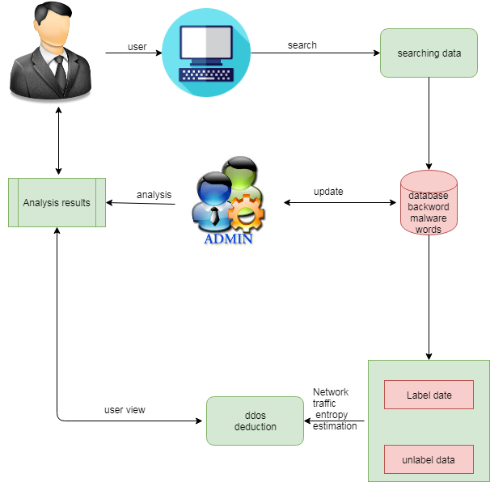
SYSTEM DESIGN
ARCHITECTURE

Slide 19
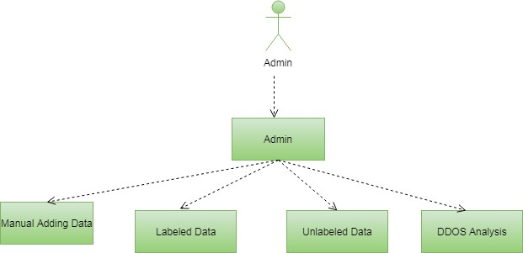
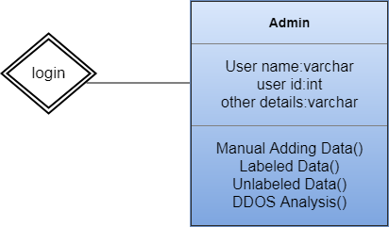
UML DIAGRAMS
Use Case Diagram
Class Diagram

Slide 20
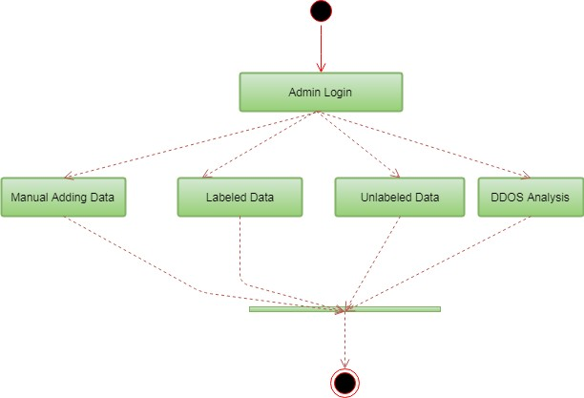
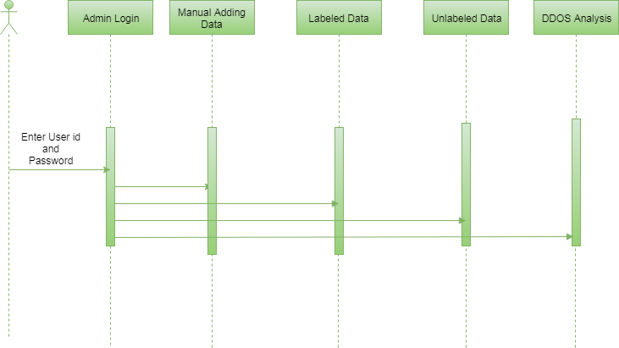
Activity Diagram
Sequence Diagram

Slide 21
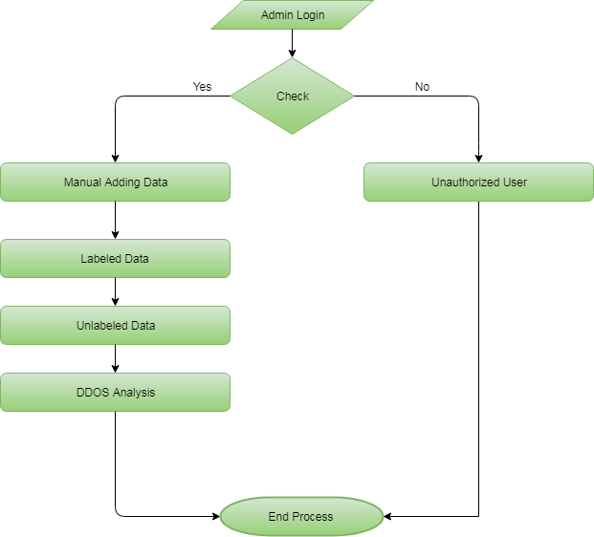
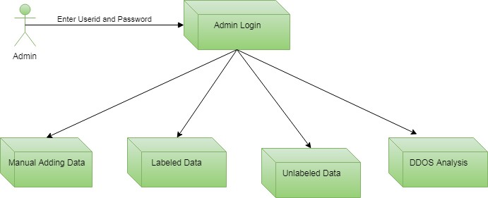
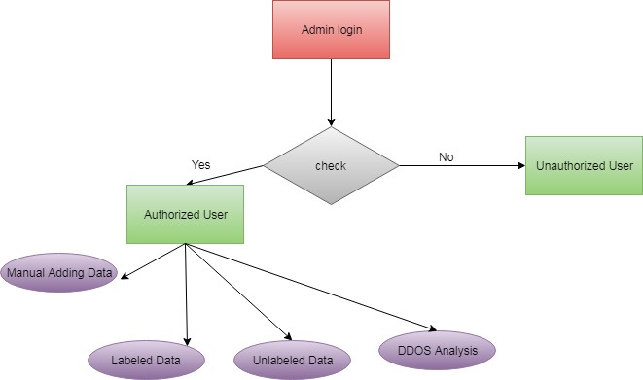
Component Diagram
ER Diagram
Data Flow Diagram

Slide 22

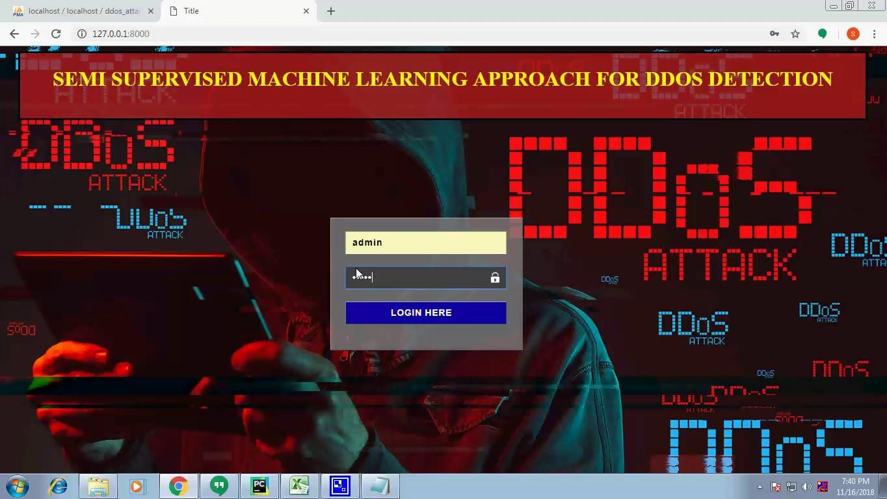
OUTPUT SCREENS
MAINPAGE

Slide 23
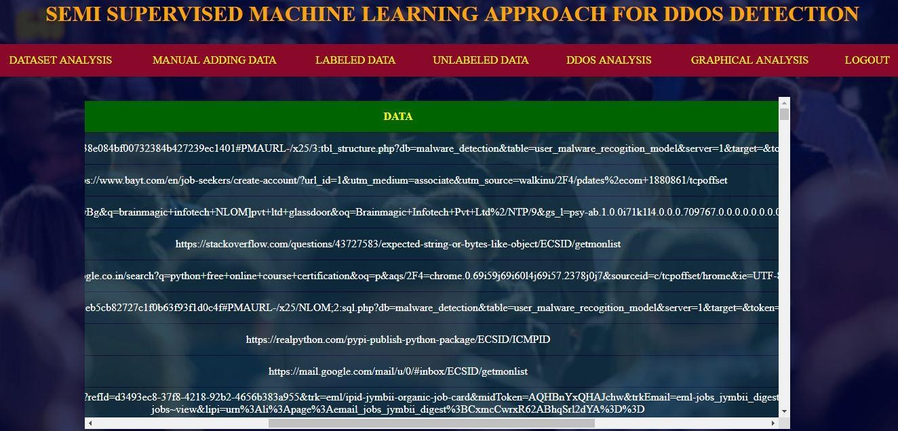
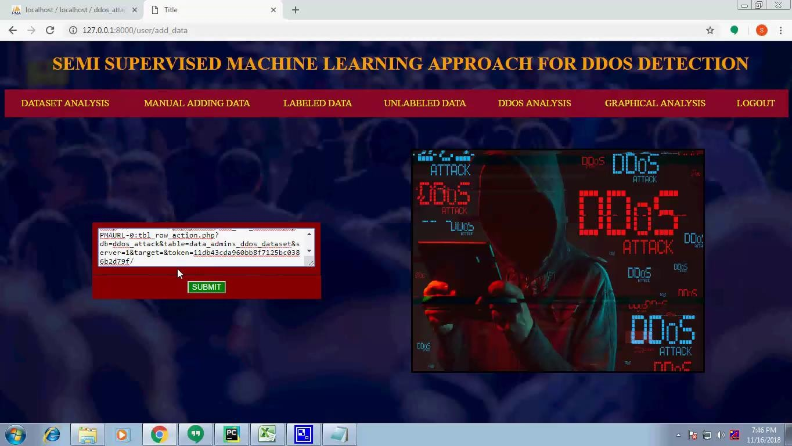
DATASET ANALYSIS
USER MANUALLY ADDING DATA

Slide 24
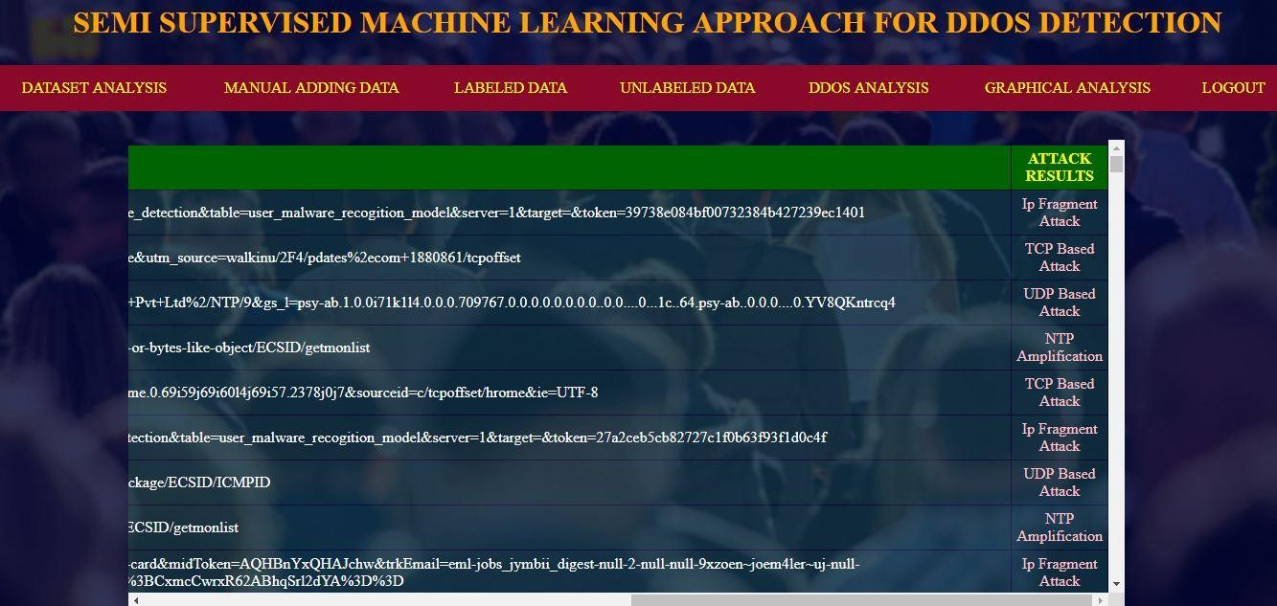
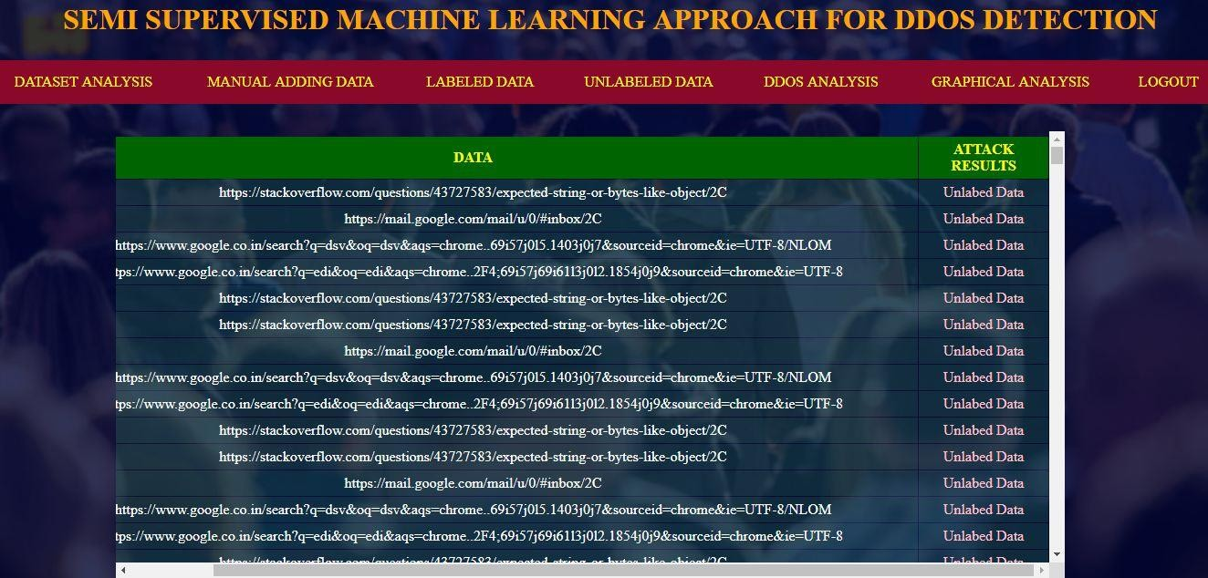
LABELED DATA
UNLABELED DATA

Slide 25
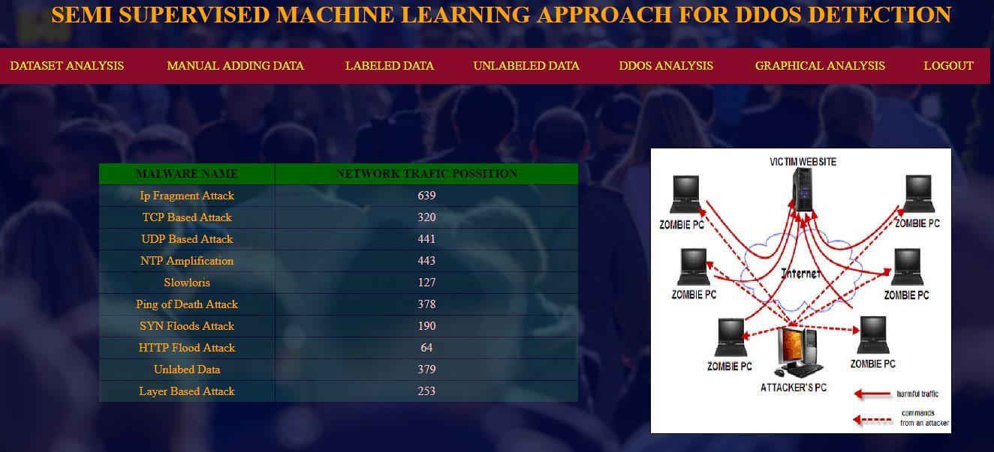
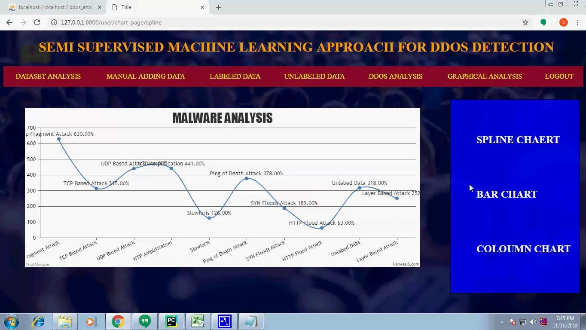
DDOS ANALYSIS
GRAPHICAL ANALYSIS
SPLINE CHART

Slide 26
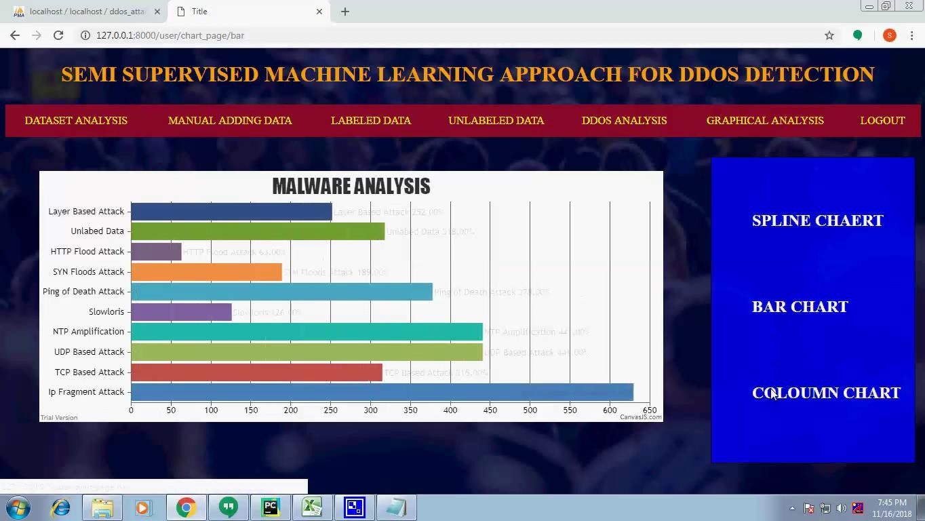
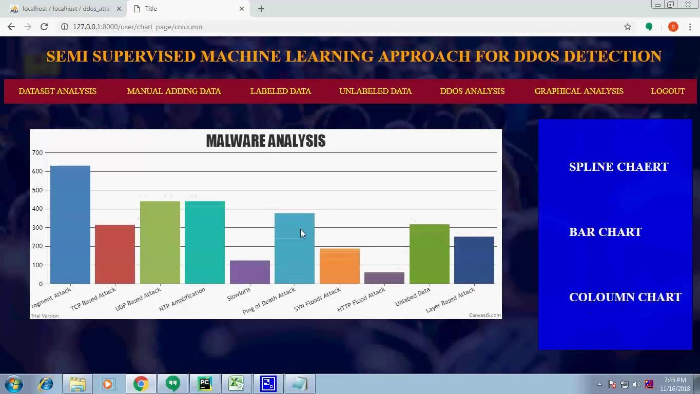
BAR CHART
COLUMN CHART

Slide 27
CONCLUSION
Android is a new and fastest growing threat to malware. Currently, many research methods and antivirus scanners are not hazardous to the growing size and diversity of mobile malware. As a solution, we introduce a solution for mobile malware detection using network traffic flows, which assumes that each HTTP flow is a document and analyzes HTTP flow requests using NLP string analysis.
The N-Gram line generation, feature selection algorithm, and SVM algorithm are used to create a useful malware detection model. Our evaluation demonstrates the efficiency of this solution, and our trained model greatly improves existing approaches and identifies malicious leaks with some false warnings. The harmful detection rate is 99.15%, but the wrong rate for harmful traffic is 0.45%. Using the newly discovered malware further verifies the performance of the proposed system.

Slide 28
THANK YOU

