Slide 1

UNIVERSITY CAPSTONE PROJECT PRESENTATION
AURELIUS
Academic Submission Details
Course / Module: ____________________
Teacher / Supervisor: _______________
Presentation Date: __________________
Group: 4 students
Next-Generation Autonomous AI-Agent
Human Resource Management OS
PREDICTIVE MATH
SECURE AI AGENT
REAL-TIME HR OS
University: ____________________ | Program: ____________________ | Teacher: ____________________
Executive Pitch Deck
01
Notes:
Welcome members of the evaluation committee. Today, I am proud to present Aurelius—an innovative, next-generation administrative operating system designed to transform corporate resource allocation and proactive workforce analytics from simple databases into highly active, predictive, and agentic systems.

Slide 2
PROJECT TEAM
Group Members and Roles
Replace the placeholder names with the real names before submission.
Student 1 Name: ____________________
Student 2 Name: ____________________
Role: Research and Requirements
Role: Backend and Data Layer
Student ID: ____________________
Student ID: ____________________
Student 3 Name: ____________________
Student 4 Name: ____________________
Role: Frontend and UX Design
Role: Testing, Documentation and Presentation
Student ID: ____________________
Student ID: ____________________
This slide clearly shows who contributed to the project and makes the presentation suitable for a group university submission.
AURELIUS Management OS | University Presentation
02

Slide 3
AGENDA
Presentation Outline
A clear structure helps the teacher follow the project logic from problem to conclusion.
01
Project introduction
What AURELIUS is and why the project was selected
02
Problem statement
Main HR technology problems addressed by the system
03
Proposed solution
How the AI-assisted management OS supports HR decisions
04
Architecture and implementation
Frontend, backend, database, streaming, and governance layers
05
Core models and algorithms
Attrition forecasting, ONA, simulated annealing, and Markov roadmap
06
Results, limitations, and conclusion
What was achieved, what remains open, and final learning outcomes
AURELIUS Management OS | University Presentation
03

Slide 4

THE PROBLEM
The Critical Problems in Modern HR Tech
Static HR databases miss risk, waste admin hours, and slow talent decisions.
IMPACT SNAPSHOT
Passive data silos
Managers search manually and miss early attrition warnings or workflow blocks.
2.5×
replacement cost for a key employee versus annual salary
Talent acquisition blindspots
Candidate/team matching remains subjective, slow, and weak on skill precision.
83%
executives identify talent gaps as a primary barrier
Zero interactive intelligence
Static charts cannot answer natural-language questions or modify records safely.
22 days
monthly admin hours lost compiling reports manually
(Maslach & Leiter, 2016; Upadhyay & Khandelwal, 2018)
AURELIUS Management OS
02
Notes:
Modern organizational systems are failing in three major areas. First, they are passive data silos. They do not warn you when critical developers are burning out. Second, talent acquisition is highly subjective, resulting in poor team alignments. Third, data remains locked behind rigid, non-interactive dashboards. Aurelius resolves all three points.

Slide 5

THE SOLUTION
AURELIUS Autonomous HR OS
A predictive, conversational, and governable intelligence layer for HR decisions.
AURELIUS
INTELLIGENCE KERNEL
Predict • Explain • Act under governance
Predictive Insights
Interactive AI Agent
Proactive Algorithms
Survival timeline hazard functions pinpoint when and why employees may leave.
Natural language prompts search data, mutate records, and ingest files securely.
ONA PageRank + Simulated Annealing optimize teams and expertise mapping.
(Upadhyay & Khandelwal, 2018; Kaplan & Haenlein, 2019)
AURELIUS Management OS
03
Notes:
Aurelius shifts the paradigm. It integrates proactive mathematical algorithms, like graph PageRank and Simulated Annealing, directly with a secure, real-time natural language agent. It is a system that thinks, predicts, and acts under strict guidelines.

Slide 6

SYSTEM ARCHITECTURE
Architecture & Premium UI Design
React glassmorphism frontend, FastAPI backend, SQLModel database, and SSE streaming.
CORE TECH STACK
RUNTIME FLOW
Backend
1
User prompt / file
FastAPI, SQLModel ORM, SQLite database.
2
RBAC + sanitization
Frontend
React + Vite, TailwindCSS, glassmorphism layers.
3
Intelligence kernel math
AI Engine
4
Limited context + DB query
Multi-provider orchestration: local + cloud LLM routes.
5
Structured Markdown answer
SSE Streaming
Real-time tokens and compact reasoning blocks.
6
SSE token stream
(Kaplan & Haenlein, 2019)
AURELIUS Management OS
04
Notes:
The technical stack is built for performance and stability. Aurelius uses a React frontend connected to a fast FastAPI backend, leveraging SQLModel. By streaming real-time tokens and reasoning steps through Server-Sent Events, it delivers a beautiful, executive-grade glassmorphism UI.

Slide 7
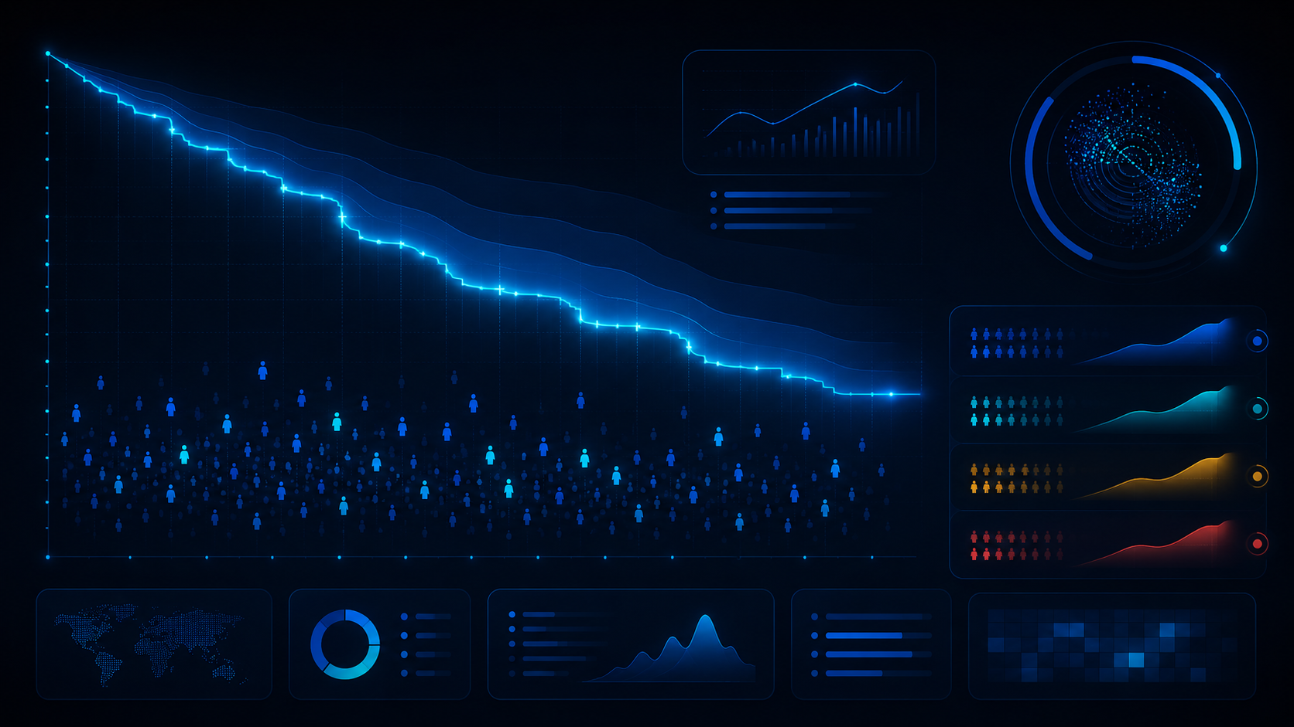
PREDICTIVE ATTRITION
Survival Curve Modeling
Forecast resignation risk before it becomes irreversible.
12-MONTH SURVIVAL PROJECTION
S(t) = P(Tenure > t)
HAZARD MULTIPLIERS
+40%
Muted sentiment
+50%
Salary disparity
+30%
Task overload
Action: trigger proactive warnings when 6-month survival drops below 70%.
(Cox, 1972; Maslach & Leiter, 2016)
AURELIUS Management OS
05
Notes:
One of Aurelius’s key innovations is predictive attrition modeling. Rather than waiting for resignation letters, it computes a twelve-month mathematical survival probability for each employee. The model uses compensation ratios, sentiment scores, and workload signals, enabling targeted, pre-emptive retention strategies.

Slide 8

ORGANIZATIONAL NETWORK ANALYSIS
ONA Reveals the Real Collaboration Graph
Hierarchy shows reporting lines; ONA shows how work and knowledge actually move.
Mathematical graph metrics
• PageRank power iteration
• Brandes betweenness centrality
• Organic collaboration edges
• Mentor and bottleneck discovery
PageRank
Betweenness
Silo mapping
Finds internal influence and knowledge leaders.
Locates bridge employees connecting silos.
Exposes isolated departments hidden by org charts.
(Brin & Page, 1998; Brandes, 2001)
AURELIUS Management OS
06
Notes:
Traditional hierarchy charts tell you who reports to whom; they do not show how information actually flows. The ONA graph models organic collaborative networks. Aurelius runs PageRank iterations to identify true knowledge mentors, and Brandes Betweenness Centrality to locate bridge employees whose sudden exit would isolate entire departments.

Slide 9

HEURISTIC TEAM ASSEMBLY
Simulated Annealing for Optimal Teams
Solves hard combinatorial selection without brute-force search.
COOLING CURVE
75M+
unique 5-person combinations from a 100-employee database
Cooling timeline
T=100.0 down to T=0.1 using α=0.95.
Heuristic score
70% skill match + 30% department diversity.
Performance benchmark
Metropolis criterion
Single database prefetch → in-memory annealing loop → optimal configuration in under 3ms.
Accepts early sub-optimal moves to escape local optima.
(Kirkpatrick et al., 1983)
AURELIUS Management OS
07
Notes:
Building a project team is a hard combinatorial problem. By applying a Simulated Annealing thermodynamic heuristic, Aurelius can solve millions of combinations quickly. It accepts intermediate bad states early on to escape local traps, ensuring we find highly optimized, multi-disciplinary teams.

Slide 10

GOVERNANCE
RBAC, Human Gate & Audit Trails
The AI agent is powerful, but not uncontrolled.
ROLE-BASED ACCESS CONTROL
AUDIT LEDGER
Read-only boundaries
Non-admin users remain restricted to dashboards and safe data access.
Timestamp
Zero AI autonomous deletions
User / agent actor
The governance kernel blocks deletion commands at source.
Target record context
Human-in-the-loop confirmation
Blocked mutations
Critical database changes require explicit UI approval.
Security alert
(Kaplan & Haenlein, 2019)
AURELIUS Management OS
08
Notes:
Security and compliance are core capstone constraints. Aurelius enforces strict Role-Based Access Control. The AI agent is barred from performing autonomous database deletions. Any delete requests require explicit human-in-the-loop validation, all recorded in a secure database audit ledger.

Slide 11

PERFORMANCE
Caching, Scalability & Endpoint Speed
Aurelius is optimized to avoid database fatigue and token overload.
N+1 QUERY ELIMINATION
VERIFIED BENCHMARKS
<5ms
intelligence calculation endpoint time
400×
speedup after query/caching refactor
<80ms
Pre-fetch all skills once, group in memory, and run optimization without repeated DB calls.
SSE start latency for real-time streaming
(Kirkpatrick et al., 1983)
AURELIUS Management OS
09
Notes:
To make Aurelius production-ready, we eliminated database thread lock issues and nested loop bottlenecks. By pre-fetching skills once and grouping them in-memory, database roundtrips drop from over 300 to exactly 2. This brings endpoint execution speeds under 5 milliseconds, representing a major performance increase.

Slide 12

ROADMAP & CLOSE
Future Roadmap & Career Transition Intelligence
From HR records to proactive workforce operating system.
MARKOV CAREER TRANSITIONS
Key conclusion
Models promotion and lateral movement pathways with transition matrices.
Aurelius fuses predictive math, graph intelligence, heuristic optimization, and a secure conversational agent into one course project prototype with production-oriented design.
Phase 1
Resume parser with semantic scoring + vector matching
Phase 2
Native vector search with pgvector / sqlite-vss
Phase 3
Autonomous agentic workflow task queues
Thank you
(Cox, 1972; Upadhyay & Khandelwal, 2018)
AURELIUS Management OS
10
Notes:
Looking forward, Aurelius integrates Markov career roadmaps. It transitions administrative HR tools from simple records into proactive engines. Aurelius is not just a concept—it is a live, production-grade platform ready for enterprise-style deployment. Thank you, and I now open the floor to questions.

Slide 13
ACADEMIC SOURCES
References
APA-style references used for in-text citations in the presentation.
Brandes, U. (2001). A faster algorithm for betweenness centrality. Journal of Mathematical Sociology, 25(2), 163-177. https://doi.org/10.1080/0022250X.2001.9990249
Kirkpatrick, S., Gelatt, C. D., & Vecchi, M. P. (1983). Optimization by simulated annealing. Science, 220(4598), 671-680. https://doi.org/10.1126/science.220.4598.671
Brin, S., & Page, L. (1998). The anatomy of a large-scale hypertextual Web search engine. Computer Networks and ISDN Systems, 30(1-7), 107-117. https://doi.org/10.1016/S0169-7552(98)00110-X
Maslach, C., & Leiter, M. P. (2016). Understanding the burnout experience: Recent research and its implications for psychiatry. World Psychiatry, 15(2), 103-111. https://doi.org/10.1002/wps.20311
Cox, D. R. (1972). Regression models and life-tables. Journal of the Royal Statistical Society: Series B, 34(2), 187-202. https://doi.org/10.1111/j.2517-6161.1972.tb00899.x
Upadhyay, A. K., & Khandelwal, K. (2018). Applying artificial intelligence: Implications for recruitment. Strategic HR Review, 17(5), 255-258. https://doi.org/10.1108/SHR-07-2018-0051
Kaplan, A., & Haenlein, M. (2019). Siri, Siri, in my hand: Who is the fairest in the land? Business Horizons, 62(1), 15-25. https://doi.org/10.1016/j.bushor.2018.08.004
Note: Keep the in-text citations on the relevant slides and list the full references here to reduce plagiarism risk.
AURELIUS Management OS | University Presentation
R

Slide 14
GOVERNANCE
RBAC, Human Gate & Audit Trails
The AI agent is powerful, but not uncontrolled.
ROLE-BASED ACCESS CONTROL
AUDIT LEDGER
Read-only boundaries
Non-admin users remain restricted to dashboards and safe data access.
Timestamp
Zero AI autonomous deletions
User / agent actor
The governance kernel blocks deletion commands at source.
Target record context
Human-in-the-loop confirmation
Blocked mutations
Critical database changes require explicit UI approval.
Security alert
(Kaplan & Haenlein, 2019)
AURELIUS Management OS
08

