Slide 1
Project Presentation of CO-OP Project at Industry (Module-2) (22CS421)
On
Deep Learning-Based Brain Tumor Detection Using CNN
Supervised By
Dr.Gifty Gupta
Department of Computer Science and Engineering,
Chitkara University, Punjab
Garv Saini
2210990315
Arshdeep Singh
2210990171

Slide 2
Introduction
Brain tumors are abnormal growths of cells in the brain that can be either benign (non-cancerous) or malignant (cancerous), and they pose a serious threat to human life as they affect critical brain functions. Early detection and accurate diagnosis are extremely important for effective treatment and improving patient survival rates. Magnetic Resonance Imaging (MRI) is one of the most widely used techniques for brain imaging because it provides detailed and high-resolution images of brain tissues. However, traditional analysis of MRI scans relies heavily on manual interpretation by radiologists, which is often time-consuming and prone to human error, especially when dealing with large volumes of data. Therefore, there is a strong need for automated and efficient systems that can assist in the accurate and faster detection of brain tumors.
2

Slide 3
Problem Statement
Manual analysis of MRI scans is a time-consuming and labor-intensive process that requires radiologists to carefully examine each image, which becomes increasingly difficult when dealing with a large number of scans. This heavy reliance on human interpretation also introduces the possibility of errors, as even experienced professionals may overlook subtle patterns or inconsistencies, leading to inaccurate diagnoses. Additionally, the rapid growth in medical imaging data makes it challenging to efficiently process and analyze such vast datasets using traditional methods. These limitations highlight the urgent need for a system that is not only faster but also more accurate and reliable. Therefore, developing an automated approach for brain tumor detection can significantly reduce human effort, minimize errors, and improve the overall efficiency and precision of medical diagnosis.

Slide 4
Objective
Develop an automated brain tumor detection system
Use deep learning technique: Convolutional Neural Networks (CNNs)
Analyze MRI brain images efficiently
Classify images into:Tumor & Non-Tumor
Automatically learn complex patterns from data
Reduce dependency on manual diagnosis
Improve accuracy and reliability
Minimize human error
Speed up the diagnosis process
Provide consistent and scalable results
Assist medical professionals in decision-making

Slide 5
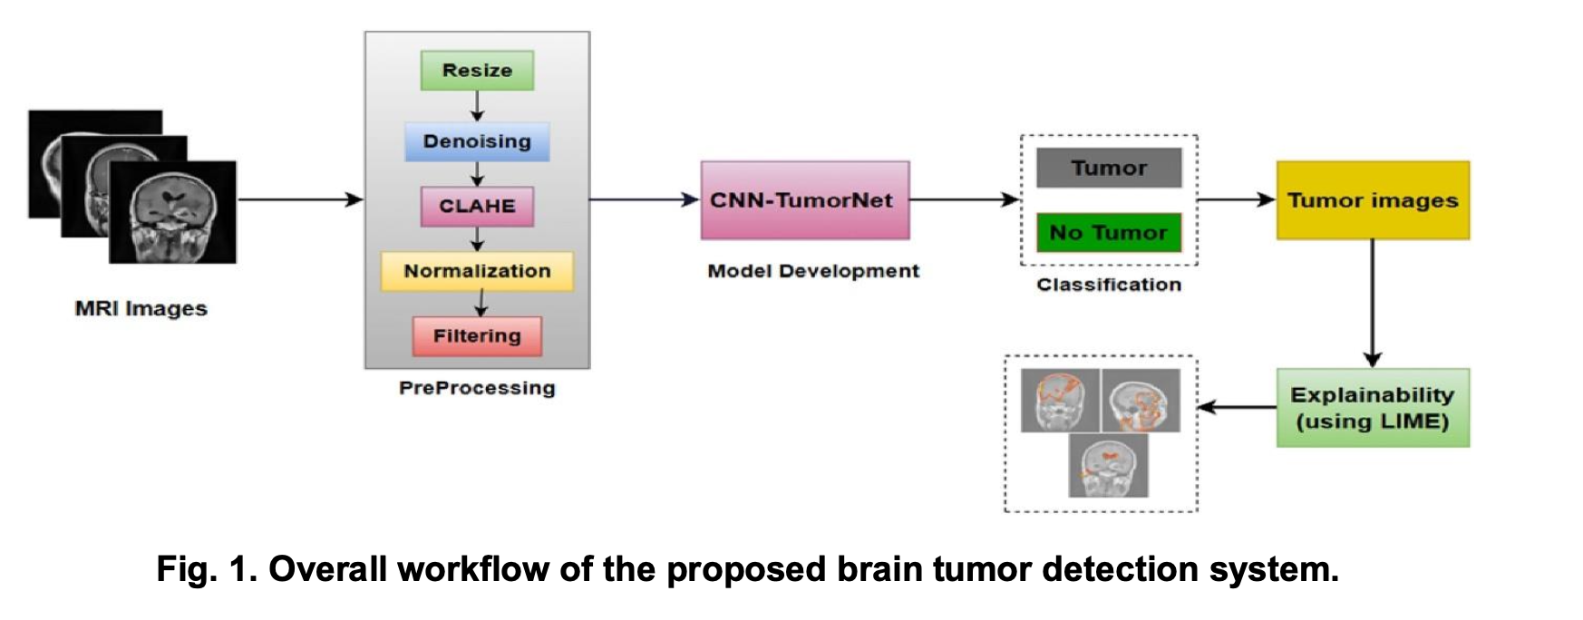
Methodology
Data Collection
Data Preprocessing
CNN Model Design
Model Training
Classification

Slide 6
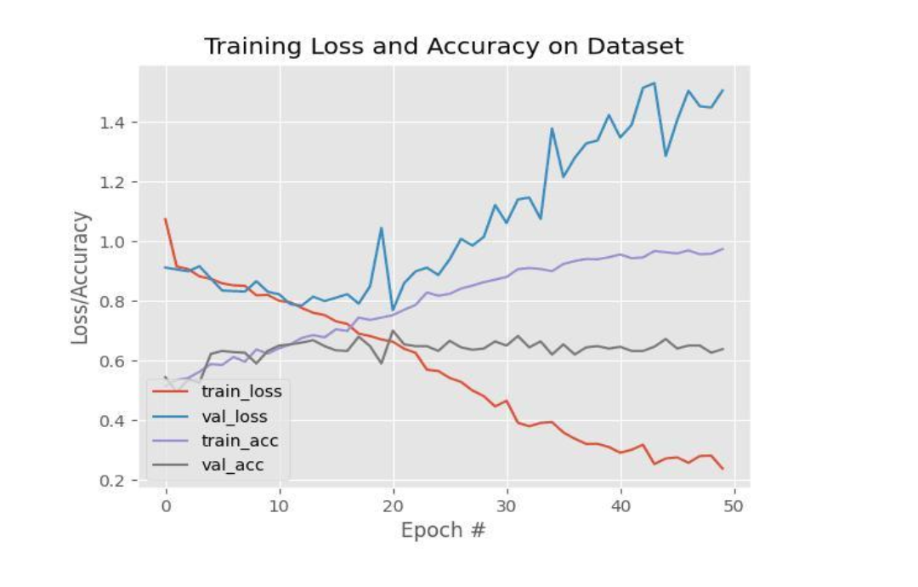
Results

Slide 7
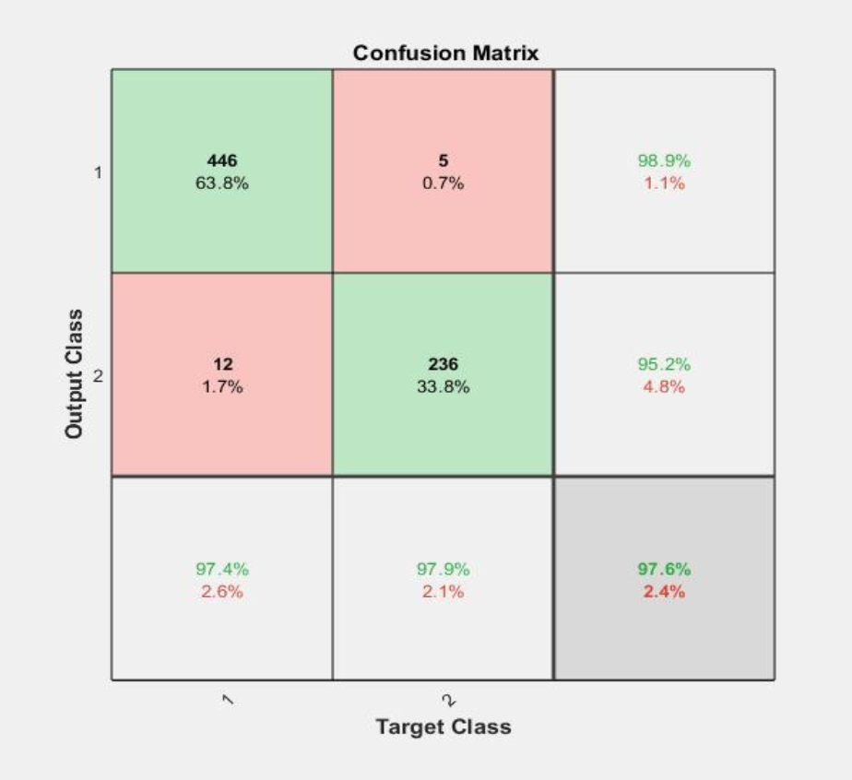
Analysis

Slide 8
Conclusion
The CNN-based system proves to be highly effective in automatically detecting brain tumors from MRI images with reliable performance.
The model achieves high accuracy in tumor detection by learning complex patterns and features from medical imaging data.
The system significantly reduces human error by minimizing manual analysis and providing consistent automated predictions.
It serves as a valuable tool for medical professionals by assisting in faster, more accurate, and efficient diagnosis.
The proposed model demonstrates strong generalization capability by performing consistently well on both training and unseen test data.
The use of preprocessing techniques such as normalization and data augmentation plays a crucial role in improving model performance and stability.
The system offers a scalable and adaptable solution that can be further enhanced and integrated into real-world medical applications.

Slide 9
Future Work
Extend the system from binary classification to multi-class classification to identify different tumor types like glioma, meningioma, and pituitary tumors for better clinical usefulness.
Implement advanced deep learning models such as ResNet and VGG16 to enhance feature extraction and improve overall accuracy.
Increase the size and diversity of the dataset by including MRI images from multiple sources to improve generalization and reduce overfitting.
Optimize the model to make it more efficient by reducing computational cost while maintaining high performance and stability.
Develop a real-time application with a user-friendly interface that allows doctors to upload MRI scans and receive instant predictions.
Integrate the system into healthcare environments to support radiologists, reduce workload, and improve diagnostic efficiency.

Slide 10
Thank You
10

