Slide 1
E-commerce Website
Presented
by
Divyayush Verma-2210990299
Divyanoor Singh Saini-2210990297
Garv Saini-2210990315
Gautam Mishra-2210990320
Under the supervision
of
Mr.Vikas Patel
Ms.Parul Gahelot
CSE
Chitkara University, Punjab

Slide 2
Introduction
Welcome to the in-depth exploration of HTML,CSS and JS integration for an E-Commerce Website. This presentation will cover the essential techniques and best practices for creating a compelling E-Commerce Website.

Slide 3
Motivation of Research
The motivation behind the research for our E-Commerce Website ,developed using HTML,CSS and JS is driven by a commitment to excellence, user satisfaction and staying ahead in the E-Commerce field.

Slide 4

HTML STRUCTURE
HTML(hyper text markup language) plays a fundamental and crucial role in the structure and presentation of content on our E-Commerce Website.

Slide 5
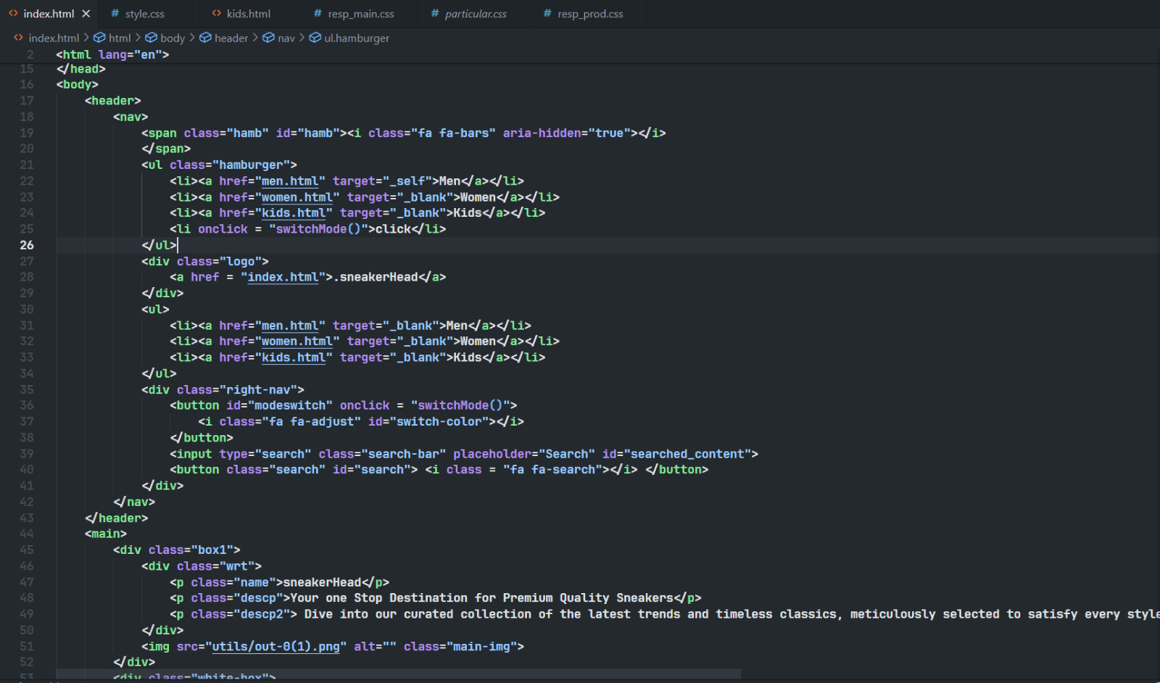
HTML CODE SNAPSHOTS

Slide 6

CSS STYLING
We utilized CSS to create visually appealing layouts designs that capture the attention of the readers. It helped us to apply responsive design and optimized styles for various devices.

Slide 7
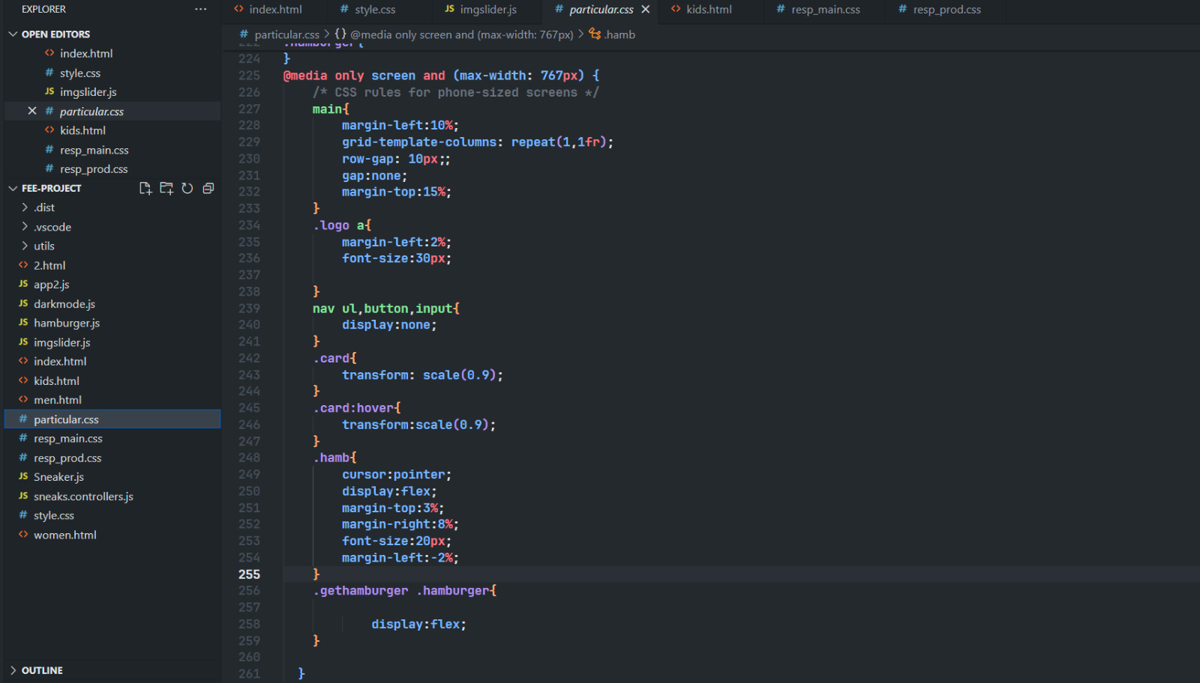
CSS SNAPSHOTS

Slide 8
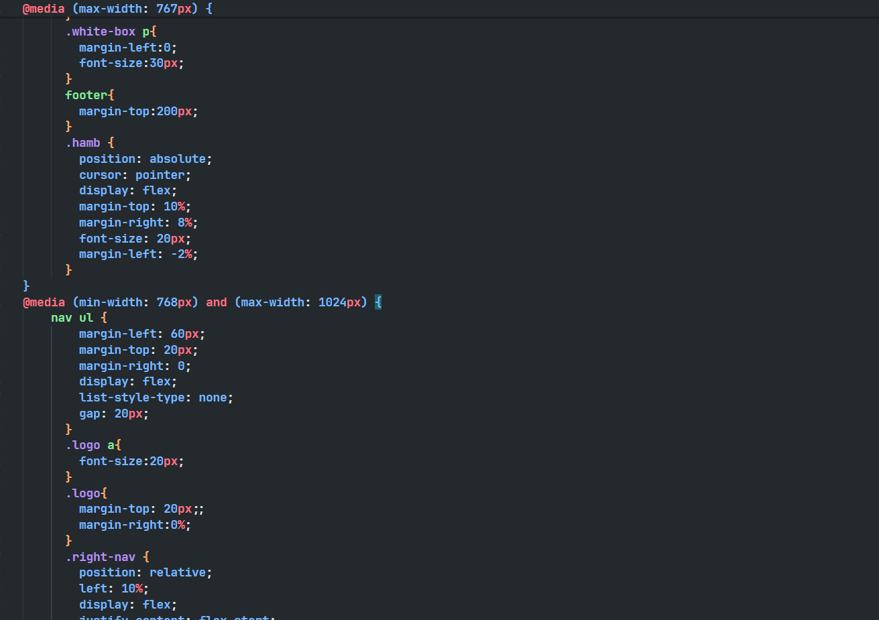
CSS SNAPSHOTS

Slide 9

JS INTEGRATION
We enhanced our user interaction with JavaScript. With the help of JavaScript we implemented features such as dark mode, image slider, interactive elements and seamless navigation.

Slide 10
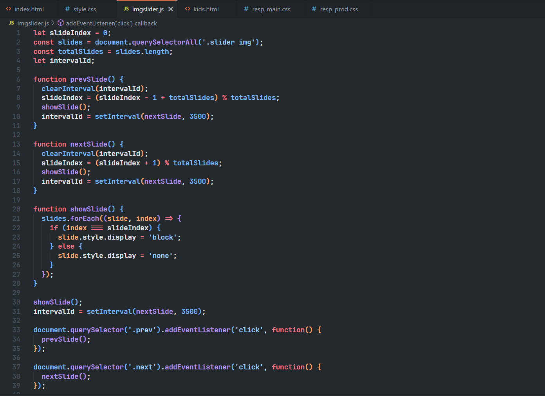
JAVASCRIPT SNAPSHOTS

Slide 11
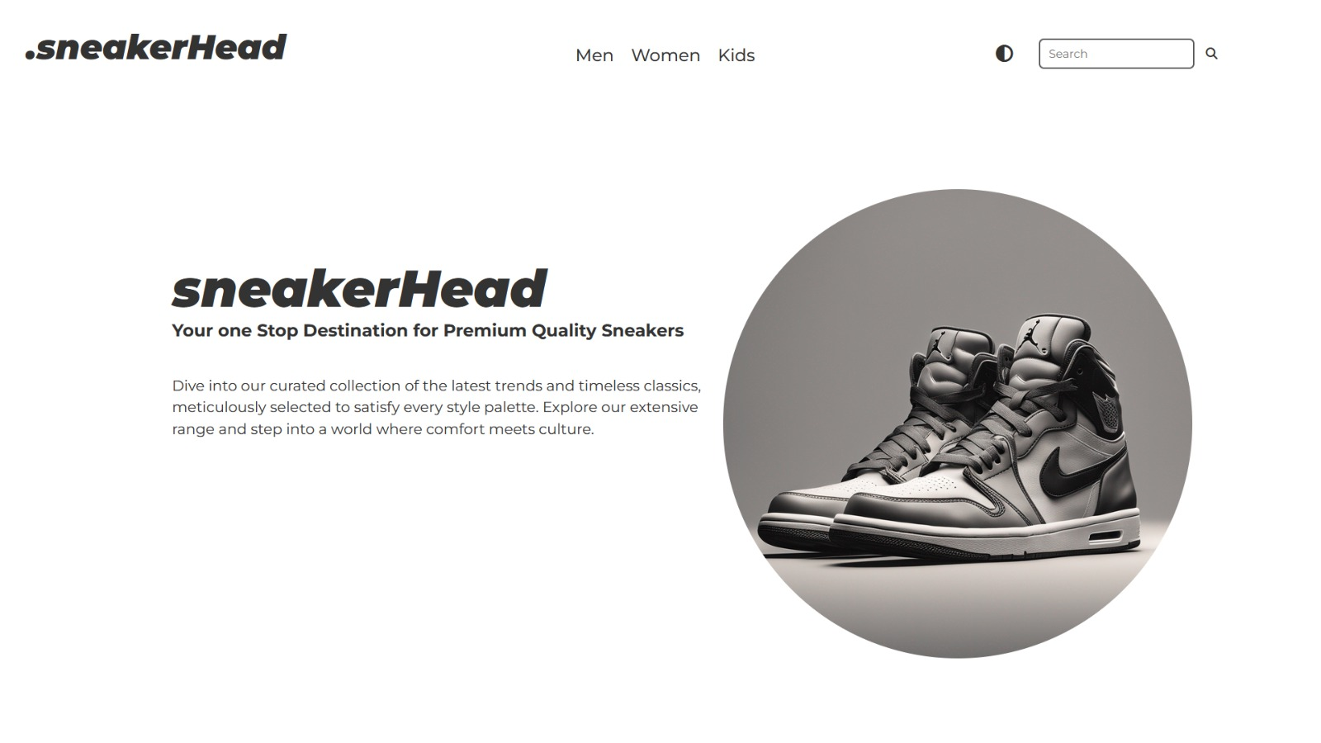
FINAL OUTPUT

Slide 12
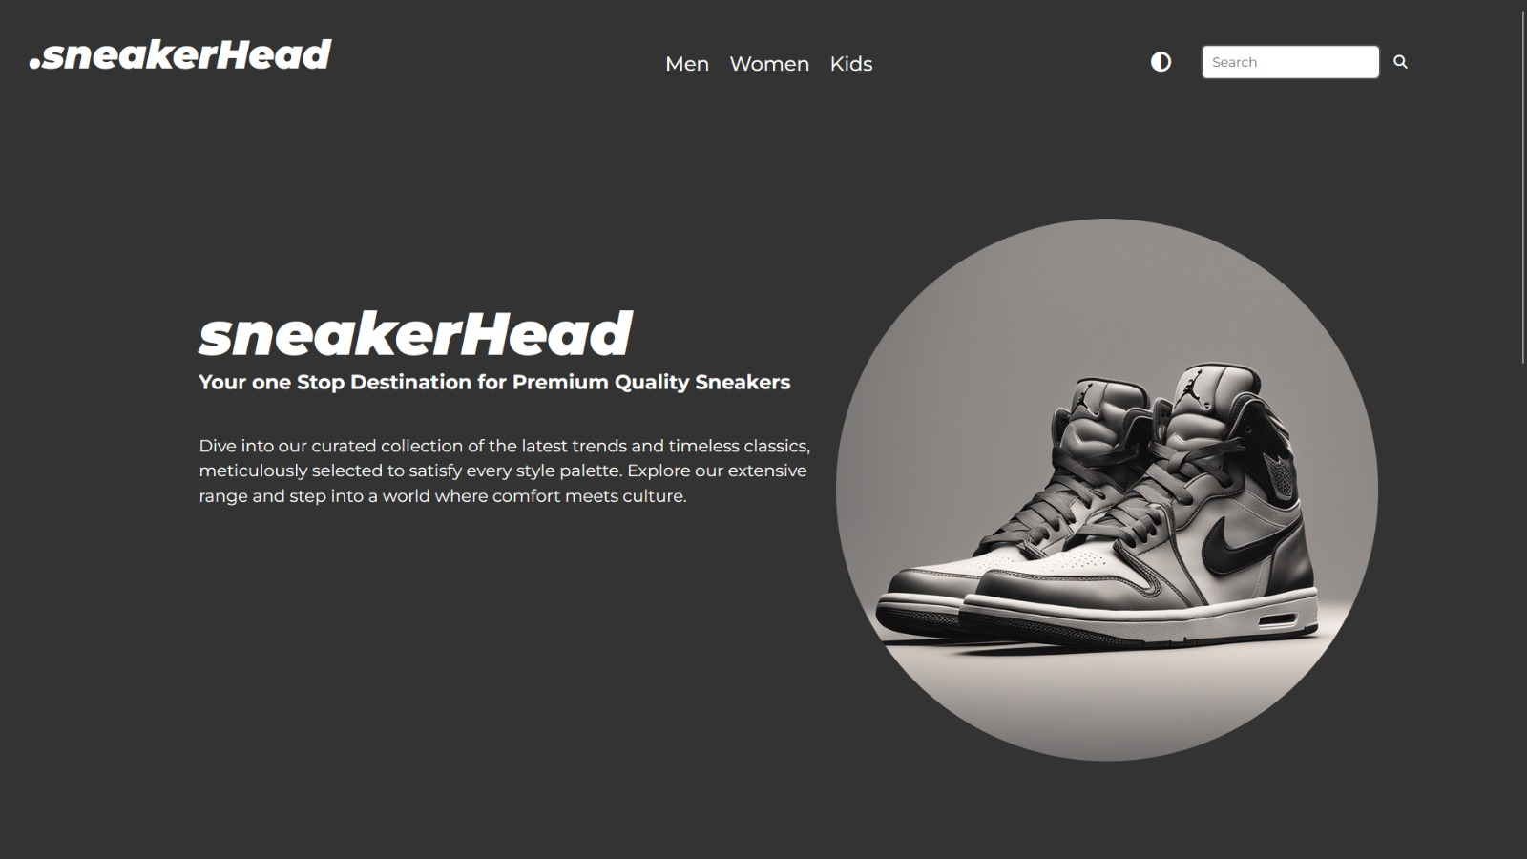

Slide 13
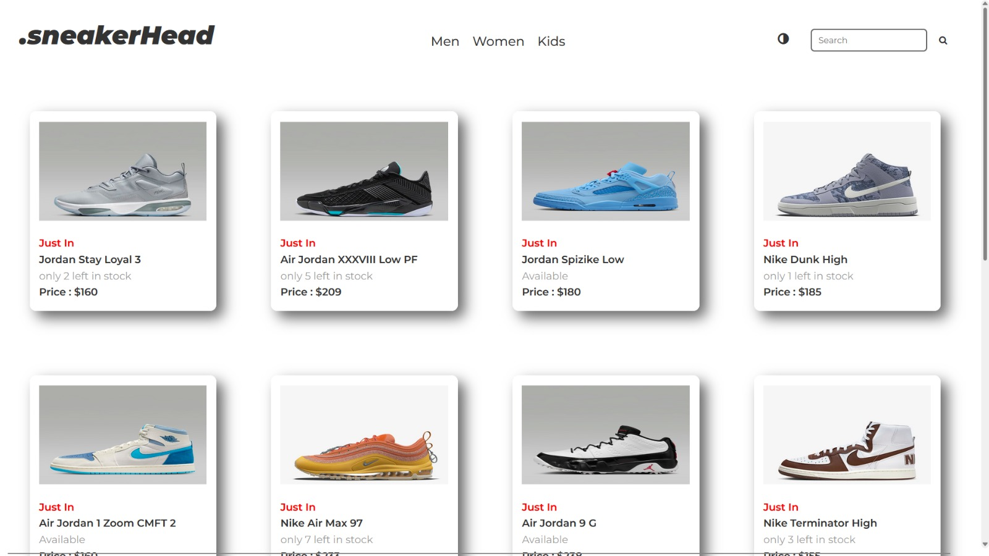

Slide 14
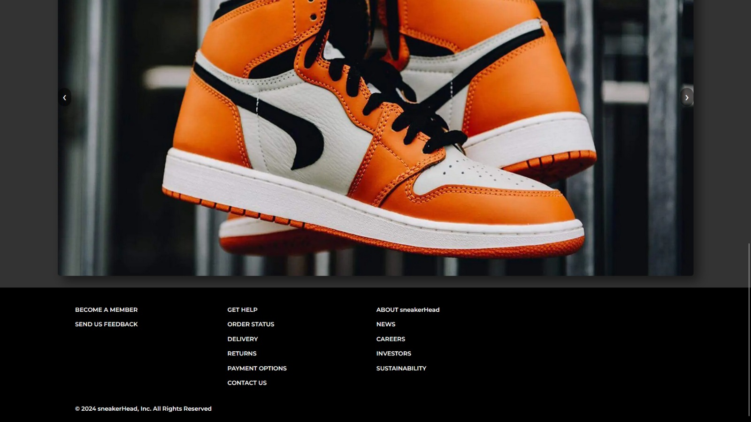

Slide 15
References
List of key references here for your study
Codepen.io- https://codepen.io/dhatGuy/pen/YzymwNV
Nike.in- https://www.nike.com/in/
Adidas.co.in- https://www.adidas.co.in/
ChatGPT
YouTube – Lama Dev

Slide 16


