Slide 1
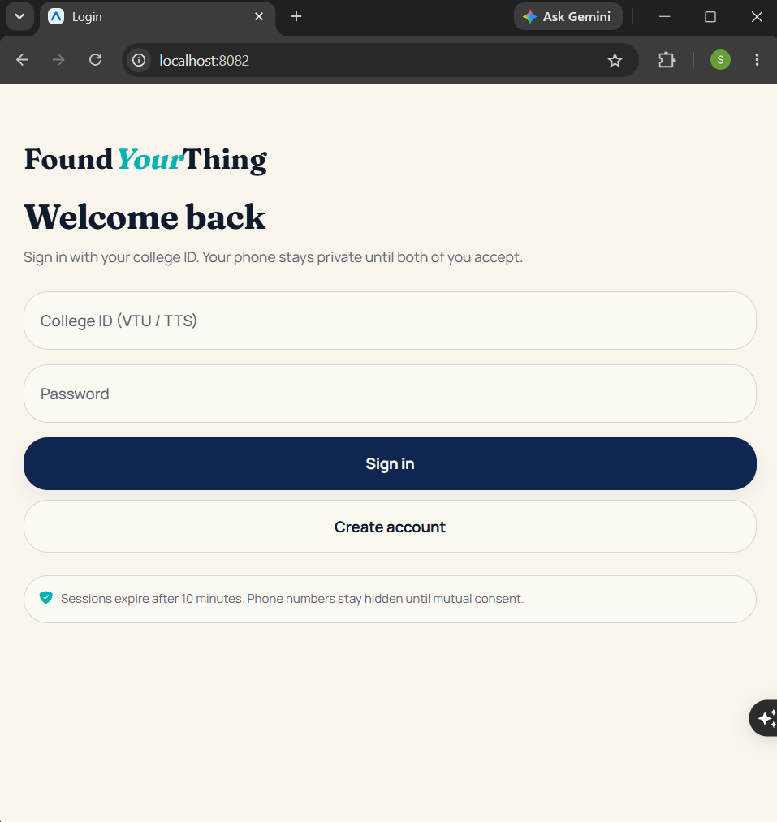
LIVE PROTOTYPE
FoundYourThing
Privacy-first campus lost & found
Idea Quest 2026
Working prototype · Android / iOS / Web
React Native (Expo) + FastAPI + local AI matching
College ID gate: VTU (students) · TTS (staff)

Slide 2
02 · Problem Statement
Losing valuables on campus is normal. Getting them back is not.
Scattered channels
WhatsApp groups, notice boards, and security desks — no single trusted place.
Phone numbers leak first
Students post contact info publicly before knowing if the other person is genuine.
Fake finds & spam
Downloaded photos and low-value clutter (pens, erasers) drown real reports.
Manual matching fails
Owners scroll endlessly. Finders rarely search. Recovery stays slow.
FoundYourThing · Idea Quest 2026 · Privacy-first campus lost & found
2 / 8

Slide 3
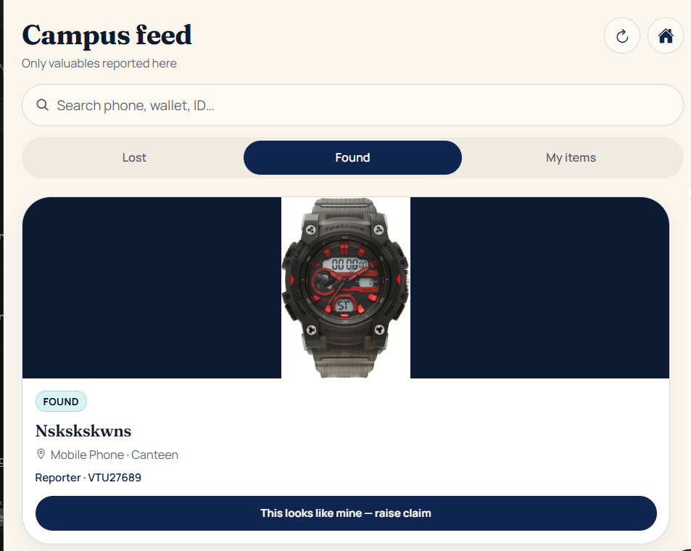
03 · Proposed Solution
One campus network. Trust before contact.
1
Valuables only
Phones, laptops, watches, wallets, ID cards, bags, keys, earbuds, spectacles — stationery rejected.
2
4-stage privacy
Public → Match → Claim → Connected. Phone unlocks only after mutual accept.
3
Local AI match
Image + text fingerprints on the college server. No third-party vision API required.
4
Symmetric claims
Lost owner can claim a found item — and a finder can raise a found report against a lost listing.
5
College ID gate
Only VTU… (students) and TTS… (staff) can register or log in. Outsiders blocked.
6
LiveGo ready
Optional finder photo provenance: fresh camera capture checked via EXIF + pixels.
FoundYourThing · Idea Quest 2026 · Privacy-first campus lost & found
3 / 8

Slide 4
04 · Architecture & Workflow
How a report becomes a reunion
1
2
3
4
5
Report
Photo + category
+ location
Fingerprint
Local image &
text embedding
Match
Score + confidence
label
Claim
Masked name
request
Connect
Phone shared
after accept
System map (kept simple)
Mobile / Web
Expo SDK 54 · React Native · TypeScript
Android · iOS · Browser
API
Python FastAPI · JWT sessions
Valuables policy · Campus ID
Intelligence
NumPy image + text embeddings
Honest match confidence
Data
SQLite (dev) → PostgreSQL
Photos on server storage
FoundYourThing · Idea Quest 2026 · Privacy-first campus lost & found
4 / 8

Slide 5
05 · Expected Impact
Faster recovery. Less exposure. Cleaner campus feeds.
Students & staff
One place to report and claim valuables without posting phone numbers in public groups.
Privacy by design
Contact details unlock in stages — phone only after both parties accept.
Less fraud noise
Valuables-only policy + optional LiveGo camera checks reduce fake found posts.
Institution ready
VTU/TTS ID gate keeps the network closed to the college community.
4 stages
privacy disclosure
1 codebase
Android · iOS · Web
0 cloud AI bill
on-campus matching
10 min
secure sessions
FoundYourThing · Idea Quest 2026 · Privacy-first campus lost & found
5 / 8

Slide 6
06 · Feasibility & Implementation Plan
Already built. Next: harden and deploy.
Completed (prototype)
Next 8–10 weeks
● Auth: register / login / refresh with VTU·TTS validation
● Report lost & found with photo upload + categories
● Campus feed with Lost / Found / My items + search
● AI match scores with confidence labels (Strong / Weak)
● Claims: against-found and against-lost (two-way)
● Privacy disclosure enforced server-side
● Cross-device UI (phone + laptop browser)
● LiveGo feature flag for finder photo verification
Week 1–2
Pilot Postgres + cloud photo storage
Week 3–4
Upgrade matching to CLIP / vision model
Week 5–6
Push notifications for new matches
Week 7–8
College pilot with 1–2 departments
Week 9–10
Admin dashboard for staff (TTS)
FoundYourThing · Idea Quest 2026 · Privacy-first campus lost & found
6 / 8

Slide 7
07 · Scalability & Future Scope
From one campus to a college network
Near-term
Medium-term
Long-term
→ PostgreSQL + object storage for photos
→ Real vision model for category checks
→ Push alerts on match / claim / accept
→ Staff admin view for TTS accounts
→ QR handoff at pickup desk
→ Multi-campus feeds with college codes
→ Heatmaps of loss hotspots
→ SSO with official college identity
→ Inter-college recovery network
→ Fraud reputation signals
→ Offline-first campus Wi-Fi mode
→ Open API for hostel / transport desks
FoundYourThing · Idea Quest 2026 · Privacy-first campus lost & found
7 / 8

Slide 8
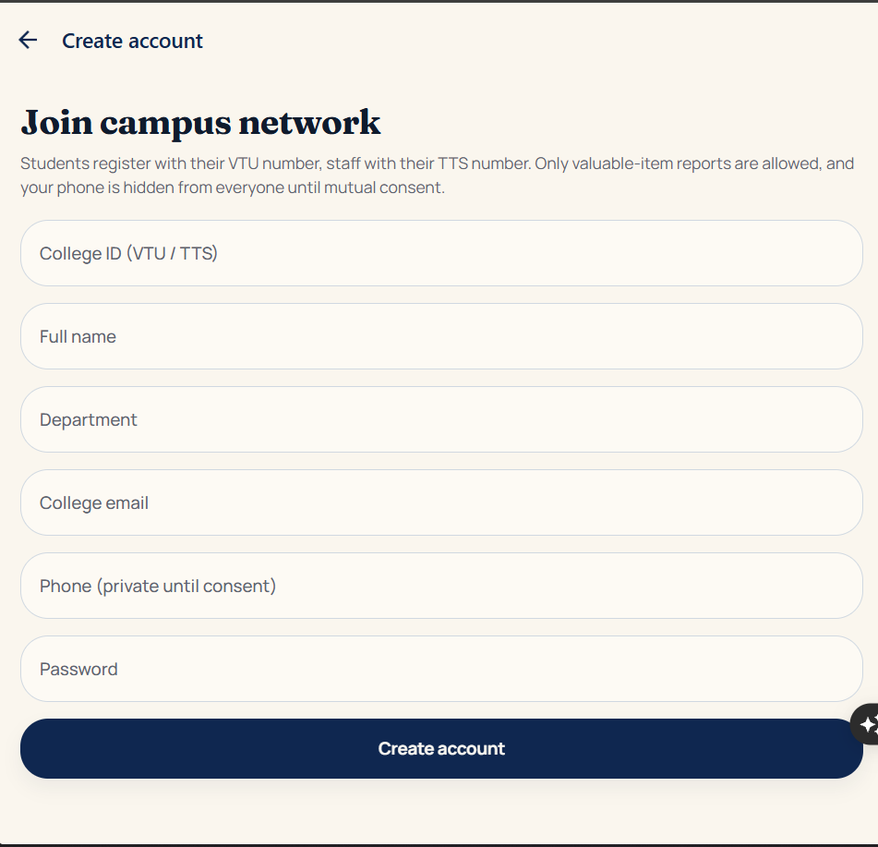
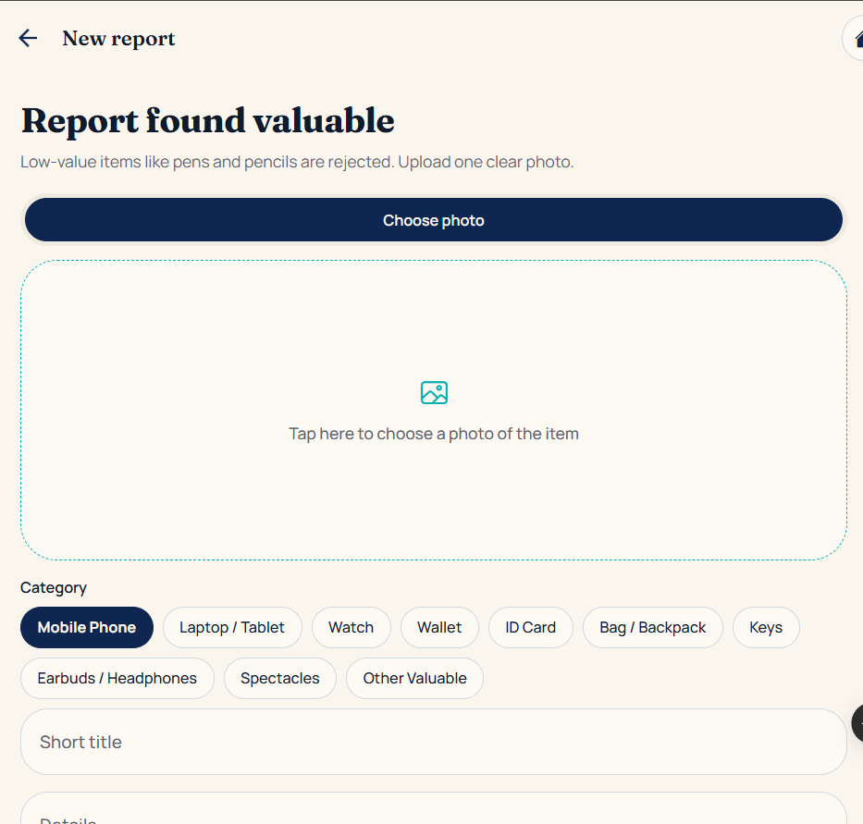
08 · Demo / Prototype
Running today — web, Android Expo Go, iOS Expo Go
Sign in · VTU / TTS
Join campus network
Report found valuable
Demo path: Register (VTU/TTS) → Report lost/found → Browse campus feed → Raise claim → Accept → Phone unlocks
FoundYourThing · Idea Quest 2026 · Privacy-first campus lost & found
8 / 8

