Slide 1

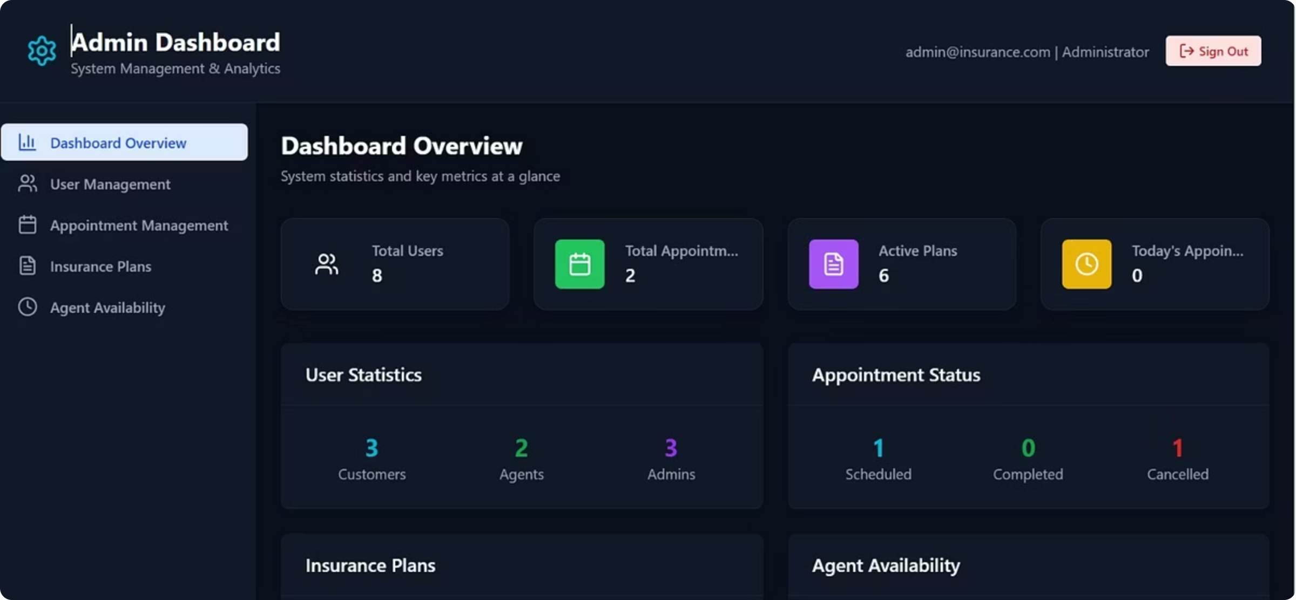
InsureAI System
A Smart Insurance Management Platform Connecting Admins, Agents, and Customers

Slide 2
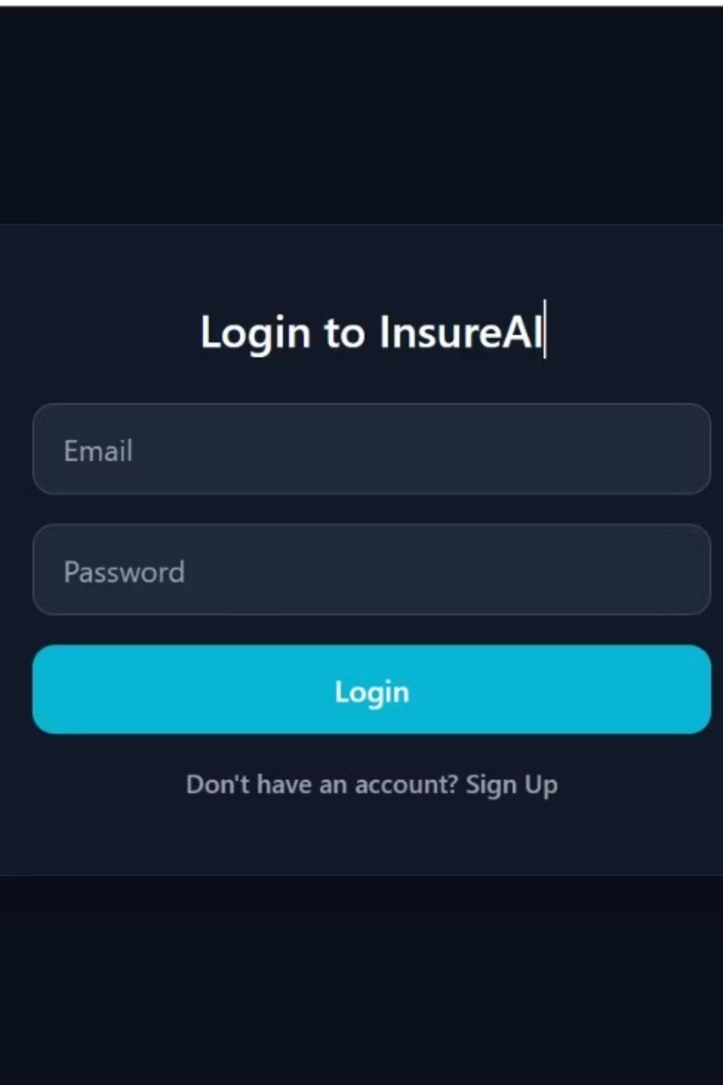
Secure Authentication System
Secure Login
Role-Based Registration
Users authenticate with email and encrypted password for protected access
New users select their role (Customer, Agent, or Admin) during signup
User-Friendly Interface
Simple, intuitive design makes account creation and login effortless

Slide 3

Admin Dashboard Overview
Centralized Control Panel
The dashboard serves as the command center for monitoring users, appointments, and insurance plans through a unified interface.
User Management
Complete Overview: Track all registered accounts.
Role Assignment: Assign and manage Customer, Agent, and Admin roles.
Account Control: Securely manage user statuses.
Real-time Analytics
User Distribution: Insights on Customers, Agents, and Admins.
Appointment Tracking: Monitor statuses (Scheduled, Completed, Cancelled, Pending).
Quick Actions
Immediate access to key operations: Add User, Create Plan, and View Reports.

Slide 4

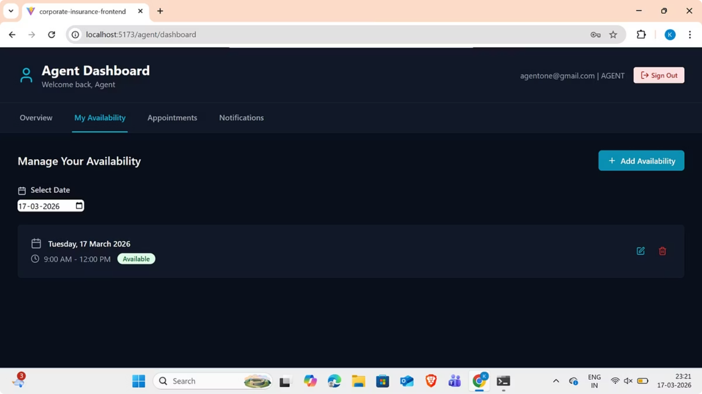
Agent Dashboard
A complete command center for managing schedules, client relationships, and appointment workflows.
Availability & Scheduling
Add Time Slots: Define flexible time ranges for client bookings.
Calendar Integration: View visual patterns of availability.
Instant Updates: Modify availability in real-time.
Appointment Workflow
Scheduled: View upcoming meetings and client details.
Completed: Track history of finalized sessions.
Cancelled: Manage status updates for removed appointments.
Customer Interactions
Communication Tracking: Monitor recent messages and inquiries.
Interaction History: Comprehensive log of past appointment notes and service records.

Slide 5
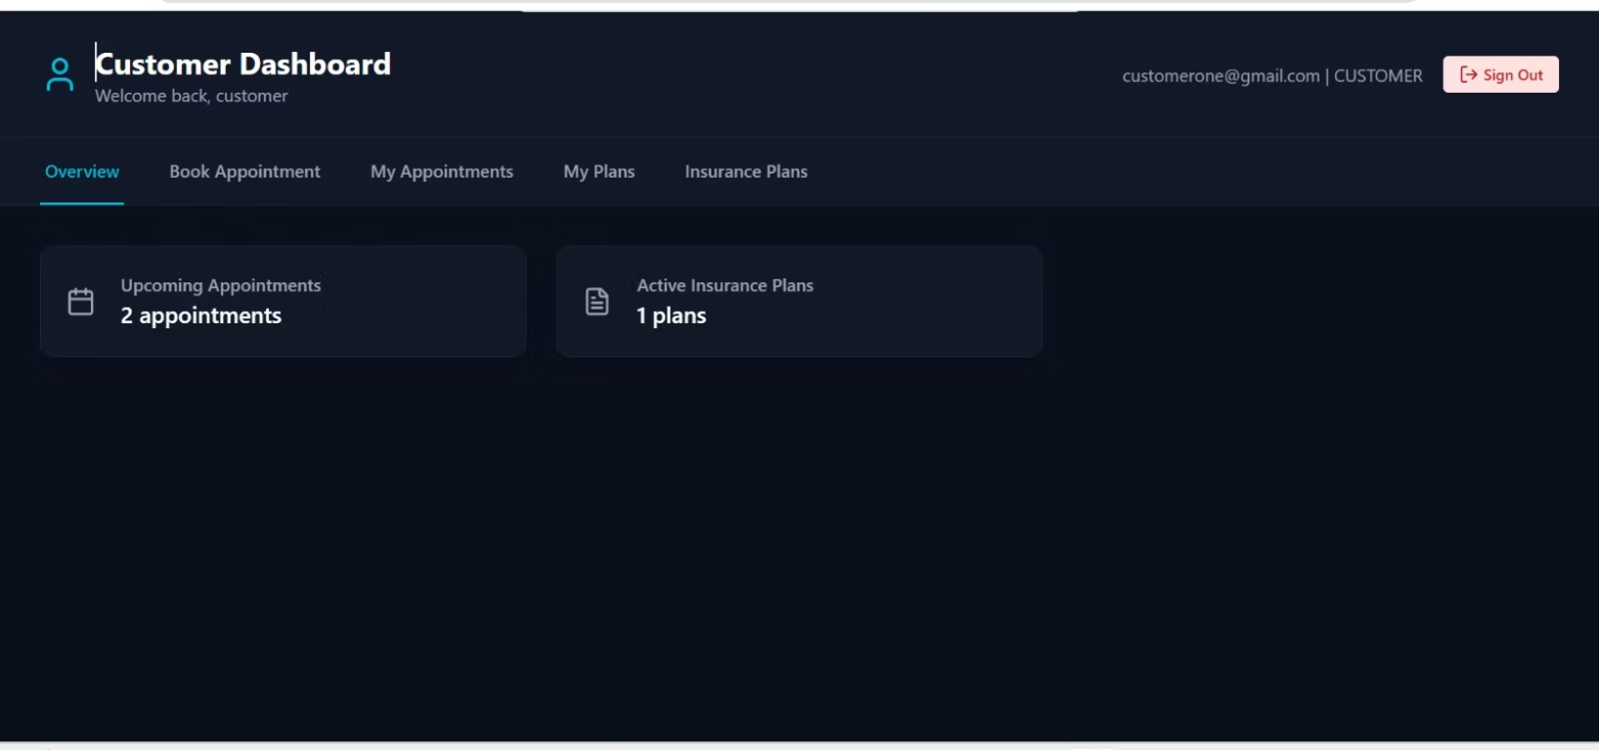
Customer Dashboard
The Customer Dashboard serves as a comprehensive, personalized hub for managing all insurance needs, providing users with a seamless interface to oversee their coverage, interactions, and scheduling.
Customer Experience Overview
Upcoming Appointments: Easily see and manage all scheduled meetings with agents.
Active Insurance Plans: Quick access to policy details, coverage information, validity dates, and premium schedules.
Activity Overview: A detailed summary of your recent interactions, status updates, and account history.
Appointment Booking System
Insurance Plans & Policy Details
Browse and select from available agents.
Choose your preferred date and time slot from our integrated calendar.
Review and confirm appointments instantly.
Browse available insurance plans tailored to your needs.
View comprehensive plan information including coverage limits and terms.
Book appointments with agents or opt-in directly to new plans.

Slide 6






Conclusion: InsureAI's Impact
InsureAI is set to revolutionize the insurance sector, offering substantial benefits to all stakeholders.
Streamlined Operations
Enhanced Efficiency
Intuitive Experience
Digitalization simplifies complex insurance management processes for all users.
Significant time and resource savings across admin, agent, and customer workflows.
A user-friendly design ensures smooth interactions and high satisfaction.
Future-Proof Platform
Innovating Forward
Designed for growth and flexibility to meet evolving industry demands.
Upcoming AI features for personalized recommendations and automated processes.

