Slide 1
RetrainWise
216
6
4
3
benchmark runs (standard size)
policies compared
streams (3 real + synthetic)
cost regimes
• A lifecycle-aware agent for cost-benefit training decisions
• Monitor → estimate value recovery → price the action → explain → approve → validate → promote
• One Streamlit + SQLite application, CPU-only, fully offline demo on a synthetic drift stream
• Benchmark: 216 replayed runs on synthetic, electricity, airlines, covertype (standard size, seeds [1, 2, 3], regimes cheap, balanced, expensive)
RetrainWise · costs are simulated USD under stated assumptions
1

Slide 2
Problem
• Calendar retraining ignores whether anything changed
• Drift-triggered retraining ignores what an update costs and whether it helps
• The real question: retrain fully, update incrementally, or defer — right now?
• Covariate shift (PSI) is not proof that predictions got worse; label evidence is needed
RetrainWise · costs are simulated USD under stated assumptions
2

Slide 3
Decision rule
• Expected benefit = error-rate reduction × predictions over horizon × value per avoided error
• Total cost = compute + engineering + validation + expected deployment-risk cost; defer = 0
• Error reduction measured on a chronological hold-out that no compared model trained on
• Scaled by a realisation factor learned from measured post-update outcomes (prior 0.7)
• 8 guardrails: compatibility, evidence, cooldown, minimum benefit, net > 0, P(net>0), action limit, budget
• Approval, artifact checksum and validation gate enforced in deterministic code
RetrainWise · costs are simulated USD under stated assumptions
3

Slide 4
Architecture
• L1 monitoring: prequential metrics, ADWIN + DDM on errors, fixed-bin PSI with noise floor, learning debt
• L2 decision engine: shadow candidates, itemised simulated costs, ranking, sensitivity
• L3 agent: bounded read-only tools, optional local Ollama, consistency check, deterministic fallback
• L4 action: unique approvals, validation gate, versioned registry, rollback, bounded autonomy
• SQLite is the source of truth; experiment jobs run in a separate worker process
RetrainWise · costs are simulated USD under stated assumptions
4

Slide 5
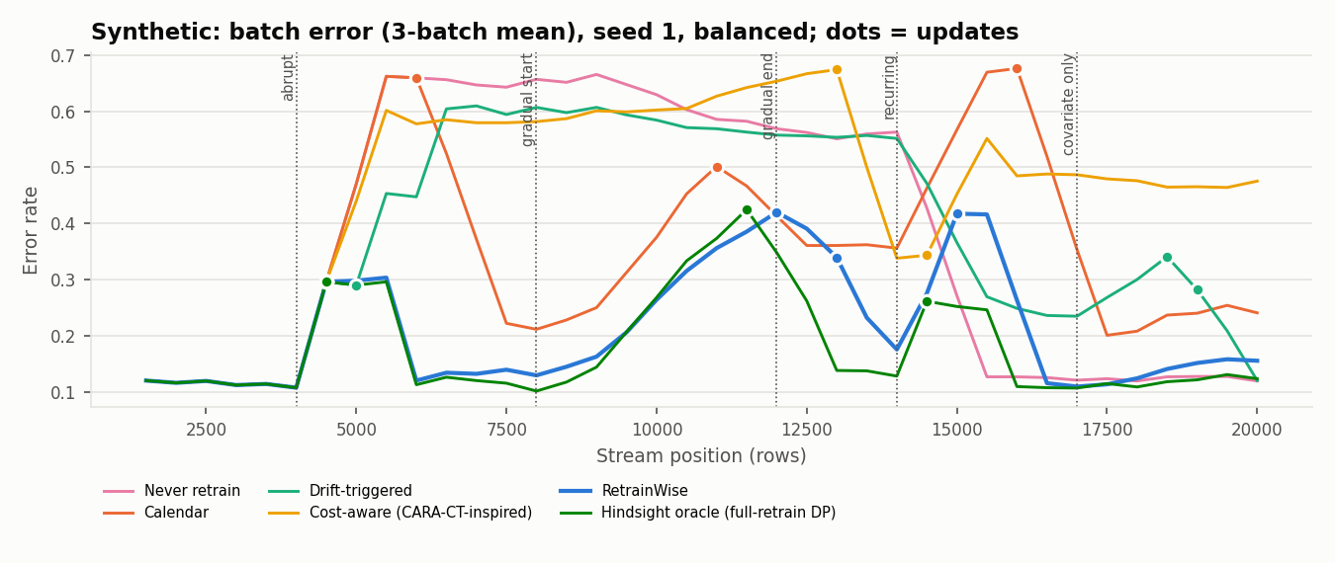
Results — synthetic (balanced regime, mean of seeds)
• Never retrain: TCO $7,245 (±81), acc 0.619, updates 0.0
• Calendar: TCO $7,264 (±292), acc 0.641, updates 3.0
• Drift-triggered: TCO $6,550 (±1,585), acc 0.705, updates 6.3
• Cost-aware: TCO $8,223 (±1,075), acc 0.583, updates 2.0
• RetrainWise: TCO $4,769 (±141), acc 0.784, updates 5.7
• Hindsight oracle: TCO $3,984 (±140), acc 0.817, updates 3.3
RetrainWise · costs are simulated USD under stated assumptions
5
Notes:
Numbers read from the aggregate CSV.

Slide 6
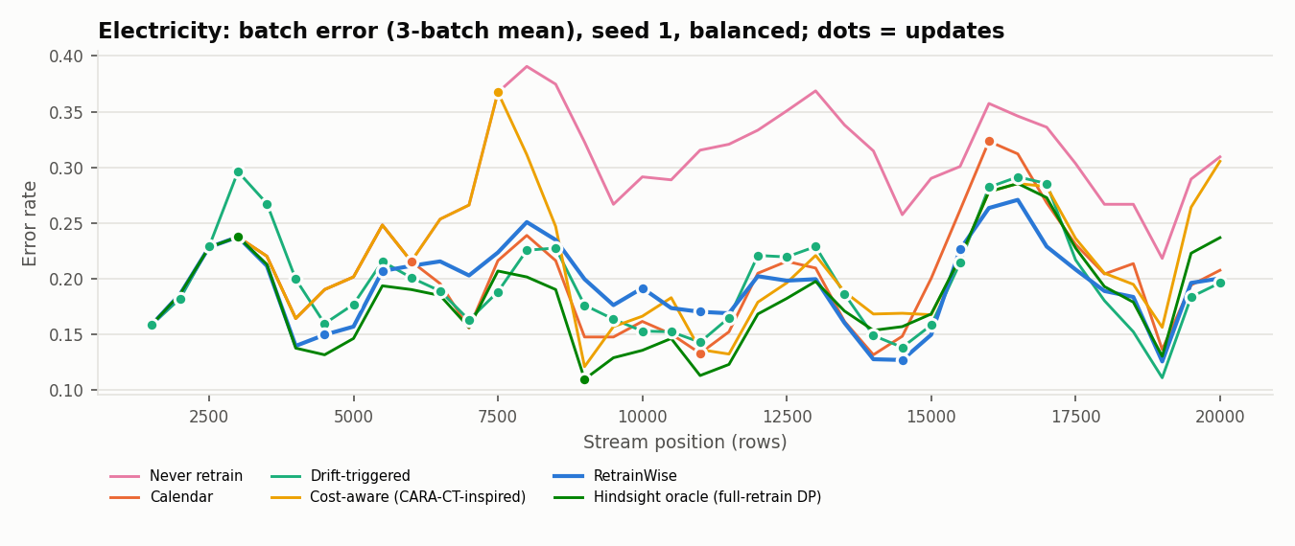
Results — electricity (balanced regime, mean of seeds)
• Never retrain: TCO $5,173 (±278), acc 0.728, updates 0.0
• Calendar: TCO $4,200 (±73), acc 0.803, updates 3.0
• Drift-triggered: TCO $9,054 (±275), acc 0.795, updates 34.3
• Cost-aware: TCO $4,746 (±387), acc 0.758, updates 1.0
• RetrainWise: TCO $4,669 (±543), acc 0.783, updates 6.3
• Hindsight oracle: TCO $3,771 (±82), acc 0.817, updates 2.0
RetrainWise · costs are simulated USD under stated assumptions
6
Notes:
Numbers read from the aggregate CSV.

Slide 7
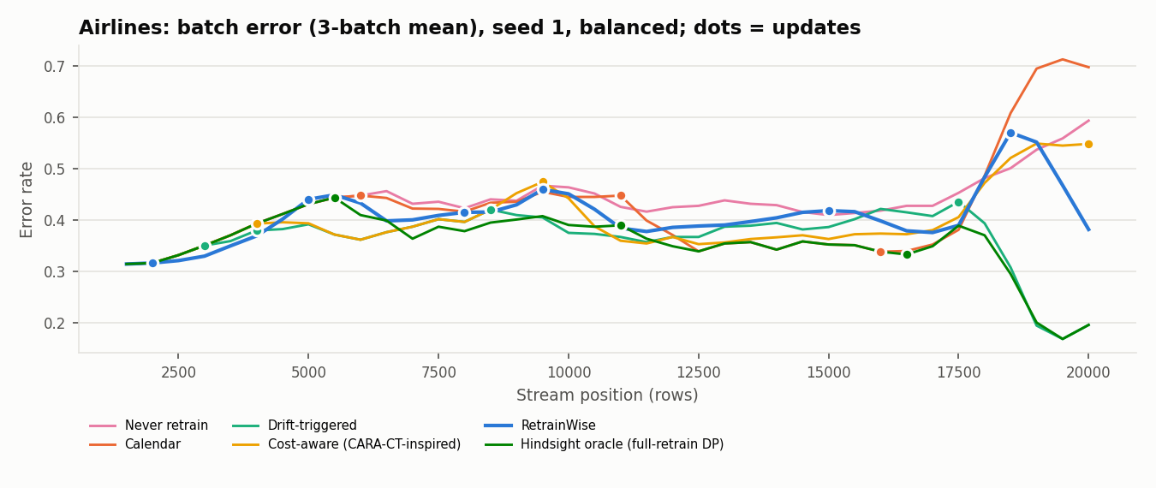
Results — airlines (balanced regime, mean of seeds)
• Never retrain: TCO $8,643 (±318), acc 0.545, updates 0.0
• Calendar: TCO $8,532 (±830), acc 0.575, updates 3.0
• Drift-triggered: TCO $8,263 (±738), acc 0.615, updates 6.3
• Cost-aware: TCO $8,209 (±213), acc 0.589, updates 2.7
• RetrainWise: TCO $8,020 (±421), acc 0.606, updates 5.3
• Hindsight oracle: TCO $7,222 (±130), acc 0.646, updates 3.3
RetrainWise · costs are simulated USD under stated assumptions
7
Notes:
Numbers read from the aggregate CSV.

Slide 8
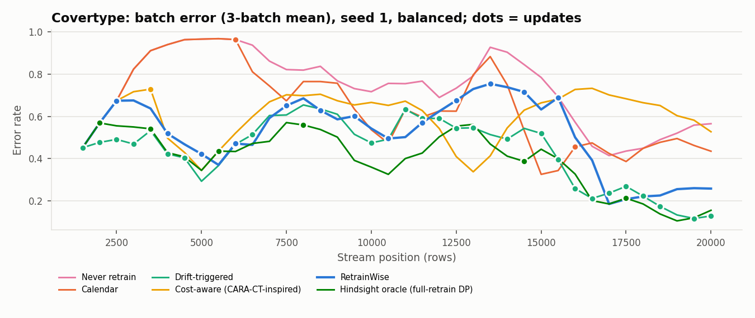
Results — covertype (balanced regime, mean of seeds)
• Never retrain: TCO $13,713 (±266), acc 0.278, updates 0.0
• Calendar: TCO $13,115 (±480), acc 0.333, updates 3.0
• Drift-triggered: TCO $12,760 (±483), acc 0.557, updates 29.0
• Cost-aware: TCO $11,522 (±1,299), acc 0.428, updates 4.3
• RetrainWise: TCO $11,336 (±90), acc 0.481, updates 13.7
• Hindsight oracle: TCO $8,567 (±232), acc 0.612, updates 8.0
RetrainWise · costs are simulated USD under stated assumptions
8
Notes:
Numbers read from the aggregate CSV.

Slide 9
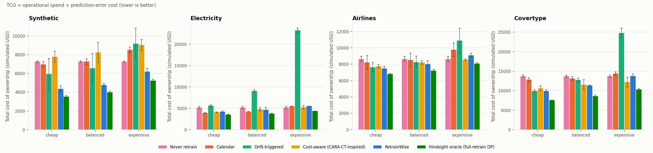
Total cost of ownership across regimes
RetrainWise · costs are simulated USD under stated assumptions
9

Slide 10
Honest reading of the standard results
6/12
1.92
+0.2%
34%
cells with lowest online TCO
mean TCO rank (of 5 online)
median gap to best online
evaluation share of spend (expensive)
• Where RetrainWise loses: evaluation overhead in the expensive regime, 30% hold-out, conservative guardrails
• Electricity: calendar refits on the full window were cheaper in every regime
• Costs are simulated; conclusions concern relative behaviour under stated assumptions
• Oracle is optimal only over {defer, full retrain on 3 windows} at checkpoints, with hindsight
RetrainWise · costs are simulated USD under stated assumptions
10

Slide 11
Complete datasets (seed 1, balanced, batch 2,000)
TCO (simulated $) | Never retrain | Calendar | Drift-triggered | Cost-aware | RetrainWise | Hindsight oracle
electricity (45,312 rows) | 13,744 | 12,774 | 14,493 | 12,565 | 11,177 ★ | 10,559
airlines (539,383 rows) | 262,881 | 242,679 | 228,599 | 230,494 | 211,337 ★ | 203,730
covertype (581,012 rows) | 261,571 | 209,372 | 161,316 ★ | 270,189 | 246,710 | 161,076
★ = lowest TCO among online policies. On Covertype RetrainWise spent $2,998 of its $3,000 budget and was then blocked; the budget-unaware drift baseline spent $43,354.
RetrainWise · costs are simulated USD under stated assumptions
11

Slide 12
Real local LLM test (Ollama, CPU)
• llama3.1: called the evaluation tool and recommended the same action as the engine, but mislabelled an interval
• qwen2.5-coder: emitted tool calls as text, then recommended 'defer' against the engine's 'partial'
• After the fixes qwen matched the engine's action but still misstated a cost ($40 vs $50)
• Fixes: textual tool calls parsed, evaluation tool required, deterministic consistency check with visible warning
• Every LLM report carries the deterministic verified figures; decisions never depend on the LLM
RetrainWise · costs are simulated USD under stated assumptions
12

Slide 13
Limitations and future work
• Value-of-information rule for when to pay for shadow evaluation (the main loss driver)
• Budget scaled to stream value; only one learner (linear SGD); 3 seeds, no significance tests
• Engineer-hour and incident costs are synthetic; prices are an assumed static snapshot
• Covertype and Airlines are stream replays; baseline is CARA-CT-inspired, not exact CARA
• LLM explanations are advisory and can be wrong — shown by the real Ollama test
RetrainWise · costs are simulated USD under stated assumptions
13

