Slide 1
COMPUTER FUNDAMENTALS

Slide 2
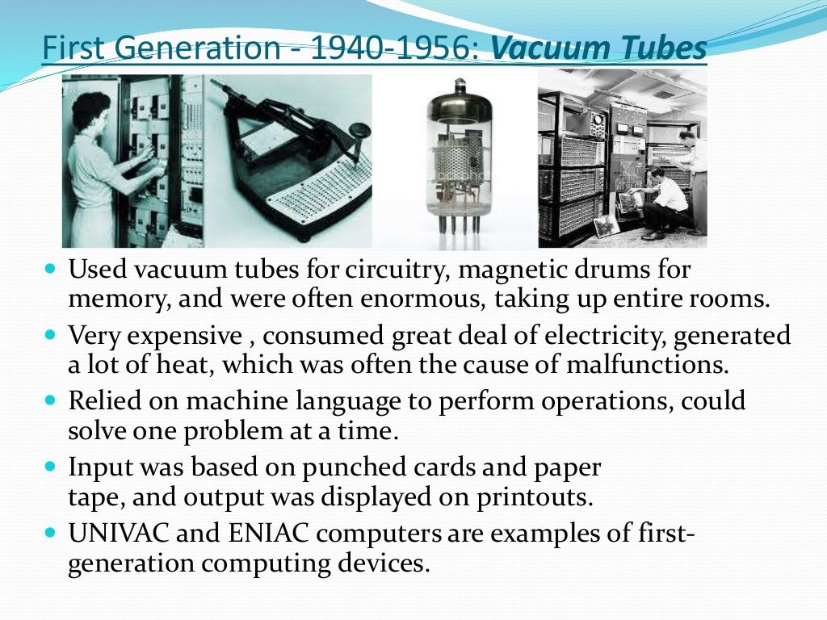

Slide 3
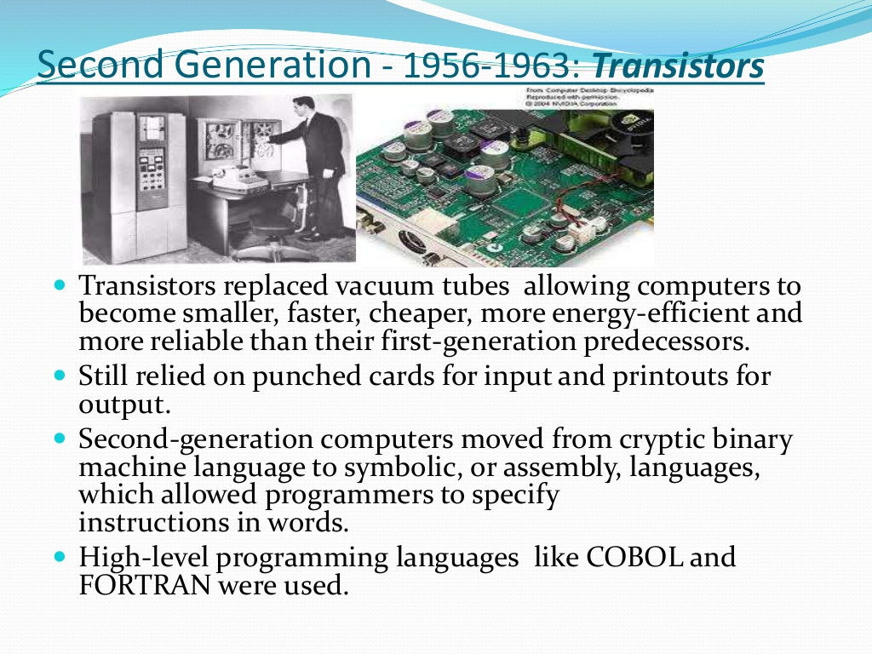

Slide 4
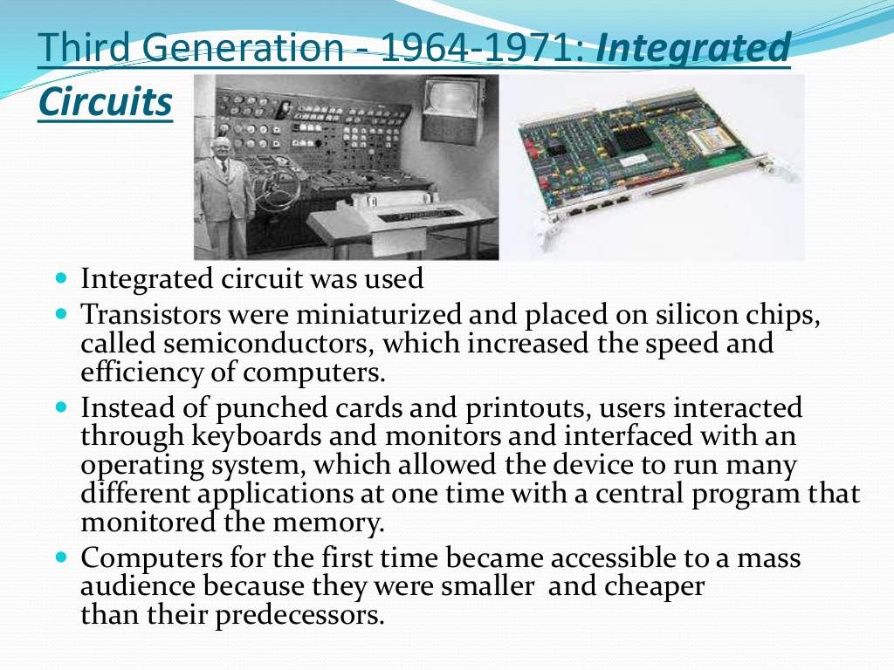

Slide 5
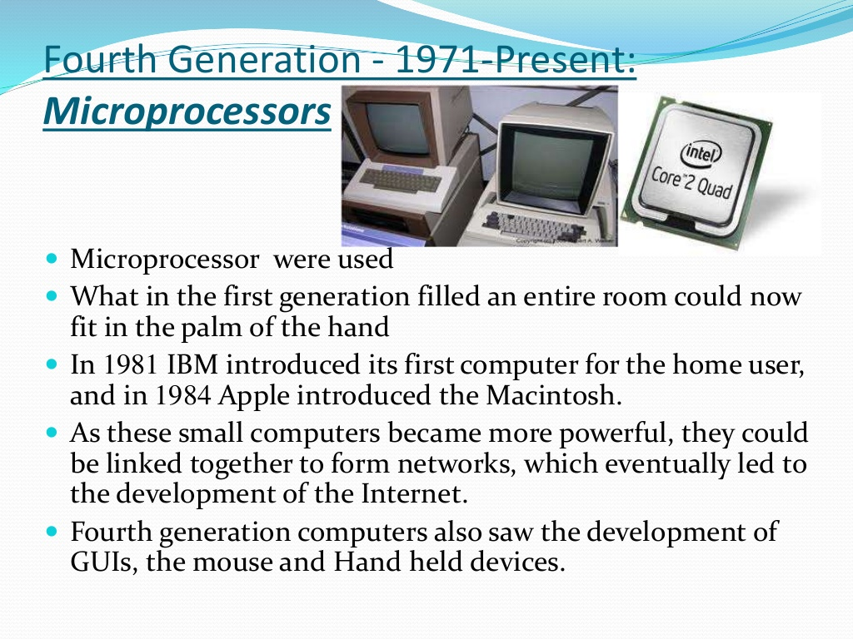

Slide 6
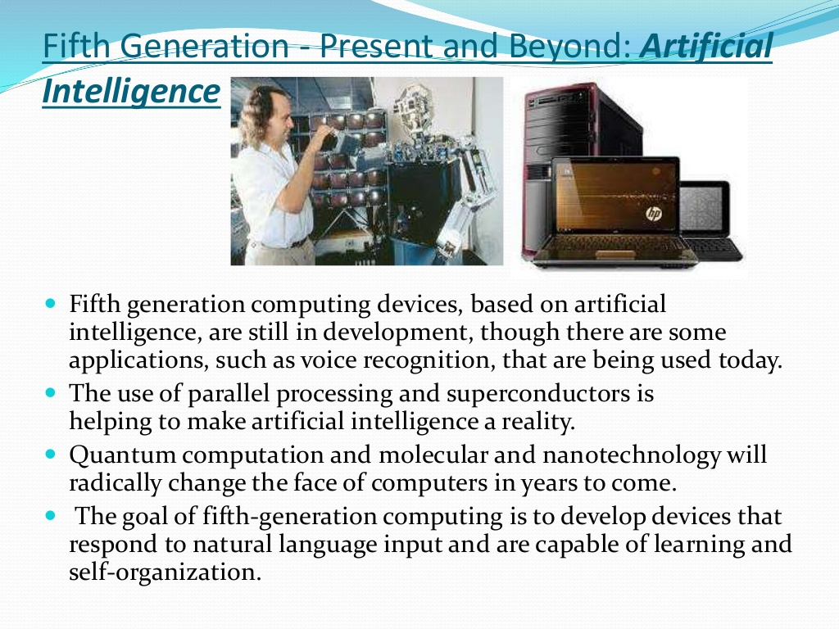

Slide 7
Overview cont’d..
UNIT-V
    Network Fundamentals
    Internet
    Net Surfing/Net Browsing

Slide 8
CONTENTS
Overview
Introduction to Computers
  Characteristics of Computers
  History/Evolution
  Generation Of Computers

Slide 9
Introduction To Computers
Definition:
    Its an electronic Device that is used for information Processing.
    Computer.. Latin word.. compute
    Calculation Machine
A computer system includes a computer, peripheral devices, and software

Slide 10
Introduction To Computers
Accepts input, processes data, stores data, and produces output
Input refers to whatever is sent to a Computer system
Data refers to the symbols that represent facts, objects, and ideas
Processing is the way that a computer manipulates data
A computer processes data in a device called the central processing unit (CPU)

Slide 11
Introduction To Computers
Memory is an area of a computer that holds data that is waiting to be processed, stored, or output
Storage is the area where data can be left on a permanent basis
Computer output is the result produced by the computer
An output device displays, prints or transmits the results of processing

Slide 12
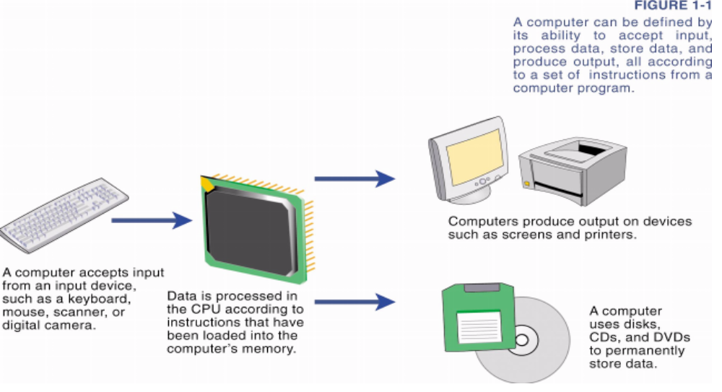
Introduction To Computers

Slide 13
Introduction To Computers
Computer
  Performs computations and makes logical decisions
  Millions / billions times faster than human beings
Computer programs
  Sets of instructions for which computer processes data
Hardware
  Physical devices of computer system
Software
  Programs that run on computers

Slide 14
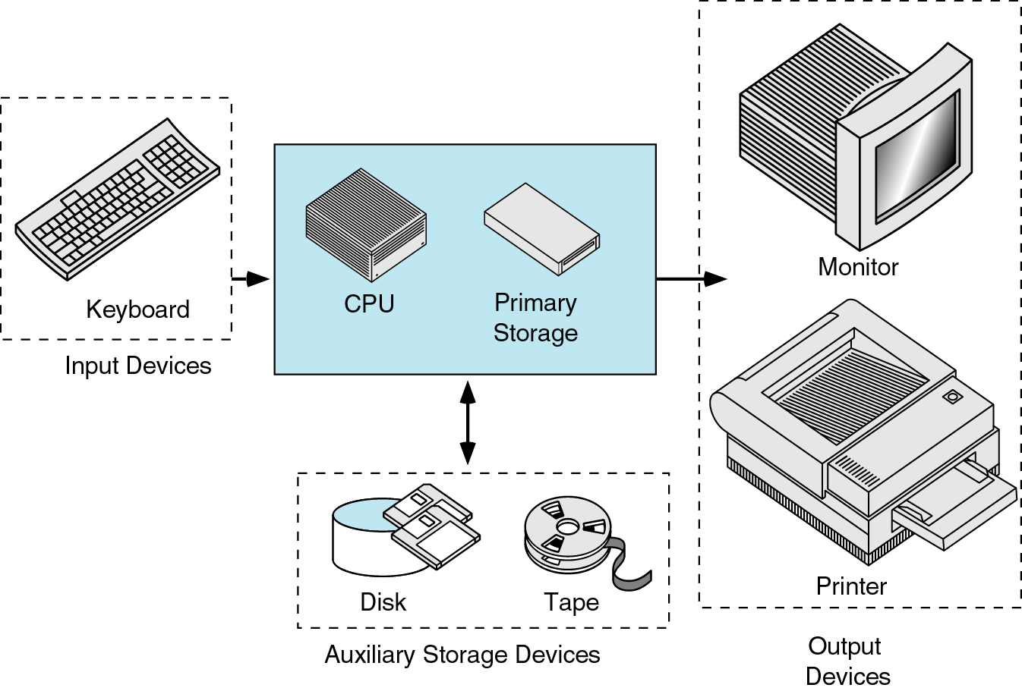
Definition:
    Introduction To Computer Software
    Operating system
    Problem solving Techniques
    Computer Prog ramming languages
    Computer Threats

Slide 15
Introduction To Computers
Capabilities of Computers
    Huge Data Storage
    Input and Output
    Processing

Slide 16
Introduction To Computers
Characteristics of Computers
    High Processing Speed
    Accuracy
    Reliability
    Versatility
    Diligence

Slide 17
Introduction To Computers
History Of Computers

Slide 18
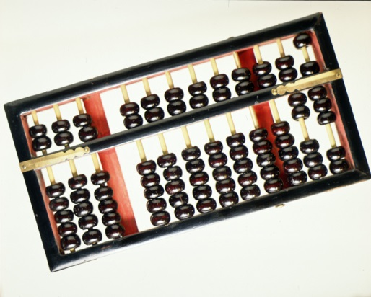
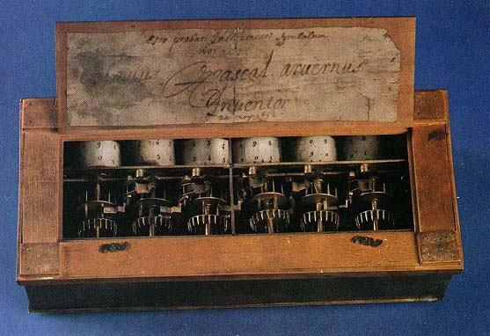
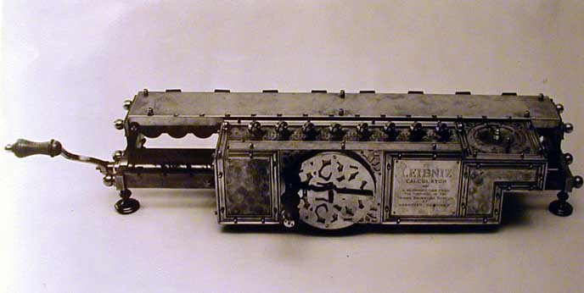
Before the 1500s, in Europe, calculations were made with an abacus
  Invented around 500BC, available in many cultures (China, Mesopotamia, Japan, Greece, Rome, etc.)
In 1642, Blaise Pascal (French mathematician, physicist, philosopher) invented a mechanical calculator called the Pascaline
In 1671, Gottfried von Leibniz (German mathematician, philosopher) extended the Pascaline to do multiplications, divisions, square roots: the Stepped Reckoner
None of these machines had memory, and they required human intervention at each step

Slide 19
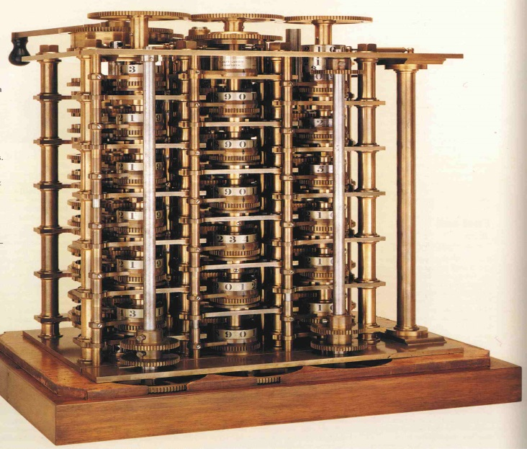
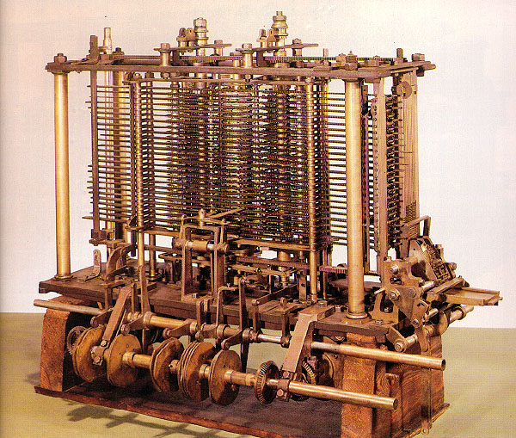
In 1822 Charles Babbage (English mathematician, philosopher), sometimes called the “father of computing” built the Difference Engine
Machine designed to automate the computation (tabulation) of polynomial functions (which are known to be good approximations of many useful functions)
  Based on the “method of finite difference”
  Implements some storage
In 1833 Babbage designed the Analytical Engine, but he died before he could build it
  It was built after his death, powered by steam

Slide 20
Introduction To Computers
Generations of Computers

Slide 21
Introduction To Computers
Generation of Computers
    First Generation (1946-59)
    Second Generation(1957-64)
    Third Generation(1965-70)
    Fourth Generation(1970-90)
    Fifth Generation(1990 till date)

Slide 22
Introduction To Computers
Generation 0: Mechanical Calculators
Generation 1: Vacuum Tube Computers
Generation 2: Transistor Computers
Generation 3: Integrated Circuits
Generation 4: Microprocessors

Slide 23
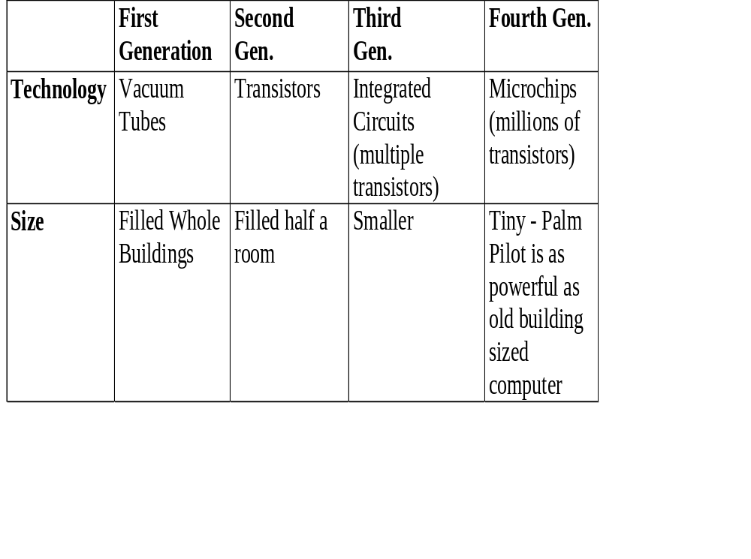
Introduction To Computers

Slide 24
Introduction To Computers
Some Pictures…..

Slide 25
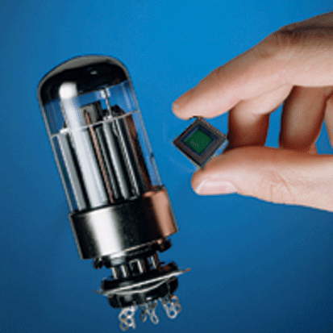
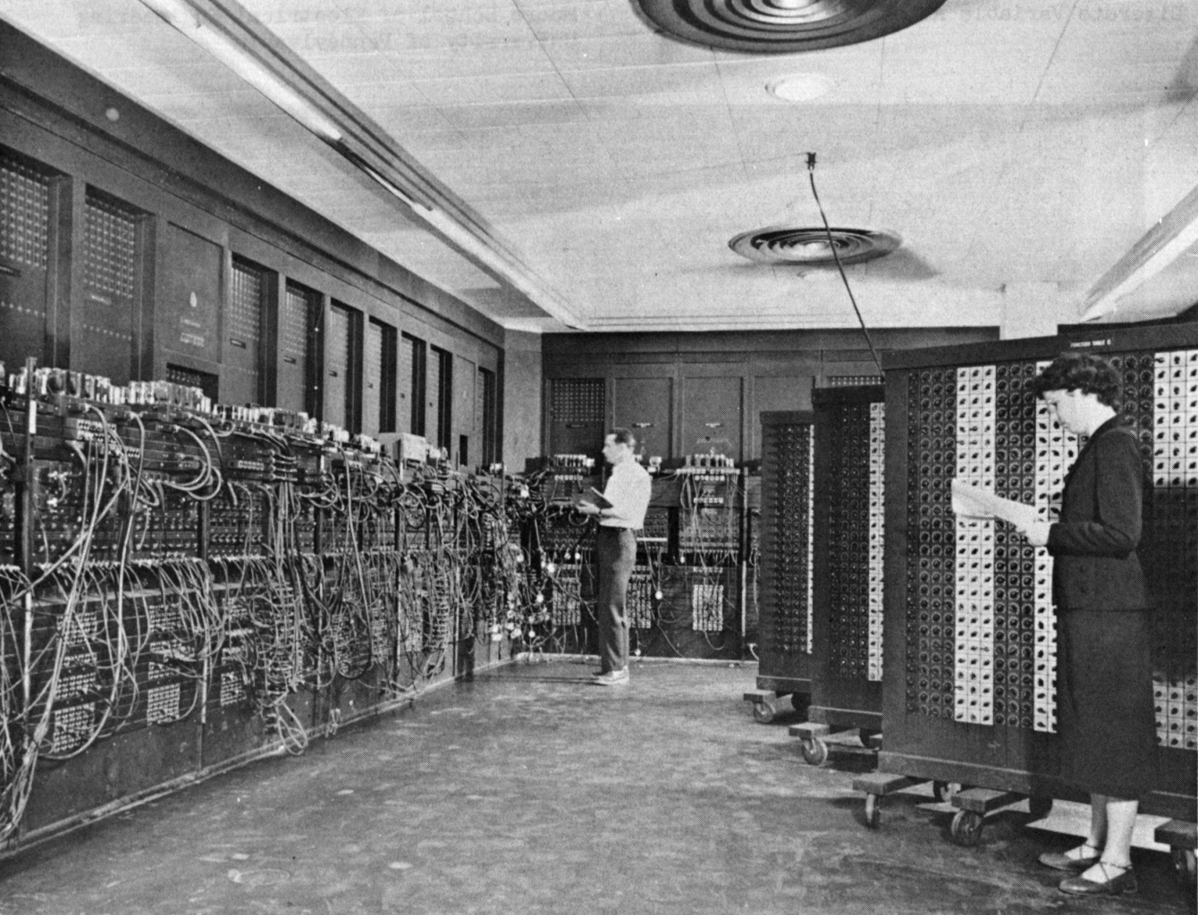
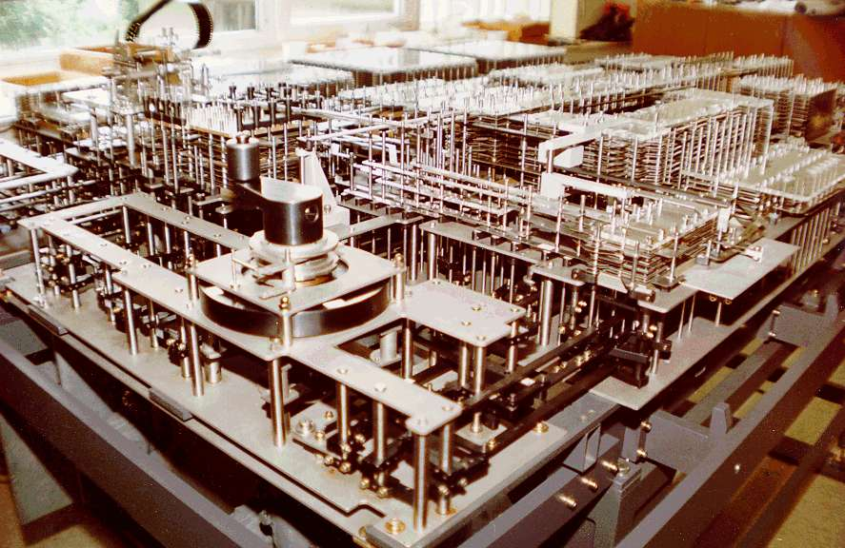
Generation 1 : ENIAC
The ENIAC (Electronic Numerical Integrator and Computer) was unveiled in 1946: the first all-electronic, general-purpose digital computer

Slide 26
The use of binary
In the 30s Claude Shannon (the father of “information theory”) had proposed that the use of binary arithmetic and boolean logic should be used with electronic circuits
The Von-Neumann architecture
CPU
Memory
I/O
System

Slide 27
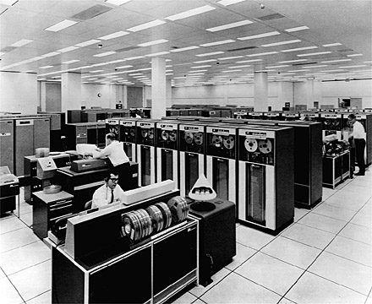
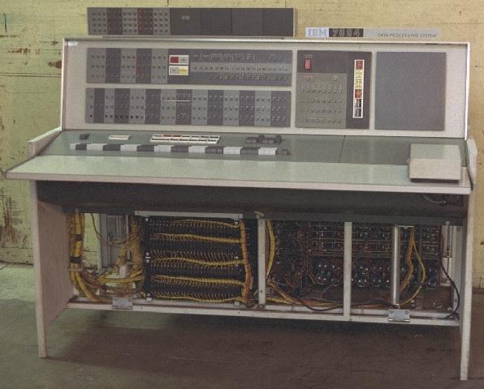
Generation 2: IBM7094

Slide 28
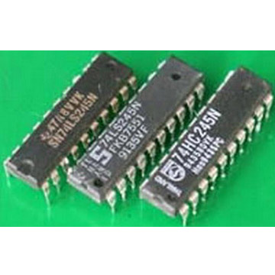
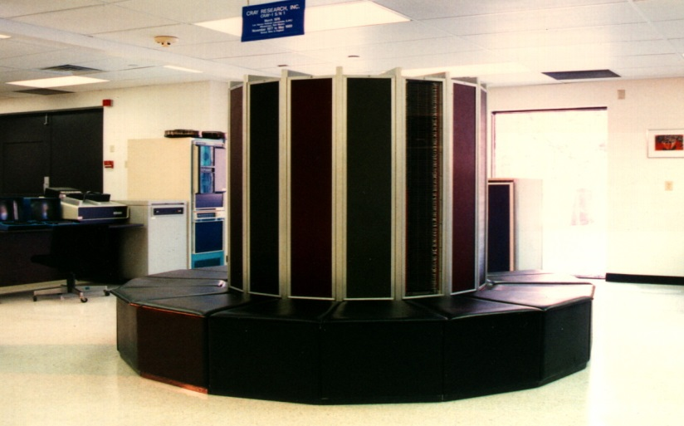
Generation 3: Integrated Circuits
Seymour Cray created the Cray Research Corporation
Cray-1: $8.8 million, 160 million instructions per seconds and 8 Mbytes of memory

Slide 29
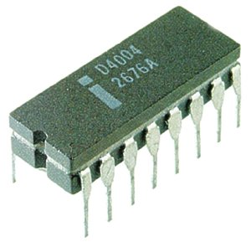
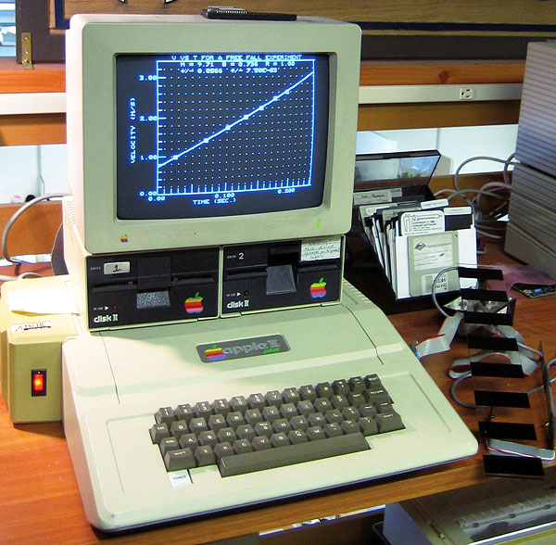
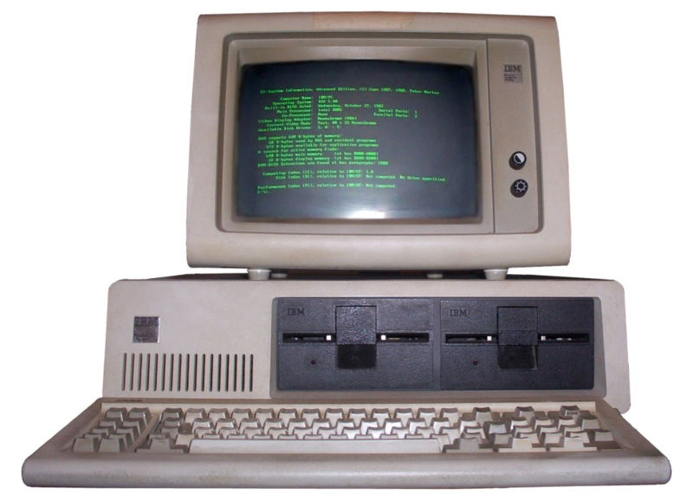
Generation 4: VLSI
Improvements to IC technology made it possible to integrate more and more transistors in a single chip
  SSI (Small Scale Integration): 10-100
  MSI (Medium Scale Integration): 100-1,000
  LSI (Large Scale Integration): 1,000-10,000
  VLSI (Very Large Scale Integration): >10,000
Microprocessors

Slide 30
Generation 5?
The term “Generation 5” is used sometimes to refer to all more or less “sci fi” future developments
Voice recognition
Artificial intelligence
Quantum computing
Bio computing
Nano technology
Learning
Natural languages

Slide 31
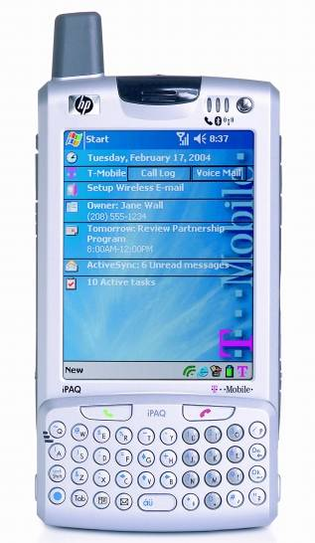
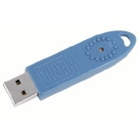
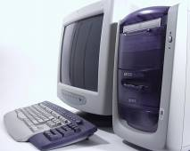
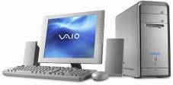
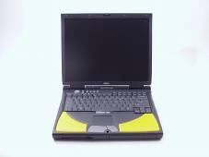
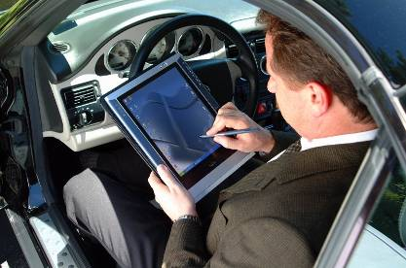

Slide 32
COMPUTER FUNDAMENTALS
Source of Knowledge:
  The Mother of Information…
“The Internet”
The World Wide Web

