Slide 1
Secure data hiding in images using steganography
CAPSTONE PROJECT
Presented By: RAMOJU VARAHA NARASIMHA SAI NIKHIL
Student Name : RAMOJU VARAHA NARASIMHA SAI NIKHIL
College Name & Department : RAGHU ENGINEERING COLLEGE & ECE

Slide 2
OUTLINE
Problem Statement
Technology used
Wow factor
End users
Result
Conclusion
Git-hub Link
Future scope

Slide 3
Problem Statement
In today's digital world, secure communication is essential to prevent data breaches. Traditional encryption methods can be easily detected. This project implements steganography to hide messages inside images using a passcode, ensuring data security and confidentiality. The goal is to create a robust image-based encryption system in Python using OpenCV (cv2).

Slide 4
Technology used
Programming Language: Python
Libraries: OpenCV (cv2), NumPy, PIL (Pillow)
Platform: Python IDLE

Slide 5
Wow factors
Encrypts a secret message within an image without noticeable visual changes.
Uses a passcode to add an extra layer of security.
Prevents detection by conventional encryption detection tools.
Easy to implement and highly efficient for secure communication.

Slide 6
End users
Cybersecurity enthusiasts and professionals.
Journalists and activists needing secure communication.
General users looking for a simple yet effective encryption tool.
Organizations handling confidential data.

Slide 7
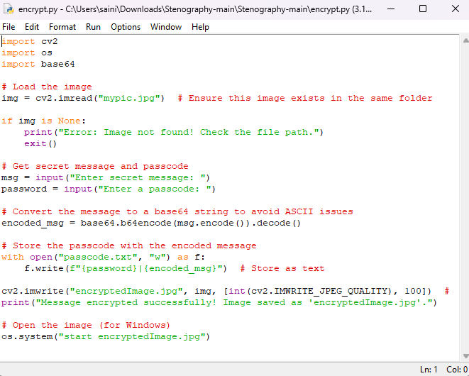
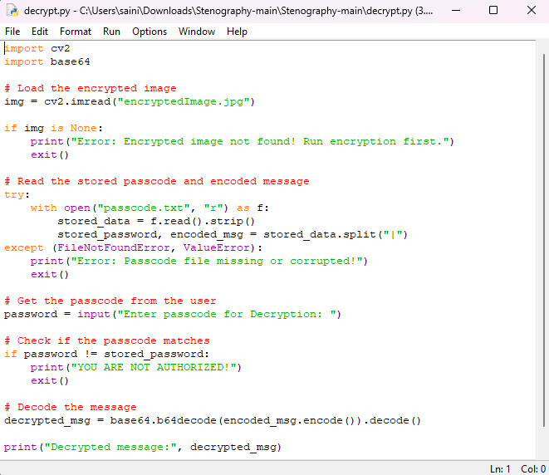
Results
Encryption code
Decryption code

Slide 8
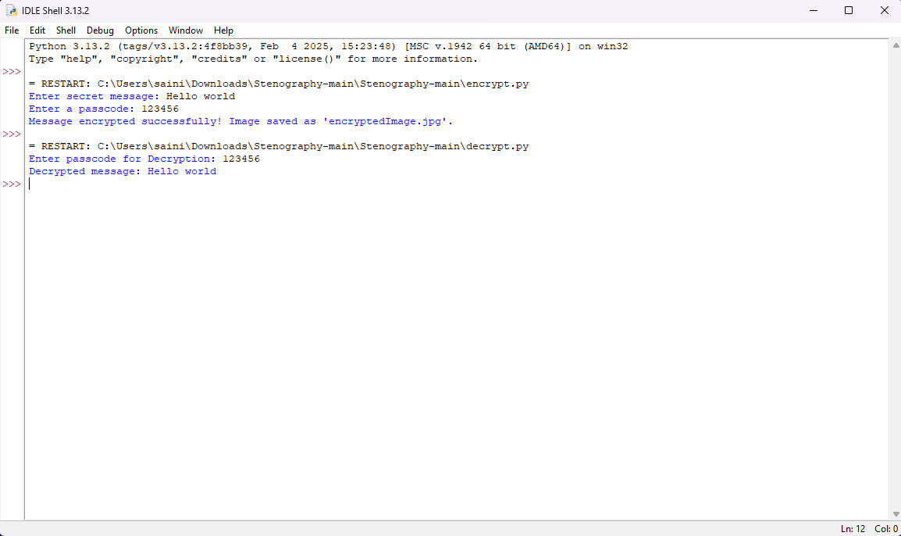
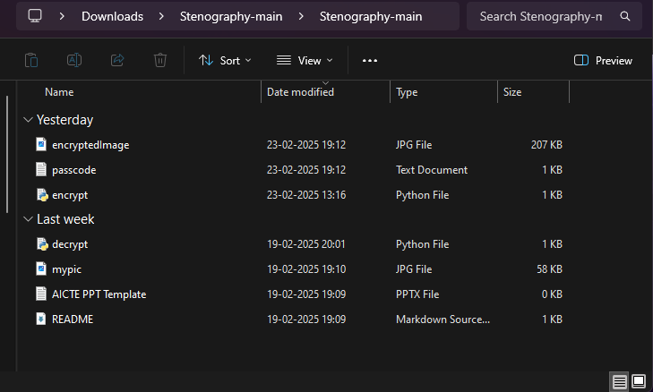
Output

Slide 9
Conclusion
This project provides a simple yet effective method for secure communication using image steganography. By integrating encryption with a passcode, it enhances security while ensuring the data remains undetectable. The implementation in Python using OpenCV showcases the efficiency of steganographic techniques.

Slide 10
GitHub Link
GITHUB LINK :- https://github.com/sainikhil132222/STEGANOGRAPHY.git

Slide 11
Future scope(optional)
Extending support for different image formats and higher-resolution images.
Implementing AI-based detection resistance techniques.
Enhancing security with multi-layer encryption.
Developing a user-friendly GUI for non-technical users.

Slide 12
THANK YOU

