Slide 1
Object Shape Recognition and Motion tracking for Robotic pick and place application
AIMLCZG628T: Dissertation Presentation,
M.Tech., Artificial Intelligence & Machine Learning
Sai Nikhil Abinas Mohanty , 2022AA05245
BITS PILANI

Slide 2
Outline
Introduction
Objective
Solution Methodology
Model Block Diagram
MLOPs Implementation/Containerization
Experimental Setup & Code Walkthrough
Data Generation
Results
Results Analysis & Future Scope of Work
Conclusion
References

Slide 3
Introduction
In modern manufacturing and logistics, automation plays a critical role in enhancing efficiency, accuracy, and speed. One of the key components of automation is the ability of robotic systems to handle and manipulate objects of various shapes and sizes. However, traditional robotic arms often struggle with identifying and picking different type of objects that are moving on a conveyor belt, especially when these objects vary in shape and orientation. This challenge necessitates the integration of advanced computer vision techniques to empower robotic arms with the ability to dynamically identify and pick moving objects
Automatic pick and place of a moving object in a conveyor belt by a robotics system is a wide industrial use case that has been popular in industries like warehouse, material management, automotive manufacturing. The solution of this use case includes conventional methods such as mechanical and sensor-based systems.
The dissertation would provide a comprehensive study and implementation on leveraging computer vision, video analytics techniques to enable a robotic arm to pick up various shapes of moving objects on a conveyor system. The project will focus on using depth camera as an input and will develop an image pre-processing and feature extraction algorithm for feature extraction and image modification best suitable for our use case.

Slide 4
Objective
Project : Develop a object detection, motion estimation and anomaly detection model for single object on conveyor for robot pick and place application
Scope : The goal is to solve the problem by utilizing Computer Vision, Video Analytics and ML/DL techniques. Instead of creating only the algorithm or model, the dissertation focuses on the developing an end-to-end application that can be used by an end user. Scope limits till developing MQTT publishing message and not simulation of robot arm.

Slide 5
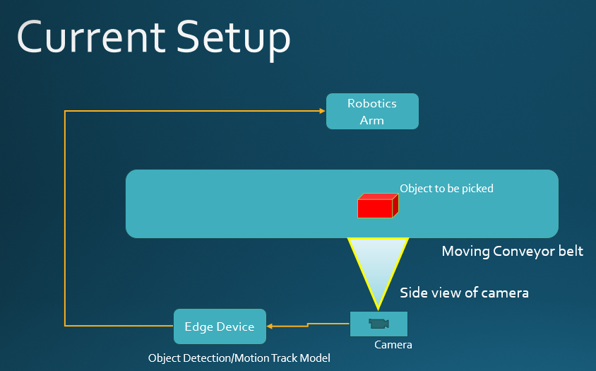
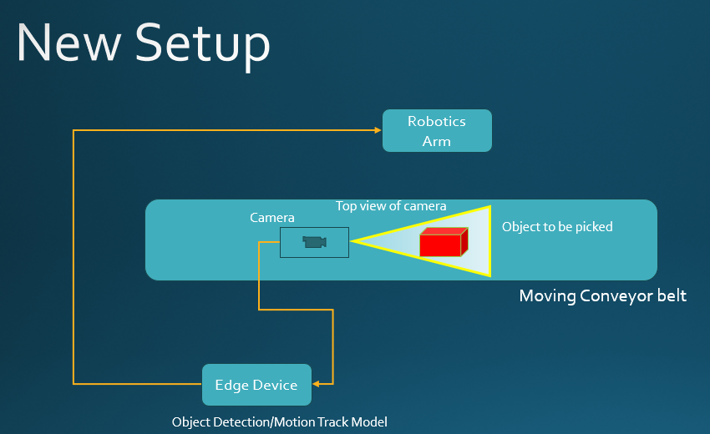
Existing Solution

Slide 6
Solution Methodology
The project proposes a model chaining solution to do object shape detection then motion estimation of the object in frame and finally to predict if the object has anomaly or not.
The input is a video file which can be uploaded by user via a web application.
The model is then run on the input frames and store the frame data and meta data in a local folder.
A MQTT publisher script is created to publish the frame meta data and model inference output to MQTT broker, which then can be consumed by the MQTT subscriber running on a different system.
The model is then packaged as a docker image, which can be run as a container to make it modular.
Next slide shows the architecture diagram of the overall solution.

Slide 7
Architecture Diagram
Web App
Container 2
Image File Upload
Video file upload
Data Store
Image and meta data store
Meta data store
Static Object Detection Model
Motion Detection and Motion Tracking Model
Anomaly Detection Model
Frame store
MQTT Publisher Script
Node 1
Container 1
MQTT Broker
Node 2
MQTT Subscriber Script

Slide 8
Overall Model Flow
Code for publishing object coordinates and shape information
GUI Interface
Image dataset upload
Video file upload
Visualization of segmented object and motion coordinates
Image Pre-Processing
Object Segmentation using Deep Reinforcement Learning
Motion Estimation using Optical Flow
Anomaly Detection Model using One-SVM

Slide 9
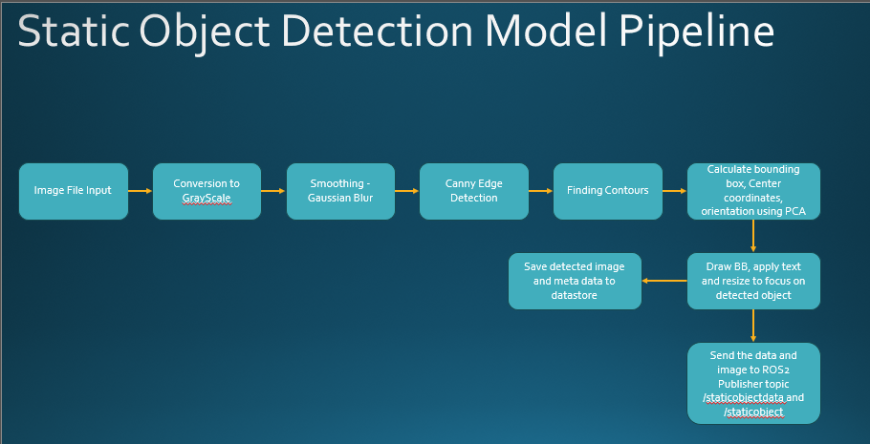
Object Detection Model
For the object detection and motion tracking, the solution proposes to use image processing and motion detection algorithm to detect the object. The reason for this approach is we want to build a generic model where the background always remains same in a frame, but the type of objects can change. Hence, having a model that is supervised and trained with a specific object say cube may fail if we introduce an unknown object with different shape.

Slide 10
Motion Detection Model
Video File Input
Apply Background Subtractor
Get Foreground mask
Detect moving object using background subtractor technique
Finding Contours
Calculate bounding box, Center coordinates, current position
Save detected image and meta data to datastore
Draw BB, put text on the detected object image
Calculate Speed of the object in each frame and average speed of moving object
Send the data and image to ROS2 Publisher topic /staticobjectdata and /staticobject

Slide 11
Anomaly Detection Model
As an extension to the problem statement, there is a possibility that foreign objects or anomalous objects may also be present in the conveyor belt. The objective is any deviation to the normal object should be detected as an anomaly and to be reported back to the MQTT environment.
Out of these, One-Class SVM model is chosen as an approach. One-Class SVM is an approach to learn from the distribution of normal data and classify the frames that deviate significantly as anomalies.
Anomaly Detection Model Pipeline
Offline Capture frames with normal data and store in local folder
Image preprocessing
OneClass SVM Model Training
One Class SVM Predict
Report Anomalous
Continuous Frame Input

Slide 12
Motion Detection & Anomaly Detection Inference Results
After model is run on each frame, below parameters are published as inference results.
Bounding box for each frame contains below parameters:
y = [bx, by, bw, bh]
bx and by: Coordinates of the centre of the bounding box
bh and bw: Height and width of the bounding box
Coordinate of the object detected – X Coordinate and Y Coordinate
Orientation of the object using PCA method in degree angle.
Speed of the object is calculated using the difference in position between subsequent frames.
Motion detected or not using the speed value in each frame.
Anomaly detected or not as a parameter
Sample inference result: {'frame_number': 80, 'BB_X': '705', 'BB_Y': '161', 'BB_W': '81', 'BB_H': '82', 'X Cordinate': '745', 'Y Cordinate': '202', 'Orientation': '1.1523898376868555', 'Anomaly Detected': 'True', 'Motion Detected': 'True', 'Speed of Object': '2679.4356801829063'}

Slide 13
MLOPs Implementation
To make this solution easily deployable in any environment, we want to package the model into a docker image with all dependencies installed. Then this solution can be deployed as model as a microservice.
For storing the inference results, we are storing the annotated frames to the local folder and meta data to the excel storage. The same can be extended to store frames using minio and store meta data using influxdb.
MLOps Flow
Video File input
Model Code
Model Inference
Meta data Publisher to MQTT
Docker Container
Annotated Frame store
Frame meta data store
Local Folder/Datastore

Slide 14
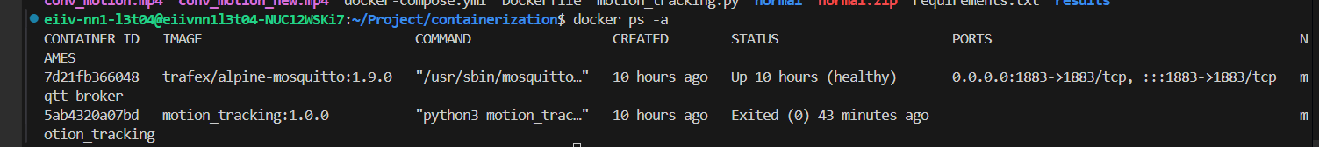
Containerization
The model is containerized with the dependencies such as pip modules, python version, OS version and volume mounting the paths.
MQTT broker is run as containerized environment.
Containerization
Steps to run model as container:
Docker compose build to build the model image.
Docker compose up –d to run the inference.
Containerized Model
WebApp
MQTT Broker
Docker Container 2
Docker Container 3
Docker Container 1

Slide 15
Web Application
As discussed in abstract review, the suggestion was to develop a web application from where the user can be able to upload image or video file and run the model.
Here we studied to use Flask with Django framework for development of basic web application. This will have basic features such as upload video file button, button to run motion tracking model
Web Application
Static object detection model
Anomaly detection model
Video File Upload
Run Detection/Motion Tracking Model
Button 1
Button 2
Motion Detection/Tracking Model

Slide 16
Experimental Setup & Code
Node 1
Node 2
System connected with camera and running Algo
Running Mosquito MQTT subscriber to receive frame meta data
MQTT Protocol

Slide 17
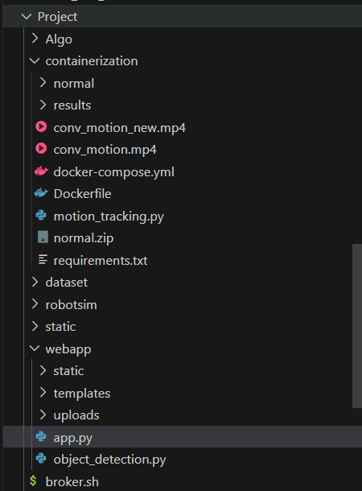
Code Framework Structure
The development done on Ubuntu 22.04 completely using python language. Below is the structure of the code.

Slide 18

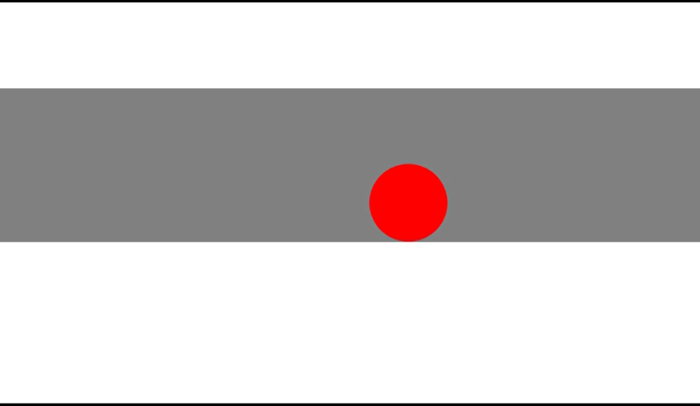
Data Generation
This is a use case where we do not want to train the model with a specific type of labelled object. Hence, simulated data is generated using python script.
Two python scripts created to generate synthetic data of cube and circular object in the conveyor belt with one object at a time. A video file is generated with those simulated images that will serve as input to the model.
Synthetic data with video file
Cube on conveyor belt
Circular shape on conveyor belt

Slide 19
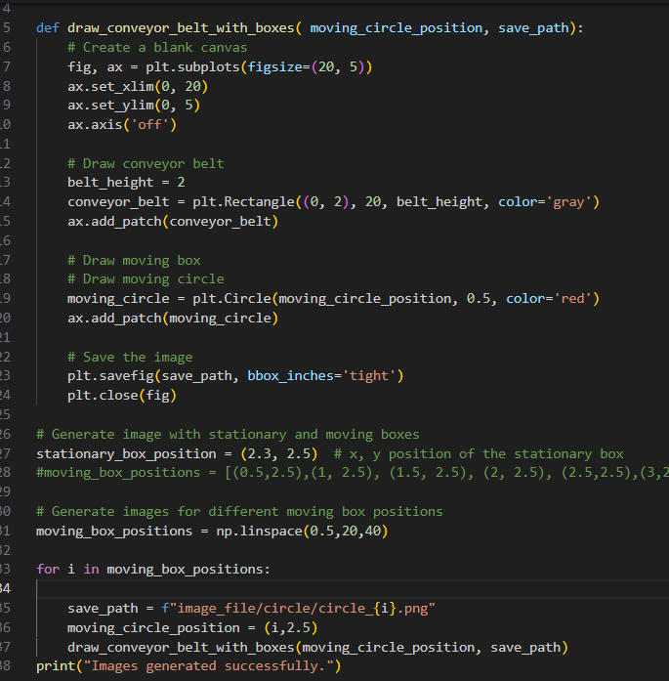
Synthetic Data Generation
Generation of Normal Data
Python with matplotlib and PIL are used to generate the 2D cube on a conveyor belt in png format. To simulate the motion of the object, each frame is created with position of the cube with a difference of 0.5.
40 images are generated with 2D cube on conveyor ,which is also our normal data
Generation of Anomaly Data for Training and Validation
Python with matplotlib and PIL are used to generate the 2D circular object on a conveyor belt in png format. To simulate the motion of the object, each frame is created with position of the circle with a difference of 0.5.
40 images are generated with 2D circle on conveyor ,which is also our anomaly data
Code Snippet

Slide 20
Video file generation from the frame
Ffmpeg tool is used to convert the sequence of frames in png format to a video file in mp4 format with 1FPS as frame rate. This video file will be used as an input source for mode inference.
Again the same tool will be used in the script to create a video file of the annotated inference frames.
To install ffmpeg tool in ubuntu: sudo apt install ffmpeg
Run the command: ffmpeg -framerate 1 -pattern_type glob -i '*.png' -c:v libx264 -vf "pad=ceil(iw/2)*2:ceil(ih/2)*2" -pix_fmt yuv420p out_new_conv.mp4

Slide 21
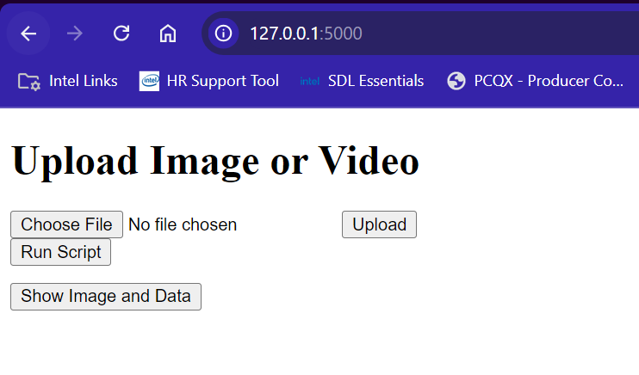
Running WebApp
To run the webapp, go inside webapp folder and run python3 app.py
It will host the server in http://127.0.0.1:5000/
Choose file and upload button is used to upload the video file on which inference need to be run.
http://127.0.0.1:5000/run-script method is used to run the model. This will run docker restart motion_tracking . The command will re-run the model on the uploaded file.
snapshot of web application:

Slide 22
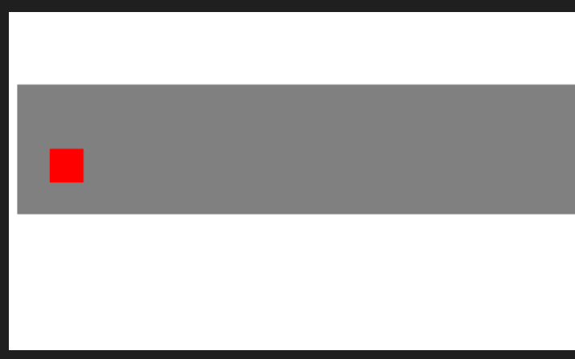
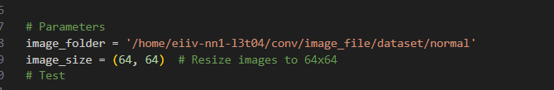
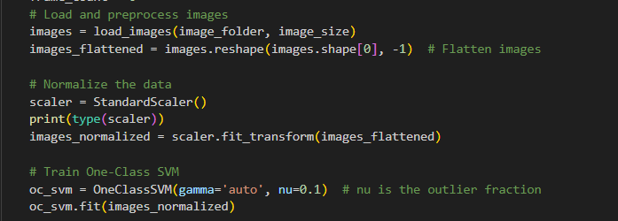
Anomaly Model Training
In the model script created using python language, for once the very first time anomaly model will get trained on a set of normal data. As we want to make it generic so that the model shall detect any other objects apart from the normal data as anomaly.
Sample Normal data

Slide 23
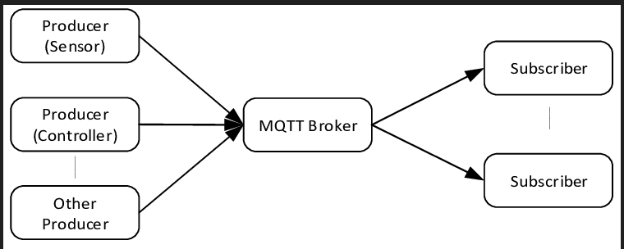
Establishing MQTT Connection b/w Systems
MQTT (Message Queuing Telemetry Transport) is a lightweight, publish-subscribe messaging protocol designed for low-bandwidth, high-latency, or unreliable networks. It's widely used in Internet of Things (IoT) systems due to its simplicity and efficiency in transporting messages between devices.
Each message is passed through a broker and the messages are published to a topic. Any subscriber connected to the same broker and subscribed to the same topic will receive the data.
Mosquitto MQTT broker is used here and docker image is used. Created a shell script to run mqtt broker.
Command: ./broker.sh 1883 0
To listen to a specific topic, below command is used in subscriber system: mosquitto_sub –h <brokerip> -p 1883 -t “topic_name“

Slide 24
Results
The model is able to detect stationary object on the conveyor belt and predict if the object is in motion or not.
The algorithm estimates the bounding box coordinates, center of the object, orientation and speed of the object.
Then the anomaly model detects if the object on the conveyor belt is a normal object or anomaly object.
The frame is then annotated with the details and stored in the motion_results folder.
The sequence of annotated frames are then converted into an mp4 video file.
The MQTT publisher is then publishes the inference results associated with each frame in dictionary format to the MQTT broker for the robotic arm application to consume.
Additionally, each key-value of meta data is stored in the excel file, which can also be saved into influxdb.

Slide 25
Annotated Frame Results after Inference
Input Video File
Annotated Output Video File

Slide 26
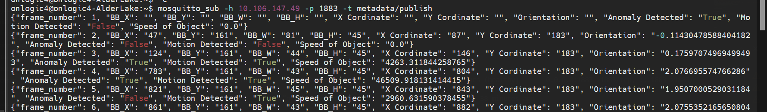
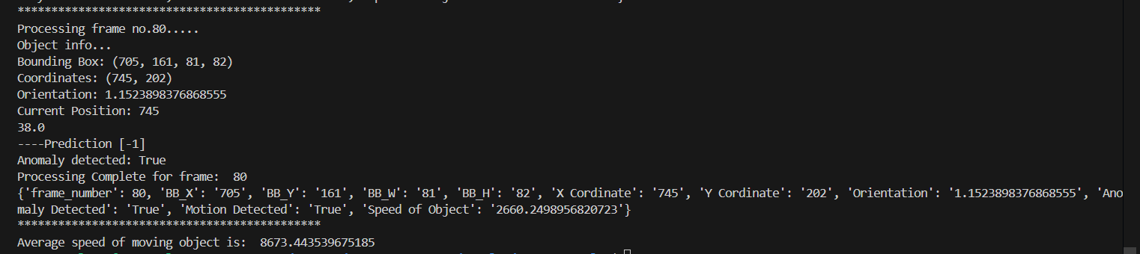
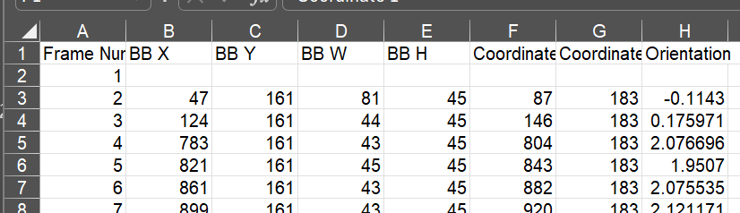
Results – metadata in MQTT, docker logs, excel store

Slide 27
Result Analysis and Future Scope of Work
Result Analysis
With the inference results, robotic arm gets all 2D information related to the object. With a fixed depth, this algorithm can be used for picking object from the conveyor belt.
For Anomaly detection, the one-SVM model is trained on a limited synthetic data of 40 images. Hence, the accuracy is around 60%. More accuracy can be achieved if the model can be trained on more training data.
Future Scope of Work
Future work is to use a depth camera to get the height of the object to make the model work with variable object height.
The model will be trained in more number of training data preferably on real normal object to achieve better accuracy. Data augentation for training the data.
Implementation of model registry to have versioning of the model image.
Implementation of datastore to store the frames and meta data in blob and time-series data base.

Slide 28
References
Qiguang Chen , Lucas Wan , Ya-Jun Pan , “Object Recognition and Localization for Pick-and-Place Task using Difference-based Dynamic Movement Primitives”, IFAC PapersOnLine 56-2 (2023), https://www.sciencedirect.com/science/article/pii/S2405896323012454
Chen, Q., Wan, L., Ravichadran, P., Pan, Y.J., and Chang, Y.K. (2022). “Vision-based impedance control of a 7-dof robotic manipulator for pick-and-place tasks in grasping fruits”, 2022 CSME International Congress of Canadian Mechanical Engineering
Dr.V.Raju, “feature extraction of object for a pick and place robot”, https://www.jetir.org/papers/JETIR2202153.pdf
Ramin Ghiasi , Muhammad Arslan Khan, “An unsupervised anomaly detection framework for onboard monitoring of railway track geometrical defects using one-class support vector machine”., July 2024, https://www.sciencedirect.com/science/article/pii/S0952197624003257

Slide 29
Thank You

