Slide 1
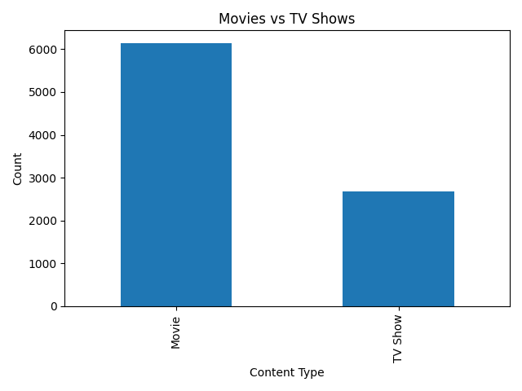
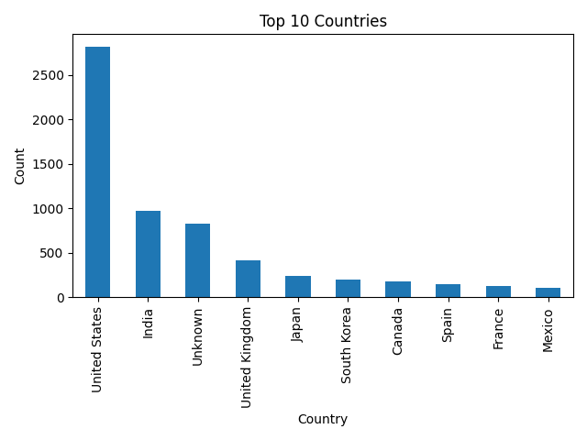
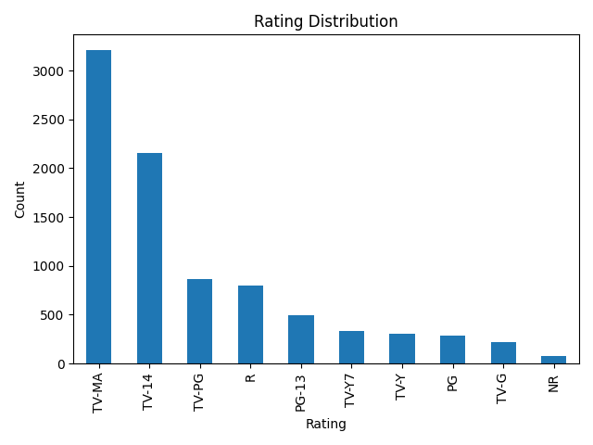
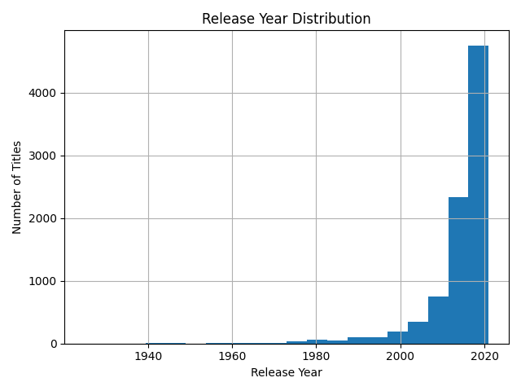
NETFLIX EDA DASHBOARD
Total Titles
8807
Movies
6131
TV Shows
2676
Top Country
United States
Key Insights:
Movies dominate Netflix content.
United States has highest content count.
TV-MA is the most common rating.
Netflix content increased significantly after 2015.

