Slide 1



Digital Signal Processing
Implementation Of LSM FIR Based Adaptive Filter System Identification
Presented By - Chamala Sai Nikhil Reddy
Enrolment Number : 11015237

Slide 2
Introduction to Adaptive filter
.
Desired sng
Input signal
Filter A.F
Output Signal
+
Error sng
The Filter is used to reshape certain input signals in such a way that its output is a good estimate of the given desired signal
It is a digital filter with self adjusting characteristics

Slide 3
LMS Algorithm
1.Involves a feedback connection.
2.Although LMS might seem very dificulty to work due to the randomness, the feedback acts As a lowpass filter or performs averaging so that the randomness can be filtered out
3.The time constant of averaging is inversely proportional to step size
Actually, if step size is chosen small enough , the adaptive process is made to progress slowly and the effect of the Gradient noise on the top weight are largely filtered out
4.Computational complexity of LMS is very low very attractive

Slide 4
LEARNING CURVE(MSE):The LMS technique relies on existing data to determine the gradient vector. LMS includes an iterative technique that makes repeated weight vector corrections in the direction of the gradient vector's negative, eventually resulting in the minimal mean square error.
System Identification: The process of identifying the coefficients of an unknown system using an adaptive filter is known as system identification.

Slide 5
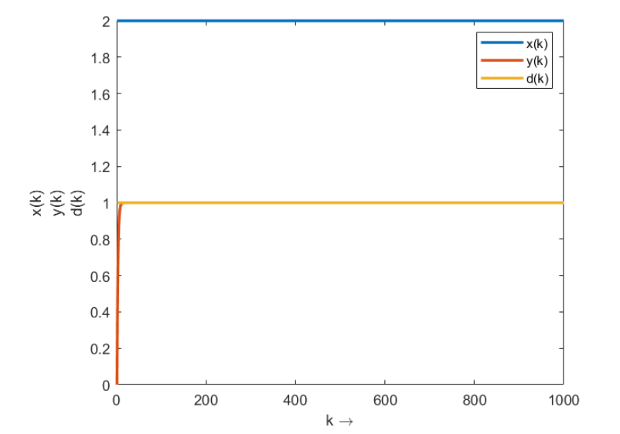
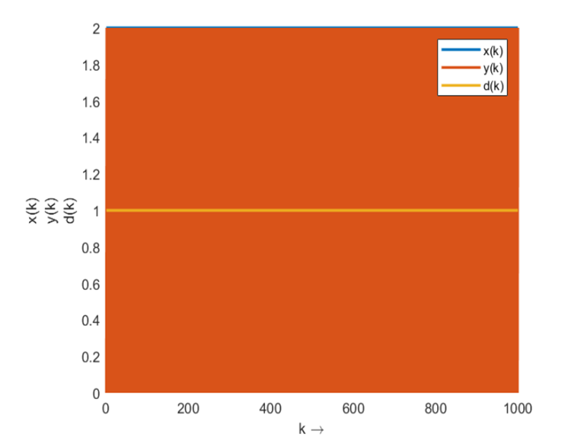
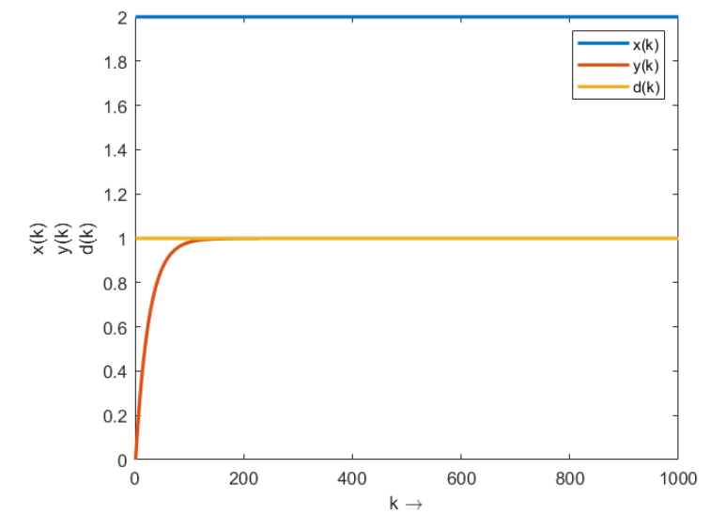
Graphs of LMS Algorithm

Slide 6
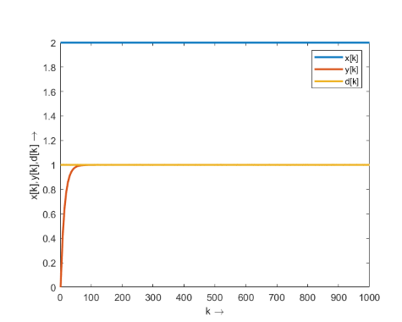
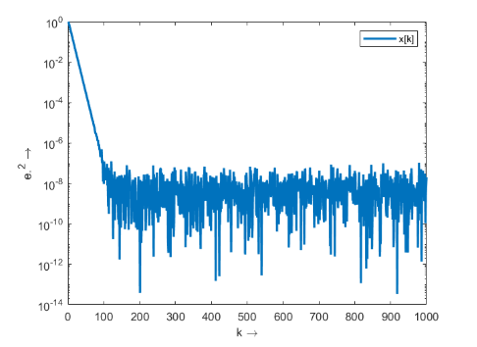
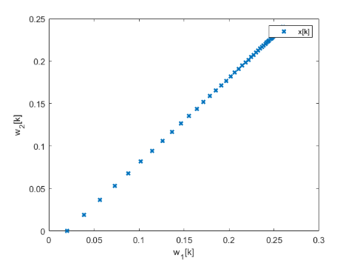
Learning Curve

Slide 7
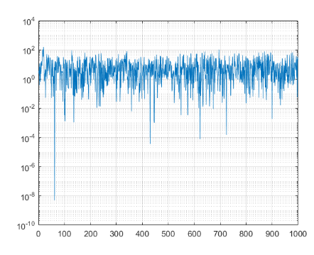
System identification

Slide 8
REFERENCE: https://www.slideshare.net/FirasMohammedAliAlRa/introduction-to-adaptive-filters [1] Mrs. A B Diggikar, Mrs. SS Ardhapurkar, Design and Implementation of Adaptive Filtering Algorithm For Noise Cancellation in Speech Signal on FPGA , International Conference on Computing, Electronics and Electrical Technology ,(2012),PP.22-25. [2] Elias Bjamason, Analysis of Filtered X-LMS Algorithm, IEEE Transaction on Speech and Audio Processing, Volume No 3, Issue No 6, ,(2012),pp.504- 514.
THANKYOU

