Slide 1
ExamHub
🎓
An Intelligent Online Examination & Assessment Platform
Sai Nikitha NSR
.NET 10 · Angular 21 · PostgreSQL · Azure · JWT Security
✅ 693 automated tests passing
Notes:
HOOK (25–30s): During one of my placement assessments, my internet dropped right in the middle of the exam. The whole session became unusable — an examiner had to step in, a brand new account had to be created, and I restarted from scratch. That moment showed me how much online exams still lean on manual intervention. So when I got the chance to build an online examination platform, I didn't want to build just another CRUD app — I wanted to fix those real problems. That's how ExamHub was born.

Slide 2
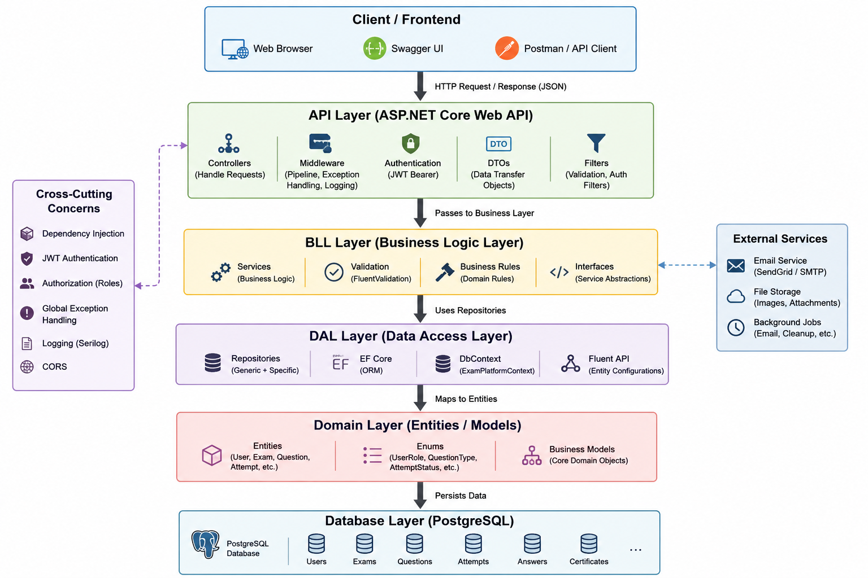
THE REALITY TODAY
The Problem The Solution
Architecture Diagram
🌐
Connection drops ruin exams
One network blip and the whole session breaks.
🛠️
Manual examiner intervention
Restarts and new accounts eat everyone's time.
📉
Learning stops at the score
Students see a number, not how to improve.
🔔
Basic, noisy notifications
No timely signal for approvals or results.
🤖
No intelligent feedback
Traditional platforms can't coach a student.
ExamHub · Intelligent Assessment
2 / 7
Notes:
(20s) Most exam platforms share the same gaps. A dropped connection can ruin a session. Fixing it means manual work for the examiner. And once the exam is over, students just get a score — no guidance. Notifications are basic, and there's zero intelligent feedback. These are the five problems I set out to solve.

Slide 3
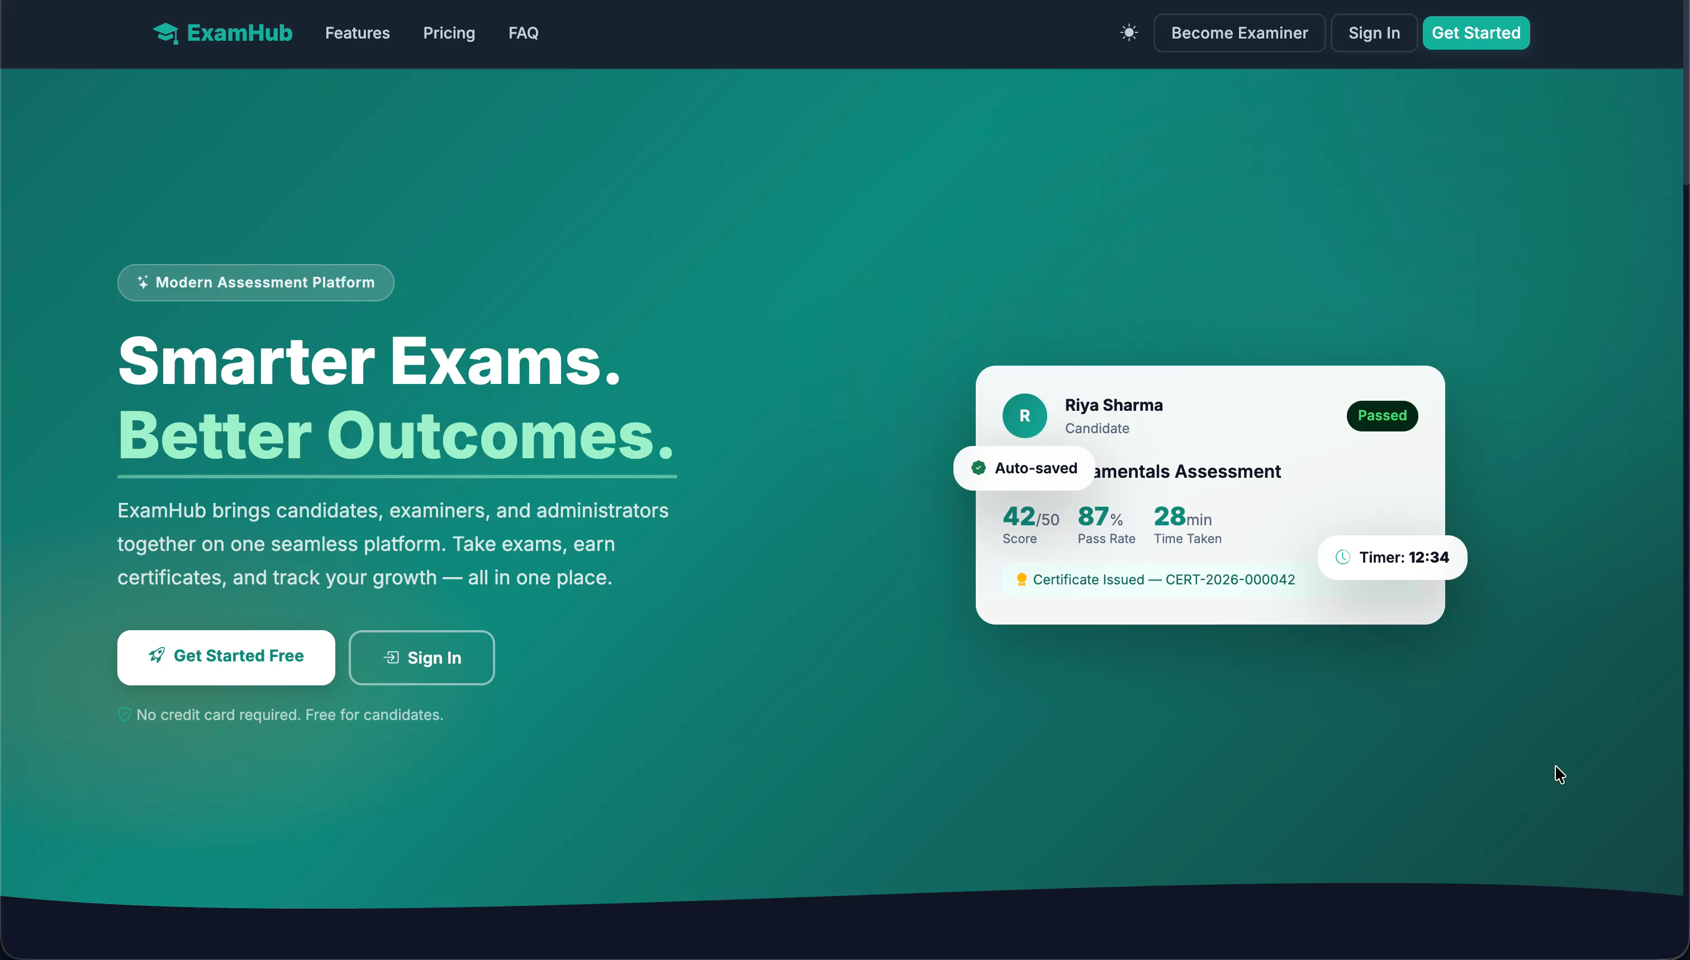
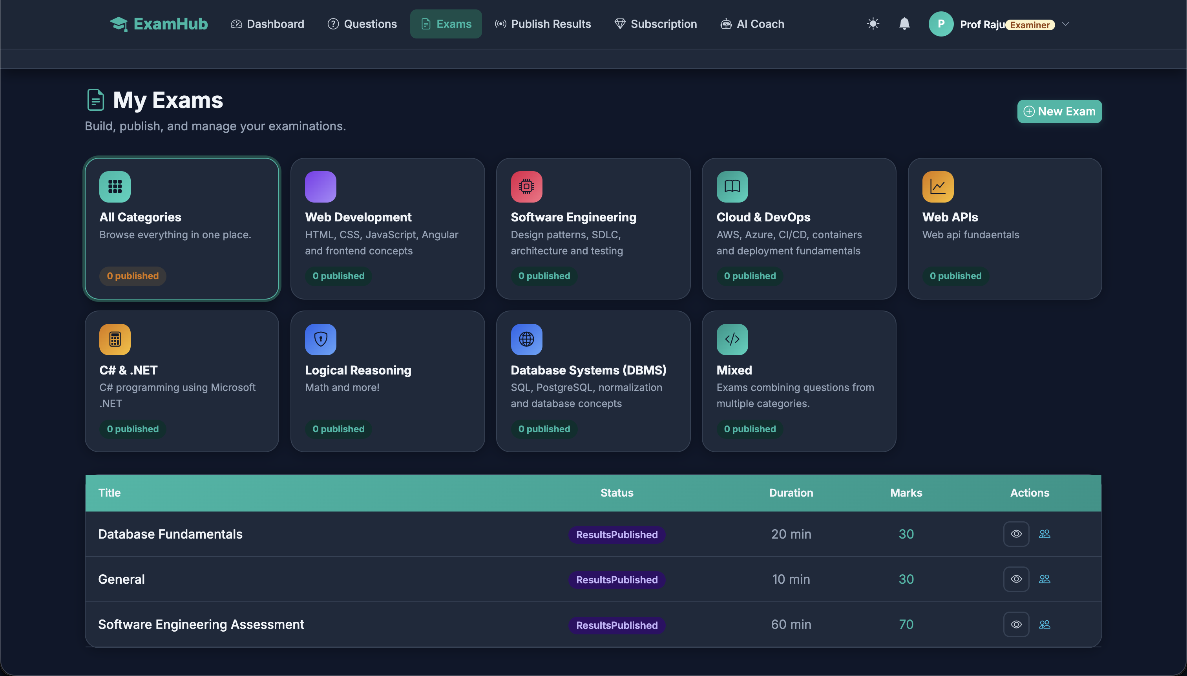
UI - Landing page and examiner dashboard with all categories
THE DIFFERENCE
Why ExamHub?
Traditional Platforms
✕ Static, fragile exams
✕ Manual workflows
✕ Only final scores
✕ Basic notifications
✕ Rigid, fixed attempts
ExamHub
✓ Resume-friendly, server-timed exams
✓ Role-based Admin / Examiner / Candidate
✓ AI-powered Learning Coach
✓ Smart, event-driven notifications
✓ Verified certificates + analytics
3 / 7
ExamHub · Intelligent Assessment
Notes:
(20s) Instead of listing features, here's the contrast. Traditional platforms are static, manual, and stop at a score. ExamHub is resume-friendly with a server-authoritative timer, fully role-based, and it goes beyond the score — an AI Learning Coach, smart notifications, verified certificates and analytics. That's the leap.

Slide 4
WHAT POWERS IT
Core Features
🤖
AI Learning Coach
💳
Premium Exam System
👥
Role-Based Platform
• Personalized study plan
• Topic-wise feedback
• Claude-powered insights
• Paid certification exams
• Subscription tiers
• Secure simulated payments
• Admin control centre
• Examiner workspace
• Candidate portal
📊
Analytics Dashboard
🔔
Smart Notifications
🔒
Security by Design
• Performance trends
• Topic-level analysis
• Certificates earned
• Approvals & exam updates
• Results published
• Certificate generated
• JWT authentication
• Role guards + IDOR-safe
• Rate limiting
✅ Engineered for reliability: 500 backend + 193 frontend unit tests — 100% passing
ExamHub · Intelligent Assessment
4 / 7
Notes:
(25s) These are the pillars. The AI Learning Coach turns a student's topic scores into a personalized study plan using Claude. A premium exam system with subscriptions and secure payments. Three real roles — Admin, Examiner, Candidate. Analytics, smart notifications, and security built in from day one — JWT, role guards, rate limiting. And none of this is a prototype: it's backed by nearly 700 automated tests, all passing.

Slide 5
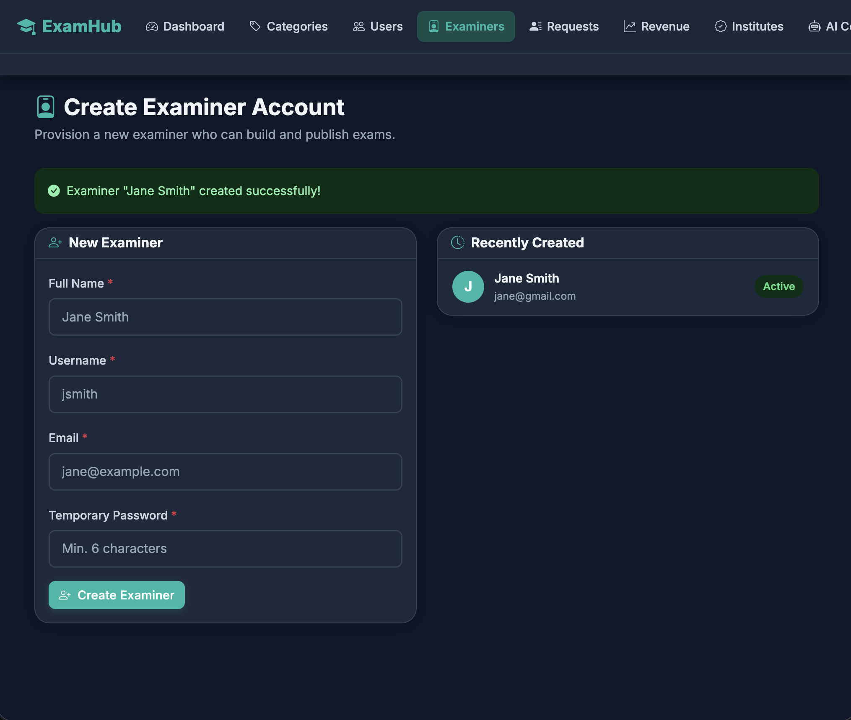
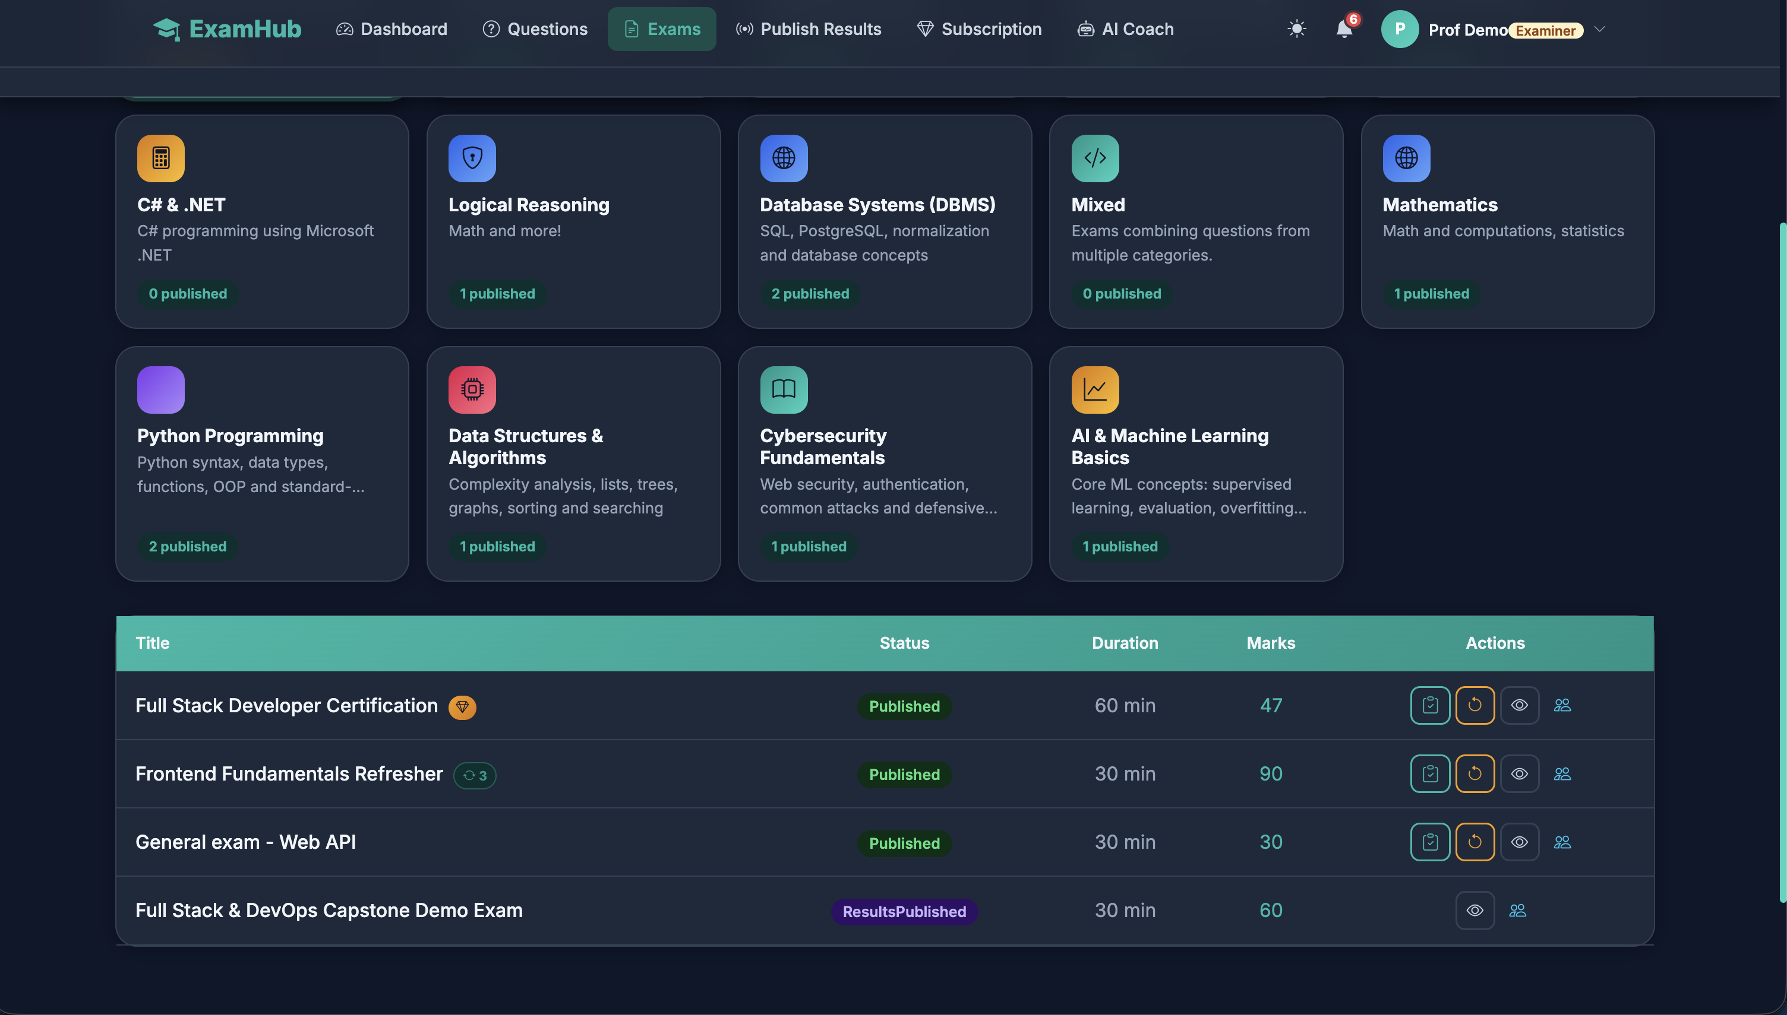
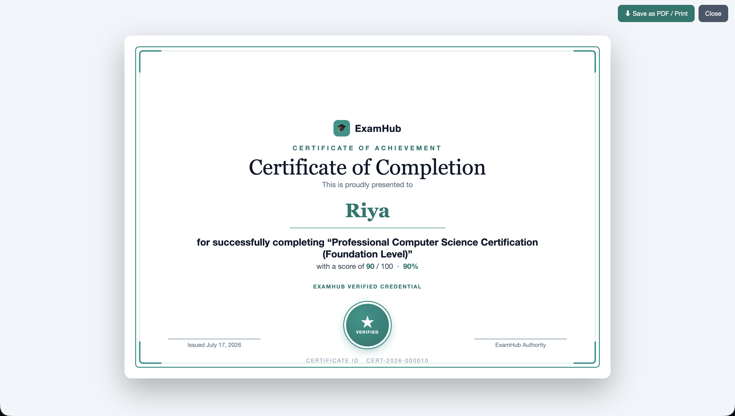
HOW IT FITS TOGETHER
Platform Overview
Admin
→
Examiner
→
Candidate
→
AI Coach
→
Certificate
→
Analytics
🛡️ Admin
✍️ Examiner
🎯 Candidate
• Manage users
• Approve examiners
• Revenue & analytics
• Create & schedule exams
• Manage question bank
• Publish results
• Purchase & take exams
• Receive AI feedback
• Earn certificates
ExamHub · Intelligent Assessment
5 / 7
Notes:
(15s) The whole platform is one connected flow. The Admin runs the control centre and approves examiners. Examiners build and publish exams. Candidates take them, get AI feedback, and earn certificates — with analytics closing the loop. Three roles, one seamless journey.

Slide 6
WHAT YOU'RE ABOUT TO SEE
Live Demo Roadmap
→
→
→
1
2
3
4
Purchase premium exam
Exam starts
Anti-tab-switch proctoring
Exam submitted
→
→
→
5
6
7
8
Result published
Notification received
Certificate generated
AI Coach explains weak topics
▶ Rolling the 2-minute live demo
Notes:
(15s) Here's exactly what you'll see in the next two minutes: a candidate buys a premium exam, takes it under proctoring that blocks tab-switching, submits, the examiner publishes results, a notification fires, a certificate is generated, and the AI Coach explains the weak topics. Let me show you live. [Play video]

Slide 7
Thank You
Questions?
ExamHub · Sai Nikitha NSR · Intelligent Online Examination Platform
Notes:
Thank you — I'd be happy to take any questions.

