Slide 1

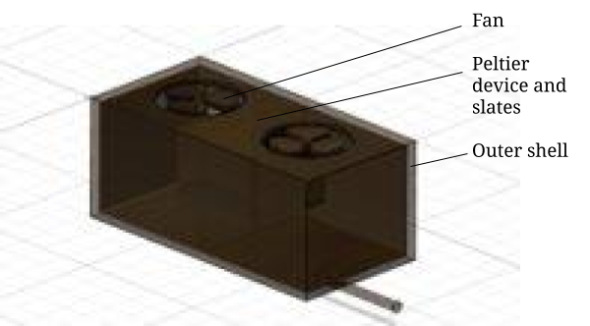
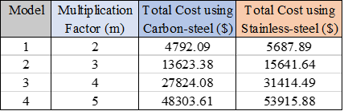
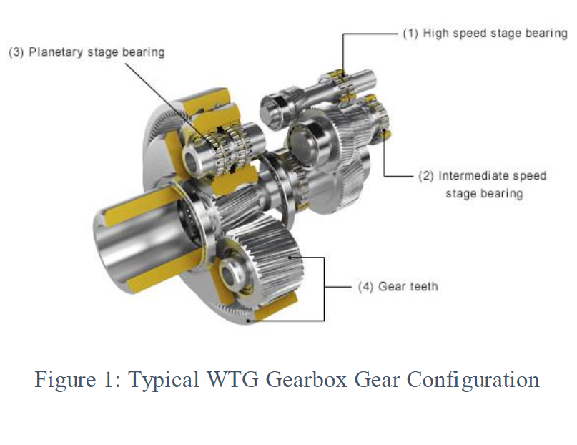
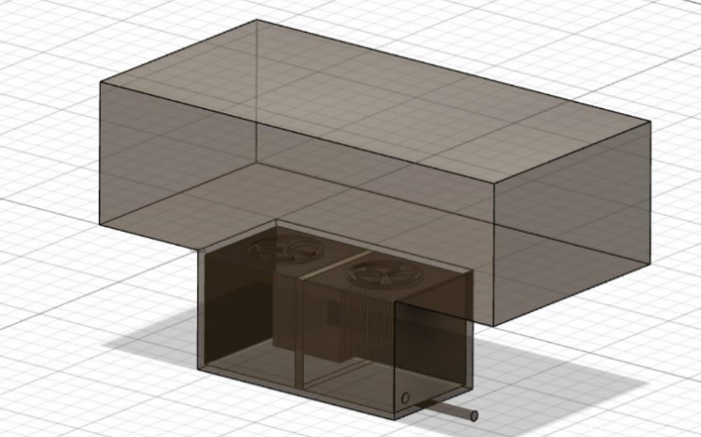
GE Wind Turbine Generator Gearbox EGR 100-015 Aman Todi, Craig Stebbing, Kritika Saini, Vedi Patel
Introduction
RESULTS/ CONCLUSION
A WTG gearbox operates in difficult environments and is subject to water ingress leading to corrosion of delicate machinery.
There are multiple solutions to this problem but many of those are not feasible.
Using a material like stainless-steel in the gearbox will prevent corrosion but its high cost makes it impractical to use.
A dehumidifier attached to the gearbox to remove water as well as moisture from it seems to be a promising solution.
Peltier device - purchased from outside source
Shell's material – Carbon-steel
Heat sinks – Aluminum
Fans - polypropylene
Final cost ranges from $5687.89-$53915.88 depending upon the size of the device with respect to the gearbox.
Table 1: Total Estimated Cost
METHODS
Included a Peltier device in order to create a temperature difference.
The temp. difference was used to condense water vapor into its liquid form and remove it from the gearbox
Metal slates were added to the Peltier device to provide a surface for water to condense on to
The fans help draw in unfiltered air, and return dry air back into the gearbox
Calculated the volume of each individual part and the cost of the desired materials
Compared costs when using different materials for the outer shell in order to find what is most cost efficient
REFERENCES
Wood, R. "Tribology and corrosion aspects of wind turbines." Wind Energy-Challenges for Materials, Mechanics and Surface Science (2010).

