Slide 1
Real Time Human Facial Emotion Recognition Using YOLO With Confidence and IoU Threshold Optimization
Group1: Rahul Saini, Thuvarakan Mathipalan, Koti Reddy Kommireddy, Sri Sowharan Palanisamy Krishnamurthy

Slide 2
Introduction
Facial emotion recognition is essential for:
  Human Computer Interaction
  Security systems
  Mental health analysis
  Smart environments
Deep learning enables real time emotion detection
  YOLO is chosen for:
    High speed
    Strong detection accuracy
This project builds a real time facial emotion recognition system using YOLO

Slide 3
Objectives
To detect human faces and classify basic emotions in real time using YOLO
To optimize YOLO performance by tuning confidence and IoU thresholds for improved detection stability and accuracy
To demonstrate the complete system through a real time webcam based facial emotion recognition

Slide 4
Literature Review
Prior research confirms the importance of:
  Reliable facial emotion recognition systems
YOLOv8 proven to:
  Improve real time detection speed
  Maintain high accuracy
Studies show:
  IoU & confidence tuning improves detection quality

Slide 5
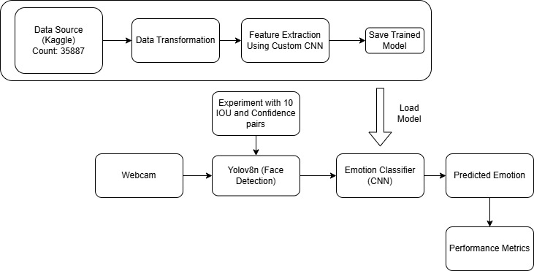
Methodology

Slide 6
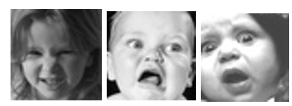
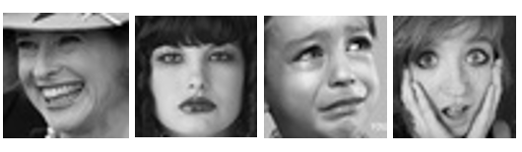
Dataset (FER-2013)
Dataset: FER-2013 (from Kaggle)
35887 grayscale images
Image size: 48 × 48 pixels
7 emotion classes:
Angry, Disgust, Fear, Happy,
Neutral, Sad and Surprise
Data split:
  80% Training
  20% Testing

Slide 7
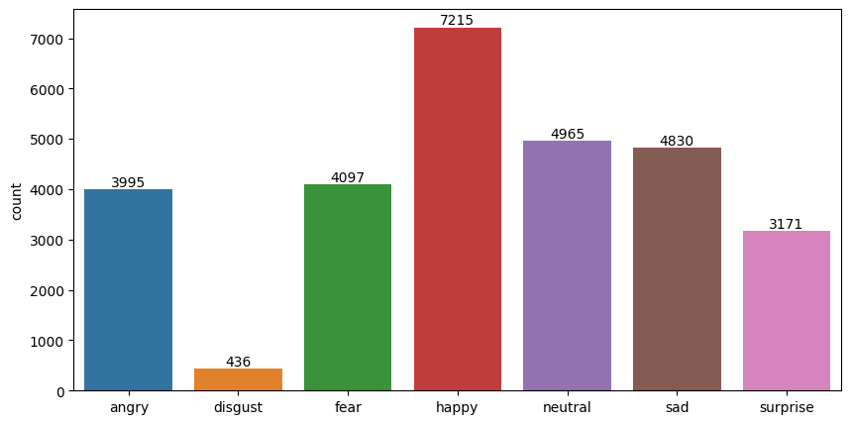
Train and Test Data Distribution
Train data count - 28709
Test data count - 7178

Slide 8
Data Preprocessing
Images:
  Converted to grayscale
  Resized to 48 × 48
Transformed into:
  Tensors
  Normalized values
Purpose:
  Ensure uniform input
  Improve model performance

Slide 9
Model Architecture Overview
Two main models used:
  CNN for emotion classification
  YOLOv8n for real time face detection
YOLOv8n chosen because:
  Lightweight
  Fast processing
  Suitable for webcam based systems

Slide 10
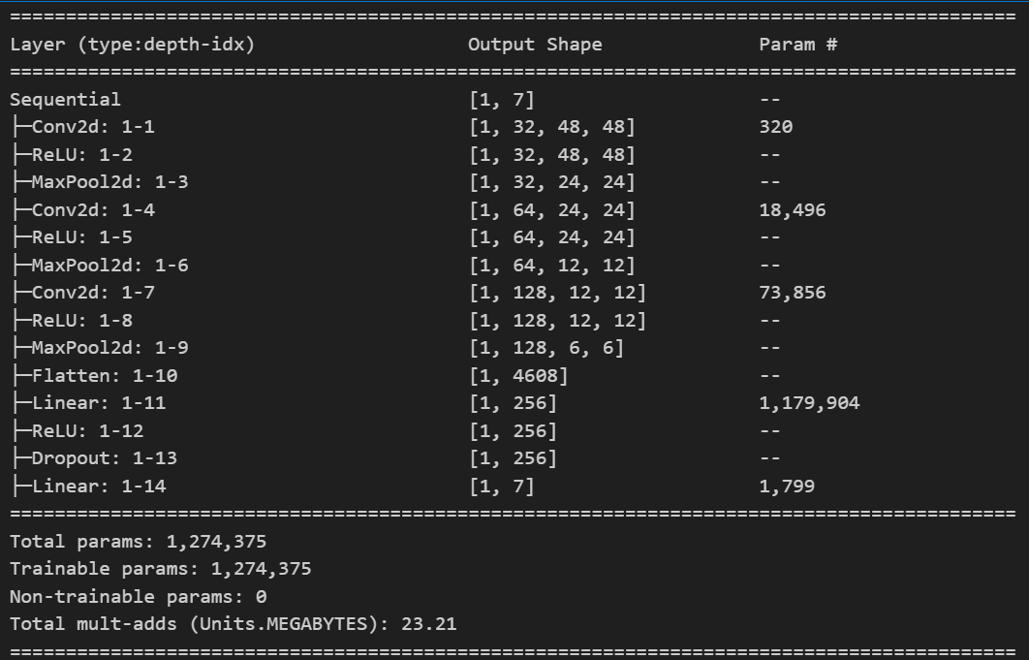
CNN Architecture

Slide 11
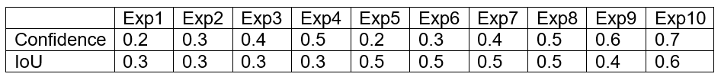
Experiments Setup
10 experiments conducted
Different combinations of:
  IoU thresholds: 0.3, 0.4, 0.5, 0.6
  Confidence thresholds: 0.2 - 0.7

Slide 12
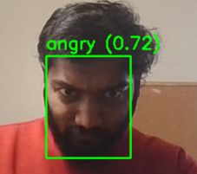
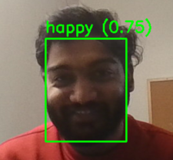
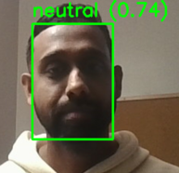
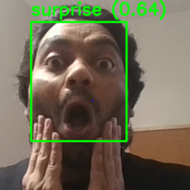
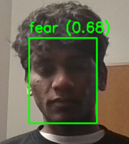
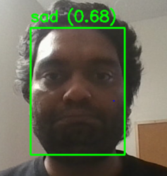
System Demonstration

Slide 13
Results
Detects face in 8 out of 10 experiments
Average confidence score:
  Between 0.71 - 0.79
Emotion consistency:
  Ranged from 0.43 - 0.97
Best performance observed with:
  Balanced IoU & confidence thresholds

Slide 14
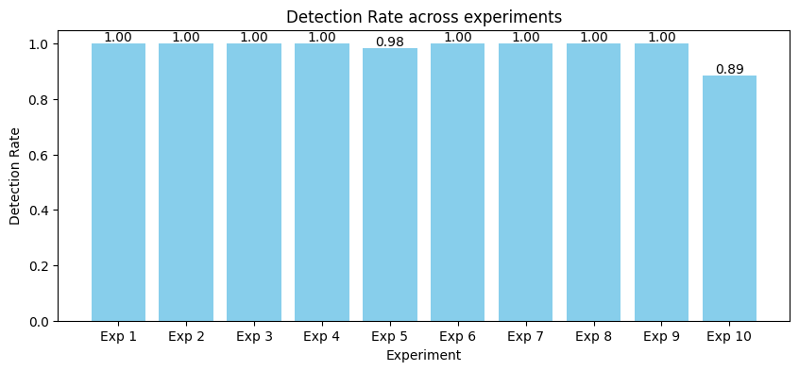
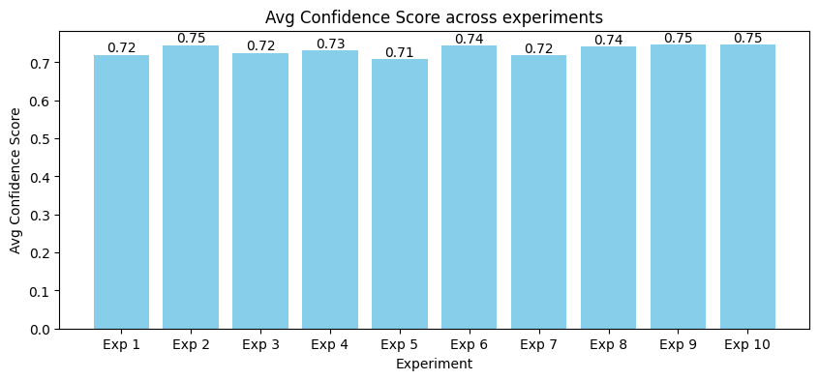
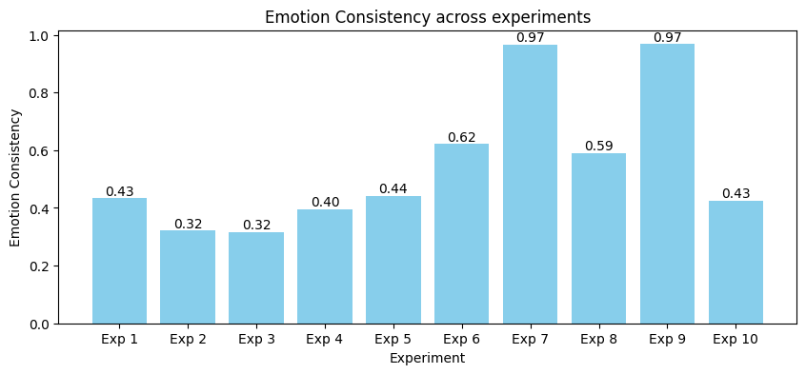
Experiment Overview

Slide 15
Conclusion
The experiments demonstrate that face detection performs reliably across varying confidence and IoU thresholds
Detection rates remained consistently near 1.0
Confidence scores stayed stable between 0.72 - 0.75
Emotion consistency showed greater sensitivity to parameter changes
Mid range thresholds (Confidence 0.4 - 0.6, IoU 0.5) produced the most reliable and stable emotion predictions

Slide 16
Future Work
Improve generalization by:
  Expanding the dataset
Explore advanced architectures, such as:
  Vision Transformers
  Hybrid CNN Transformer models
Aim to achieve enhanced emotion recognition performance

Slide 17
References
M. Tanweer, M. Tanveer, A. Mayo, Q. Ain, and J. Ahmed, “Real-Time Intelligent Facial Expression Recognition System,” J. Indep. Stud. Res. Comput., vol. 20, Dec. 2022, doi: 10.31645/JISRC.22.20.2.4.
A. Alshammari and M. E. Alshammari, “Emotional Facial Expression Detection using YOLOv8,” Eng. Technol. Appl. Sci. Res., vol. 14, no. 5, pp. 16619–16623, Oct. 2024, doi: 10.48084/etasr.8433.
M. M. A. Parambil et al., “Navigating the YOLO Landscape: A Comparative Study of Object Detection Models for Emotion Recognition,” IEEE Access, vol. 12, pp. 109427–109442, 2024, doi: 10.1109/ACCESS.2024.3439346.
S. Arya, “Measuring Success: Comprehensive Evaluation Metrics for Object Detection Models,” Analytics Vidhya. Accessed: Dec. 08, 2025. [Online]. Available: https://www.analyticsvidhya.com/blog/2024/02/evaluation-matrix-for-object-detection-using-iou-and-map/
“FER-2013.” Accessed: Dec. 08, 2025. [Online]. Available: https://www.kaggle.com/datasets/msambare/fer2013
Ultralytics, “Explore Ultralytics YOLOv8.” Accessed: Dec. 09, 2025. [Online]. Available: https://docs.ultralytics.com/models/yolov8/
A. Dosovitskiy et al., “An Image is Worth 16x16 Words: Transformers for Image Recognition at Scale,” June 03, 2021, arXiv: arXiv:2010.11929. doi: 10.48550/arXiv.2010.11929.

Slide 18


