Slide 1


Slide 2
Where we started

Slide 3
3 weeks framework
The every day Jedi Bootcamp sessions contains
Basic knowledge about the topic
Learning new technologies
Doubt clear sessions
Bug fixing
Subject Matter Expert conducts
Project progress evaluation
Checking the whether requirements are met or not

Slide 4
Stakeholders
Sponsors
Flipkart
Subject Matter Expert
SMEs
Other HR managers and experts
Trainers
Trainers

Slide 5
AGENDA
Our Journey
Our team
Project Goal
Engineering Practices
Technical Stack
Development
Challenges & Learning
Questions

Slide 6
Unix basic
Git
SDLC
Core Java
My SQL
Drop Wizard

Slide 7
Learning basic Unix commands
Setting up version controlling
Studies UML
Made Use case diagram
Created Class diagram
Activity diagram
Sequence Diagram
Core Java
Started Implementation
Connect with database
Created RESTful web service for the system
Moved Project to DropWizard
Setting up development Environment
Testing
Documentation

Slide 8
The Team
👦
👦
Amit Balyan (Mentor) Tejeshwar Saini (Me)

Slide 9
Project Goal
To create a Course Registration System using core Java and technologies , where a student can register and a professor can assess him.

Slide 10
Engineering Practices
Agile development
Unified modelling language
Use case diagram
Class diagram
Activity diagram
Sequence diagram
Version control software

Slide 11
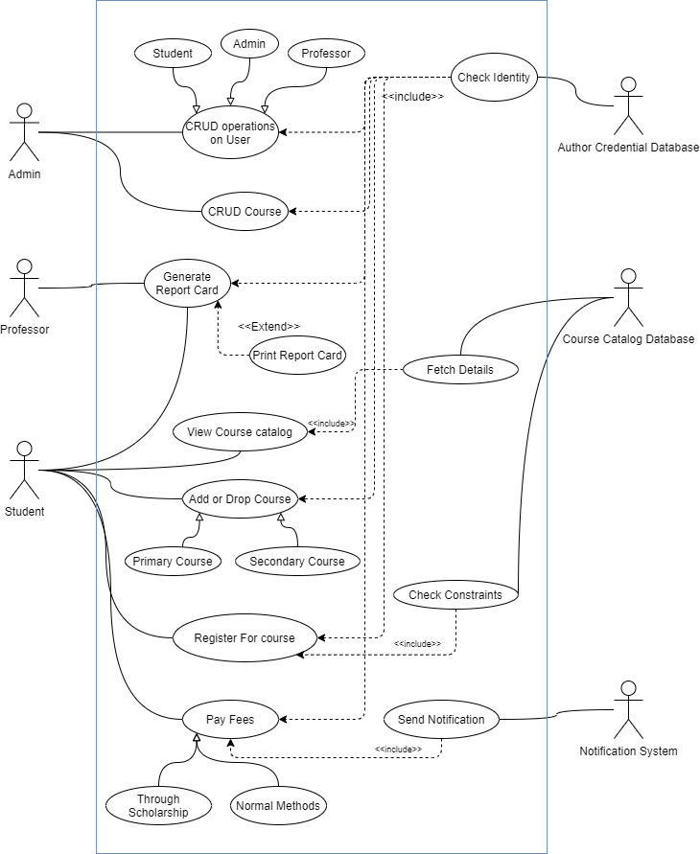

Slide 12
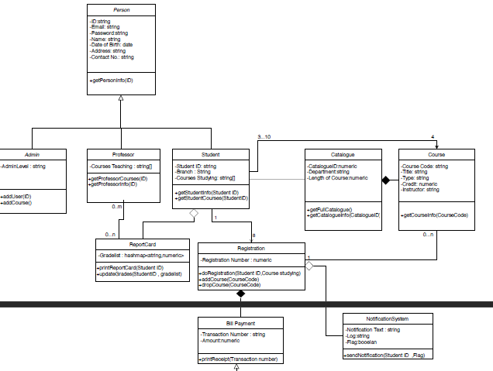

Slide 13
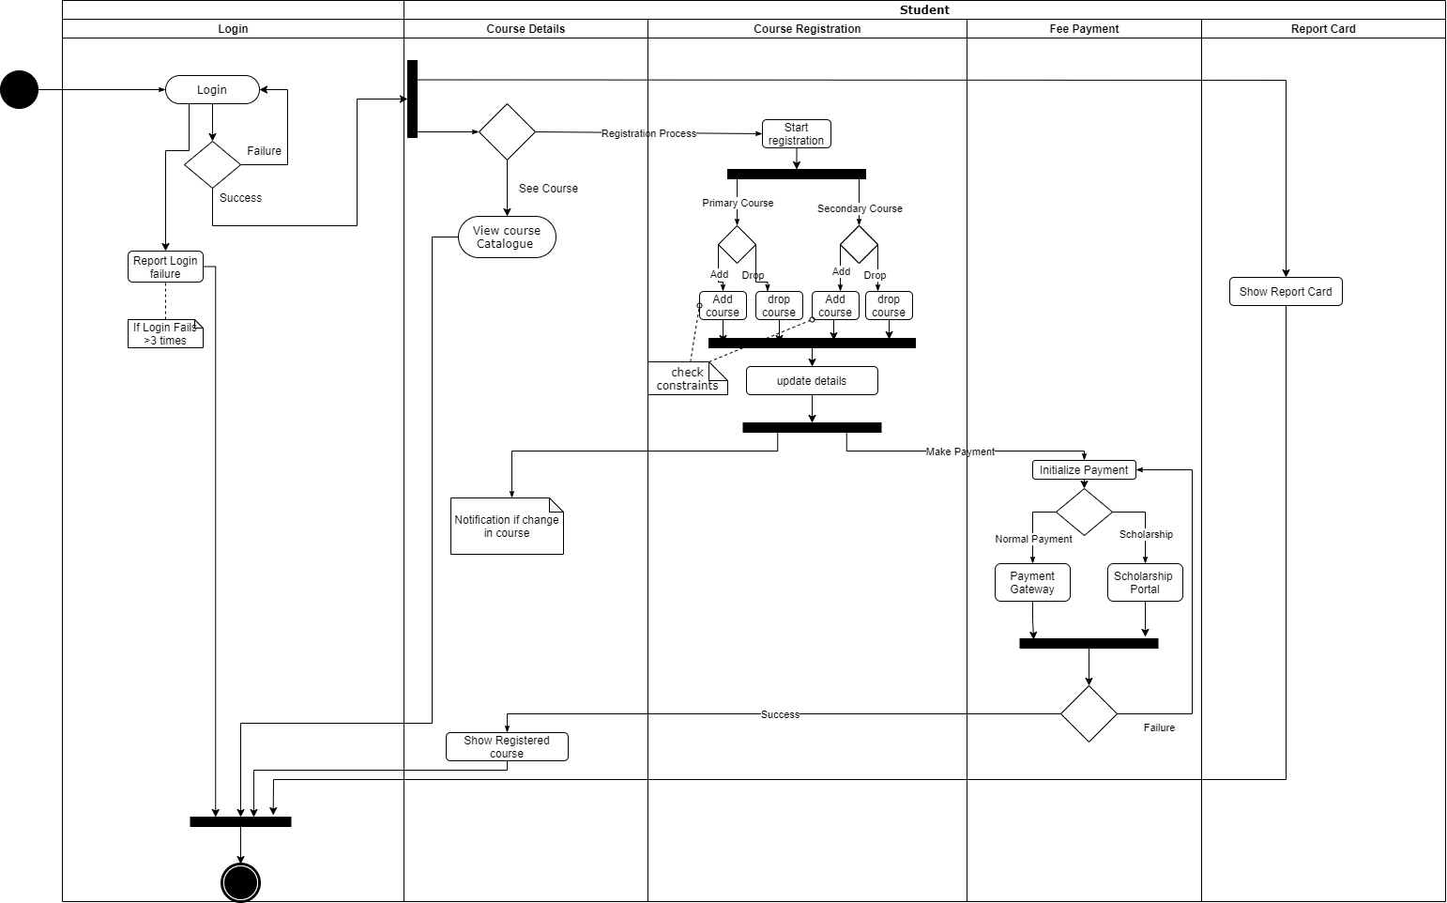

Slide 14
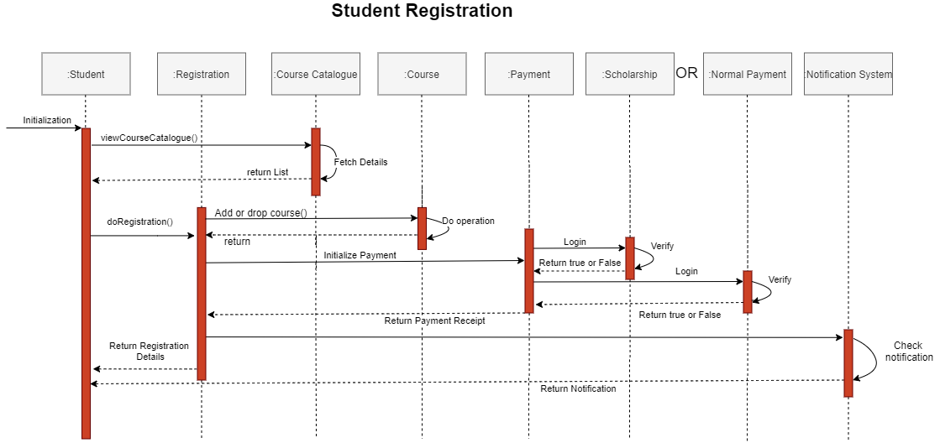

Slide 15
Engineering Practices
Java generics
Database Management
Logger
Documentation
RESTful web services

Slide 16
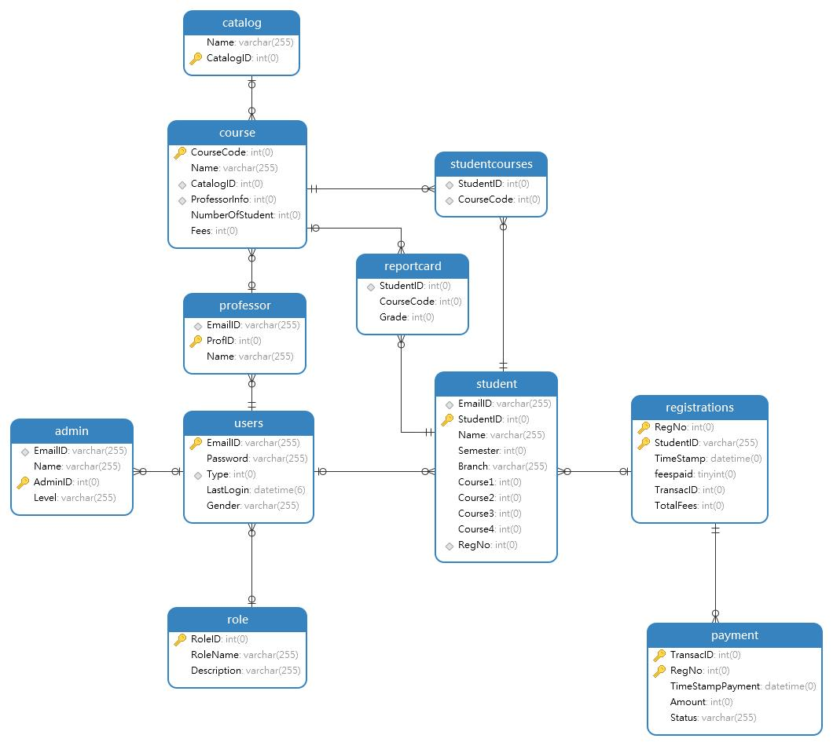

Slide 17






Technology Stack
Backend
Frontend
Tools
Data
GitHub
Navicat
Core Language
Postman
MySQL
Apache Tomcat

Slide 18
Software Development
Analysis
Design
Implementation
Testing
Delivery

Slide 19
Challenges & Learning
Setting up the environment
Identifying the use cases
Determine the flow of data
Designing database
Risk analysis

Slide 20
Project Demo

Slide 21
Questions

Slide 22
THANK YOU .. !!

