Slide 1


DATABASE SYSTEM FOR PRINCE GEORGE’S COMMUNITY COLLEGE
AMITH ADIRAJU
MANOJA KONERU
SAI NITESH PALAMAKULA
VIJAYASHREE CHODAVARAM

Slide 2

Overview
Introduction
User Requirements
ERD
Design
Functionality

Slide 3




Introduction
Database For Non Profit Institution
Digital Access Of Data Records
e-Payment
Programming Languages: JAVA
Database: Mysql
Jdbc-odbc connectivity
SQL Injection Validations
User Interface- Html, CSS

Slide 4

User Requirements
Admin
Adding Courses : Credit Courses and Non Credit Courses
View International students registered for non-credit courses
View Payments

Slide 5

User Requirements (continued)
Faculty
Faculty ID
Assign Grade
Remove student from course
View Students Registered for the Course

Slide 6

User Requirements (continued)
Student
Unique ID
Four Types Of Students
Payment
Register courses

Slide 7

User Requirements (continued)
Visitor
Enroll for a program in the university
View Credit / Non - Credit Based Courses
View Contact details
View Department details
View Faculty Profiles
View Program details

Slide 8
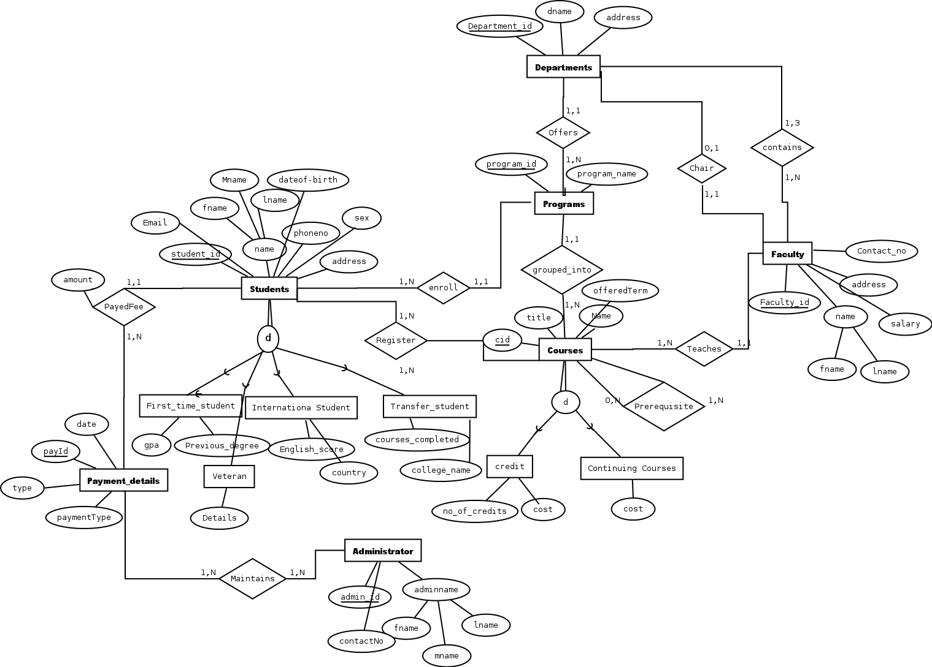
ERD

Slide 9
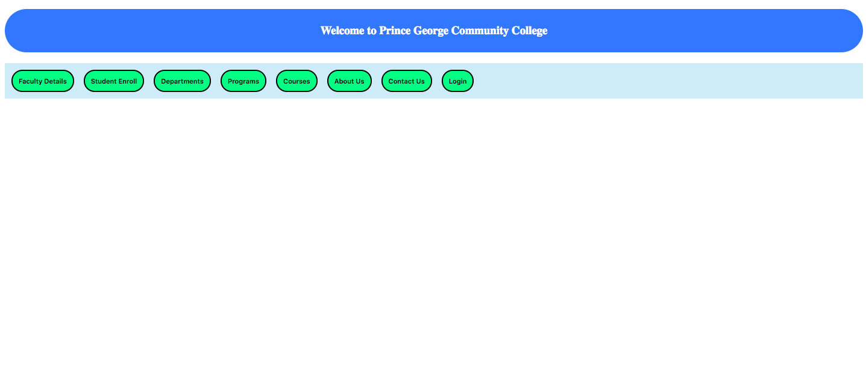
Functionality
WELCOME PAGE

Slide 10
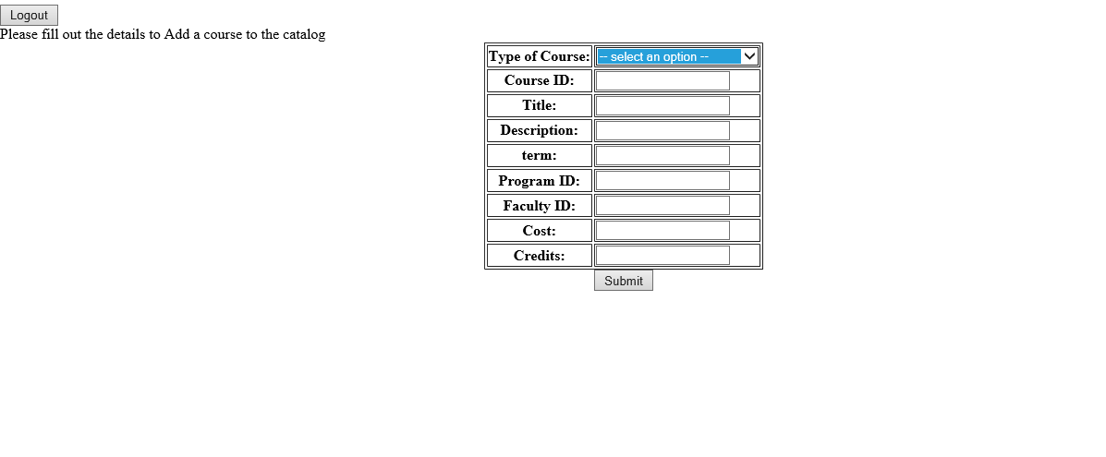
Functionality(continued)
Admin - Add Course

Slide 11
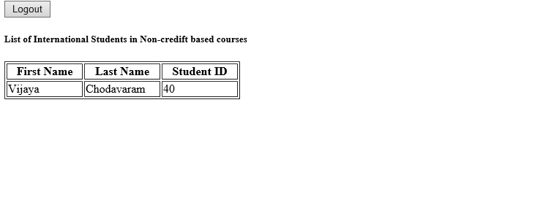
Functionality(continued)
Admin: VIEW INTERNATIONAL STUDENTS

Slide 12


Functionality(continued)
Faculty - Update Student Record

Slide 13
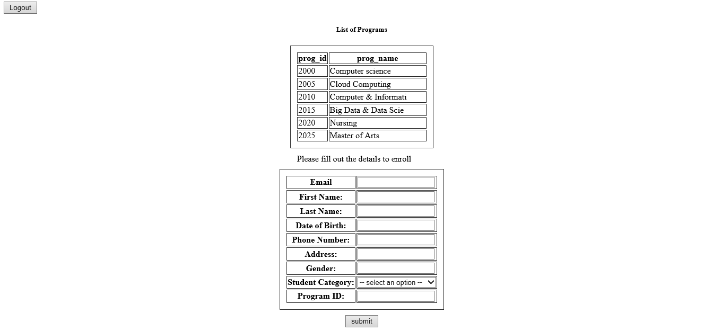
Functionality(continued)
Visitor - Enroll

Slide 14
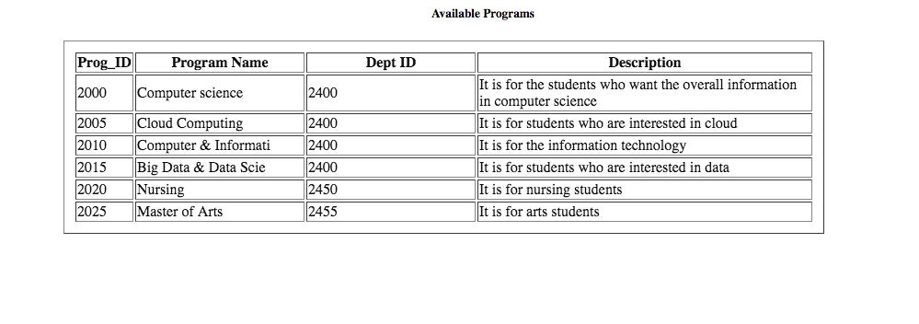
Functionality(continued)
Visitor – View Programs

Slide 15

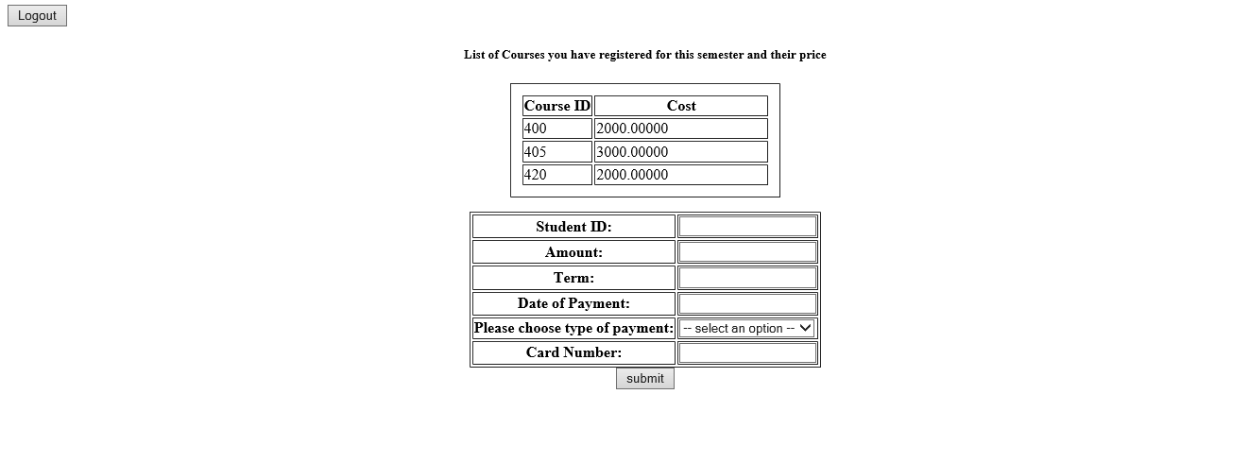
Functionality(continued)
Student Payment

Slide 16
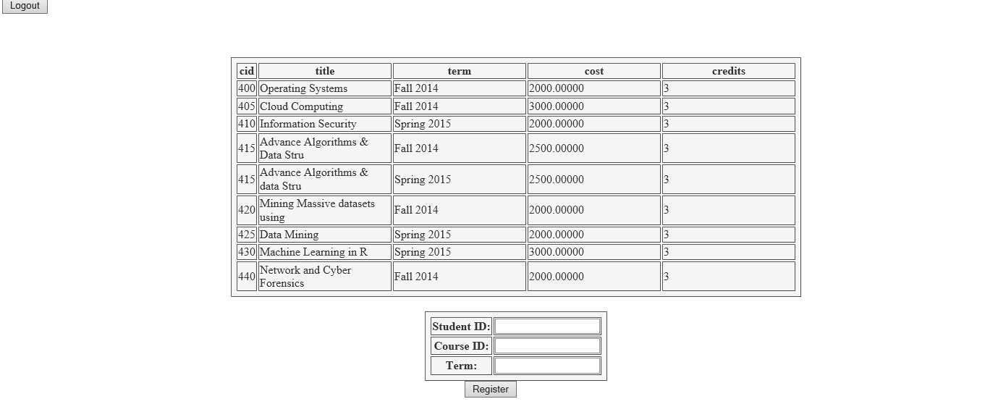
Functionality(continued)
Student Register

Slide 17
QUESTIONS ??

