Slide 1
IoT based Fire Detector and Automatic Extinguisher

Slide 2
PROPOSED ARCHITECTURE
FIRE SENSOR
BLYNK CLOUD
RELAY
ARDUINO UNO
Or
NODEMCU
Interlinked
BLYNK APP
PUMP
BUZZER,LEDS

Slide 3
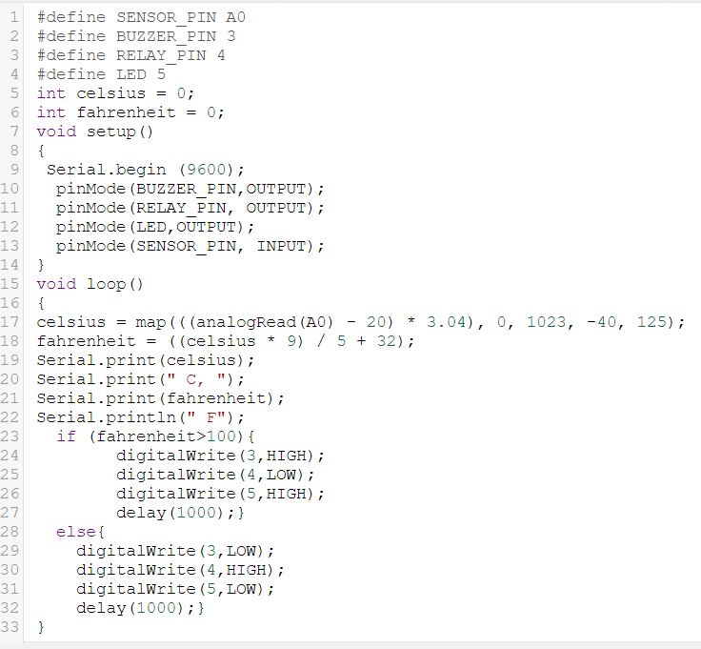
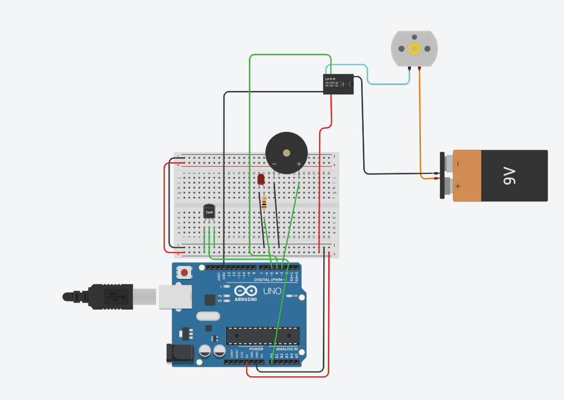
Software stimulation
WORK DONE

Slide 4
HARDWARE COMPONENTS USED
NODEMCU/ARDUINO UNO
5V BATTERY
RELAY MODULE
6V MINI WATER PUMP
FLAME SENSOR
LED’S
BUZZER
JUMPER WIRES

Slide 5
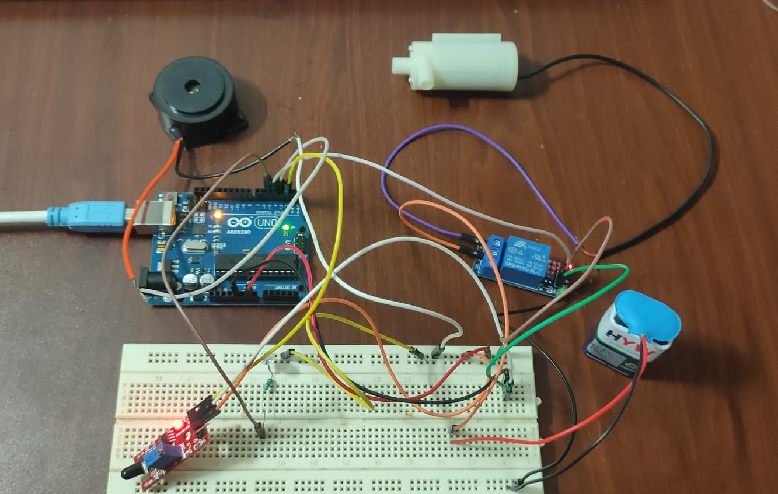
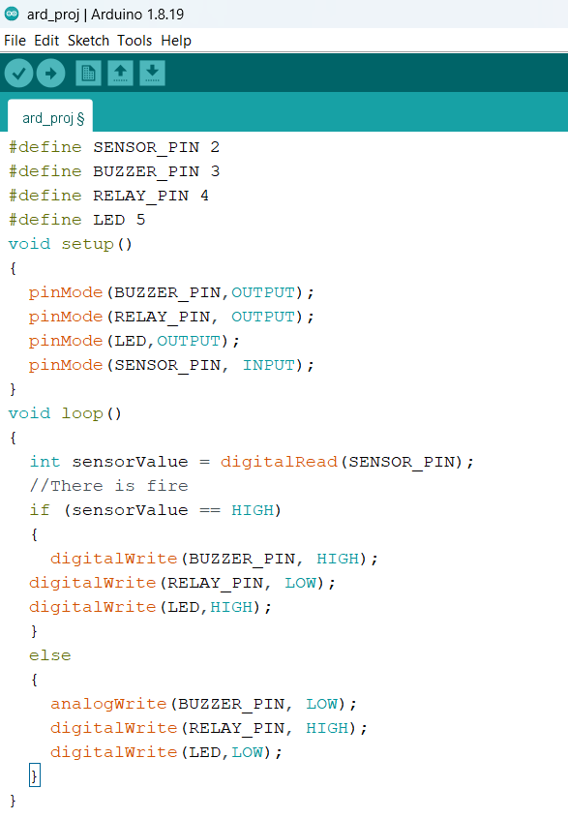
HARDWARE IMPLEMENTAION

Slide 6
Thank You

