Slide 1

ACE Engineering College
Ankushapur (v), Ghatkesar(M), Medchal Dist-501301
AUTONOMOUS CODE REVIEW AGENT
  Presented by:
Pamulaparthi Sai Nithin (23AG1A67B2)
Yellanki Srinidhi (23AG1A67C8)
Sri Ramoju Manideep (23AG1A67C1)
Putta Shiva Prasad (23AG1A67B7)
Internal Guide
Dr. RALLA SURESH
Associate Professor

Slide 2
Contents
1. Problem Statement
2. Abstract
3. Objectives
4. Literature Survey
5. Methodology
6. Hardware & Software Requirements
7. System Architecture
8. Advantages
9. UML Diagrams
10. Future Scope
11. Conclusion

Slide 3
Problem Statement
Manual code review is time-consuming and inconsistent, depending heavily on the reviewer’s experience.
Existing static analysis tools like SonarQube, PMD, and Checkstyle detect issues but provide limited contextual explanations and fix recommendations.
AI/LLM-based code review systems can generate inaccurate or inconsistent suggestions and may lack reliable issue detection.
Developers often need to manually interpret detected issues, identify root causes, and determine appropriate fixes, increasing review effort and time.
There is a need for an automated, context-aware code review system that combines static analysis, AI reasoning, severity prioritization, intelligent fix suggestions, and comprehensive reports.

Slide 4
Abstract
Software development requires regular code reviews to identify bugs, security vulnerabilities, and code-quality issues. However, manual code review is time-consuming, error-prone, and highly dependent on developer expertise. Existing tools such as SonarQube, PMD, and Checkstyle can detect coding issues but provide limited contextual explanations and fix recommendations, while AI/LLM-based approaches may generate inconsistent suggestions. Existing studies and tools commonly report detection performance in the 80–95% range, depending on the dataset and type of issue. These limitations create a need for an automated and intelligent code-review solution.
The proposed Autonomous Code Review Agent combines SonarQube, GitHub API, LangChain, and an LLM to automatically analyze source code, detect bugs, security vulnerabilities, and code-quality issues, and provide human-readable explanations and context-aware fix suggestions. The system targets approximately 90–95% issue-detection accuracy, 85–90% accuracy for fix suggestions, and aims to reduce manual review effort by 50–70% and review time by 40–60%. By prioritizing issues based on severity and generating comprehensive review reports, the proposed system aims to improve software quality, security, reliability, and maintainability while reducing developer effort.

Slide 5
Objectives
To develop an AI-powered Autonomous Code Review Agent that automates the code review process and detects bugs, code smells, security vulnerabilities, and coding violations.
To use LangChain and an LLM to understand code context and provide human-readable explanations and intelligent fix suggestions.
To integrate GitHub API and SonarQube for automated source-code analysis and review of code changes.
To prioritize issues based on severity and security impact and generate comprehensive code review reports.

Slide 6
Literature Survey
Title Name | Author(s) | Technologies Used | Limitations | Year
Automated Code Review Using Large Language Models | J. Smith, A. Johnson DOI:https://arxiv.org/abs/2507.18476?utm | GPT-4, Python, Static Analysis | Limited support for large repositories and high computational cost | 2025
AI-Assisted Code Review for Software Quality Improvement | M. Brown, R. Davis DOI:https://arxiv.org/abs/2507.19115?utm | Machine Learning, NLP, SonarQube | Focuses mainly on bug detection with limited code fix recommendations | 2025
Static Code Analysis with SonarQube for Secure Software Development | S. Kumar, P. Sharma DOI:https://doi.org/10.1007/s10664-026-10858-8?utm | SonarQube, Java, Static Analysis | Unable to provide contextual explanations or intelligent remediation | 2024
Intelligent Code Review Using Large Language Models | L. Chen, H. Wang DOI:https://arxiv.org/abs/2501.15134? | LangChain, LLM, Python | Limited integration with version control systems | 2024

Slide 7
Title Name | Author(s) | Technologies Used | Limitations | Year
GitHub-Based Automated Code Review Framework | D. Wilson, K. Patel DOI:https://doi.org/10.1007/s10664-022-10164-z?utm | GitHub API, Docker, Python | Reviews pull requests only and lacks AI-powered reasoning | 2023
Deep Learning Approaches for Software Defect Detection | Y. Zhang, X. Liu DOI:https://doi.org/10.1007/s10664-023-10301-2?utm | Deep Learning, Neural Networks | Requires large labeled datasets and significant training time | 2023
Code Quality Assessment Using Static Analysis Tools | Verma, R. Singh DOI:https://link.springer.com/article/10.1007/s11219-023-09655-z | PMD, Checkstyle, SonarQube | Detects coding issues but cannot explain root causes or suggest fixes | 2022
AI for Software Engineering: Intelligent Code Understanding | T. Anderson, M. Roberts DOI:https://doi.org/10.1007/s11219-026-09740-z?utm | Transformer Models, NLP | Limited practical implementation for enterprise-scale codebases | 2022

Slide 8
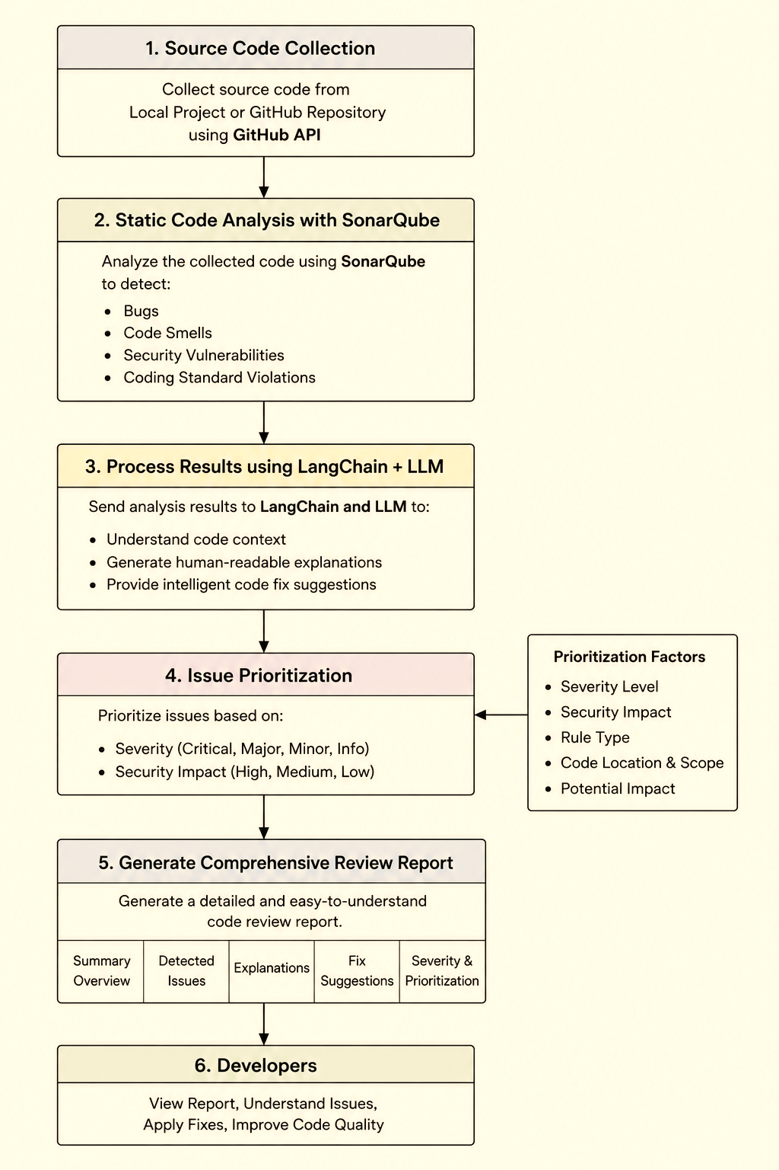
Methodology

Slide 9
Hardware & Software Requirements
Hardware
Software
Processor: Intel Core i5 / AMD Ryzen 5 or higher
RAM: Minimum 8 GB; 16 GB recommended
Storage: Minimum 20 GB free space
System: 64-bit computer
Internet: Required for GitHub API and LLM services
Operating System: Windows / Linux / macOS
Programming Language: Python
Backend: Flask
Static Analysis: SonarQube
AI Processing: LangChain + Large Language Model (LLM)
Repository Integration: GitHub API
Containerization: Docker
Version Control: Git / GitHub
Browser: Chrome / Edge / Firefox

Slide 10
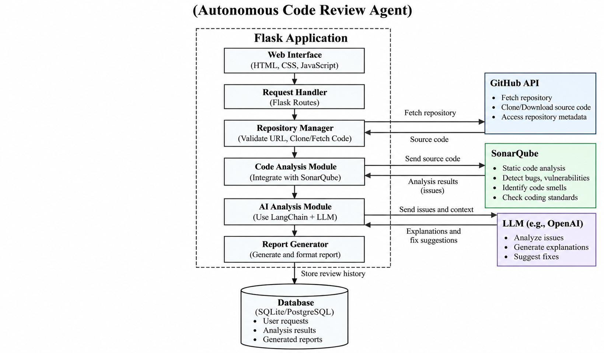
System Architecture

Slide 11
Advantages of Proposed System
Automates code review, reducing manual effort and review time.
Combines SonarQube with AI/LLM for deeper code understanding.
Explains detected issues in simple, human-readable language.
Prioritizes bugs and vulnerabilities based on severity and security impact.
Provides intelligent fix recommendations, not just error detection.
Integrates with GitHub for practical repository-based analysis.
Generates a comprehensive review report for easy developer reference.

Slide 12
UML Diagrams
UseCase Diagram
Sequence Diagram
Activity Diagram
Class Diagram
Deployment Diagram

Slide 13
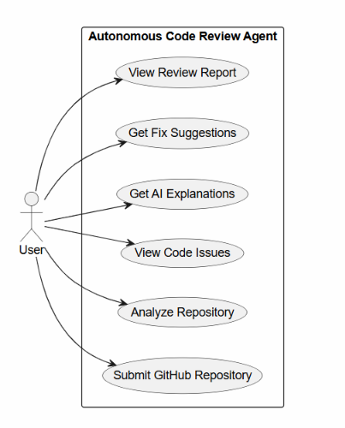
UseCase Diagram

Slide 14
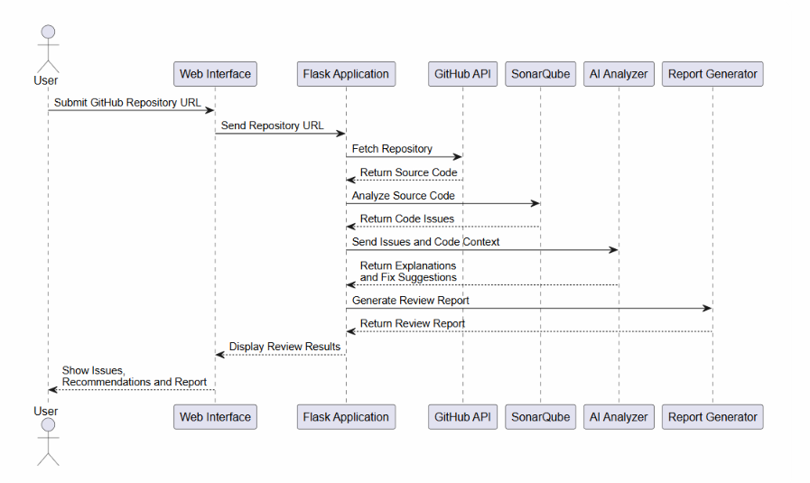
Sequence Diagram

Slide 15
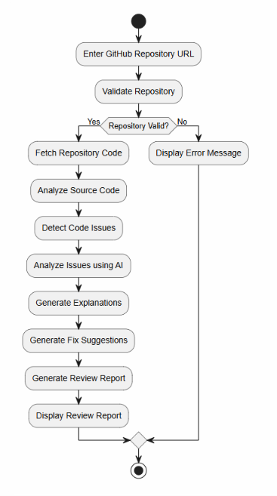
Activity Diagram

Slide 16
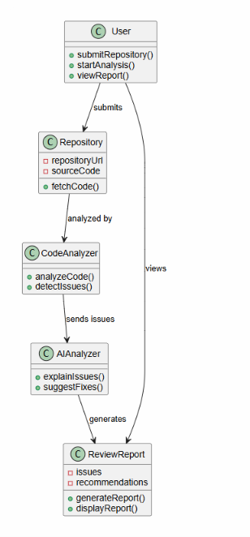
Class Diagram

Slide 17
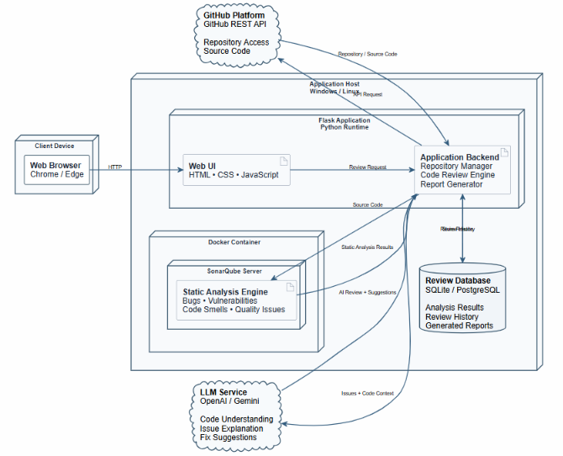
Deployment Diagram

Slide 18
Future Scope
CI/CD Integration – Automate code reviews during builds and pull requests.
Multi-Language Support – Support Java, C/C++, JavaScript, and other languages.
Advanced AI Code Fixing – Generate accurate fixes and improved code suggestions.
Continuous Code Monitoring – Monitor repositories and detect new issues automatically.

Slide 19
Conclusion
The Autonomous Code Review Agent provides an automated approach to software code review by combining SonarQube static analysis with AI-based code understanding. The system analyzes source code, identifies bugs, vulnerabilities, and code smells, and presents the detected issues in a clear and understandable manner.
By using GitHub integration, SonarQube, LangChain, and an LLM, the proposed system reduces manual code-review effort and provides useful explanations and fix suggestions. The project can be further enhanced with CI/CD integration, multi-language support, advanced AI-based fixing, and continuous repository monitoring, making it a useful foundation for automated and intelligent code review.

Slide 20

THANK YOU

