Slide 1

ACE Engineering College
Ankushapur (v), Ghatkesar(M), Medchal Dist-501301
PHISHING URL DETECTION USING MACHINE LEARNING
Presented by:
Pamulaparthi Sai Nithin(23AG1A67B2)
Tappatla Sai Pradeep(23AG1A67C3)
Putta Shiva Prasad (23AG1A67B7)
Gaddam Sathish (24AG1A6706)
Internal Guide
Mrs. T Swathi
Assistant Professor

Slide 2
Contents
Abstract
Introduction
Literature survey
Existing System v/s Proposed System
Advantages
Hardware requirements
Software requirements
System Architecture
Design(UML diagrams)
Output Screens
Conclusion
Future Enhancement
References

Slide 3
Abstract
Phishing attacks continue to pose a significant threat to online security, with attackers using deceptive URLs to steal sensitive information. Detecting phishing URLs is a critical step in mitigating these threats. This project demonstrates a machine learning-based approach to phishing URL detection using Python. The project leverages a pre-existing dataset containing both phishing and legitimate URLs, extracts basic features such as URL length, presence of special characters, and domain age, and trains a Logistic Regression model for classification.
The model is evaluated using standard metrics like accuracy, precision, recall, and F1-score. The simplicity of the approach makes it suitable for small to medium-sized projects, while also providing a foundation for further enhancements, such as incorporating more advanced features or experimenting with other machine learning algorithms. The project highlights the potential of machine learning in automating the detection of phishing URLs, contributing to improved cybersecurity measures.

Slide 4
Introduction
Phishing attacks are one of the most prevalent cyber threats, where attackers use deceptive URLs to trick users into revealing sensitive information such as passwords, credit card numbers, or personal data. Traditional methods of detecting phishing URLs, such as blacklisting, are often ineffective against evolving attack techniques. Machine learning offers a proactive and scalable solution by automatically identifying phishing URLs based on their characteristics.
This project focuses on building a phishing URL detection system using machine learning in Python. By extracting features such as URL length, presence of special characters, and domain age, and training a Logistic Regression model, the system can classify URLs as phishing or legitimate. This project serves as a foundational implementation for cybersecurity applications, with potential for further enhancement.

Slide 5
LITERATURE SURVEY
Title | Reference | Tecchnology used | Limitations | Year
Intelligent Machine Learning Algorithms for Reliable Phishing URL Identification | Dawange, N. S., & Yawalkar, N. D. P. (2024). International Journal of Advanced Research in Science Communication and Technology, 132–141. https://doi.org/10.48175/ijarsct-24519 | Machine Learning Algorithms: Random Forest, SVM, XGBoost | Technological limits include evolving phishing tactics, adversarial evasion, data imbalance, real-time processing demands, and HTTPS encryption hindering feature extraction. | Dec 2024
Machine learning model for identifying phishing websites | Nallamala, S. H., Namitha, K., Raviteja, K., Sumanth, K. S., & Kota, J. S. (2024). International journal for research in applied science and engineering technology, 12(3). https://doi.Org/10.22214/ijraset.2024.59261 | Deep Learning Models : CNN, LSTM, RNN | Phishing URL detection using ML faces limits like adversarial evasion, data imbalance, HTTPS encryption, zero-day attacks, and real-time processing constraints | March 2024
Identification of phishing urls and websites using ml | Chari, S. P. (2023). INTERANTIONAL JOURNAL OF SCIENTIFIC RESEARCH IN ENGINEERING AND MANAGEMENT, 07(12), 1–13. https://doi.org/10.55041/ijsrem27708 | Natural Language Processing (NLP) : For domain and URL analysis | Machine learning identifies phishing URLs/websites using features like URL structure, domain age, SSL certificates, and content analysis for real-time detection. | April 2023

Slide 6
Phishing URL Detection using Machine Learning | Sri Hari Nallamala, Komu Nmitha , Kadiyam Sai Sumanth , Kunchana Palli Ravi Teja. https://doi.org/10.1038/s41598-024-74725-6 | Feature Extraction Tools : Scikit-learn, pandas | Phishers use advanced techniques like obfuscated URLs or frequently changing domains to bypass ML models. | 2024
Detecting Phishing Websites Using Machine Learning | Sreenidhi Anand B.Shruthi Ambati Divya https://doi.org/10.1016/j.cose.2022.102819 | URL Parsing Libraries : urllib, tldextract | Models trained on specific datasets may fail to detect new or unseen phishing tactics effectively. | 2022
Real-Time Phishing Detection Using Machine Learning-Based URL Analysis | Dr.S.Gnanapriya https://doi.org/10.3390/electronics112236471 | WHOIS & DNS Lookup APIs : For domain metadata | Phishing datasets often have far fewer malicious URLs compared to legitimate ones, leading to biased predictions. | 2023
Phishing Attack Detection using NLP and Machine Learning | Naresh Kamble,Mishra https://doi.org/10.1007/s41060-025-00728-9 | Threat Intelligence Feeds : Integration with blacklists | ML models may struggle with real-time analysis due to processing delays or unavailable external data | 2023
Life-long phishing attack detection using continual learning | Asif ,Ejaz Adan Noor ,Midan https://doi.org/10.1002/qre.3411 | Deep Learning Models : CNN, LSTM, RNN | Attackers can alter features commonly used in detection (e.g., URL length, use of HTTPS), reducing model accuracy | 2022
Phishing URL Detection Based on Deep Learning Techniques | Arolin Jeeva,Rejis Anne W https://doi.org/10.1016/j.cose.2023.103545 | Web Scraping Tools : BeautifulSoup, Selenium | Machine learning models often analyze URLs in isolation and may miss the context—such as the webpage content, user behavior. | 2023

Slide 7
Existing System v/s Proposed System
Limitations of Existing System | Advantages of Proposed System
Can't Detect New Tricks Easily: Hackers always create new tricks. Machine learning may not catch these new patterns quickly. | Real-Time Detection: Your system can check URLs instantly and give fast results, helping users avoid threats quickly.
Needs Lots of Data: It needs a huge amount of phishing and safe URLs to learn well. Without enough data, it won’t work properly. | Updated with Latest Data: Regularly adding new phishing URLs makes the model smarter and keeps it up to date.
Takes Time to Train: Training machine learning models takes a lot of time and computer power. | Uses URL and Website Content: Instead of checking just the URL, your system can also look at the webpage text or structure for better
May Give Wrong Results (False Positives): Sometimes, it marks a safe website as phishing, which can be annoying or harmful. | Handles Shortened URLs: It can expand shortened links (like bit.ly) and then analyze the real destination.
Can Be Fooled: Smart attackers can design URLs that trick the ML model into thinking they are safe. | Better Accuracy: By combining smart features and better models, your system can reduce wrong predictions (false positives/negatives).
Struggles with Short URLs: Shortened URLs (like bit.ly) hide the real link. ML models often can't check where they lead. | Lightweight and Fast: Your system can be optimized to use less memory and work faster, even on normal computers.
Language Problems: If the phishing website uses a different language, the model may not understand it well. | User-Friendly Interface: Easy-to-use design (like a clean web page or software) helps users without technical knowledge to use it safely.
Only Focuses on URLs: Many models look only at the URL, not the actual website content, making detection incomplete. | Browser Extension or Tool Integration Your system can be made into a browser plugin or tool that warns users while they are browsing.

Slide 8
Advantages
Automation: The system automates the detection of phishing URLs, reducing the need for manual intervention. Scalability: Machine learning models can handle large datasets and adapt to new phishing techniques with retraining. Proactive Defence: Unlike blacklisting, which reacts to known threats, machine learning can detect new and evolving phishing patterns. Cost-Effective: The use of open-source tools and libraries makes the project affordable and accessible. Customizable: The system can be extended with additional features, advanced models, or integrated into larger cybersecurity frameworks. High Accuracy: Machine learning models can achieve high accuracy in distinguishing between phishing and legitimate URLs when trained on quality data.

Slide 9
Hardware Requirements :
Processor: Minimum Intel i3 or equivalent (Intel i5 or higher recommended for faster processing). RAM: 4 GB (8 GB or more recommended for handling larger datasets). Storage: 10 GB of free disk space (for storing datasets, models, and intermediate files). Internet Connection: Required for downloading datasets, libraries, and updates.

Slide 10
Software Requirements:
Operating System Windows, macOS, or Linux. Programming Language Python 3.12 Python Libraries - Pandas: For data manipulation and analysis. - NumPy: For numerical computations. - Scikit-learn: For machine learning tasks (model training, evaluation, etc.). - Joblib: For saving and loading trained models. - re (Regular Expressions): For feature extraction from URLs.
Development Environment: - Jupyter Notebook, VS Code, or any Python IDE. Web Browser: - For accessing datasets (e.g., Kaggle, UCI Machine Learning Repository) and documentation. Package Manager: - pip (for installing Python libraries).

Slide 11
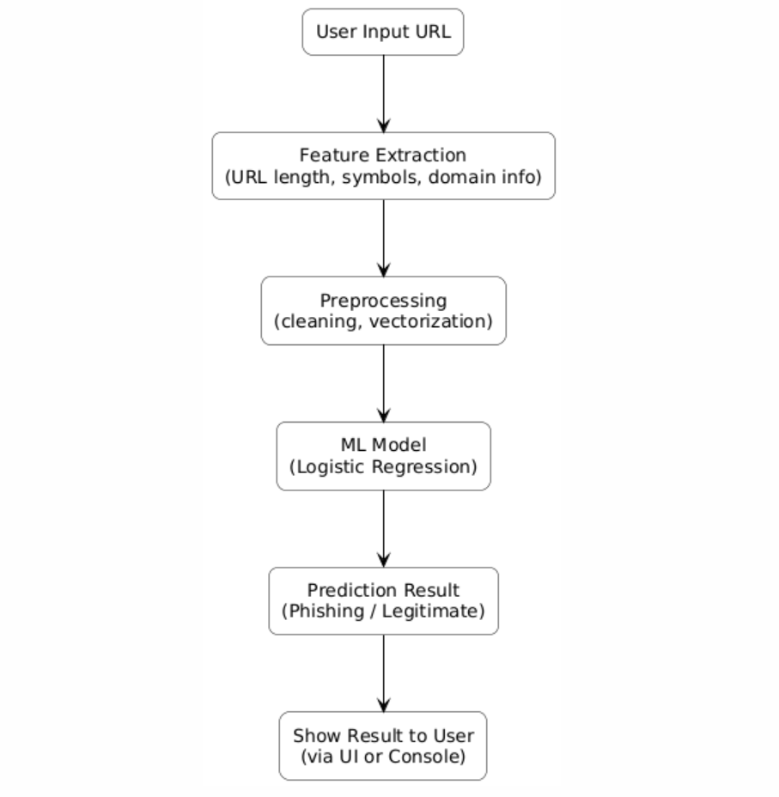
System Architecture

Slide 12
UML DIAGRAMS
Use-case diagram
Sequence diagram
Activity diagram
Class diagram
Deployment diagram

Slide 13
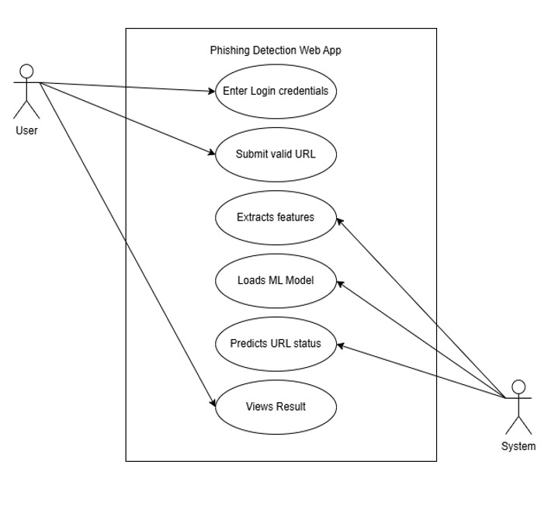
Use –Case Diagram

Slide 14
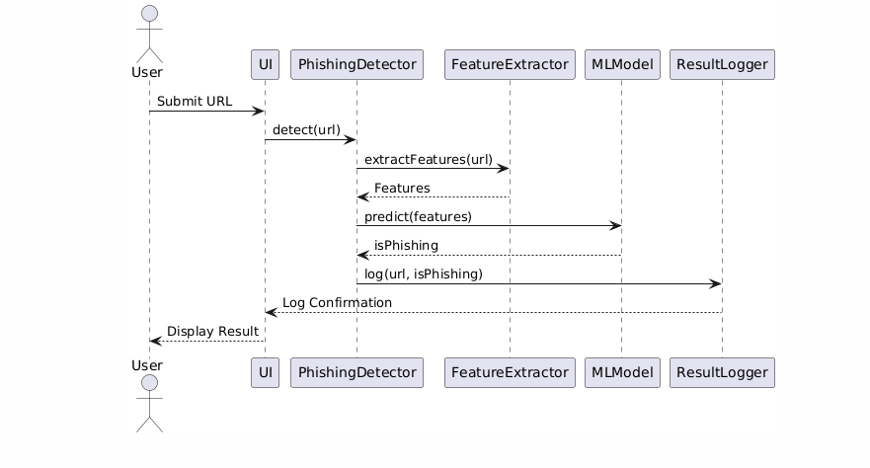
Sequence Diagram

Slide 15
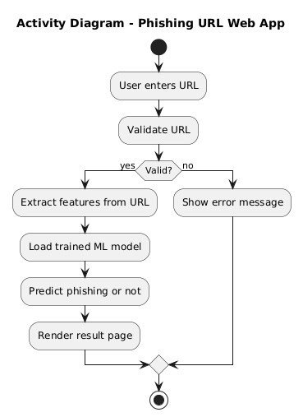
Activity Diagram

Slide 16
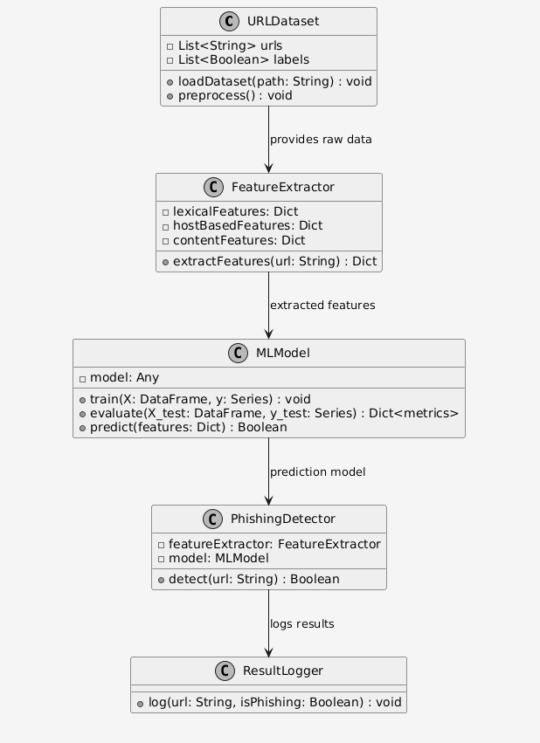
Class Diagram

Slide 17
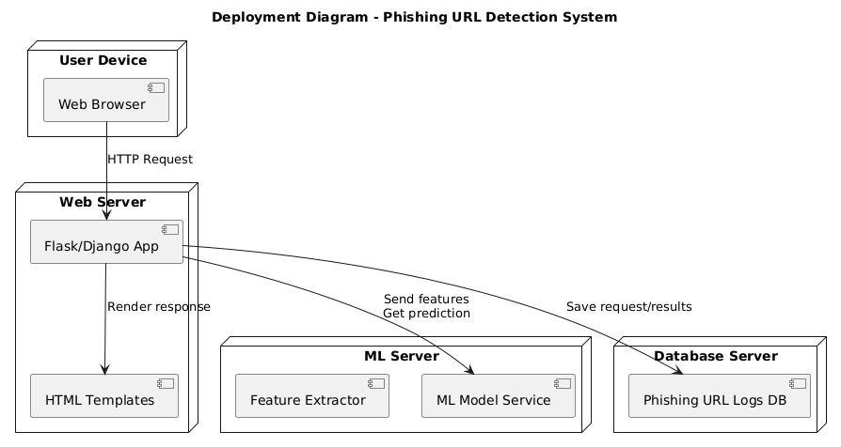
Deployment Diagram

Slide 18
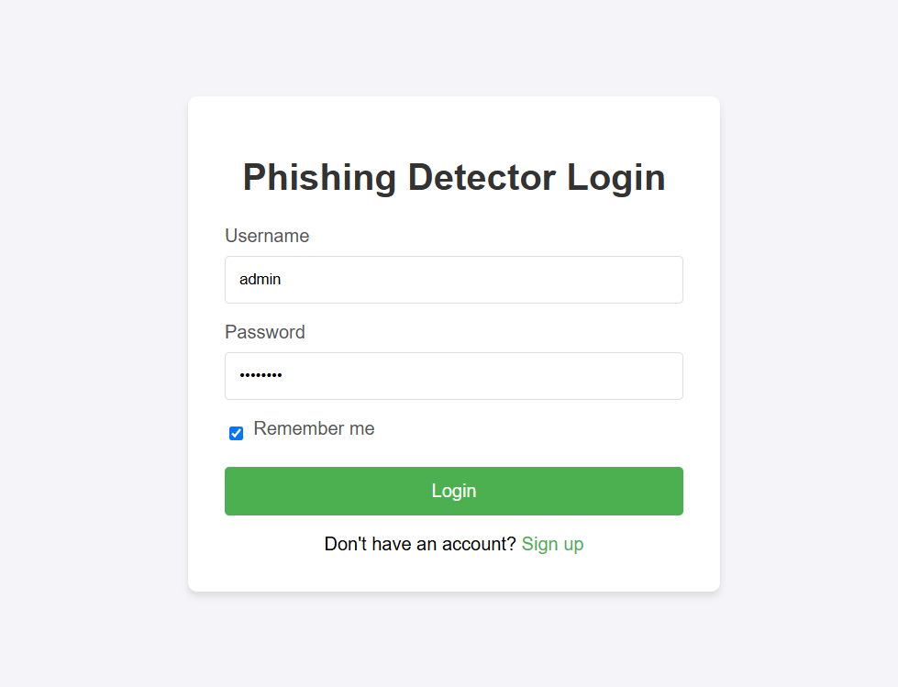
Output Screens
Once you open the web page enter you credentials and login ,if you don’t have an account then signup.

Slide 19
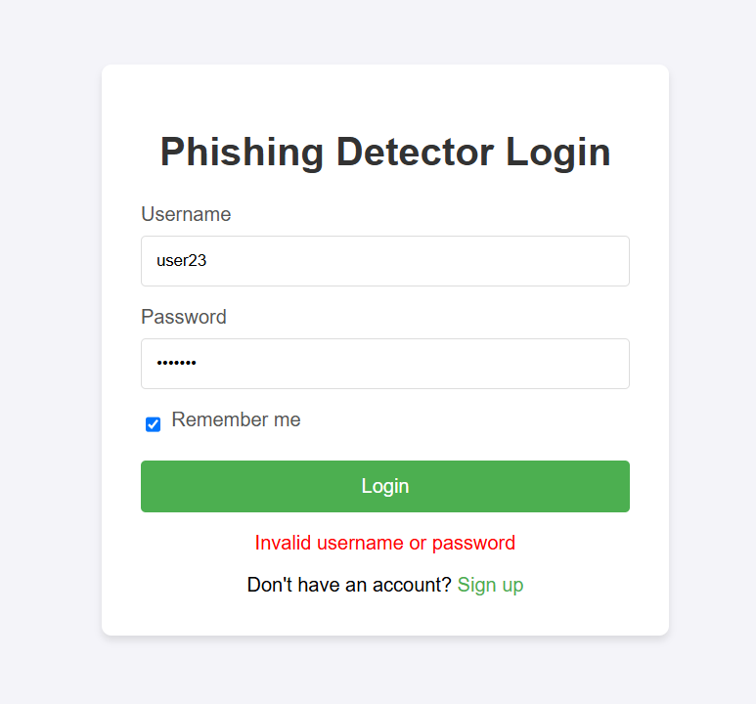
After opening the web page if the entered details of the user are incorrect the it shows invalid username or password.

Slide 20
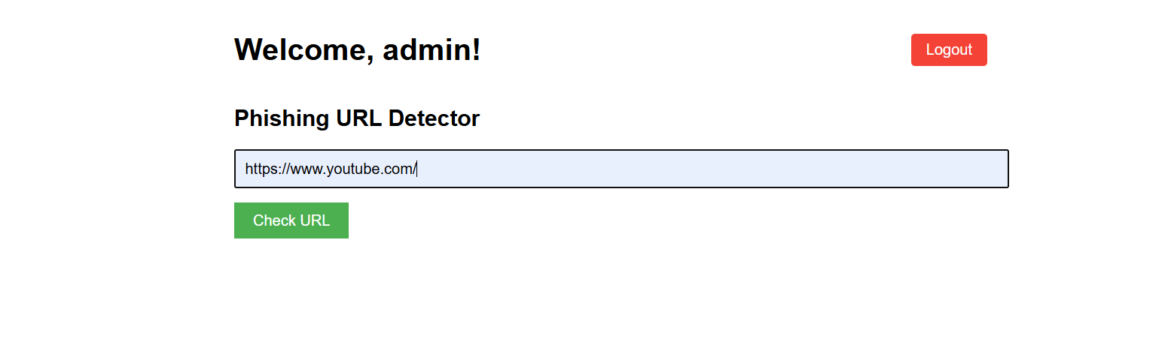
After login enter the url you want check then click check url.

Slide 21
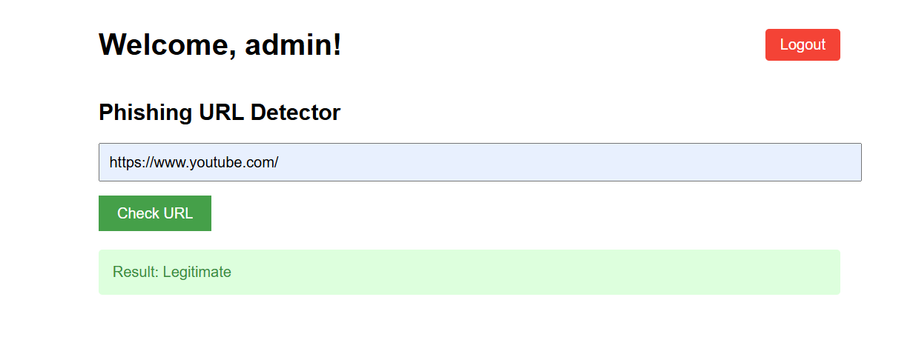
After clicking the check url if it is a secure website it shows legitimate.

Slide 22
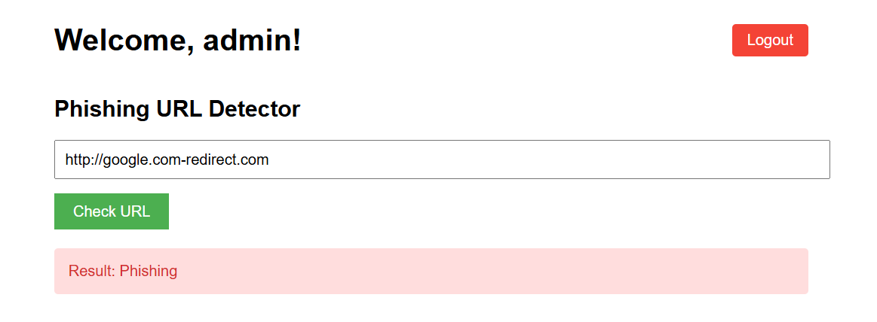
If the entered url is not secure then it shows the result as phishing.

Slide 23
Conclusion
In this mini project, we successfully developed a system to detect phishing URLs using machine learning techniques. By analyzing various features of URLs, the model can identify whether a link is safe or potentially harmful. Our approach improves security by providing users with early warnings against phishing attacks.
Compared to traditional methods, our system is faster, more accurate, and can adapt to new phishing techniques with regular updates. This project shows how machine learning can play a vital role in improving online safety and protecting users from cyber threats.
In the future, this system can be enhanced by analyzing website content, adding browser extensions, and integrating with real-time threat databases.

Slide 24
Future enhancement
Website Content Analysis: Check the actual webpage content (not just the URL) for better and deeper detection.
Browser Extension: Create a plugin for browsers that alerts users about phishing links in real time.
Real-Time URL Scanning: Automatically scan links from emails, messages, or web pages as users receive them.
Use of Deep Learning Models: Improve accuracy by using advanced models like LSTM or CNN to detect tricky phishing patterns.
Auto-Updating Dataset: Connect with online phishing databases to regularly update the system with the latest threats.

Slide 25
References
Dawange, N. S., & Yawalkar, N. D. P. (2024). International Journal of Advanced Research in Science Communication and Technology, 132–141. https://doi.org/10.48175/ijarsct-24519
Nallamala, S. H., Namitha, K., Raviteja, K., Sumanth, K. S., & Kota, J. S. (2024). International journal for research in applied science and engineering technology, 12(3). https://doi.Org/10.22214/ijraset.2024.59261
Chari, S. P. (2023). INTERANTIONAL JOURNAL OF SCIENTIFIC RESEARCH IN ENGINEERING AND MANAGEMENT, 07(12), 1–13. https://doi.org/10.55041/ijsrem27708.
Sri Hari Nallamala, Komu Nmitha , Kadiyam Sai Sumanth , Kunchana Palli Ravi Teja. https://doi.org/10.1038/s41598-024-74725-6
Sreenidhi, Anand, B. Shruthi, Ambati Divya. https://doi.org/10.1016/j.cose.2022.102819
Asif ,Ejaz Adan Noor ,Midan. https://doi.org/10.1002/qre.3411.
Sreenidhi Anand, B.Shruthi, Ambati Divya. https://doi.org/10.1016/j.cose.2022.102819.
Arolin Jeeva, Rejis Anne W. https://doi.org/10.1016/j.cose.2023.103545.

Slide 26
Thank You

