Slide 1

SAREGAMA: Digital Ecosystem for Music Entertainment Optimization
TEAM 5
K. Bhavya
P. Joshika
S. Niteswara Sai
Vikram Kumar Pradhan
Ujwala

Slide 2








Overview
The proposed ecosystem will engage artists, listeners, distributors, advertisers, and content creators through an API-driven architecture. This will optimise music discovery, consumption, and monetisation, while preserving SAREGAMA's heritage.
Optimise Discovery
Enhance Consumption
Boost Monetisation
Leverage AI-powered recommendation engines, match content with cultural context, and curate mood-based playlists to help users find new music.
Offer seamless multi-device synchronization, robust offline playback capabilities, and interactive social listening features to enrich user experience.
Implement dynamic pricing models, provide comprehensive creator economy tools, and forge strategic brand partnerships to generate diverse revenue streams.
Preserve Heritage
Enable Creator Economy
Build Community Engagement
Initiate large-scale digitization projects, create rich cultural documentation, and foster intergenerational storytelling to safeguard SAREGAMA's legacy.
Provide robust tools and platforms for artists to directly engage with fans, manage their content, and monetize their creations effectively.
Foster a vibrant community through interactive features, fan clubs, and collaborative projects, building stronger connections between artists and listeners.
Drive Innovation
Continuously explore and integrate emerging technologies like blockchain for rights management and immersive experiences to stay ahead in the digital music landscape.

Slide 3

SAREGAMA's Strategic Position & Vision
Unique Assets
Platform Vision
Heritage Catalog: 130,000+ songs, 100+ years, 25 languages.
Multi-Format Presence: Carvaan, streaming, licensing.
Brand Legacy: Trusted name, quality, nostalgia.
Cross-Generational Appeal: Classical to contemporary music.
Transform into an 'Intelligent Music Ecosystem Orchestrator' by:
Connecting stakeholders for value creation.
Leveraging AI for personalised discovery.
Enabling new revenue streams.
Democratising music creation.
Preserving cultural heritage.

Slide 4
Platform Architecture: Five Core Layers
01
02
03
Data Foundation Layer
Core Platform Services
API Gateway Layer
Music Catalog, User Behavioral Data, Rights Management (Blockchain), Cultural Context Engine.
Identity & Access, CDN, Recommendation Engine, Analytics, Payment & Settlement.
Public, Partner, Creator, and Consumer APIs for integrations.
04
05
Application Layer
Integration Layer
SAREGAMA Streaming App, Artist Portal, BI Suite, Licensing Marketplace.
External Streaming Platforms, Social Media, IoT, Payment Gateways.

Slide 5

Key Data Flows & Technology Stack
Key Data Flows
Technology Stack
Content Ingestion: Artist upload to distribution.
Discovery: User profile to personalised playlist.
Monetisation: Stream event to payment distribution.
Licensing: Request to usage monitoring.
Backend: Microservices (Node.js, Python for ML).
Database: PostgreSQL, MongoDB, Redis.
Streaming: HLS/DASH via AWS CloudFront.
AI/ML: TensorFlow (recommendation), NLP (metadata).
Blockchain: Hyperledger Fabric (rights management).
Mobile: React Native.
Analytics: Elasticsearch, Kibana.

Slide 6












Stakeholder Ecosystem Map
The platform connects six primary stakeholder groups, fostering a multi-sided marketplace.
Content Creators
Listeners
Upload content, access analytics, receive faster royalties.
Personalised recommendations, vast catalog, social features.
B2B Partners
Distributors
License music for sync, integrate features, co-brand.
License catalog via API, access metadata, gain insights.
Content Curators
Advertisers & Brands
Create playlists, earn revenue, platform visibility.
Targeted ads, sponsorships, audience insights.

Slide 7
Monetisation Model: Hybrid Strategy
The platform employs a hybrid monetisation strategy with seven distinct revenue streams.
35%
25%
20%
Consumer Subscriptions
Advertising Revenue
Licensing & Sync Rights
Freemium, Premium Individual/Family/Student, Heritage Plus.
Audio, Display, Video Ads, Sponsored Playlists, Native Content.
Streaming Platforms, Sync, Public Performance, Cover Songs.
8%
5%
4%
Artist Services & Tools
Data & Insights
Live Events & Experiences
Distribution, Production, Marketing, Analytics Premium.
Market Research, Cultural Intelligence, Predictive Analytics.
Virtual Concerts, Exclusive Sessions, Festival Partnerships.
3%
B2B Platform Licensing
White-Label Solutions, Enterprise Music, API Licensing.

Slide 8
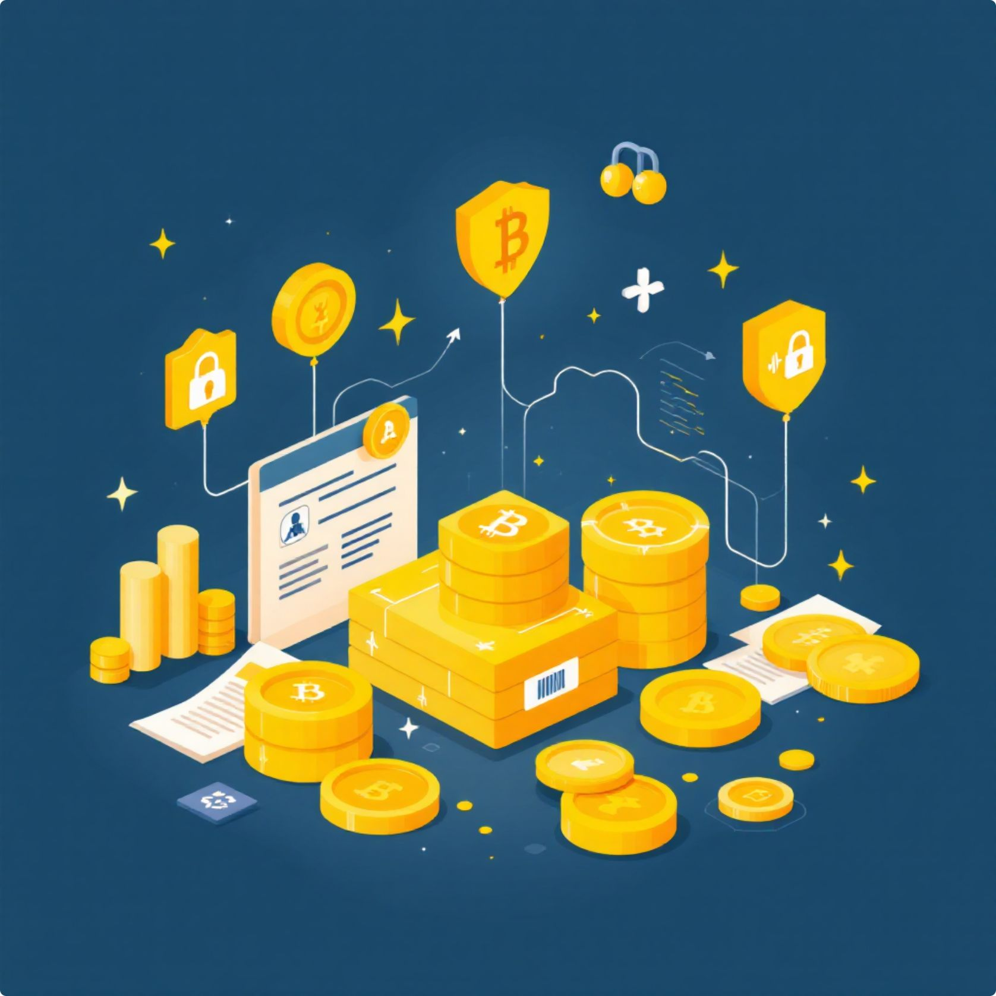
Governance & Compliance Strategy
Rights Management
Platform Governance
Blockchain-Based Rights Ledger for automated royalties.
Automated Royalty Calculation Engine.
Rights Verification Protocol with CMO integration.
Stakeholder Council for policy input.
Transparency Commitments (royalty, API, reports).
Ethical AI Governance (bias audits, explainability).
Creator Protection Measures (payment thresholds, ombudsman).
Regulatory Compliance
Copyright (DMCA, IPRS, PPL).
Data Protection (GDPR, DPDP Act 2023).
Financial (PCI-DSS, GST, FEMA, KYC/AML).
Content Moderation (AI, community, human review).

Slide 9

Scalability & Sustainability Plan
1
Phase 1 (Year 1-2)
Cloud-native on AWS/Azure, 10M MAU, India-wide, Microservices.
2
Phase 2 (Year 3-4)
South Asia, Middle East, 50M MAU, Kubernetes, serverless.
3
Phase 3 (Year 5+)
Global (50+ countries), 100M+ MAU, multi-cloud, 5G optimisation.
Growth Potential
Sustainability
Geographic Diversification: Bangladesh, Pakistan, Sri Lanka, Middle East, Global.
Catalog Development: Digitize 50K+ recordings, partner with labels, 1000 new artists/year, podcasts/audiobooks.
Partner Scalability: API-first, self-serve onboarding, revenue-sharing.
Carbon-neutral streaming: Renewable energy, efficient encoding.
Cultural sustainability: Heritage preservation fund (2% revenue), regional languages, folk artist program.

Slide 10


Conclusion: SAREGAMA's Future Roadmap
SAREGAMA aims to be the nucleus of India's music economy, delivering value for generations.
Key Differentiators
Heritage-Innovation Balance
Artist-Centric Design
Cultural Intelligence
Integrated Ecosystem
Ethical AI
Critical Success Factors
Excellence in execution
Strategic partnerships
Continuous innovation
Well-crafted governance
Patient capital
Future Plan: Technical specs (Months 1-3), Pilot (Months 4-6), Phased rollout (Months 7-12), Scaling to 5M users (Year 2), Geographic growth (Year 3+).

