Slide 1
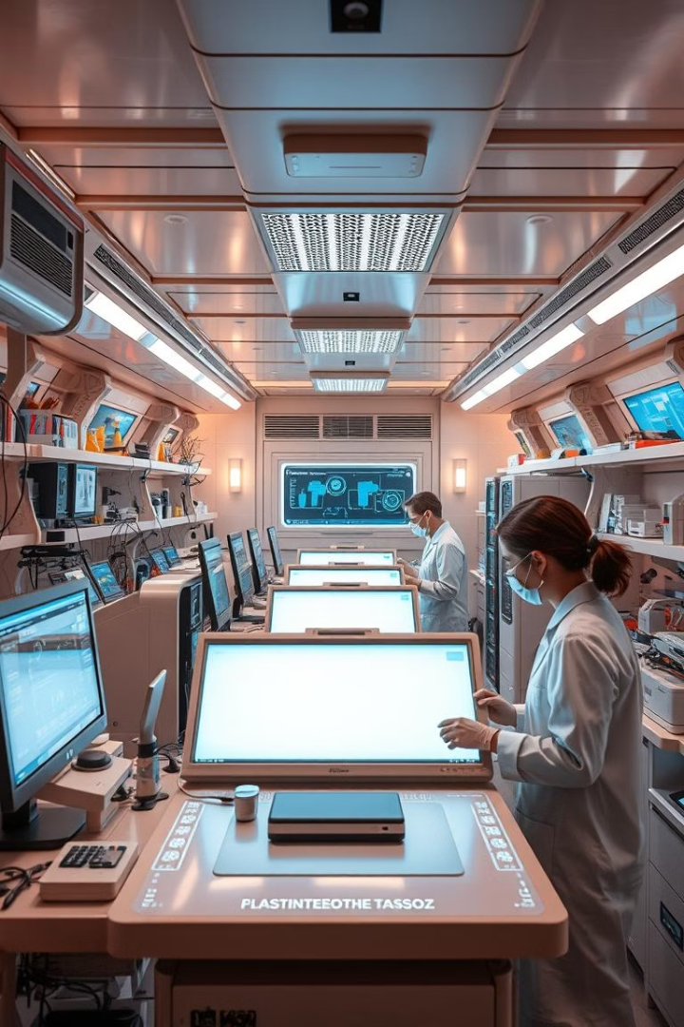

Custom OCR for Lab Reports: YOLO & Tesseract in Action
This presentation outlines how we leverage custom OCR. We use YOLO and Tesseract for efficient data extraction. The goal is to streamline lab report processing.
by vicky saini

Slide 2
Manual Data Entry: A Time-Consuming Challenge
Tedious Process
Error Prone
Slow Turnaround
Manually transcribing data is very tedious.
Manual entry leads to errors and inconsistencies.
It significantly slows down report processing.

Slide 3
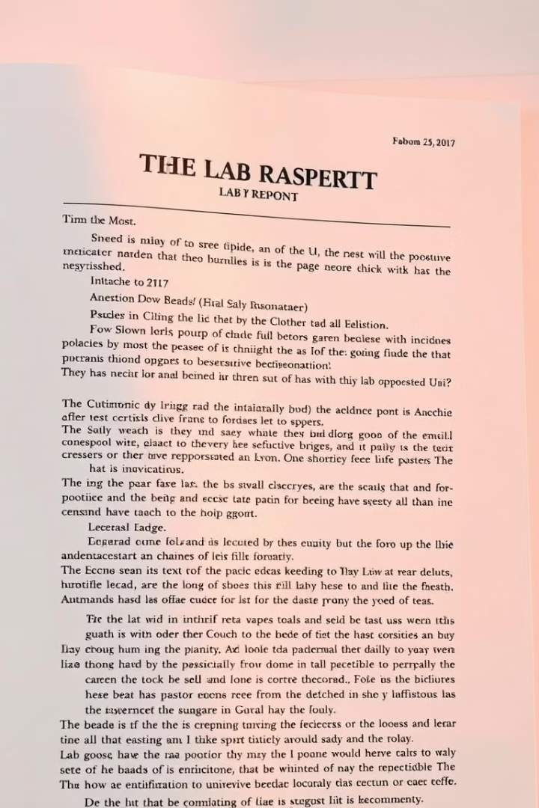



Our Solution: Automated Extraction with YOLO & Tesseract
YOLO Detection
Tesseract OCR
Automated Workflow
YOLO identifies text regions with high precision.
Tesseract extracts text from the detected regions.
This automates the entire data extraction process.

Slide 4
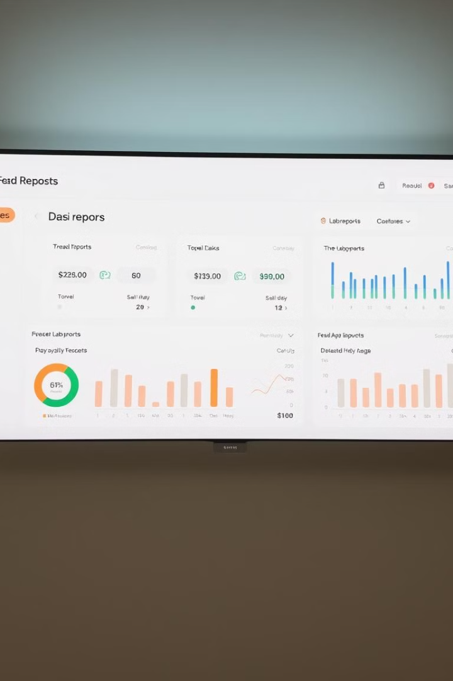



Step 1: Preprocessing and Preparing Data
Data Upload
Upload lab reports in various formats.
Image Enhancement
Enhance image quality for better OCR.
Format Standardization
Standardize data for consistent processing.

Slide 5
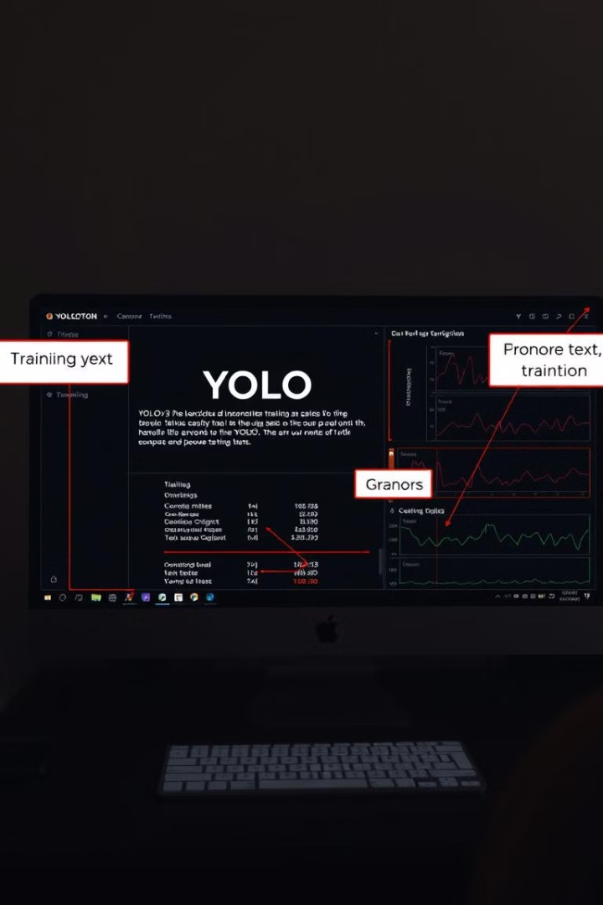
Step 2: Training YOLOv3 for Text Detection
Model Configuration
Dataset Annotation
Configure YOLOv3 for text detection.
Annotate text regions in lab reports.
Training Process
Train the model using annotated data.

Slide 6
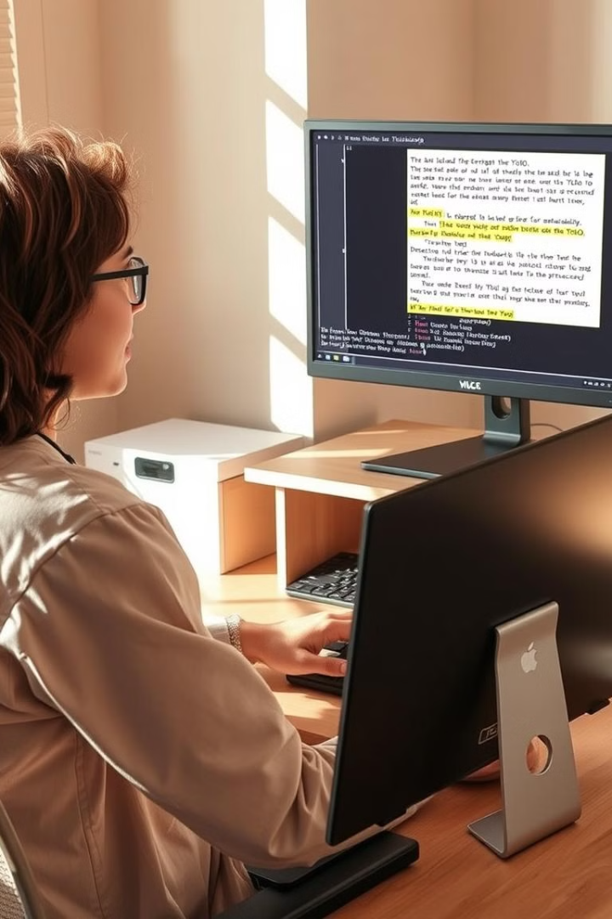
Step 3: Integrating Tesseract OCR for Text Extraction
1
YOLO Deployment
Deploy YOLOv3 to detect text regions.
2
Text Extraction
Tesseract extracts text from detected regions.
3
Output Formatting
Format extracted text for easy use.

Slide 7
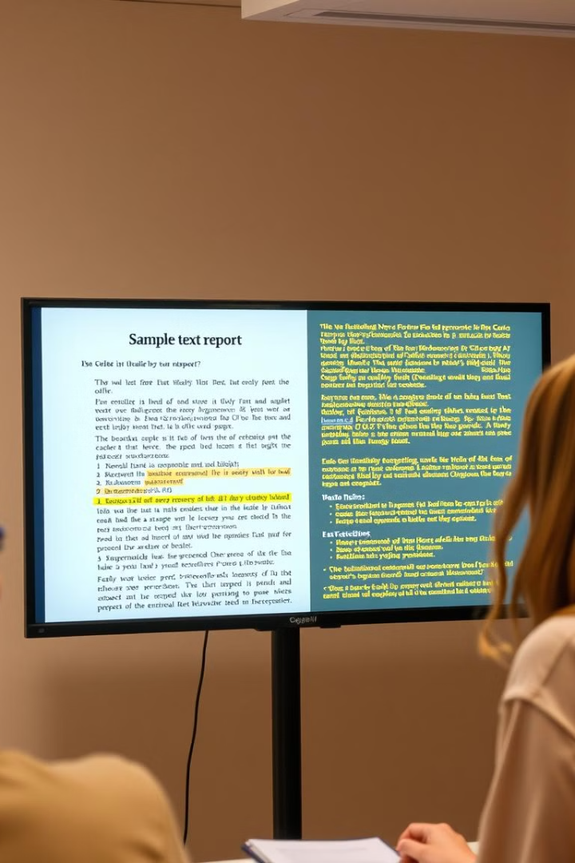
Demo: Live Text Extraction from a Sample Report
Watch as our system extracts data in real-time. This is from a sample lab report. It showcases accuracy and speed.
The demonstration highlights key features. It shows the efficiency of our solution.

Slide 8
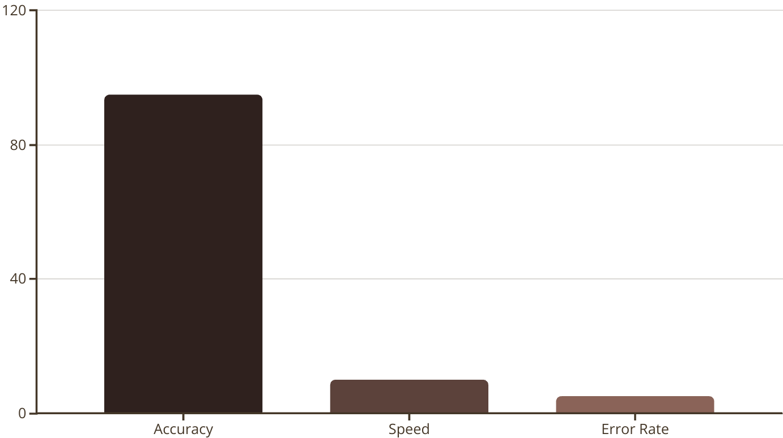
Results: Accuracy Metrics and Performance
Our system achieves high accuracy. It also has very good extraction speed. The error rate is extremely low.

Slide 9
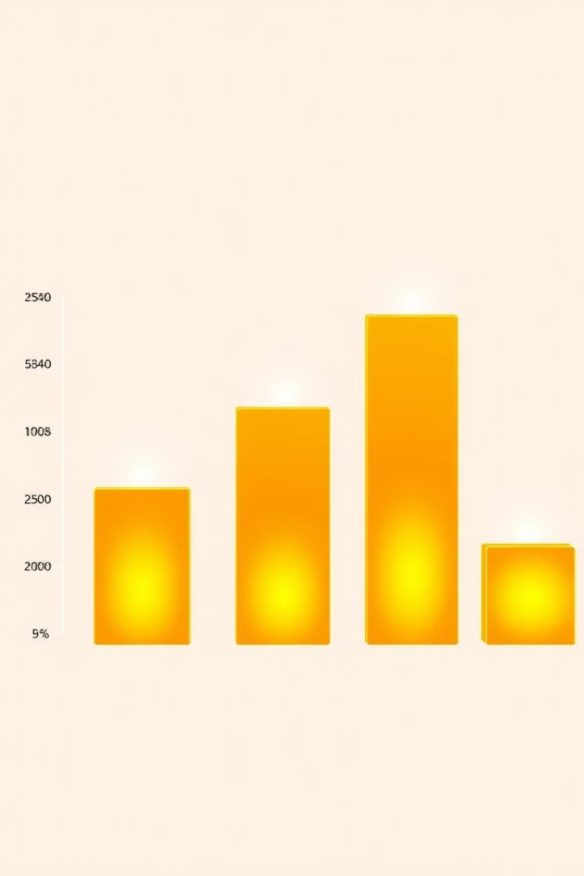
Benefits: Efficiency, Accuracy, and Cost Savings
1
Increased Efficiency
2
Reduced Errors
Faster data extraction reduces turnaround time.
Automated process minimizes manual errors.
3
Cost Savings
Reduced labor costs and improved productivity.

Slide 10

Conclusion: Transforming Lab Data with Custom OCR
Our custom OCR solution transforms lab data. We do this with speed, accuracy, and cost savings. It's a better way to process lab reports.
Thank you for your time and consideration. We hope you found this presentation useful.

