Slide 1
CS 5330 Programming Assignment 3
[Sai Nikhil]
[thirandas.s@northeastern.edu]
[thirandas.s]
[001564864]

Slide 2
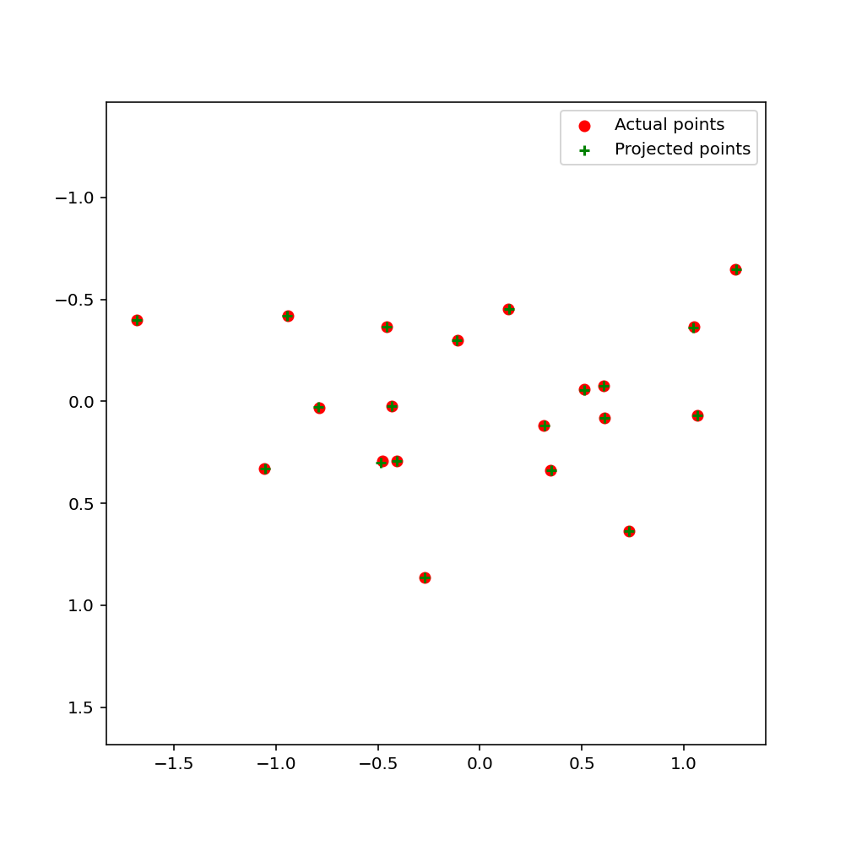
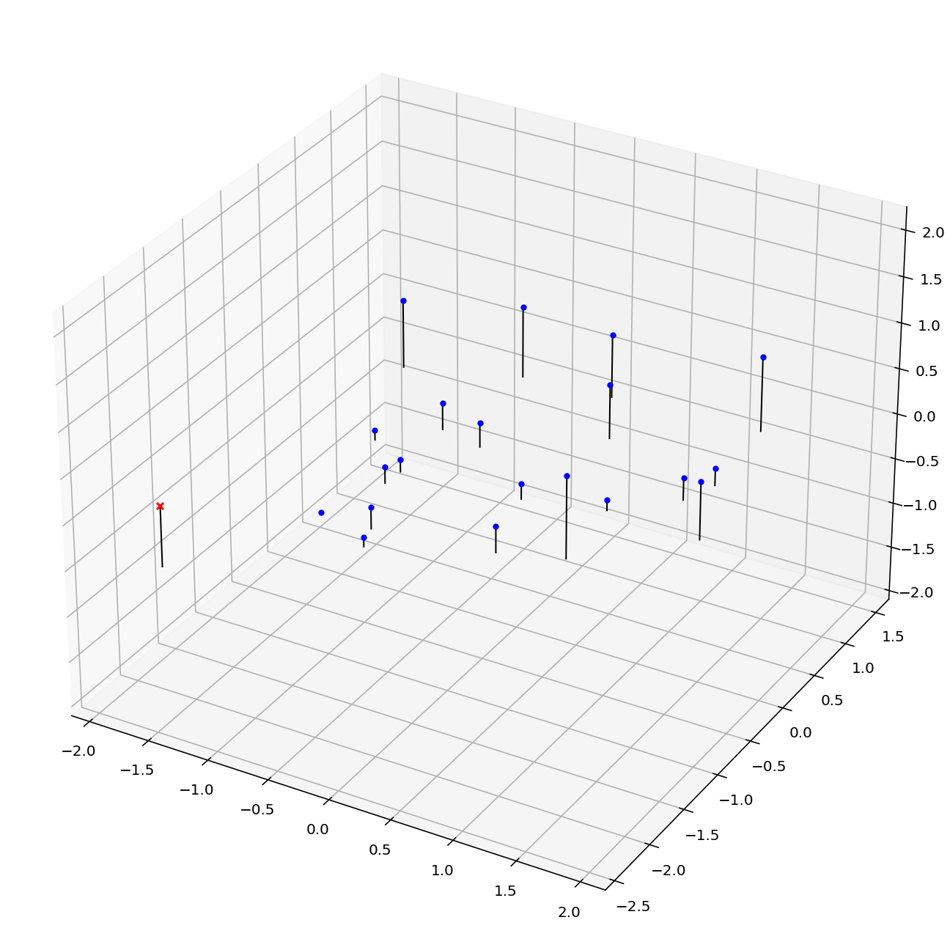
Part 1: Projection matrix
[insert visualization of projected 3D points and actual 2D points for the CCB image we provided here]
[insert visualization of camera center for the CCB image here]

Slide 3
Part 1: Projection matrix
[insert visualization of projected 3D points and actual 2D points for the Argoverse image we provided here]
[insert visualization of camera center for the Argoverse image here]

Slide 4
Part 1: Projection matrix
[What two quantities does the camera matrix relate?]
[What quantities can the camera matrix be decomposed into?]
[List any 3 factors that affect the camera projection matrix.]

Slide 5
Part 2: Fundamental matrix
[insert visualization of epipolar lines on the CCB image pair]

Slide 6
Part 2: Fundamental matrix
[Why is it that points in one image are projected by the fundamental matrix onto epipolar lines in the other image?]
[What happens to the epipoles and epipolar lines when you take two images where the camera centers are within the images? Why?]

Slide 7
Part 2: Fundamental matrix
[What does it mean when your epipolar lines are all horizontal across the two images?]
[Why is the fundamental matrix defined up to a scale?
[Why is the fundamental matrix rank 2?]

Slide 8
Part 3: RANSAC
[insert visualization of correspondences on Notre Dame after RANSAC]

Slide 9
Part 3: RANSAC
[insert visualization of epipolar lines on the Notre Dame image pair]

Slide 10
Part 3: RANSAC
[How many RANSAC iterations would we need to find the fundamental matrix with 99.9% certainty from your Mt. Rushmore and Notre Dame SIFT results assuming that they had a 90% point correspondence accuracy?]
[One might imagine that if we had more than 9 point correspondences, it would be better to use more of them to solve for the fundamental matrix. Investigate this by finding the # of RANSAC iterations you would need to run with 18 points.]
[If our dataset had a lower point correspondence accuracy, say 70%, what is the minimum # of iterations needed to find the fundamental matrix with 99.9% certainty?]

Slide 11
Part 4: Performance comparison
[insert visualization of epipolar lines on the Argoverse image pair using the linear method]
[insert visualization of epipolar lines on the Argoverse image pair using RANSAC]

Slide 12
Part 4: Performance comparison
[Describe the different performance of the two methods.]
[Why do these differences appear?]
[Which one should be more robust in real applications? Why?]

Slide 13
Part 5: Visual odometry
[How can we use our code from part 2 and part 3 to determine the “ego-motion” of a camera attached to a robot (i.e., motion of the robot)?]
[In addition to the fundamental matrix, what additional camera information is required to recover the ego-motion?]

Slide 14
Part 5: Visual odometry
[Attach a plot of the camera’s trajectory through time]

