Slide 1
AuroraCart at a Crossroads
Growth is real. Value creation is not. Where the next 12 months of investment should go.
Order-level analysis, 14,970 orders · 6,778 customers · January 2023 to December 2025
Prepared for the CEO and senior leadership team
Notes:
[0:00-0:30] Two years ago this company was smaller and more profitable. Today it is much larger and materially less profitable. I am going to show you where that profit went, why the usual explanations are wrong, and the three things I would do about it. Five charts do most of the work.

Slide 2
CONTEXT
What the numbers say we are
Notes:
[0:30-0:45] Start with what everyone in the room already agrees on.

Slide 3
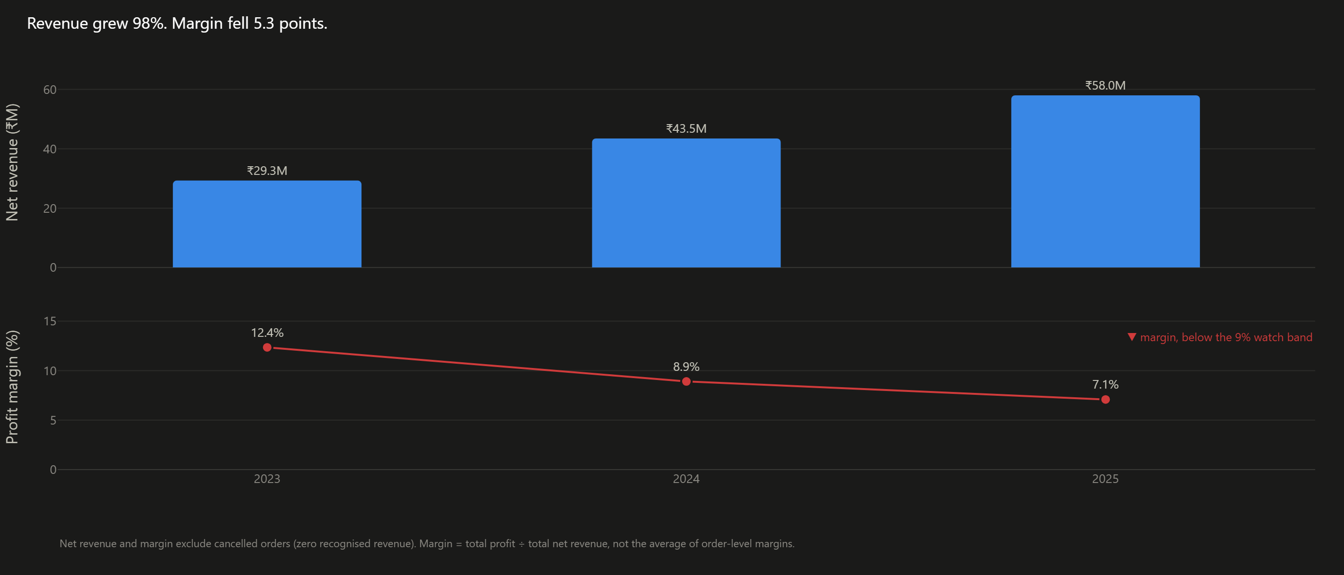
Revenue grew 98%. Margin fell 5.3 points.
₹29.3M to ₹58.0M net revenue · 12.4% to 7.1% margin
Total contribution across the three years: ₹11.6M on ₹130.8M of net revenue, an 8.9% margin.
Notes:
[0:45-1:45] The Chief Growth Officer is right that the business is bigger. Revenue nearly doubled. But margin went the other way, and not slightly: it fell by more than a third of where it started. Two separate panels here, not one dual-axis chart, because the crossing point of two arbitrary scales would be a coincidence, not a finding. The question for the next ten minutes is not whether we grew. It is what we bought with the growth.

Slide 4
TENSION
Growth was purchased, not earned
Notes:
[1:45-2:00]

Slide 5
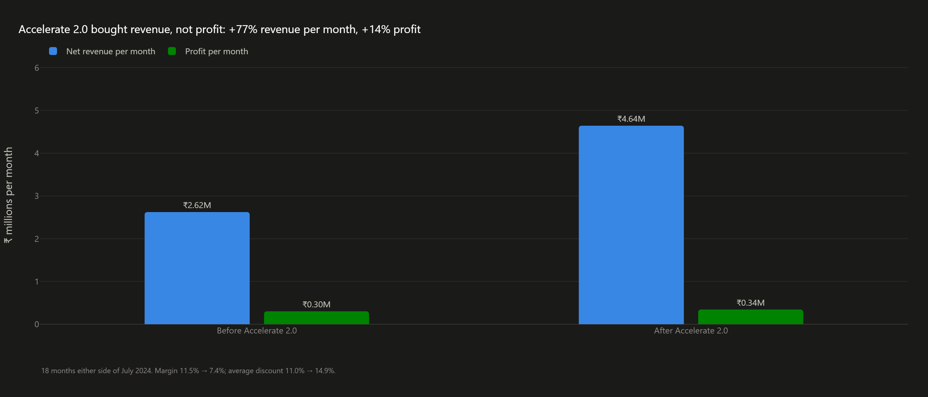
Accelerate 2.0 bought revenue at roughly five times the price of profit
Revenue per month +77%, profit per month +14% (18 months either side of July 2024)
Average discount rose from 11.0% to 14.9%; new customers' share of orders rose from 38% to 50%.
Notes:
[2:00-3:00] This is the growth programme, measured on its own terms. Per-month figures, because the two windows have to be comparable. Revenue per month rose 77%. Profit per month rose 14%. We did acquire customers and we did enter Tier 2, so the programme did what it said. It also discounted four points deeper to do it. Nothing here says stop growing. It says we are not currently being paid for the growth.

Slide 6
INVESTIGATION
So where did the margin go?
Notes:
[3:00-3:10] The obvious answer is that we grew into a worse mix. It is wrong.

Slide 7
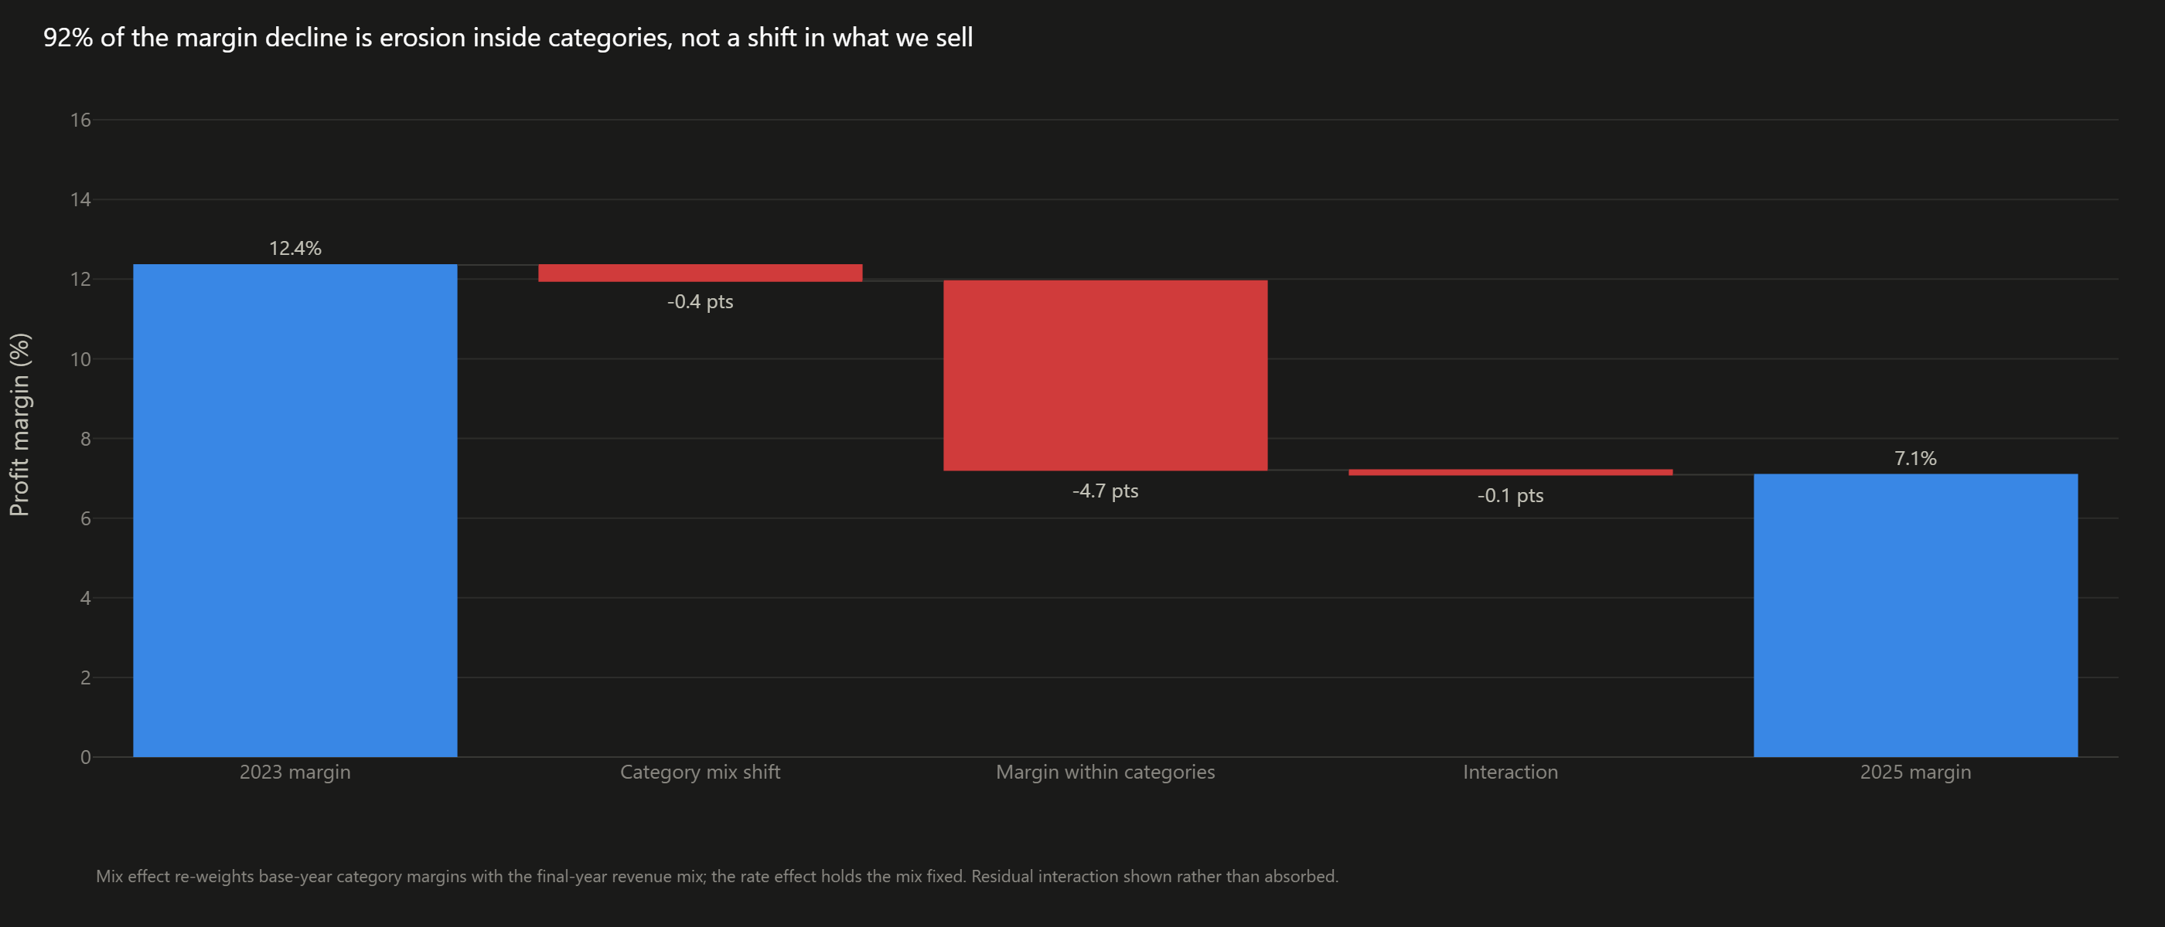
What we sell has not changed much. What we earn on it has.
92% of the decline is margin erosion inside categories; the mix shift accounts for 0.4 points
The distinction matters because the two explanations call for opposite actions: a mix problem is fixed by selling something else, an erosion problem by changing the terms we sell on.
Notes:
[3:10-4:15] I want to kill the comfortable explanation first. If the decline were a mix story, meaning we grew the low-margin categories, the fix would be merchandising. It isn't. Holding the 2023 category mix fixed, margin still lands at 7.6%. Nine tenths of the fall happened inside categories we already sold. So: which categories, and why.

Slide 8
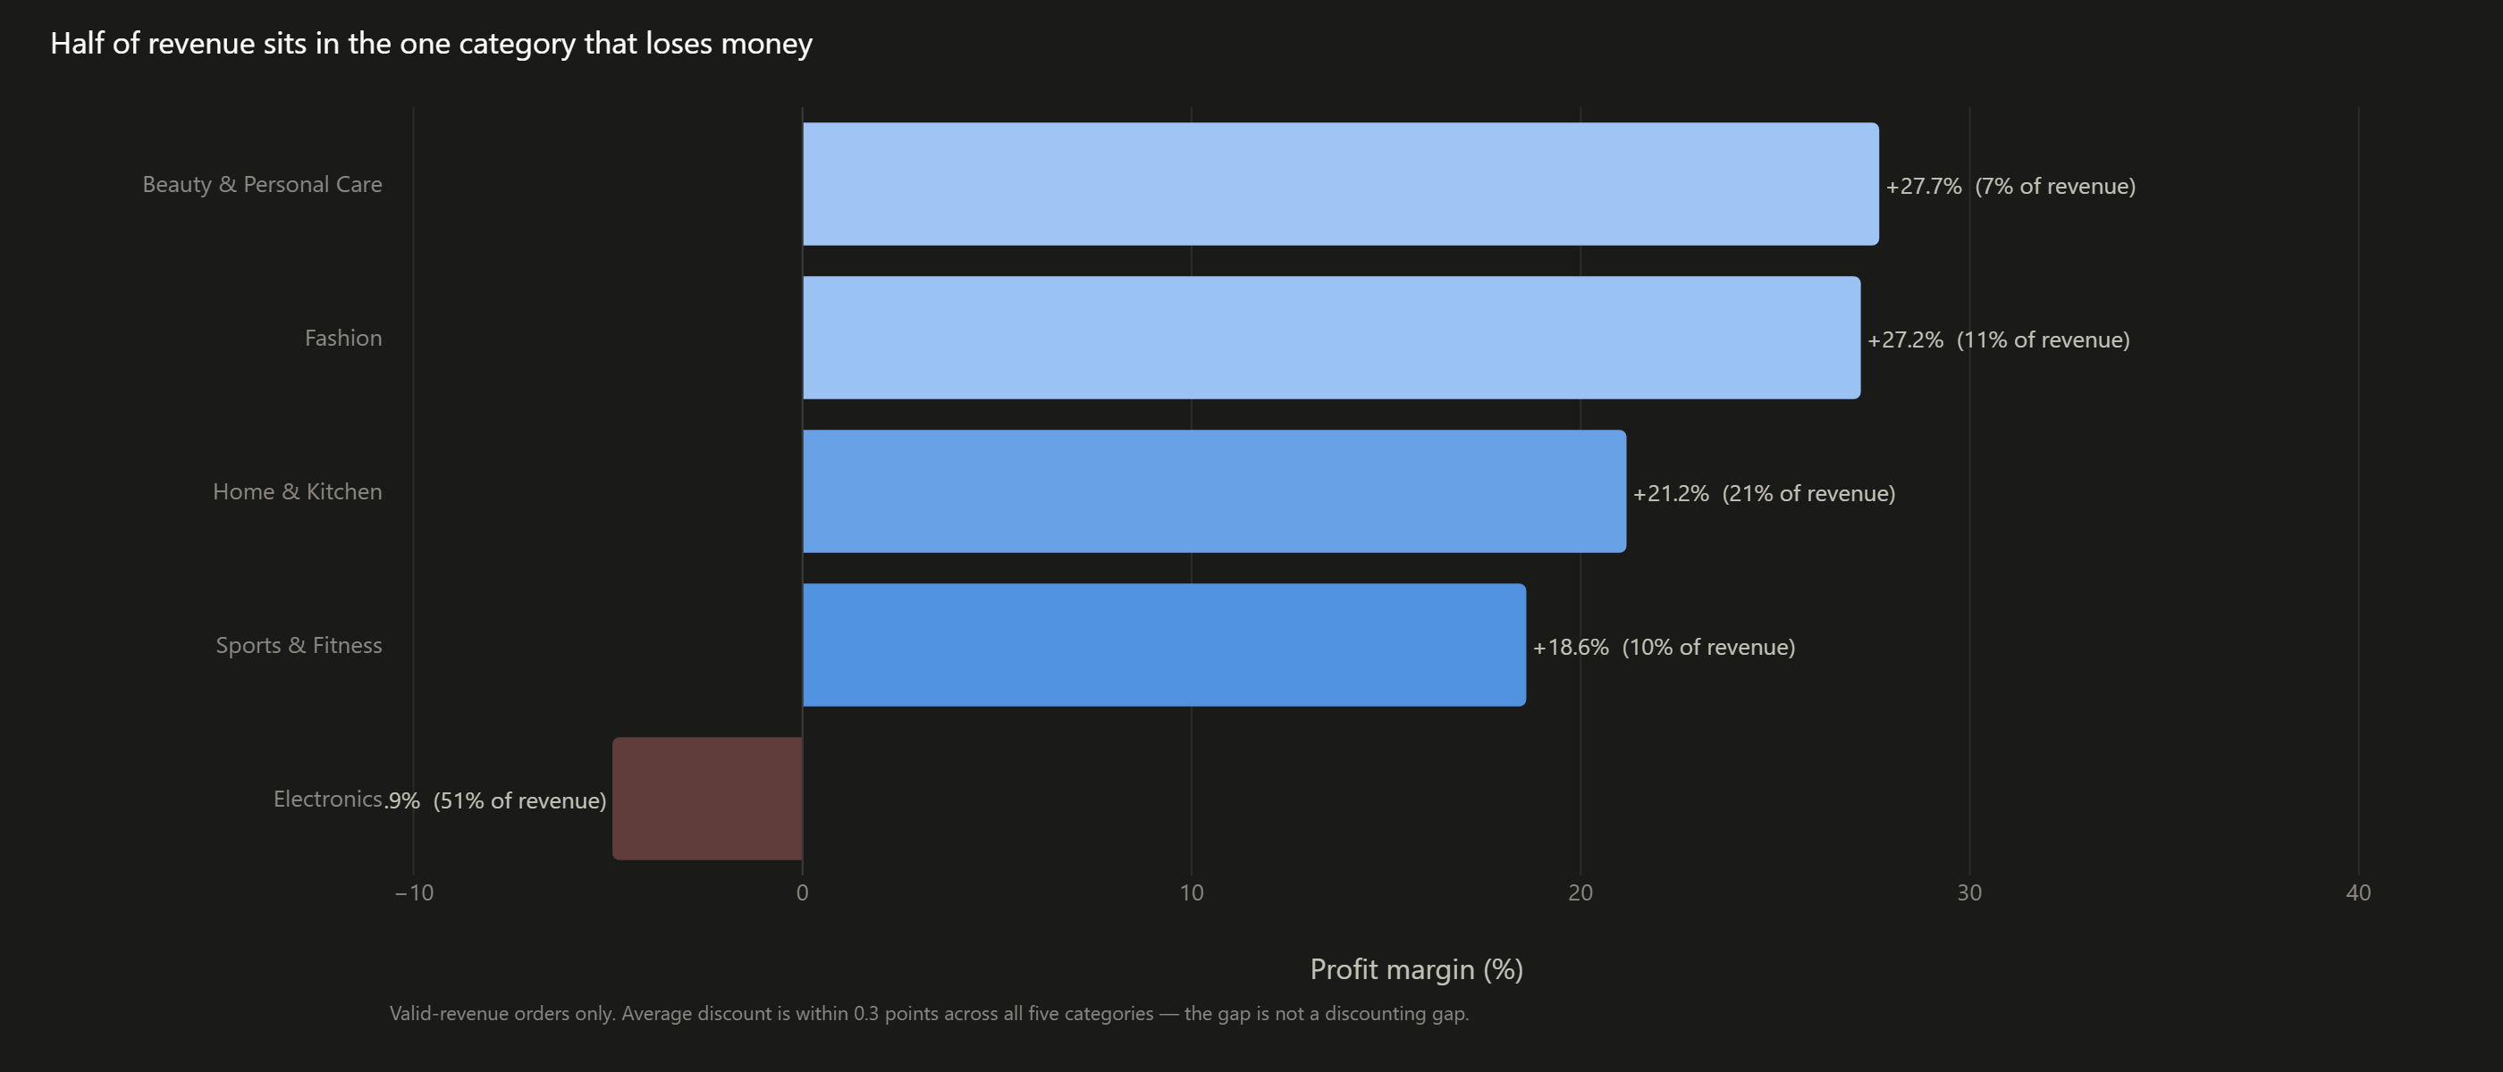
Half of revenue sits in the one category that loses money
Electronics is 51% of net revenue at -4.9% margin. Smartphones alone are 31% of revenue at -9.1%.
Electronics loses ₹3.2M of contribution while the other four categories earn between 18.6% and 27.7%.
Notes:
[4:15-5:00] Here is the concentration. Electronics is not a rounding error. It is half the company, and it is under water. Every other category is healthy. Note the average discount is within a third of a point across all five categories, so this is not a story about Electronics being discounted harder.

Slide 9
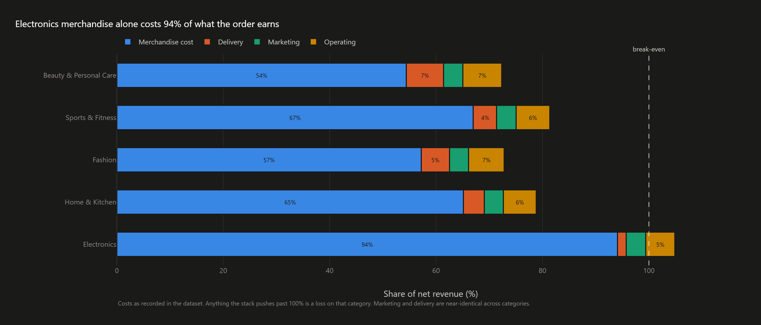
Electronics is a cost problem, not a discount problem
Merchandise cost alone is 94% of the net revenue an Electronics order recognises
Delivery, marketing and operating costs are near-identical across all five categories. The gap sits entirely in what the goods cost us relative to what we charge for them.
Notes:
[5:00-5:45] This is the diagnostic slide. When merchandise costs 94 paise of every rupee recognised, there is almost nothing left to cover delivery, marketing and operations, let alone a discount. That is why the same 13% discount that a Fashion order absorbs comfortably puts an Electronics order into loss.

Slide 10
EVIDENCE
The lever we actually control
Notes:
[5:45-5:55]

Slide 11
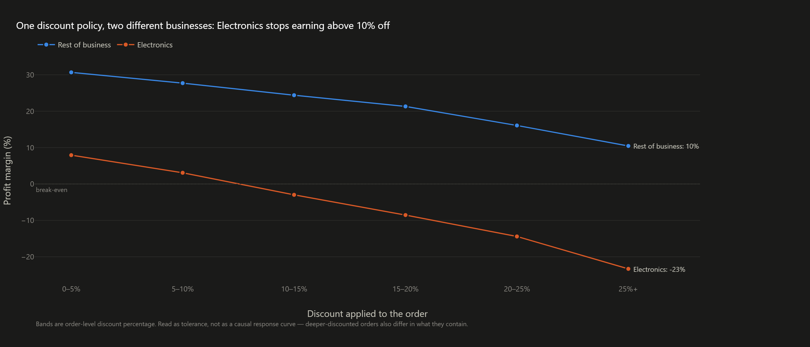
One discount policy is running two different businesses
Electronics crosses into loss above a 10% discount; the rest of the business still earns double digits at 25% off
Flash Deals (average discount 24%, 10% of revenue) are the only promotion type with a negative margin, at -2.0%. Un-promoted demand earns 15.2%.
Notes:
[5:55-6:50] This is the most actionable chart in the deck. Discount tolerance is a function of cost structure, and we have been setting it company-wide. Read this as tolerance, not as a response curve. Deeply discounted orders also differ in what is in them, and I am not claiming the discount caused the margin. But the policy implication survives either reading: the ceiling has to be set per category.

Slide 12
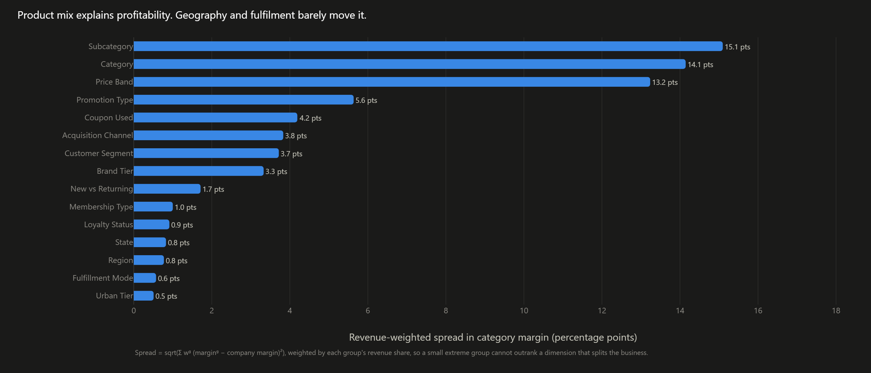
Product mix explains profitability. Geography and fulfilment barely move it.
Ranked by how much each lens actually separates margin, weighted by the revenue it splits
Region spreads margin by 0.8 points; product subcategory by 15.1. The regional debate in the leadership meeting is a debate about the wrong variable.
Notes:
[6:50-7:30] The leadership team asked whether the answer is geography, customer type, channel or fulfilment. Measured properly, as spread in margin weighted by how much revenue each cut actually splits, it is none of those. It is product. This is the slide that settles the argument in the room.

Slide 13
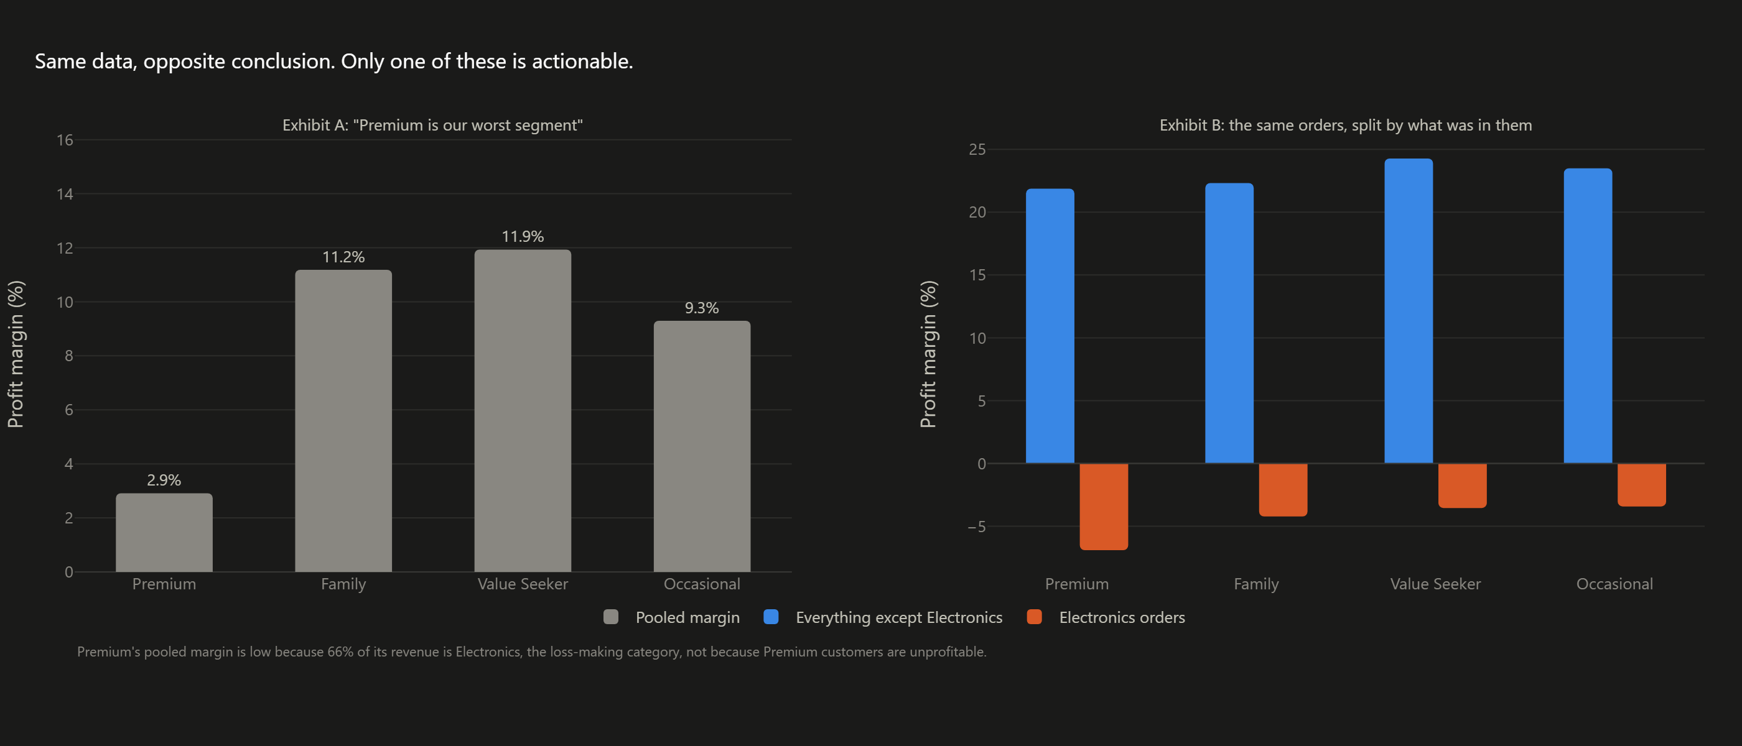
The chart that would have sent us after the wrong problem
Premium looks like our worst segment until you separate what it buys
Premium's pooled margin is 2.9%. Outside Electronics it is 21.9%, which is ordinary. 66% of Premium's revenue is Electronics.
Notes:
[7:30-8:15] Exhibit A is accurate. Every number in it is correct, and it would have started a customer-segmentation project. Exhibit B is the same orders split by what was in them, and Premium's margin is unremarkable. The segment was never the problem; it just buys the category that is. Any cut of this data that does not control for category will produce a version of this mistake.

Slide 14
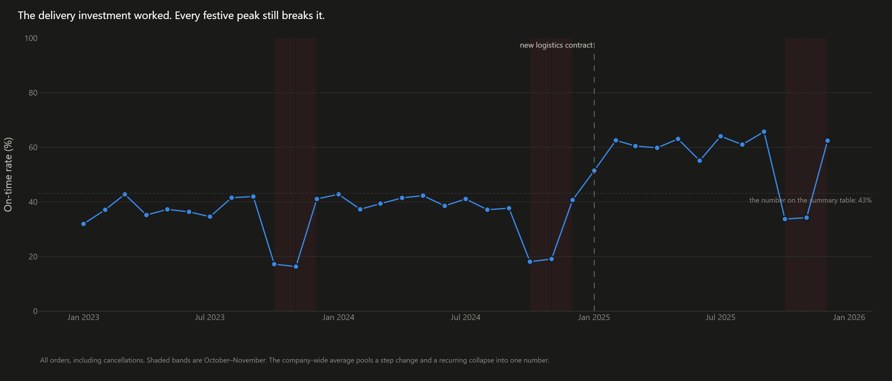
One thing is already working, and it is not where we were about to cut
On-time delivery went from 34% to 55% after the January 2025 logistics contract; complaints fell from 10.1% to 6.9%
It cost about ₹45 more per order. The company-wide average of 43% hides both the step change and the festive collapse: peak on-time was still only 34% last October and November.
Notes:
[8:15-9:00] The COO's investment paid off, and the summary table we have all been reading hides it. Pooled across three years, 43% reads as a uniformly broken function. The monthly series shows a genuine step change. It also shows the one operational risk worth naming: every festive peak still breaks delivery. That is a capacity issue, not a contract issue, and it is a watch item rather than one of my three recommendations.

Slide 15
DECISION
Three actions, in priority order
Notes:
[9:00-9:05]

Slide 16
Where to invest, where to change course
Each sized by the contribution at stake, each with the one thing we would want to know before committing
PRIORITY 1
Re-cost and re-price Electronics before scaling it
EVIDENCE
51% of revenue at -4.9% margin; merchandise costs 94% of net revenue
BENEFIT
the largest single pool of lost contribution, recoverable without touching demand elsewhere
RISK
Electronics drives traffic and attached sales; repricing may cost volume
WE WOULD NEED
SKU-level cost and competitor price data
PRIORITY 2
Set a category-aware discount ceiling; retire Flash Deals
EVIDENCE
Electronics turns loss-making above 10% off while the rest of the business earns 10%+ at 25%; Flash Deals run at -2.0%
BENEFIT
enforceable in the pricing system next quarter. A rule, not a bet
RISK
promotion is partly defensive; volume may move to competitors
WE WOULD NEED
promotion incrementality, meaning what these orders would have done unpromoted
PRIORITY 3
Underwrite acquisition on contribution, not revenue
EVIDENCE
revenue per month +77% against profit per month +14%; paid channels fell furthest and spend the most per rupee earned
BENEFIT
protects growth while it stops us buying revenue that carries almost no contribution
RISK
paid channels may be seeding customers whose value appears later
WE WOULD NEED
cohort retention and repeat value by acquisition channel
Notes:
[9:05-9:45] Three, in order, and I would not start the second before the first. Notice what is not on this list: a regional strategy, a segmentation programme, and cutting delivery investment. The evidence does not support any of them.

Slide 17
What I would not conclude from this data
The limits are part of the recommendation
Association, not causation. Late delivery correlates with lower ratings and triples the complaint rate. That is not proof that lateness causes either.
Returns are not netted out of net revenue, so a category's true contribution is somewhat worse than shown, and worst where returns run highest.
The dataset has no SKU-level cost detail, so it can say Electronics is unprofitable but not whether that is a procurement or a pricing failure.
Order-level data has no lifetime view: it cannot tell us whether a customer acquired at low contribution becomes valuable later.
This is a synthetic case dataset. The method is what transfers, not the specific rupee figures.
Notes:
[9:45-10:00] I would rather you trust the three recommendations because you know what they rest on. Each of the four gaps above maps to something I would ask for before we commit the money. Happy to take questions.

