Slide 2
1.0x
0.5x

Slide 3


Slide 4











$$ℒ_{CE}$$
$$ℒ_{KL}$$
Label$y$
$$y^{f}$$
$$y_{1}^{g}$$
$$y_{2}^{g}$$
$$y_{3}^{g}$$
$$H_{3}$$
$$H_{2}$$
$$H_{1}$$
Input $H_{0}$
Local model
Global model

Slide 5








Input $H_{0}$
Label $y$
Local model
$$y^{f}$$
$$ℒ_{CE}$$
$$y_{1}^{g}$$
$$ℒ_{KL}$$
Global model
$$y_{2}^{g}$$
$$y_{3}^{g}$$

Slide 6

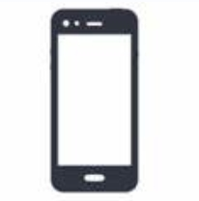




















$k^{2}$
multiply
multiply
$$Q$$
$$U$$
$$V$$
$${Sr}_{1}$$
$${Tr}_{1}$$
$${Sr}_{1}$$
$R_{1}$
$R_{2}$
$k^{2}$
$${Tr}_{1}$$
$$R_{1}$$
$k^{2}$
$${Sr}_{2}$$
$$R_{2}$$
$${Tr}_{2}$$
$${Sr}_{2}$$
$R_{1}$
$R_{2}$
$${Tr}_{2}$$
Notes:
$Q_{l}$和$V_{l}$受剪枝比例影响，$U$则是所有设备之间共享的模块,可以在所有设备的数据上得到训练

Slide 7





2
shrinkage ratio
$$0.5$$
$$0.75$$
$$1.0$$
computation capability
low
high

Slide 8
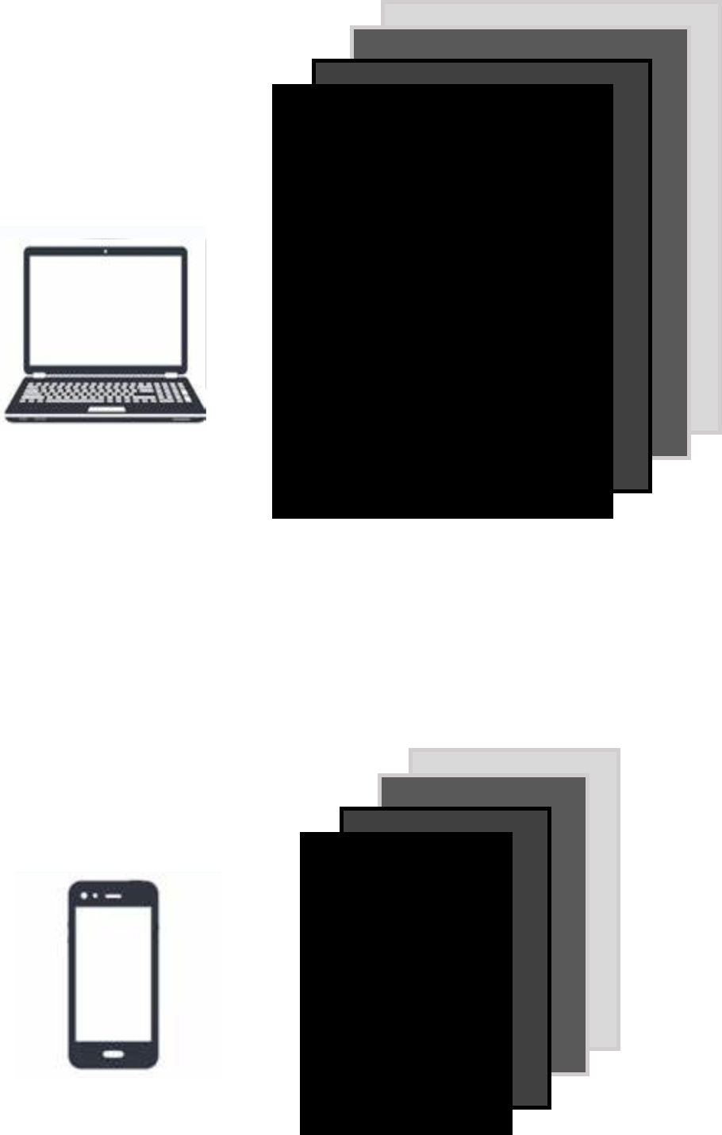
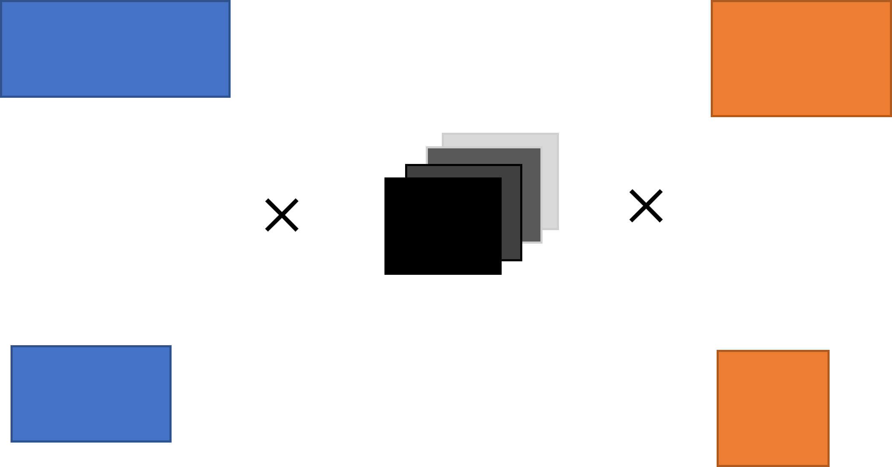
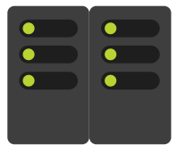
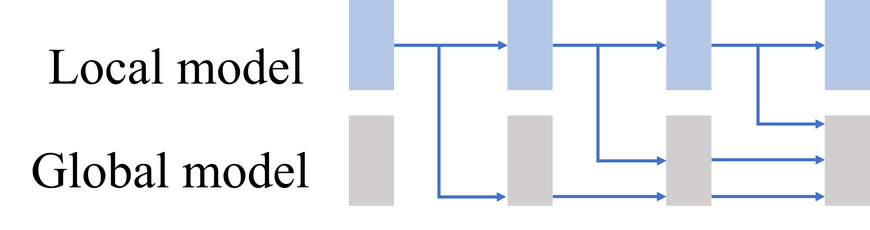
Server
Client Selection
Model Factorization
DNM
Self-Distillation training
Major distribution
Minor distribution

Slide 9
Local model
Global model

Slide 10


$$×$$
$$×$$
Notes:
$Q_{l}$和$V_{l}$受剪枝比例影响，$U$则是所有设备之间共享的模块,可以在所有设备的数据上得到训练

Slide 12
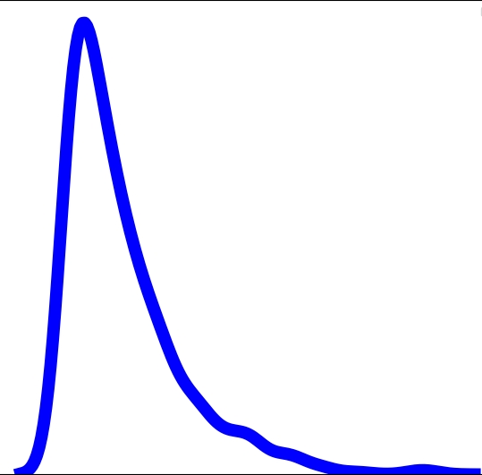
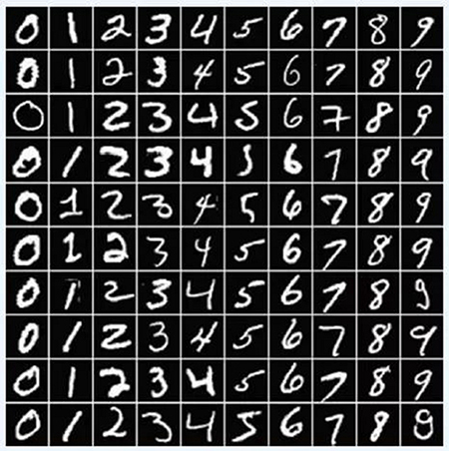
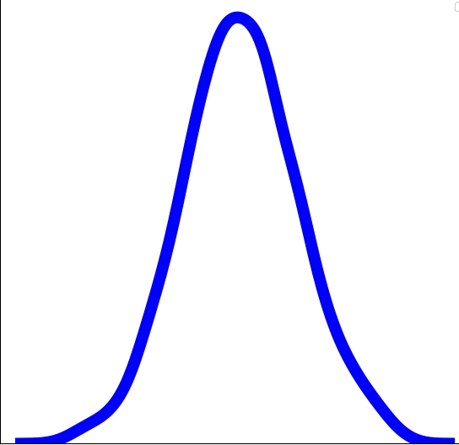































major data distribution
Data absence
Input $H_{0}$
Label $y$
1
2
1
2
Local model
$$y^{f}$$
Local model
$$ℒ_{CE}$$
low computation
high computation
$$y_{1}^{g}$$
$$ℒ_{KL}$$
Global model
$$y_{2}^{g}$$
$$y_{3}^{g}$$
3
3
Data absence & Data negligence
minor data distribution
Self-Distillation training
Data negligence
$k^{2}$
multiply
multiply
Client Selection by DNM
$$Q$$
$$U$$
$$V$$
1
$${Sr}_{1}$$
$${Sr}_{1}$$
$${Tr}_{1}$$
Server
$R_{1}$
$R_{2}$
$${Tr}_{1}$$
$k^{2}$
Local model
$k^{2}$
$$R_{1}$$
$k^{2}$
$$R_{2}$$
$${Sr}_{2}$$
$${Tr}_{2}$$
$$S$$
3
$${Sr}_{2}$$
$R_{1}$
$R_{2}$
$${Tr}_{2}$$
$$T$$
Global model
Local model
Client Selection
Model Factorization

Slide 13

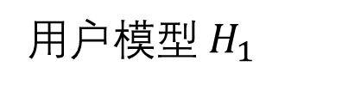





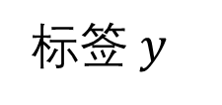



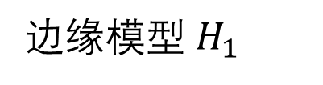












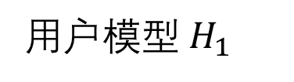



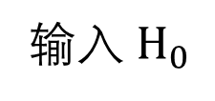









数据公平性问题
自蒸馏
数据缺失
常见分布
$$ℒ_{CE}$$
$$ℒ_{KL}$$
1
4
标签$y$
$$y^{f}$$
$$y_{1}^{g}$$
$$y_{2}^{g}$$
$$y_{3}^{g}$$
$$H_{3}$$
early exit
2
5
$$H_{2}$$
early exit
低算力
高算力
$$H_{1}$$
early exit
3
6
输入 $H_{0}$
用户模型
边缘模型
数据忽视
3
少见分布
$k^{2}$
×
×
边缘服务器
$$Q$$
$$U$$
$$V$$
$${Sr}_{1}$$
模型分解
$${Sr}_{1}$$
$${Tr}_{1}$$
4
$R_{1}$
$R_{2}$
$${Tr}_{1}$$
用户模型$H_{1}$
$k^{2}$
$k^{2}$
$$R_{1}$$
$$S$$
$k^{2}$
模型分解
$$R_{2}$$
$${Sr}_{2}$$
$${Tr}_{2}$$
$${Sr}_{2}$$
$$T$$
3
$R_{1}$
$R_{2}$
边缘模型 $H_{1}$
$${Tr}_{2}$$
用户模型$H_{1}$
设备选择
模型分解

Slide 14
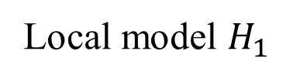




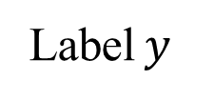


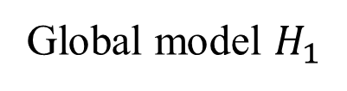









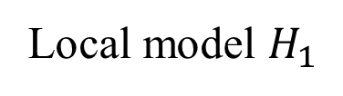


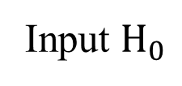






Data absence
major data distribution
$$ℒ_{KL}$$
$$ℒ_{CE}$$
$k^{2}$
multiply
multiply
1
$$Q$$
$$U$$
$$V$$
Label$y$
$$y^{f}$$
$$y_{2}^{g}$$
$$y_{3}^{g}$$
4
Client Selection
by DNM
Server
$${Sr}_{1}$$
factorization
$$y_{1}^{g}$$
$${Sr}_{1}$$
$${Tr}_{1}$$
4
$$H_{3}$$
$R_{1}$
$R_{2}$
early exit
$${Tr}_{1}$$
2
5
Local model $H_{1}$
$k^{2}$
$$H_{2}$$
$k^{2}$
early exit
$$R_{1}$$
low capability
high capability
$$H_{1}$$
$$S$$
$k^{2}$
factorization
early exit
$$R_{2}$$
$${Sr}_{2}$$
$${Tr}_{2}$$
$${Sr}_{2}$$
Input $H_{0}$
3
6
3
$R_{1}$
$R_{2}$
$$T$$
Local model
Global model
Global model $H_{1}$
$${Tr}_{2}$$
Data negligence
3
Local model $H_{1}$
Server
minor data distribution
Client Selection
Model Factorization
Self-Distillation Training
Data fairness problem

