Slide 1
IMS

Slide 2
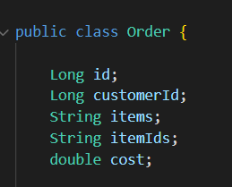
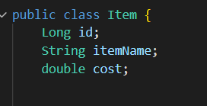
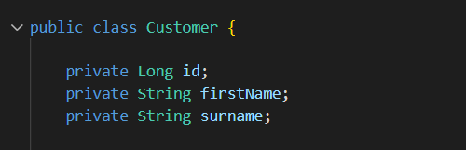
Specification:
A customer needs to have a name.
An item needs to have a name and a value.
An order needs to have a customer and contains items.

Slide 3
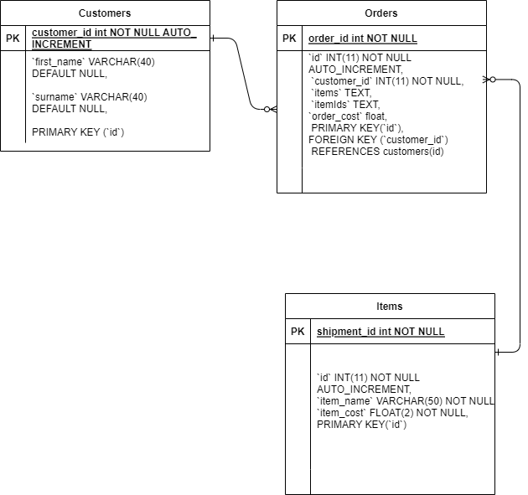
ER DIAGRAM:

Slide 4
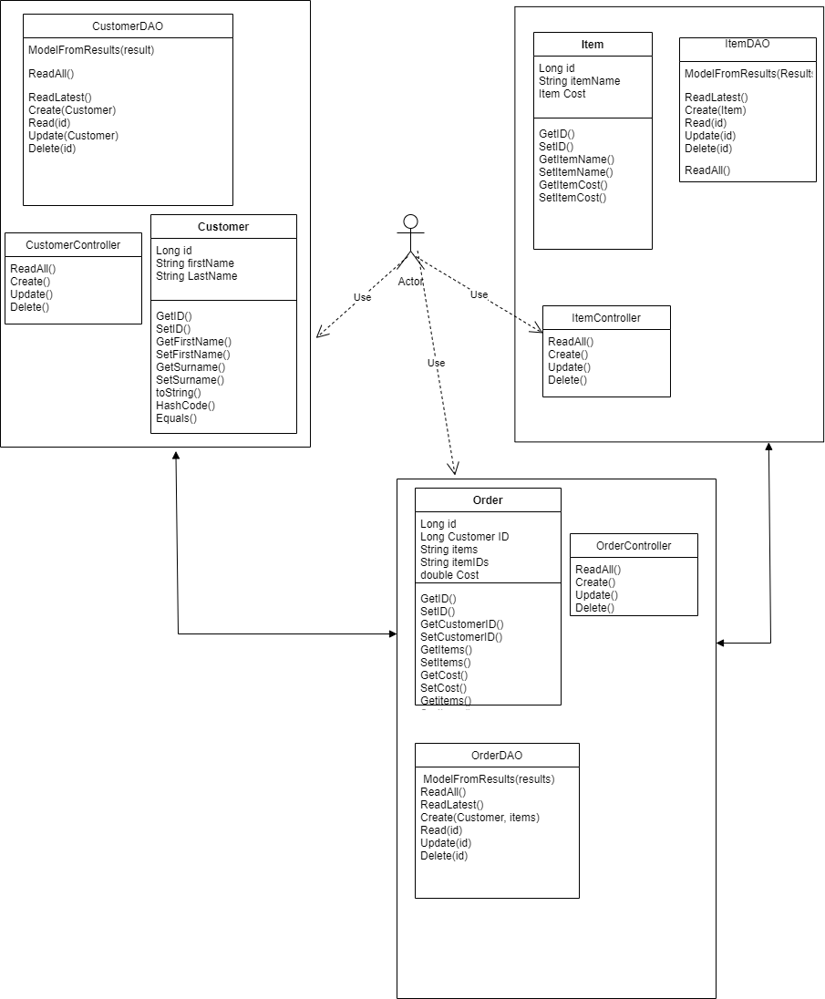
A look at the skeleton file:
Domain – defines our objects (database)
DAO – sends queries to our database
Controller – get user inputs
Hence we have
Order.class, item.class, customer. Class (Domains)
OrderDAO, ItemDAO, CustomerDAO (DAOs)
OrderController, ItemController, CustomerController (Controller)

Slide 5
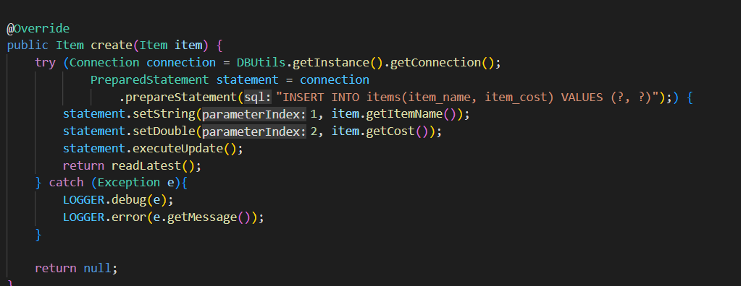
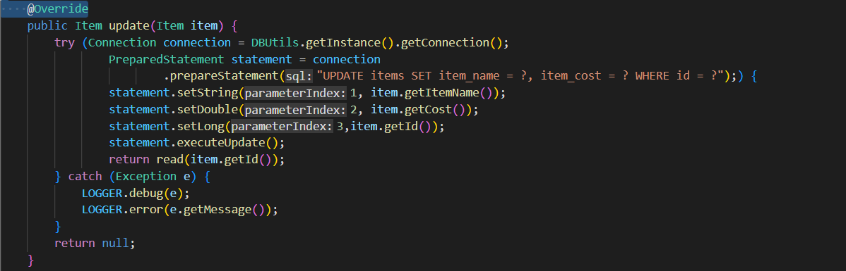
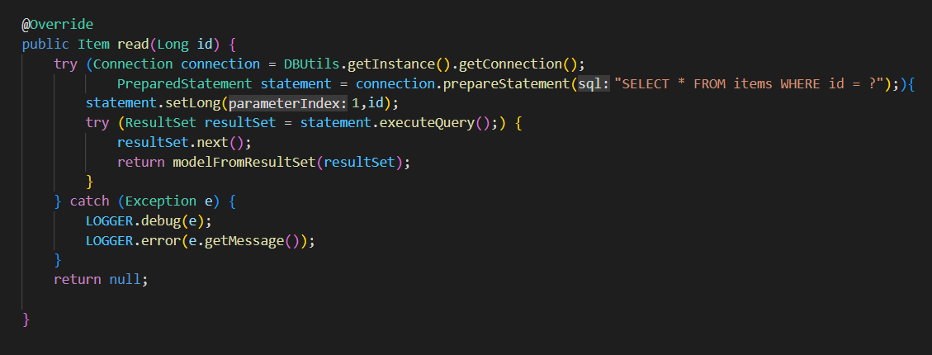
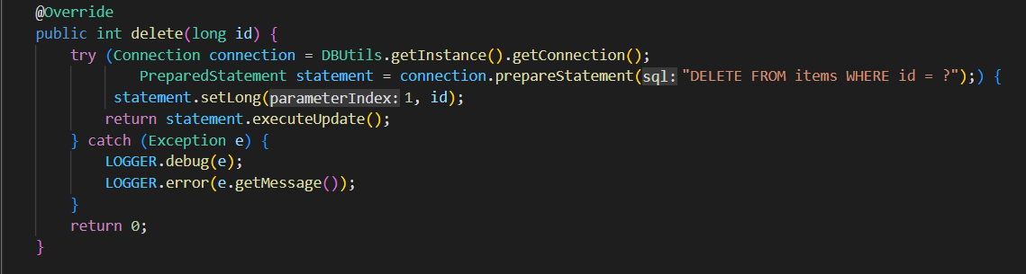
Closer look at DAO CRUD: item example

Slide 6
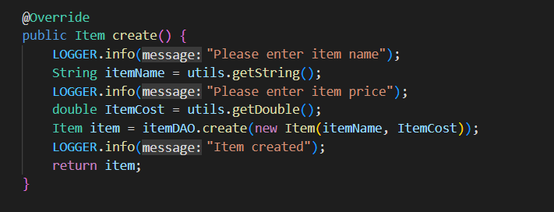
Closer look at controllers:
Item example

Slide 7
Special case of Order controller
Order id(long) | Customer id(long) | Items(String) | ItemIds (string) | cost
Item names and item cost are stored in another table so how is data retrieved?
Instance of itemDAO
ItemIds held in string
When user inputs string of item Id it is converted to a long and item.read(ID).getName() is called
Item.read(ID).getCost() is also called
Names are concatenated into a string
Cost are cumulated

Slide 8
Testing
At the moment not complete 75% pass rate

Slide 9
What went well
Code logic works
Understood how the objects work together
Ims perform minimum basic requirements
How could it have improved.
Got on to extension tasks
Had a forth table orderline(id, FK(order id), FK(customer id), itemid)

