Slide 1
PathCompanion AI
An Agentic Career and Talent Companion System
CSE 6035 — Development Project · Presentation / VIVA (PRES1)
[Student Name] · [Student ID – Cardiff ID – ICBT ID]
Supervisor: [Supervisor Name] · BSc (Hons) Software Engineering
6 AI agents · 2 custom-trained ML models · zero operating cost

Slide 2
Background — The Career Fragmentation Problem
Job seekers today juggle many disconnected platforms. Insight gained in one tool never reaches the others.
Job boards
Resume builders
LinkedIn, Indeed, Remotive — search only, no skill feedback
Format documents, but never tailor per job (ATS ignored)
Course platforms
Interview practice
Teach skills, disconnected from your actual gap
Text-based, scripted, unaware of the real job
The result: a persistent talent gap. Employers cannot find skilled candidates, while capable people cannot see which skills they lack, where to learn them, or how to present themselves — and career coaching is unaffordable for most graduates in developing economies.
2

Slide 3
Problem Statement — Six Key Issues
1. Inefficient job discovery
2. Invisible skill gaps
3. Unguided learning
Openings buried across platforms; keyword search misses semantic matches
No structured feedback on which skills separate you from a target role
Free resources exist, but sequencing them needs expertise learners lack
4. Generic resumes
5. Interview anxiety
6. Opaque career progression
ATS rewards per-job keyword alignment; applicants send one resume everywhere
No safe, realistic spoken rehearsal environment exists
What role comes next? Which skills? How long? Nobody tells you
No mainstream tool connects these steps — that integration gap is what this project solves.
3

Slide 4
Aim and Objectives
Aim: design, implement and evaluate a full-stack, multi-agent AI web application providing end-to-end career support — six cooperating agents over shared memory, with two custom-trained ML models at the analytical core.
Supabase (PostgreSQL + pgvector) schema as shared memory, with row-level security
Train + evaluate Model 1: resume category classifier (Kaggle dataset, 24 classes) vs baseline
Train + evaluate Model 2: multi-label skill extraction (ESCO-aligned, weak supervision)
Job aggregation from free public APIs with hybrid semantic + skill-overlap matching
Skill-gap analysis, learning plans, ATS-tailored resumes, voice mock interviews, career paths
Interconnected cascade: skill learned → gap + resume refresh in < 30 s, non-blocking
Operate entirely within free tiers of all external services
4

Slide 5
Product Requirements (MoSCoW)
MUST
SHOULD / COULD
Register / login; master profile with skills (FR-01)
Aggregate jobs + semantic embeddings (FR-02)
Hybrid match with matched/missing skills (FR-03)
Skill extraction via trained Model 2 (FR-04, FR-05)
Learning plans, ≥3 free resources per skill (FR-06)
Resume classification via trained Model 1 (FR-07)
ATS-tailored resume per job, PDF export (FR-08)
Voice mock interview: TTS + STT + feedback (FR-09)
Career-path mapping (FR-11) · Cascade < 30 s (FR-12)
Panic control with anxiety tracking (FR-10, Should)
Cross-app AI assistant (FR-14, Should)
Mock exam + e-mailed certificates (FR-13, Could — delivered)
Key non-functional requirements
Security: row-level security on every per-user table
Performance: interview turn latency ≈ 2 s; streamed replies
Responsiveness: long tasks run in background, UI never blocks
Cost: 100% free-tier services
Reproducibility: versioned notebooks, fixed seeds
5

Slide 6
Development Methods
Agile (Scrum) — eight 2-week sprints, each ending in a demonstrable increment; two sprints dedicated to ML.
P1 Schema + RLS
P2 Job Scout
P3 ML Model 1
P4 ML Model 2
P5 Resume + Learning
P6 Interview
P7 Cascade
P8 Test + Deploy
Technology stack
Practices
Frontend: React 18 + Vite, Supabase JS (auth)
Backend: FastAPI (Python 3.11, async), 9 routers + service layer
Data: Supabase — PostgreSQL + pgvector, HNSW indexes, RLS
ML: scikit-learn, Hugging Face Transformers, PyTorch, Colab T4
AI services (free tier): Gemini Flash, Groq Llama 3.3 70B, Groq Whisper, Edge-TTS
Git + GitHub feature branching
Backlog with MoSCoW priorities; user stories with acceptance criteria
pytest / Vitest; Postman; FastAPI /docs verification
Versioned Colab notebooks — reproducible training (seed 42)
6

Slide 7
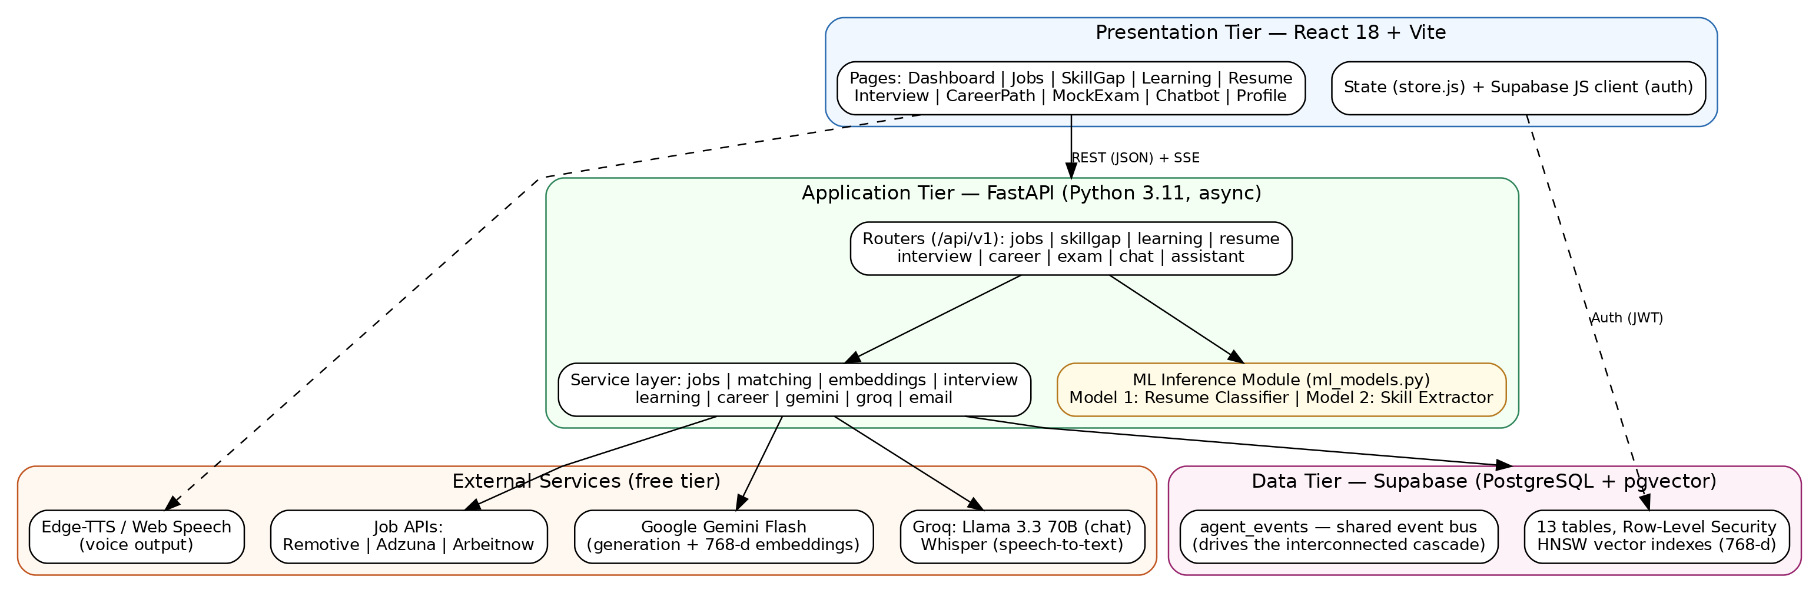
System Architecture
3 tiers + ML inference module
Agents never call each other — they share memory (13 tables) and an event bus (agent_events).
REST + SSE streaming; JWT auth; row-level security per user.
Every module works standalone;
the cascade makes them cooperate.
7

Slide 8
Hybrid Intelligence — Two Custom-Trained Models
MODEL 1 — Resume Category Classifier
MODEL 2 — Skill Extraction (multi-label)
Task: map a resume to 1 of 24 occupational categories
Data: Kaggle Resume Dataset — 2,484 resumes, stratified 90/10 split
Baseline: TF-IDF + Logistic Regression
Final: fine-tuned DistilBERT (max 256 tokens)
Serves the Resume agent: category + top-3 confidence
Task: detect which of 25 ESCO-aligned skills appear in text
Data: ~11,800 public job postings, LLM-assisted weak labelling
Baseline: TF-IDF + One-vs-Rest Logistic Regression
Final: multi-label DistilBERT (sigmoid + BCE, 3 epochs, T4 GPU)
Serves Skill Gap + job matching: present / missing partition
Why train our own models? Deterministic, reproducible results · no external dependency for the most frequent tasks · a rigorous, quantitatively evaluable engineering contribution.
8

Slide 9
Findings — Model Evaluation
Model 1: +16.8 pts accuracy over the classical baseline (82.3% vs 65.5%). Macro-F1 0.751 — below the 0.80 target due to 256-token truncation and class imbalance (honest limitation, mitigations identified).
Model 2: micro-F1 [insert from final run] against the ≥ 0.70 target on ~11,800 postings, 25 labels.
System: cascade completes < 30 s without blocking the UI; interview turns ≈ 2 s; entire stack runs on free tiers.
Key claim: the fine-tuned transformer clearly and measurably outperforms the classical baseline on the same split.
9

Slide 10
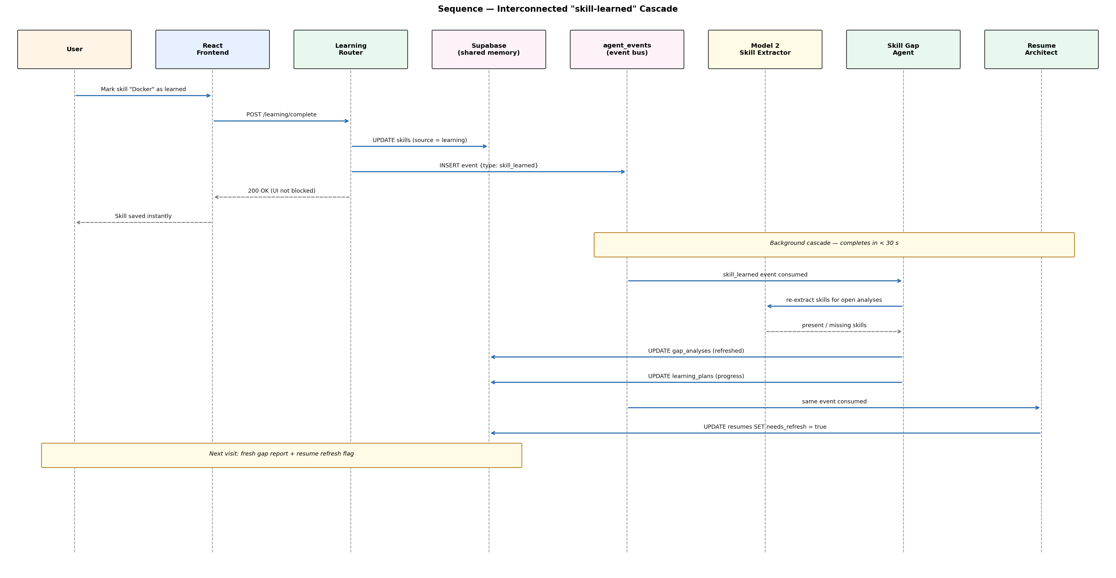
The Interconnected Cascade — System USP
Mark a skill as learned → event bus → gap analyses refresh (via Model 2) → resumes flagged — automatic, idempotent, < 30 seconds, UI never blocked.
10

Slide 11
Live Demonstration
Artefact demonstration — 45% of this assessment
1
Login → Dashboard
2
Profile & Skills
Stack live: backend + database connected
Shared memory all agents read
3
Job Scout
4
Skill Gap
Sync + semantic matches with match %
Model 2 live — present vs missing skills
5
Learning → mark learned
6
Resume classify
Watch the cascade refresh gap + flag resume
Model 1 live — category + confidence
7
Voice Interview
8
Mock Exam
Spoken Q&A + panic control
Added scope: score + certificate
System is already running with realistic data prepared, as required by the brief.
11

Slide 12
Contribution to Knowledge
Engineering contribution
Machine-learning contribution
A working reference architecture for event-driven multi-agent AI over a relational + vector database (pgvector), where agents cooperate through shared memory without direct coupling — every module standalone AND interconnected.
A reproducible, quantitatively evaluated hybrid-intelligence pattern: custom-trained DistilBERT models for deterministic analysis tasks, benchmarked against classical baselines, with LLMs reserved for open-ended generation.
Methodological contribution
Social contribution
Demonstrates LLM-assisted weak supervision (Zhang et al., 2022) applied end-to-end by an individual: from public data to a served multi-label skill-extraction model.
A zero-marginal-cost career companion — realistic to release to students and graduates who cannot afford professional coaching, including anxiety-aware interview rehearsal.
Directly addresses all three learning outcomes: problem specification, literature-grounded design, and evaluated artefact.
12

Slide 13
Limitations and Future Work
Honest limitations
Future work
Model 1 macro-F1 0.751 < 0.80 target — 256-token truncation + class imbalance; fixes: 512 tokens, class weighting, more epochs
Model 2 vocabulary limited to 25 high-frequency skills
Weak labels inherit LLM annotation noise (gold subset mitigates)
Free-tier latency not guaranteed under provider throttling
Daily Journal agent + monthly Career Progress Summariser
Expanded ESCO vocabulary with hierarchical classification
One-click apply with tailored resume; e-mail/WhatsApp automation
Recruiter portal over anonymised profiles
Multilingual UI (Tamil, Sinhala) + React Native mobile client
13

Slide 14
Thank You
Questions & Discussion
PathCompanion AI — 6 agents · 2 trained models · 13 tables · 1 shared memory · 0 running cost

