Slide 1
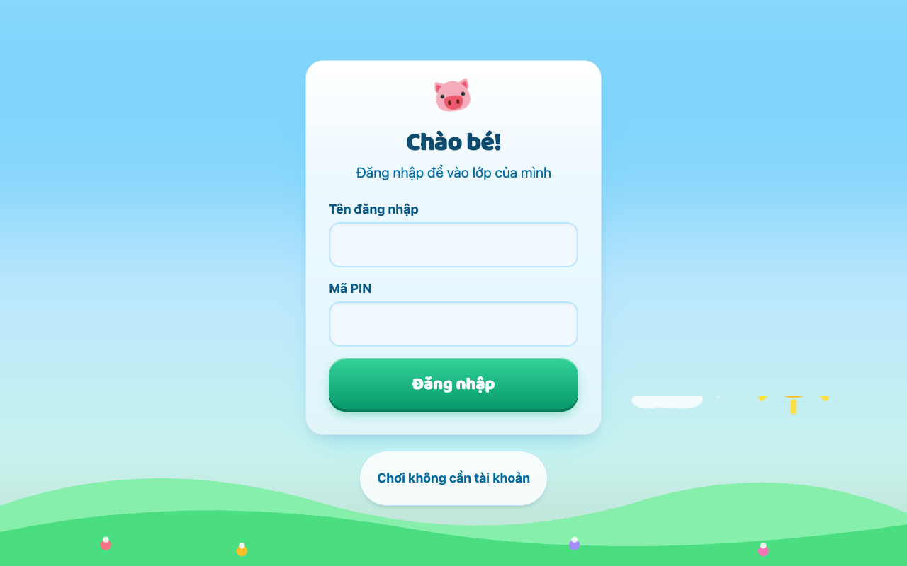
PROPOSAL BAN HANG / SALES DECK
HEOPIA
Hanh trinh tieng Anh cua Be Heo
Nen tang luyen tieng Anh tu hoc cho hoc sinh tieu hoc
Lop 1-5 - bam sat SGK Global Success + Cambridge
Web app - khong can cai dat - co che do khach mien phi
ioe-leduyminh.vercel.app - proposal: heopia.com

Slide 2
Van de - Phu huynh va truong hoc dang thieu gi?
Hoc sinh tieu hoc thieu moi truong luyen tieng Anh ngoai gio hoc. Tren lop it co hoi noi/nghe; gia dinh khong phai ai cung day kem duoc.
Cac app hien co hoac khong dung chuong trinh, hoac dat va nang. App quoc te (Duolingo ABC, Khan Kids) hay nhung khong bam SGK Viet Nam; app noi dia (Monkey Junior, VMonkey) tra phi cao va nang native app.
Truong hoc can cong cu re, de trien khai theo lop. Cac giai phap hien tai chu yeu ban B2C cho phu huynh, thieu cong cu quan ly lop: cap tai khoan, gioi han noi dung, theo doi.
Tre 6-11 tuoi can "choi de hoc", khong can them bai tap kho. Noi dung kho, giao dien so sai = tre bo sau vai phut.

Slide 3
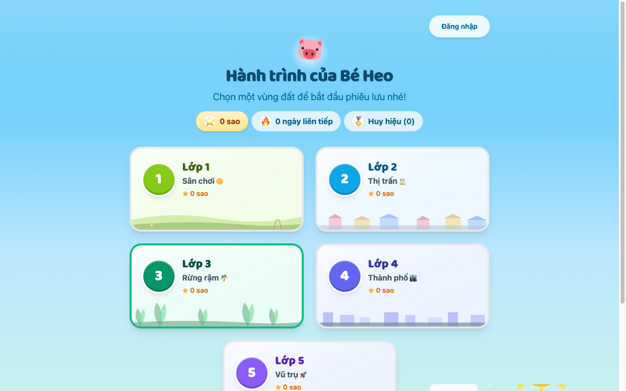
San pham: the gioi luyen tap "Hanh trinh cua Be Heo"
5 vung dat = 5 lop hoc. San choi (L1) -> Thi tran (L2) -> Rung ram (L3) -> Thanh pho (L4) -> Vu tru (L5): ban do hanh trinh tao cam giac phieu luu.
Noi dung bam chuan. ~524 tu vung xay theo SGK Global Success (~60%) + Cambridge (~30%) - 79 chu de, moi lop mot pool rieng.
4 vong luyen da dang. Bat chu cai thua, nghe-dien tu, ghi am phat am, ghep hinh-mo ta - co cham diem va giai thich tieng Viet.
Gamification day du. Ngan hang sao, streak ngay, album huy hieu, confetti, star rain, rong kho bau - tre quay lai moi ngay.
Che do lop hoc cho truong. Admin cap tai khoan username+PIN (khong can email/PII), giao lop, mo khoa noi dung theo lop.
Ban do hanh trinh: 5 vung dat - 5 lop hoc

Slide 4
Diem manh nhat
Duy nhat tren thi truong: noi dung bam SGK tieu hoc Viet Nam
trong mot trai nghiem gamified dang cap quoc te
DUNG CHUAN
GAY NGHIEN (lanh manh)
DE TRIEN KHAI
Bam SGK Global Success
cua Bo GD&DT + Cambridge.
Khong phai noi dung chung chung
quoc te "dich lai".
Mascot Be Heo dong hanh,
sao-streak-huy hieu, 5 vung dat.
Tre tu giac luyen moi ngay -
khong can phu huynh nhac.
Web app, khong cai dat,
chay tren moi thiet bi.
Admin cap lop trong 5 phut,
khong thu thap PII tre em.

Slide 5
So sanh doi thu: Heopia chien thang o dau?
Tieu chi | HEOPIA | Monkey Junior / VMonkey | Duolingo ABC | Khan Academy Kids | ioe.vn / luyen thi truyen thong
Bam SGK Viet Nam | CO - xay theo Global Success | Mot phan, chuong trinh rieng | KHONG | KHONG | CO - nhung hinh thuc thi cu
Gia / mo hinh | Lop hoc gia thap, guest free | Tra phi cao (~2-3tr/nam) | Free/premium | Free (My) | Phi thi/luyen tap
Khong can cai app | CO - web, moi thiet bi | Native app nang | Native app | Native app | Web nhung UX cu
Cong cu cho lop/truong | CO - lop, cap PIN, mo khoa noi dung | Khong/han che | KHONG | Han che | Co nhung khong linh hoat
Gamification | Map 5 vung dat + sao + streak + huy hieu | Coin + pet + truyen | Streak + gem | It | Khong
Phat am (ghi am cham) | CO - SpeechRecognition + diem gan dung | Mot phan | KHONG | KHONG | Khong
Do tuoi phu hop | 6-11 (tieu hoc VN) | 0-10 (rong) | 3-8 (My) | 2-8 (My) | Thi cu, khong "choi"

Slide 6
Mo hinh ban hang de xuat
GOI LOP HOC (B2B2C)
GOI PHU HUYNH (B2C)
FREE / GUEST
Truong/TT mua theo lop
- Admin cap tai khoan PIN, khong can email
- Mo khoa noi dung theo khoi lop
- De xuat: 30-50k/HS/nam (re hon sach bai tap)
Mua truc tiep cho con
- Toan bo 5 khoi lop
- Tu luyen khong gioi han
- De xuat: 199-299k/nam
Thu phi luc 0
- Choi ngay khong tai khoan
- Gioi han trai nghiem de dan den mua
- Kenh marketing tu nhien
Chi phi van hanh rat thap: Vercel + Supabase free/du nho -> bien loi nhuan cao.
Domain de xuat: heopia.com (~250k/nam), subdomain mien phi cho moi san pham/app tiep theo.

Slide 7
Huong dan 1: Dang nhap - hoac choi ngay mien phi
Hoc sinh dang nhap bang username + PIN (admin cap) - khong can email. Phu huynh/tre co the "Choi khong can tai khoan" de thu ngay.

Slide 8
Huong dan 2: Chon vung dat = khoi lop
Ban do hanh trinh 5 vung dat. Chip sao + streak + huy hieu hien tien do tich luy ngay tren ban do.

Slide 9
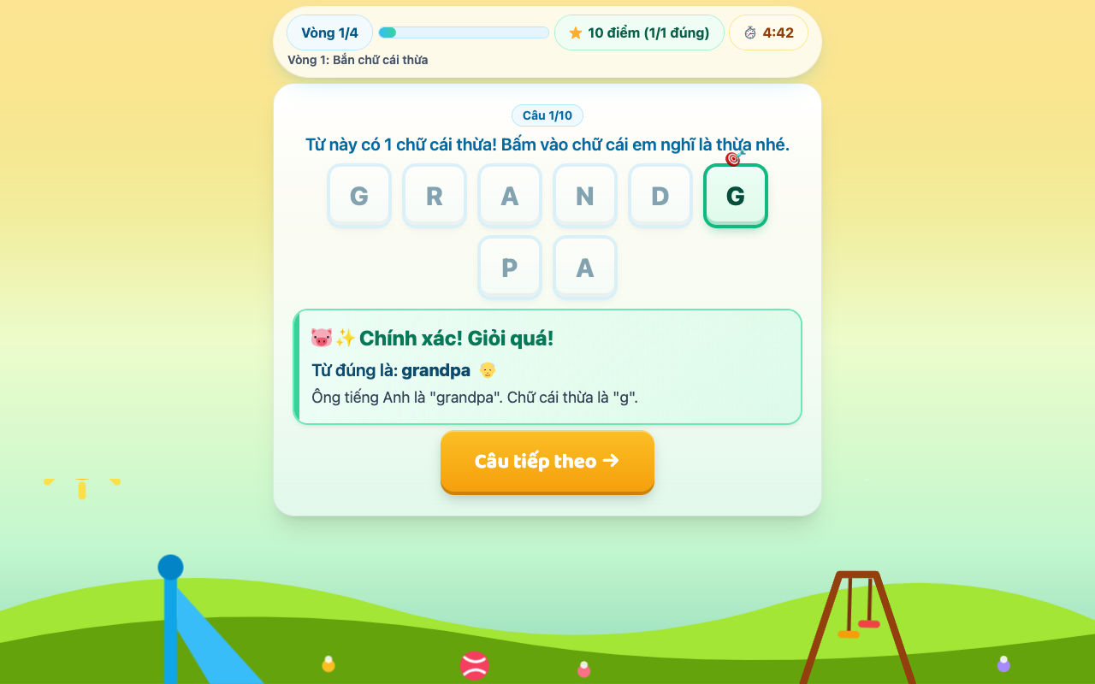
Huong dan 3: Lam bai - phan hoi tuc thi
Cau hoi da dang: chon chu cai thua, nghe-dien, ghep hinh, phat am. Dung -> confetti + giai thich; sai -> goi y nhe nhang.

Slide 10
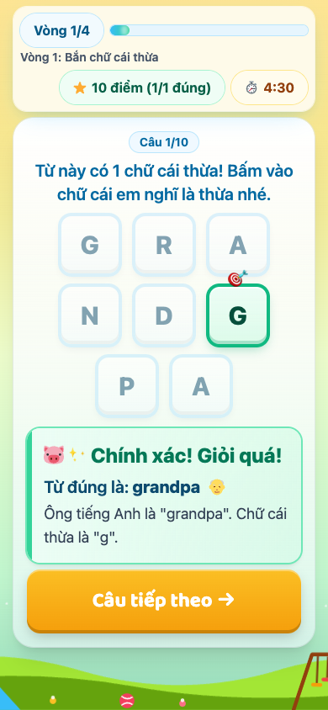
Huong dan 4: Choi moi luc moi noi
Giao dien responsive hoan chinh tren dien thoai: nut lon de bam, CTA day man hinh, khong can keo ngang.

Slide 11
Buoc tiep theo de ra thi truong
1. Mua domain + dung landing page
heopia.com (~250k/nam, Cloudflare/Porkbun). Subdomain free cho app 2 trong presale.
2. Pilot 1-2 lop mau
Dung san console admin: cap PIN cho 1 lop, do muc do su dung sau 2 tuan.
3. Dong goi goi gia
Chot gia lop hoc + phu huynh; lam trang thanh toan/dang ky don gian.
4. Content mo rong
Them chu de theo feedback lop pilot; da co khung scale 524 tu -> hang nghin.
Demo truc tiep: ioe-leduyminh.vercel.app - "Choi khong can tai khoan"

