Slide 1

INVESTO- A STOCK MARKET ANALYSIS WEB APPLICATION
CASE STUDY
Saiom Pal

Slide 2

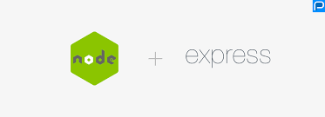

TECH STACK
FRONTEND – ANGULAR (13.1)
BACKEND- NODEJS AND EXPRESSJS (17.0.14)
DATABASE MANAGEMENT SYSTEM- MONGODB

Slide 3
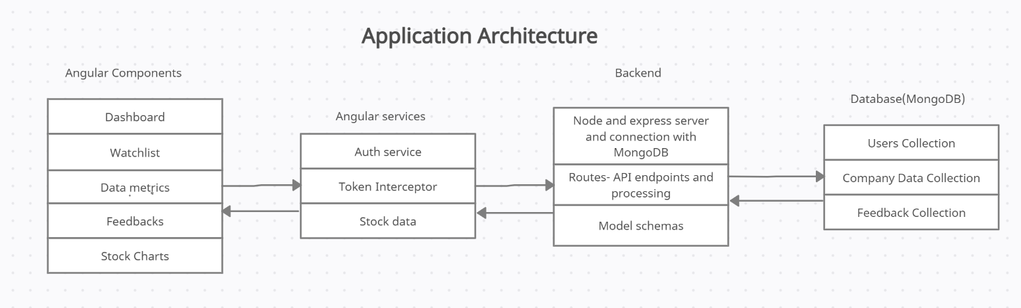
APPLICATION ARCHITECTURE

Slide 4
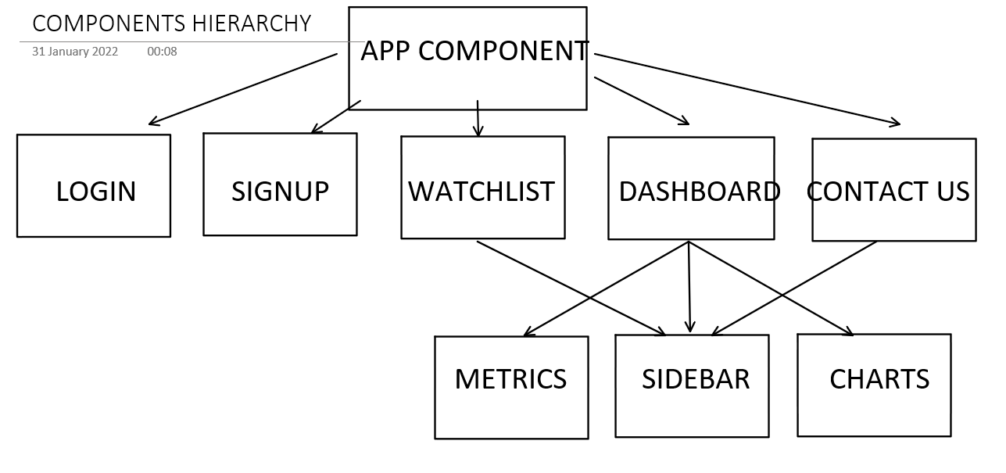
FRONTEND

Slide 5
LOGIN AND SIGNUP
These components provides the basic functionality of user login and registration.
Implemented using template driven forms in Angular with proper validations for each input field.
On submitting the data, it gets verified or stored in the backend and a JWT(JSON Web Token) token is generated as returned as a response on success.

Slide 6
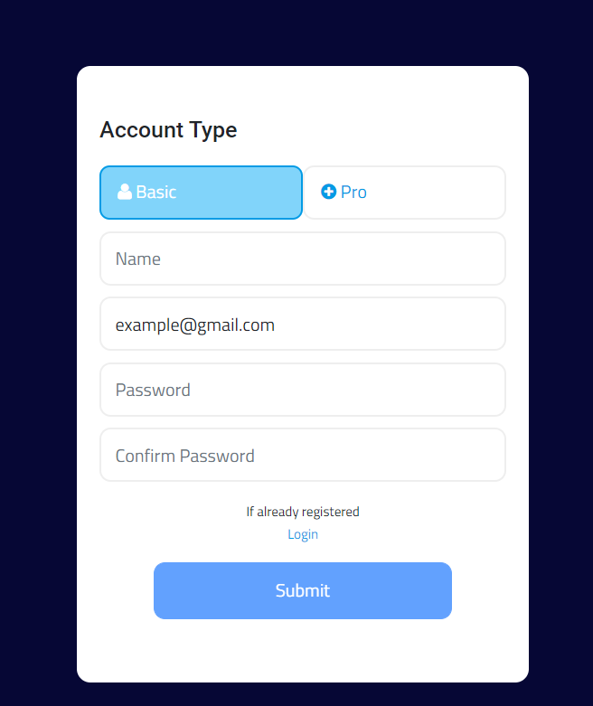
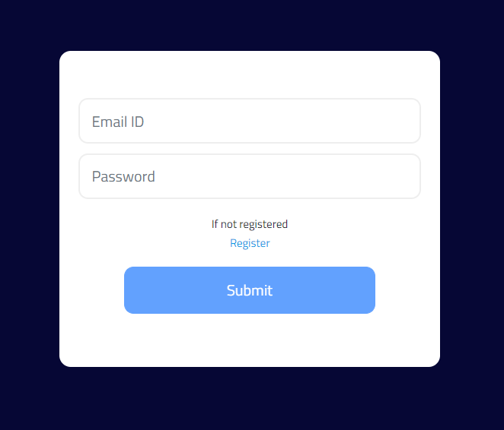

Slide 7
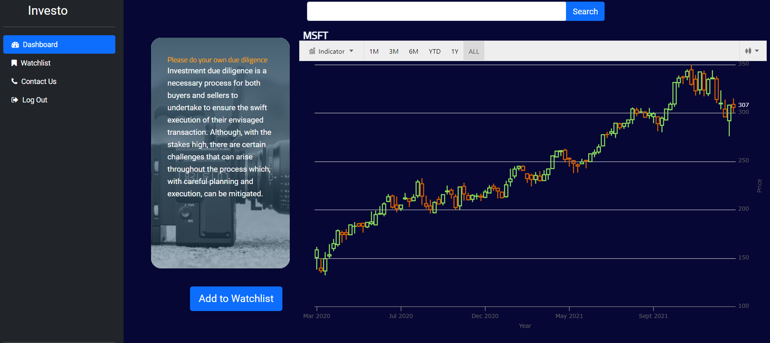
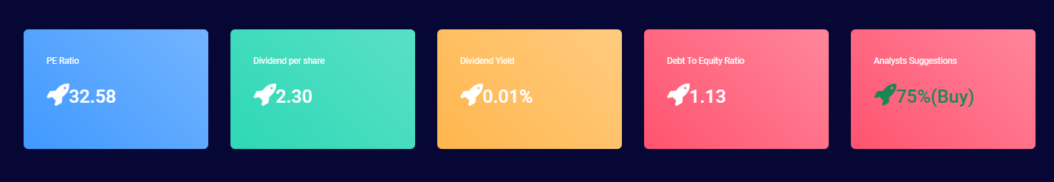
DASHBOARD
Here, the user can access stock charts, read on some key metrics of any particular stock and the details of any company.
The User has the functionality to add any of the stock to his/her own watchlist to track it later.

Slide 8
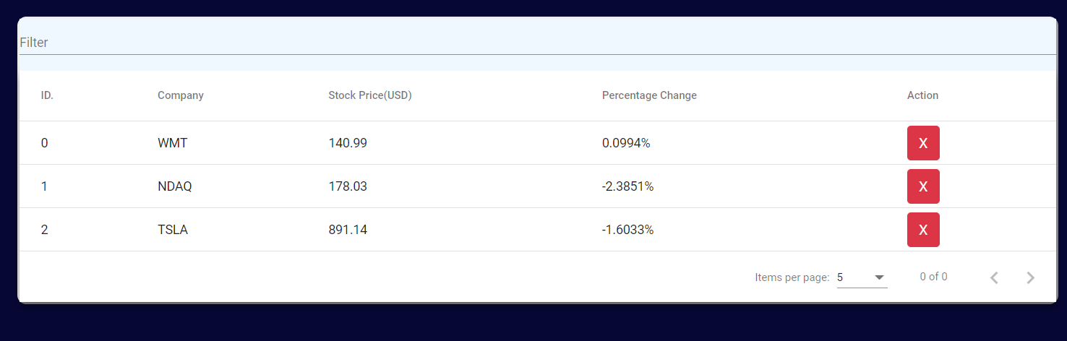
WATCHLIST
Here the user can add any preferred stock to the watchlist and can edit according to his/her choice.
The watchlist provides the last trading session’s data of the stock.

Slide 9
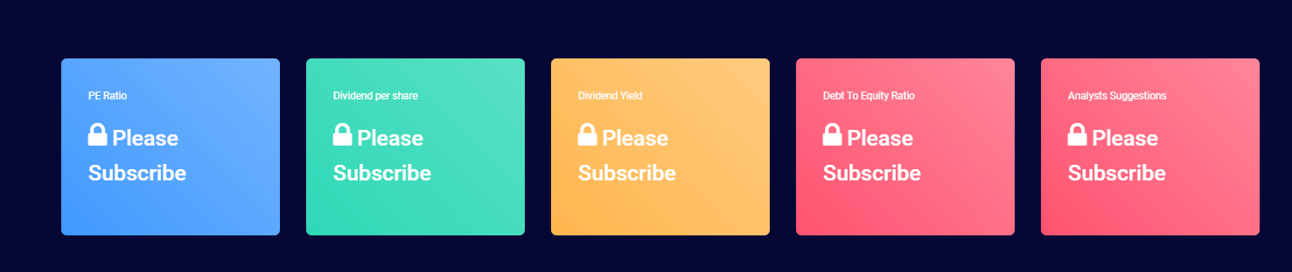
User Types
While registration of a user they are asked to select if they want basic or premium functionalities.
The view of the application is set accordingly.
The premium user has access to all of the functionalities while a basic usr can only view the stock charts.

Slide 10
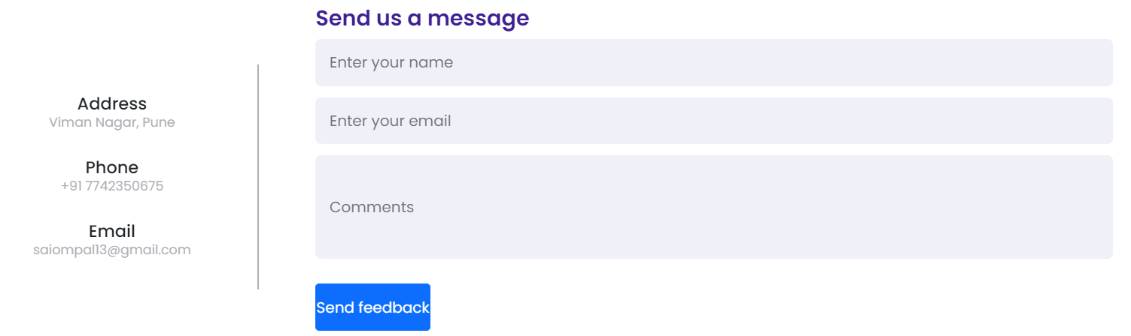
CONTACT US
Here the user can share the feedback of his/her experience of the web application using a simple form.
Also, the details of the developer is shared on this page in case the user wants to connect with developers directly.

Slide 11
THE END

