Slide 1
IOS Assignment Evaluation
Paper Title : SDNRacer: Concurrency Analysis for Software- Defined Networks
Authors : Ahmed El-Hassany, Jeremie Miserez, Pavol Bietik Laurent Vanbever, Martin Vechev
Conference: PLDI '16 Proceedings of the 37th ACM SIGPLAN Conference on Programming Language Design and Implementation
Project Team :
Bhavna Arora [PES1201700062]
Raunak Sengupta [PES1201700072]
Sarthak Gupta [PES1201700077]
Saioni Chatterjee [PES1201700118]
Manasa HK [PES1201701886]
Section : 5 G
P9-5G

Slide 2
Problem Description
Concurrency violations are an important source of bugs in Software- Defined Networks (SDN), often leading to policy or invariant violations. Concurrency violations : difficult to avoid, detect and debug.
Required to design and the implementation of a sound and complete dynamic analyzer: SDNRacer
SDNRacer, which can ensure a network is free of harmful errors such as:
1. high-level data races.
2. packet coherence violations.
3. update isolation violations.
P9-5G

Slide 3
Summary of Contribution
Thorough Happens-Before Model: captures asynchronous interaction between OpenFlow based SDN controller and SDN switches.
Set of effective ﬁlters: dramatically reduce the number of reports.
Commutativity speciﬁcation: captures precise conditions under which two operations on the network switch commute.
Implementation of SDN Racer: for dynamic analysis of production-grade (single and multi-threaded) SDN controllers for data races, per-packet consistency and update consistency.
Comprehensive evaluation of SDN Racer: attesting that it can uncover harmful and previously unknown bugs in existing SDN applications.
P9-5G

Slide 4
Methodology and Key Results
SDNRacer is a dynamic, controller-agnostic concurrency analyser.
It is based on two key ingredients :
1. a precise happens-before model for capturing when events can happen concurrently.
2. a set of sound, domain-specific filters that reduce the reported
violations by orders of magnitude.
It is evaluated on several real world controllers, running both reactive and proactive applications in large networks.
It quickly, within 30 seconds in 90% of the cases, pinpoints harmful concurrency violations without overwhelming the user with false positives.
It goes beyond detecting interferences and is capable of detecting higher level violations such as inconsistent packet forwarding during a network update.
P9-5G

Slide 5
Summary
Loading the trace
Building the happens-before graph
Applying filters
Consistency analysis
Necessity: Concurrency interferences have a root in deeper semantic problems such as black holes, forwarding loops or non-deterministic forwarding.
Cause: A forwarding table consisting of an ordered list of
1. Forwarding entries
2. Boolean predicate
3. Forwarding actions
is maintained in each SDN switch.
Concurrency issues arise due to unordered accesses to the switch flow table, one of which is a write produced by the controller.
P9-5G
Notes:
Fix the references (updated)

Slide 6
Summary
Update Consistency: Packets are forwarded by the old or the new version of the forwarding state, but not by an interleaving of the two.
Filtering:
1. Commuting Events: A race between two events is harmless if, for non-overlapping entries of the forwarding table, it would end up being identical irrespective of which event occurs before.
2. Time:If a read and write event are separated by delta seconds then they are unlikely to be recorded in practice, and are harmless (99.97%).
Happens-before relation: result must reflect order of execution. Therefore concurrent systems order events based on potential causal relationship.
Consistency properties:
1. Network updates: flow rule updates
2. Update isolation: interleaving updates results equivalent to some serial execution of the same updates
3. Packet coherence: packet processed entirely using consistent global configuration
P9-5G
Notes:
Fix the references (updated)

Slide 7
Summary
Implementation consists of (i) SDN Troubleshooting System (STS) to simulate and track a complete network, (ii) Controller framework implementations (Floodlight, POX), (iii) Concurrency Analyser which implements happens-before rules, commutativity and consistency checks.
MAC-learning, Forwarding, Circuit Pusher, Admission Control and Load Balancer tested on Floodlight and POX with Single, Linear and BinTree topologies.
2-core 8GB Ubuntu 14.04 machine used for testing.
Run on traces between 193-24612 events each spanning 26-74 secs, collected from 200 STS simulation steps.
Commutativity filter reduces >33% races in almost all traces and >73% in 65.5%.
Time based filter reduces up to 51.7% in best case of δ=2 sec.
Analysis completes in <32sec in vast majority of traces, 3.7min in worst case.
P9-5G
Notes:
Fix the references (updated)

Slide 8
Criticism and Insights
Insights:
SDNRacer has a tendency to ignore harmful races due to excessive filtering.
Eg: For the learning switch Floodlight application operating on a BinaryTree topology, SDN-predict detected 661 races while SDNRacer detected only 302 races.
One of the biggest challenges in Software Defined Networks is security. SDNRacer does not guarantee any security despite its essentiality.
Criticism:
SDNRacer would detect if there are any concurrency violations. These violations are not false positives, and thus a sound Happens Before concurrency analyser will report them.
The number of violations would be much higher when SDN controllers run more than one application concurrently.
Many violations originate from the same cause (i.e., the same bug). The user wouldn’t know the root cause of violation and would be given a large number of violations.
P9-5G

Slide 9
Extensions and Individual Contributions
Extensions:
No we did not work on the code. Yes we discussed and explored enhancement.
Current implementation has very outdated dependencies (Ubuntu 14, OpenJDK7, Python2.7).Support for all either ended or ending in 2019.
Optimisation of python code is possible by porting code to updated versions of the dependencies.
Contributions:
Everyone worked together as a team, and helping each other at each stage
Bhavna: Understanding SDN model and the happens before model, helped teammates understand the same, compilation
Raunak: read the implementation and evaluation, executing the available code to understand the paper better
Sarthak: read implementation and evaluation,executing the available code to gain insights and scope of future improvements
Saioni:Commutativity specification and consistency properties, helped in summarizing and read related reference papers
Manasa: SDNRacer and concurrency issues,helped in summarizing the paper and compilation
P9-5G
Notes:
Fix the references (updated)

Slide 10
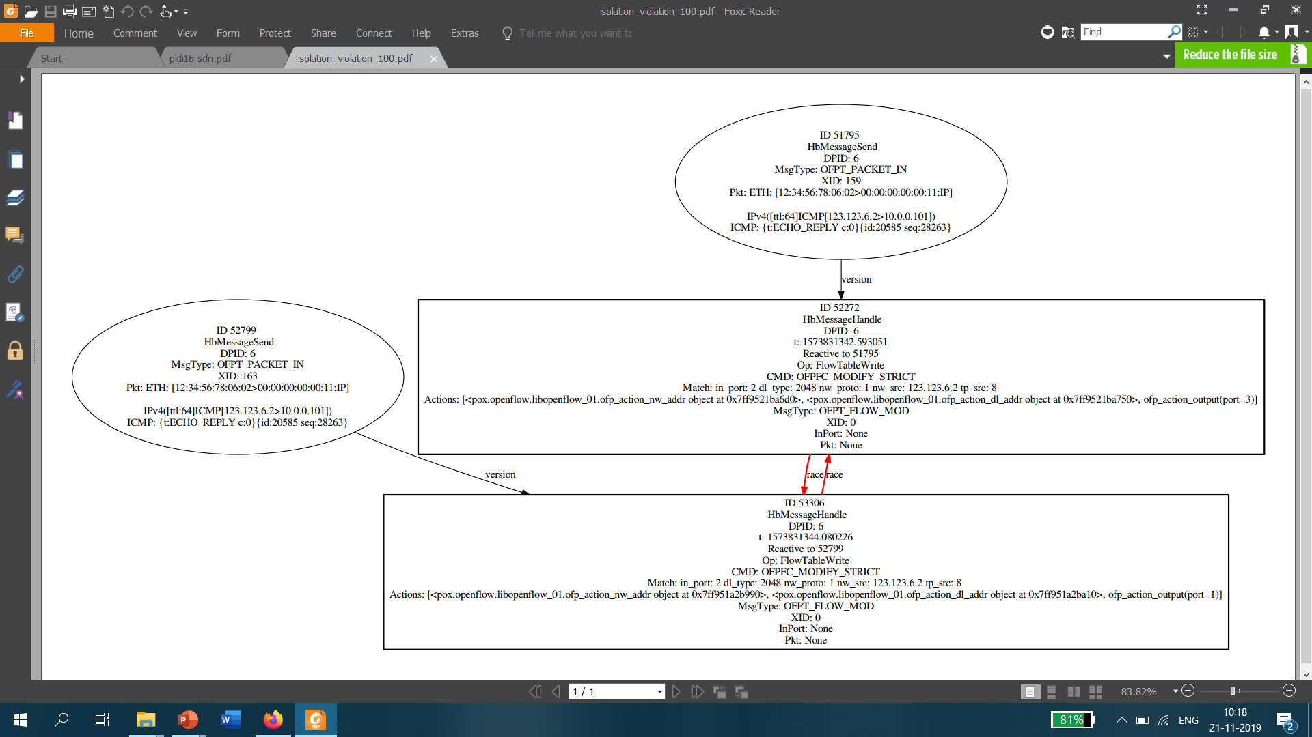
Appendix
P9-5G
Notes:
Fix the references (updated)

