Slide 1


Cyclistic Bike Share
Case Study
16 November 2022
Presented By : Saip ardo pratama
saipardopratama@gmail.com

Slide 2
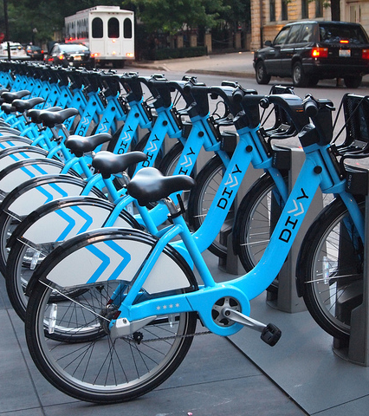
Content
Introduction
Data Insigth
Summary
Recommendation
Foto Ini oleh Penulis Tidak Diketahui dilisensikan atas namaCC BY

Slide 3

Intoduction Statement of Business Task
Understand how do annual members and casual riders use Cyclistic bikes differently
Understand Why do casual riders buy Cyclistic annual membership
The tasks will be used to design a marketing strategy to attract casual riders into annual members

Slide 4
Insigth From 12 Mont Oktober 2021 – September 2022
Lets Dive In

Slide 5
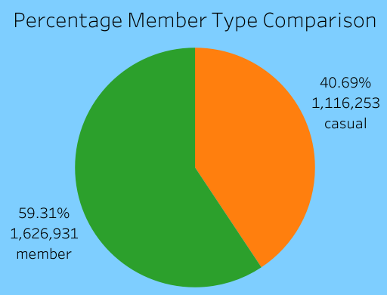
Total Riders By User Group
# Insight 1
Number of riders by membership, annual member is 19 % more than casual riders.

Slide 6
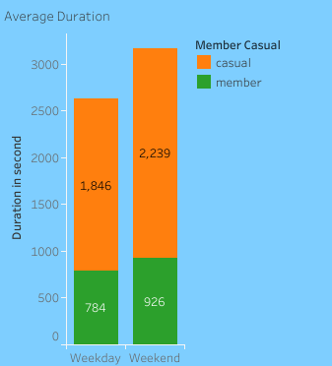
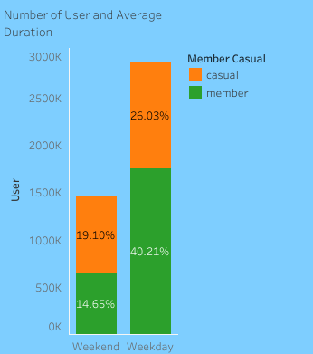
Riders in Weekday vs Weekend
# Insight 2
Anggota tahunan menggunakan sepeda kebanyakan pada hari kerja
Pengendara biasa menggunakan sepeda pada hari libur lebih banyak dibandingkan anggota tahunan
Rata-rata durasi pemakaian pengendara biasa lebih tinggi dibandingkan anggota tahunan

Slide 7
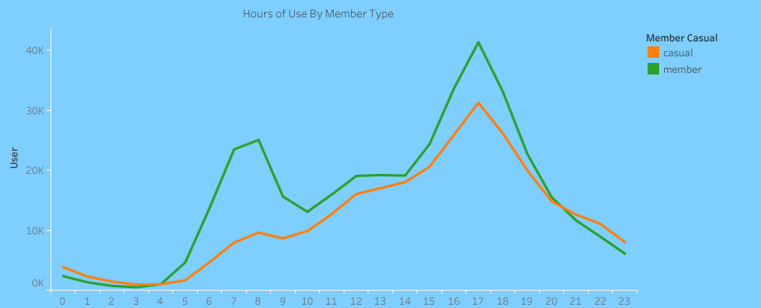
Hours Total Riders in Weekday
# Insight 3
Annual member bicycle use peaks at 8 and 17
The use of bicycles for ordinary riders reaches the peak and 17

Slide 8
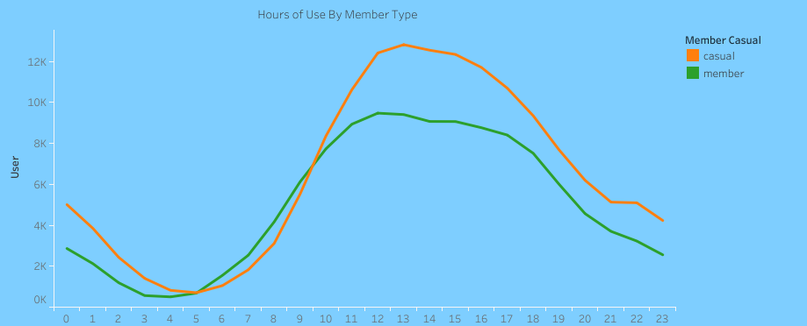
Hours Total Riders in Weekend
# Insight 4
Bike use peaks at 11 – 16 or in noon to late afternoon

Slide 9
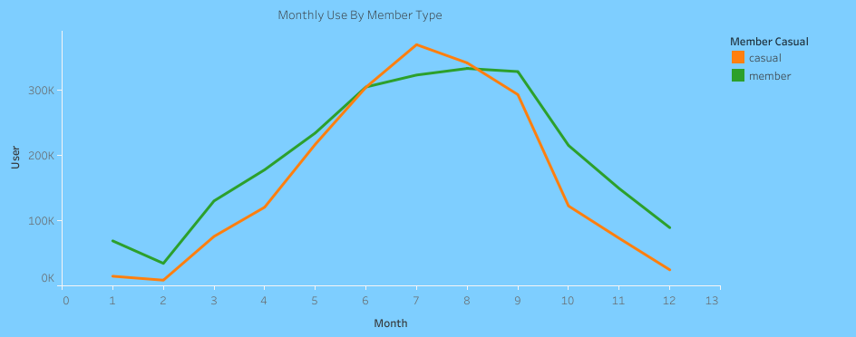
Monthly Total Riders
# Insight 5
The most bicycle use is in the 7th month, or more precisely, between the 6th – 10th months (Summer and autumn)

Slide 10
Summarize Insights

Slide 11
Summary
Overall, Casual riders take less number of rides but for longer duration
Casual riders take 19% less rides than annual members but 2.3 times longer duration.
Annual riders mostly use bikes for work trips in weekday
Annual ridest have consistent activity throughout year in weekday suggests they use bike for work trips. But casual riders use bike on weekends and holiday suggest for recreational purpose
Peak use on weekdays is at 8 and 17, and use on weekend is at 13
Riders use bikes the most in Juni to October
Peak use is in July, and most in summer and autumn seasons

Slide 12
Recomendation
Now that we know how Casual riders and Annual member use bike differently, We can :
Design of vacation travel packages with bicycles that focus on stations close to recreational locations with strategic routes
Design seasonal package, which gives riders the option to subscribe in summer and autumn
Design an annual subscription package that contains discounts for riders who have reached a certain usage duration
Design promo package during working hours on weekdays

Slide 13

Thank You!
Saip Ardo Pratama
saipardopratama@gmail.com
https://github.com/saipardopratama/Sepeda_Cyclic

