Slide 1
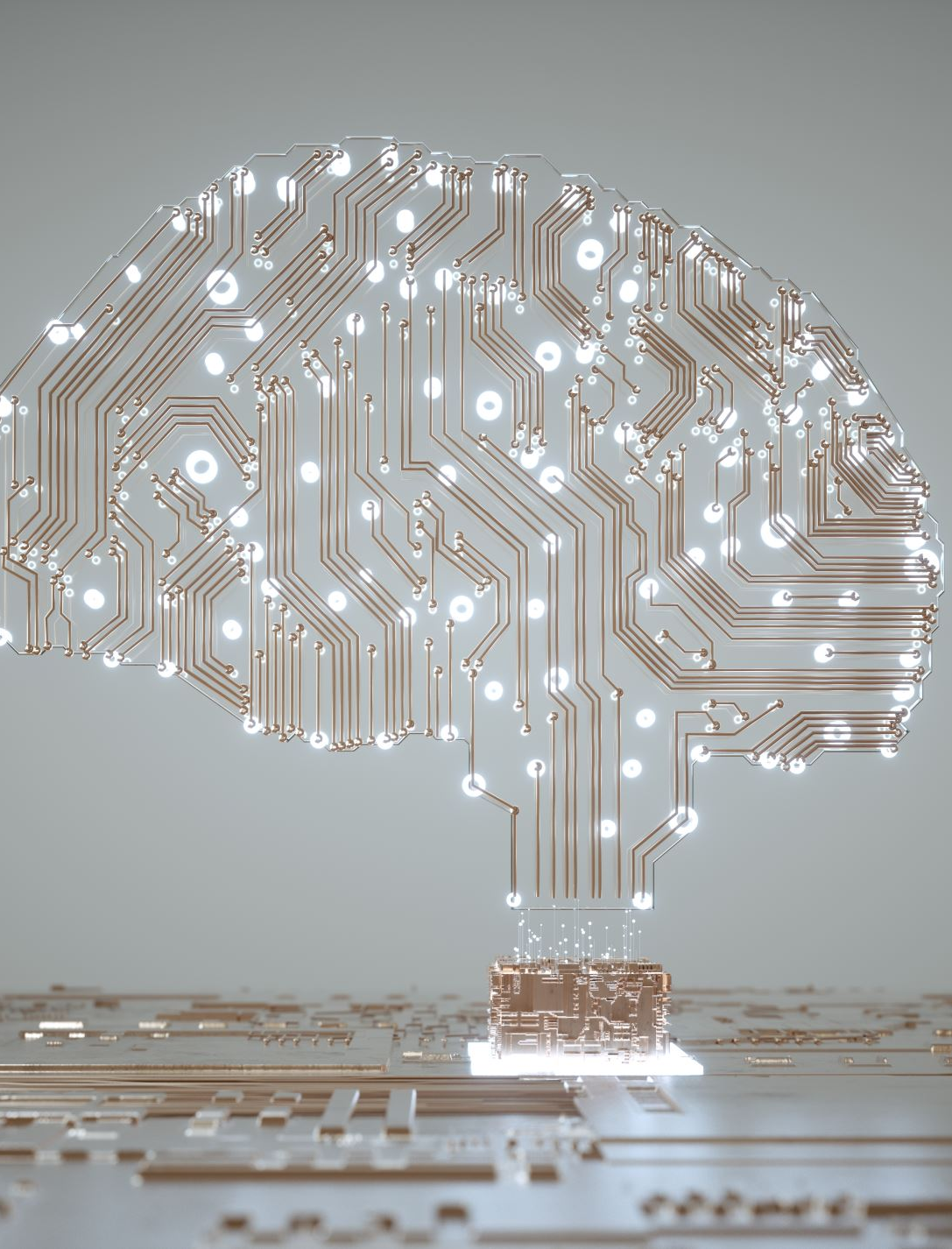
Snake Game using AI
Sai Charan Jana
Sai Pavan Gopularam
Sravani Burra

Slide 2
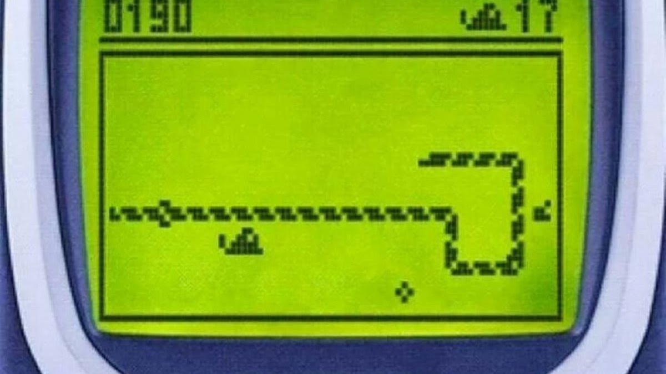
Introduction:
Snake game is a classic which was introduced in late 1970’s.
The game revolves around a snake and fruit.
The size of snake increases with eating fruits.
But the game ends when snakes bites walls or snake bites itself.

Slide 3
Pygame Library :
Pygame is a set of modules or a library in python for writing video games.
Pygame is highly portable and runs on nearly every platform and operating system.
Pygame allows a user to create fully featured games and multimedia programs in the python language.

Slide 4
Approach :
Initially to develop an autonomous python snake game, the classic python game needs to be developed.
helpers.snakeGame is an inbuilt module in pygame to create a manual pysnake game.

Slide 5
Approach :
Autonomous Snake game :
Now that we created a classic game, next we need to make it autonomous.
Three measures acts primary to make it autonomous:
Distance between snake head and fruit
Available space in the grid.
Length of the snake.

Slide 6
Approach :
helpers. ﻿snakeGameGATest :
snakeGameGATest is an Genetic algorithm imported from helpers module.
A genetic algorithm is an adaptive heuristic search algorithm inspired by "Darwin's theory of evolution in Nature."
It optimizes a machine learning or a neural network algorithm.
Here in this case it optimizes and decides the direction to move the snake head in possible directions.

Slide 7
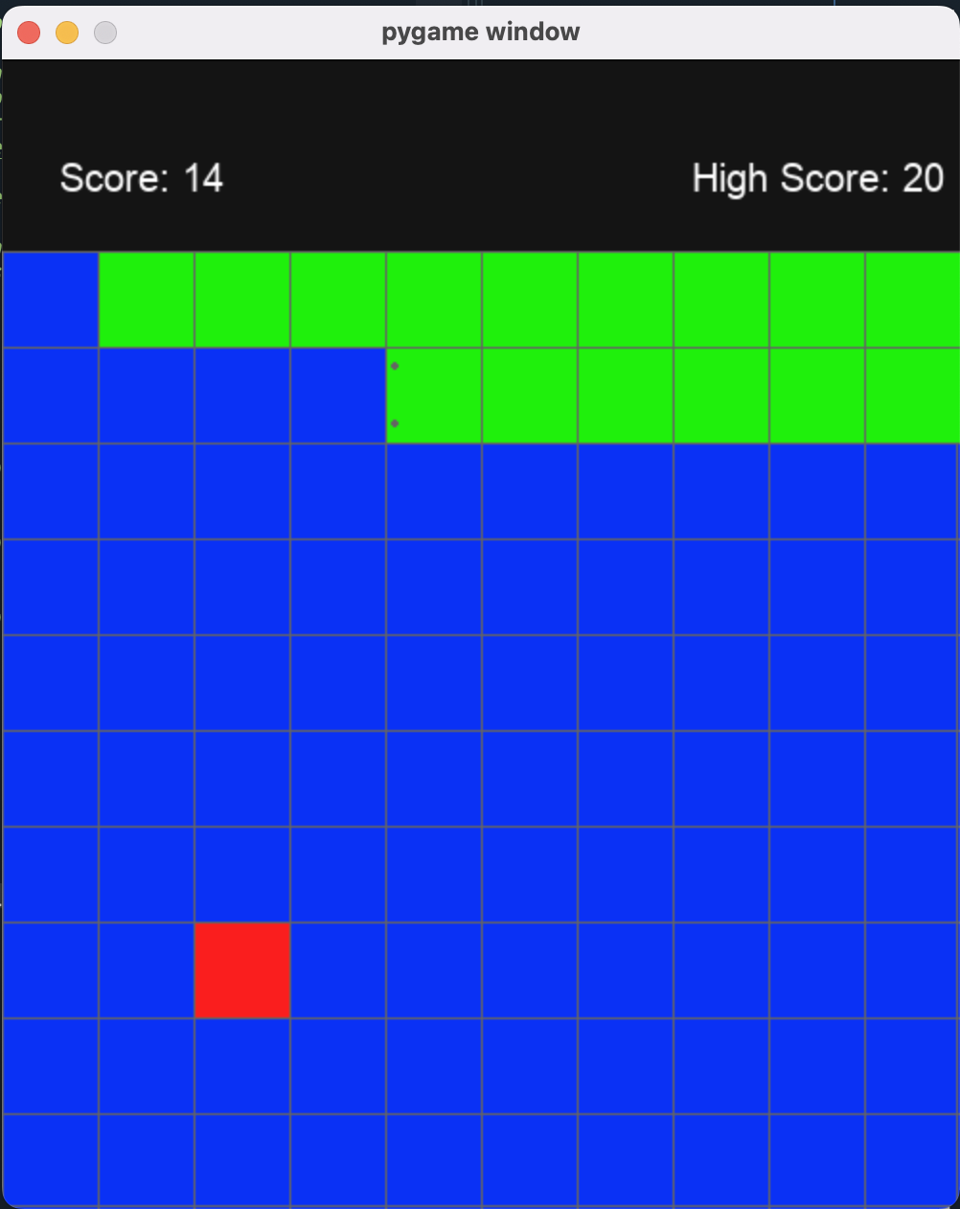
Sample Game:

Slide 8
Thank You

