Slide 1

Python Fundamentals
- Ansu M Varghese

Slide 2
Contents
Introduction
Control –flow statements
Collections
Functions
Classes
Exception Handling
File Handling

Slide 3
Introduction
Python is strongly typed (i.e. types are enforced),
dynamically, implicitly typed (i.e. you don’t have to declare variables),
case sensitive (i.e. var and VAR are two different variables)
object-oriented (i.e. everything is an object).
Python command line is a Read, Evaluate, Print, Loop environment.
Read input, Evaluate it, Print result and Loop back to the beginning. >>>REPL

Slide 4
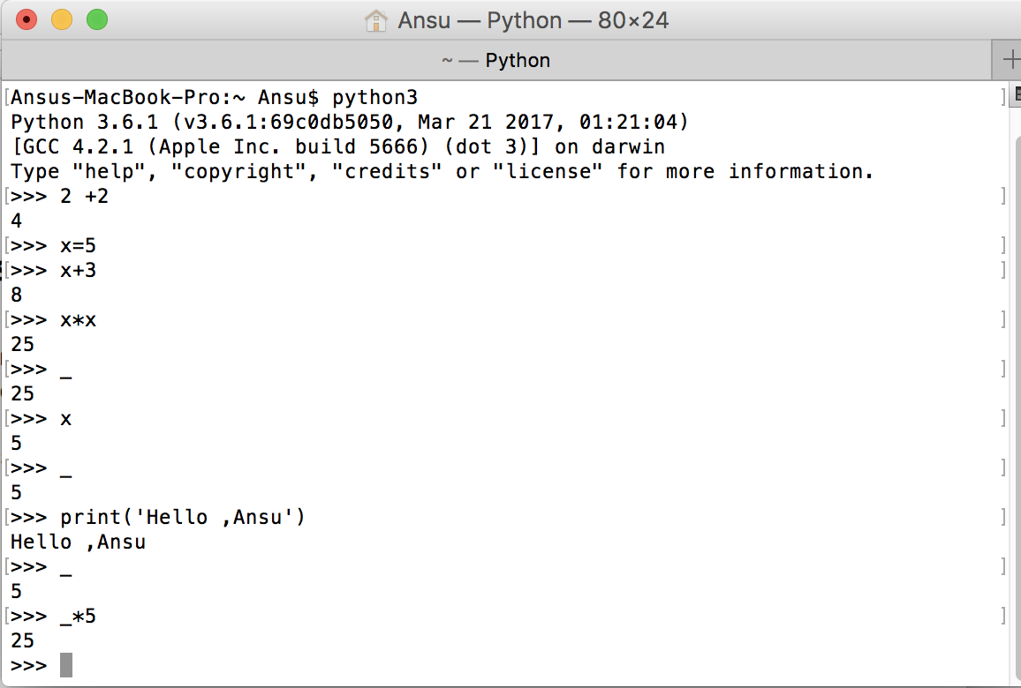
Arithmetic functions
Print method requires () as of Python 3
In Python 2 we could use print ‘hello’ or print(‘hello’).

Slide 5
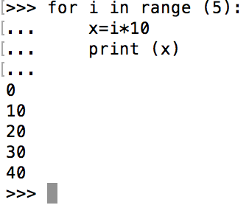
Whitespaces
Indentation is very important in Python.
Constructs like ‘if’ & ‘for’ starts with ‘:’
Python then expects the body of the construct
and hence instead of ‘>>>’ prompts with … (three dots)
The body of the construct must follow after 4 whitespaces or a tab.
There are no {} (curly brackets) for any construct.

Slide 6
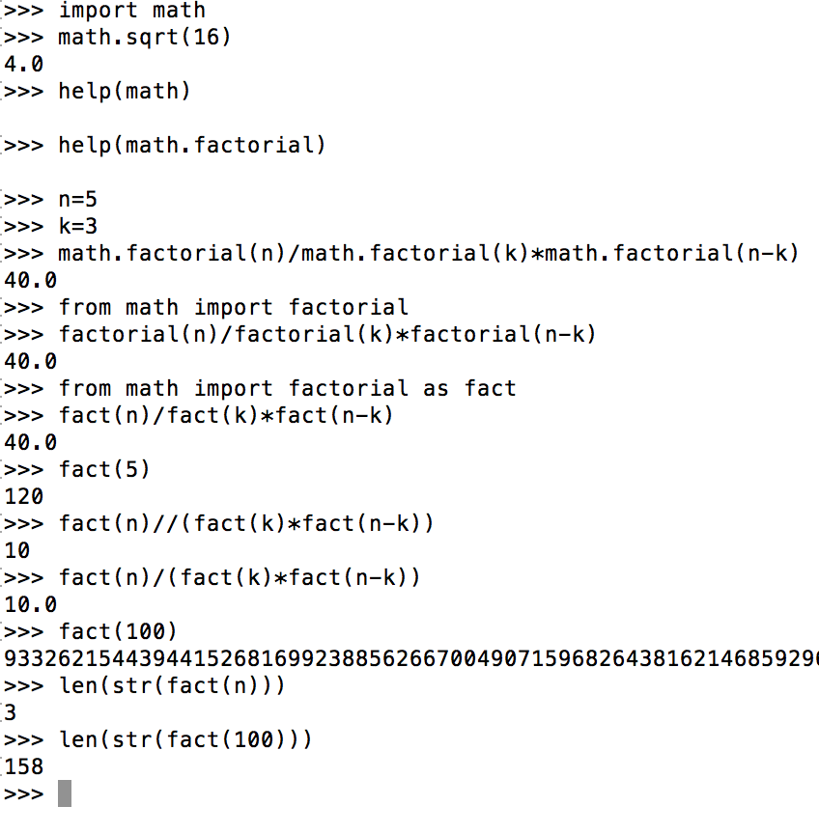
Importing from the Python Standard Library
We can access the standard library modules using the import keyword.
Eg: Import math
Importing can be done in 3 ways:
Import module
From module import function
From module import function as alias

Slide 7
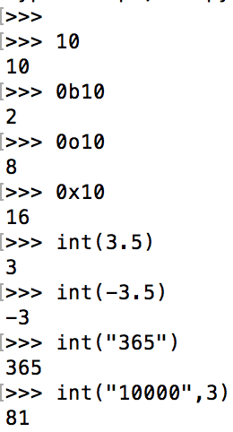
Scalar types
Integer
Are signed and have unlimited precision.
Integer literals are usually specified in decimals in Python.
Can also be specified in binary with a 0b prefix, octal with a 0o prefix and hexadecimal with a 0x prefix.
Create an integer by a call to int constructor,
Convert from other numeric types like float to integer, string to integer.
Can convert a String in binary of a certain base in integer to decimal.

Slide 8
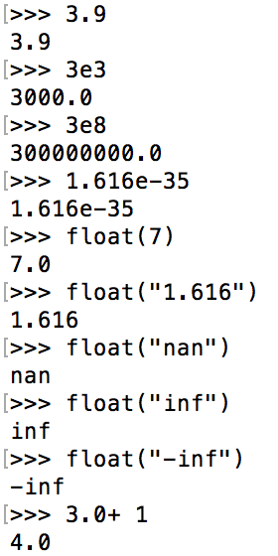
Scalar types
Float
Takes floating point values, any value, for example 10 ^ 8 can be expressed as e8.
Speed of light: 3 x (10 ^ 8) can be expressed as 3e8.
Planck’s constant 1.616 x (10 ^ -35) can be expressed as 1.616e-35.
Can convert any datatype to float by using the float constructor.
Can express ‘not a number’ (nan) as a string.
Can also express positive and negative infinity.
Any float value added to an int value is forwarded as a float value.

Slide 9
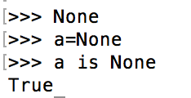
Scalar types
None
Python has a special null value called None.
Used to represent the absence of a value.
It has no effect when typed into REPL.
None can be assigned to a variable and tested using the is operator.

Slide 10
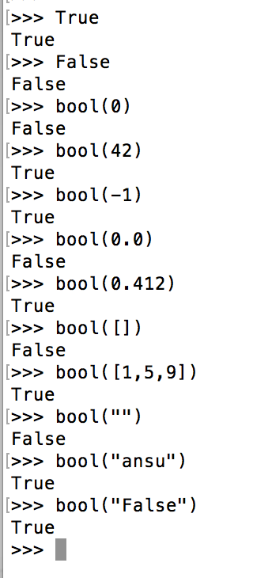
Scalar types
Bool
Represents control state, either True or False.
True on REPL gives True and False on REPL gives False.
Anything but 0 gives True, this applies to float values too.
Empty strings give False.
Empty collection objects give False.
The string “False” or “True” gives True since they are not empty strings.

Slide 11
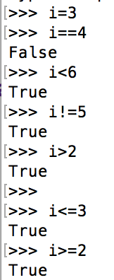
Relational Operators
Relational operators in python are ==,!=, <, >, <=, >=

Slide 12
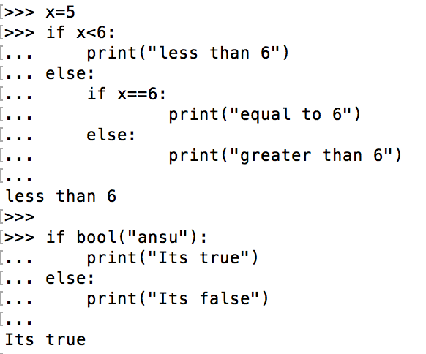
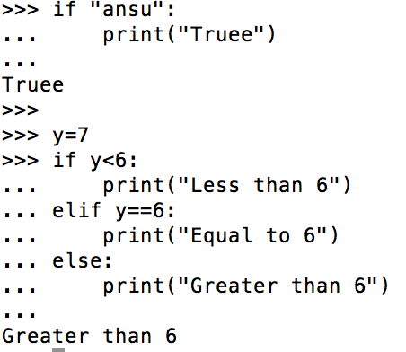
Conditional Statements
Simple IF:
If expr:
Print(“True”)
Simple IF –ELSE:
If expr:
Print(“True”)
else:
Print(“False”)

Slide 13
Conditional Statements
NESTED-IF:
If expr:
Print(“Response1”)
else:
if expr:
Print(“Response2”)
else:
Print(“Response3”)
ELIF:
NESTED-IF can be replaced by simple ELIF.
If expr:
Print(“Response1”)
elif:
Print(“Response2”)
else:
Print(“Response3”)

Slide 14
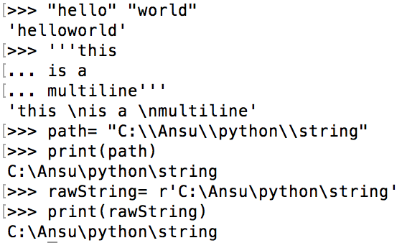
Collections - Str
They are immutable sequences of Unicode characters
A string can be enclosed either by “ or ‘.
“String” or ‘String’ is allowed , whereas “String’ is not allowed.
Concatenation: “hello” “world” or “hello”+ “world” is helloworld
Multiline String (can use single quotes or double quotes)
“”” this
… is a
… multiline””” will be stored as “this\nis a \nmultiline”.
Can include characters like \ or “ as part of a string, place \ before the character.
Raw String: To include \ within a string , it can also be written as a raw string.
Eg: path=r “C:\Ansu\python\string”

Slide 15
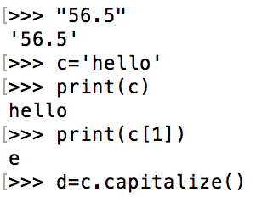
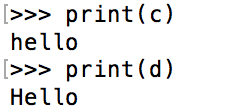
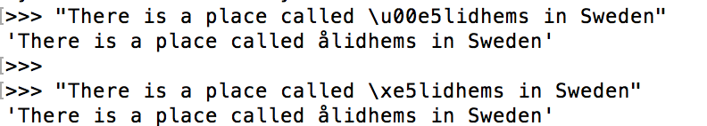
Collections - String
Strings are immutable. An existing string cannot be edited.
It is possible to use unicodes in hexadecimal, octal forms etc in a string.

Slide 16
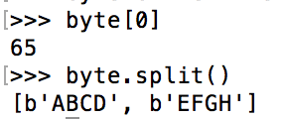
Bytes
Similar to String , but are immutable sequences of bytes.
Represented as b ‘byte’ or b “byte”.
Concepts like indexing and splitting work on bytes.
Indexing on a byte returns ascii value.
Split method returns a list of byte objects.
Strings can be encoded to bytes with an encoding type.
Similarly the bytes can be decoded back to strings using the same encoding type. (utf-8).

Slide 17
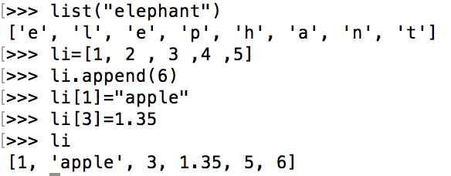
Lists
Lists are mutable sequences of objects.
It can be heterogeneous.
We can append data, remove data or replace data in a list.

Slide 18
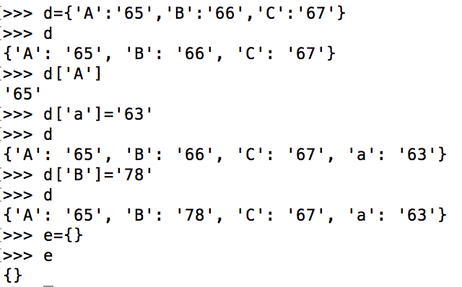
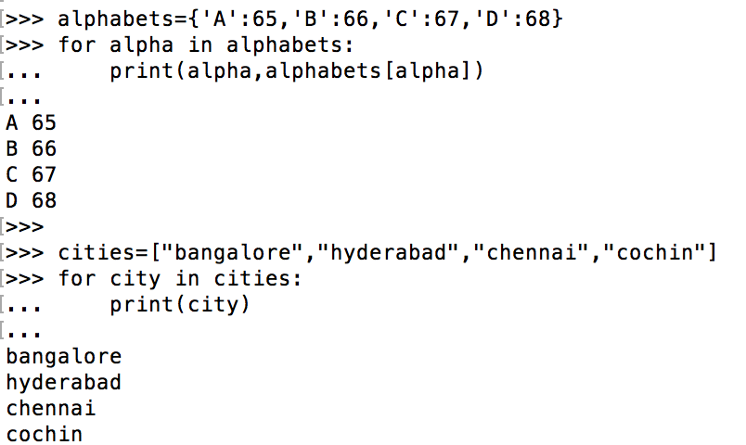
Dictionary
Mutable key value pairs.
They are called associative arrays in other languages.
Empty dictionaries can be created using empty {}.
For-Loop:
Similar to for-each loop.
Visits each item in the iterable series.
For item in iterable:
… body

Slide 19
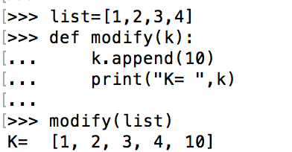
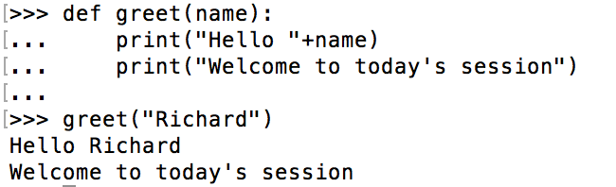

Functions
Created using the keyword “def ” followed by the name and body of the function.
Lambda functions have a single statement.

Slide 20
Classes
Classes have data and methods.
The method __init__ is called to initialize the new object when an instance is made.
Self is the empty object that python creates to set variables on it.

Slide 21
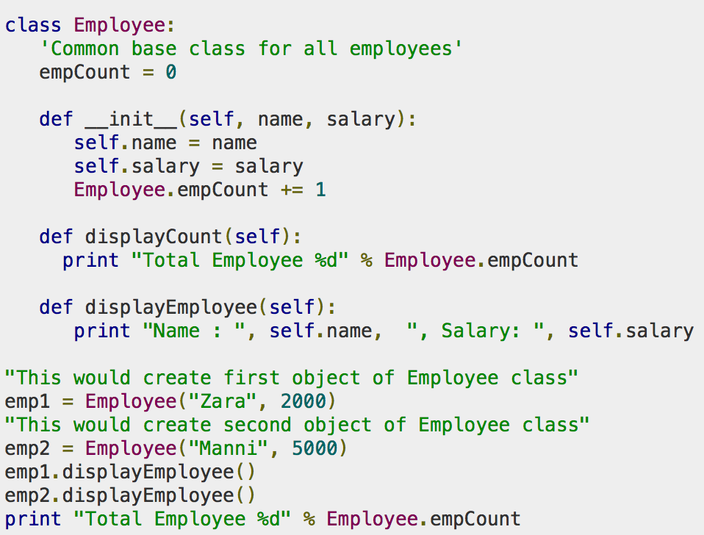


Slide 22
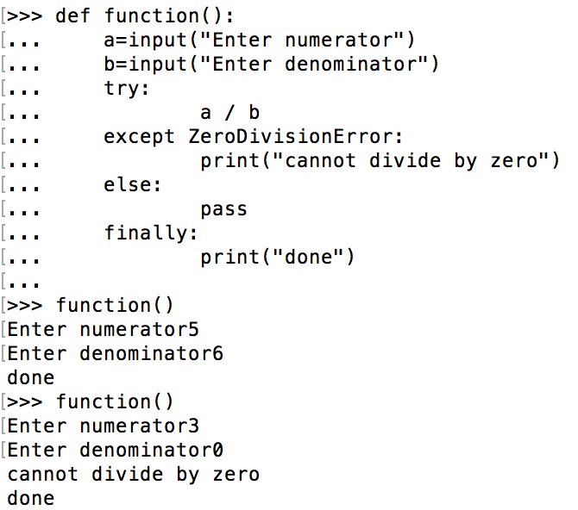
Exception handling
The keywords include try, except and finally.
The code that can go wrong is placed under try.
The exception can be caught using except.
The code in the finally block will be executed regardless of whether an exception occurs or not.
Pass keyword is used to show that nothing happens. It indicates a null block.

Slide 23
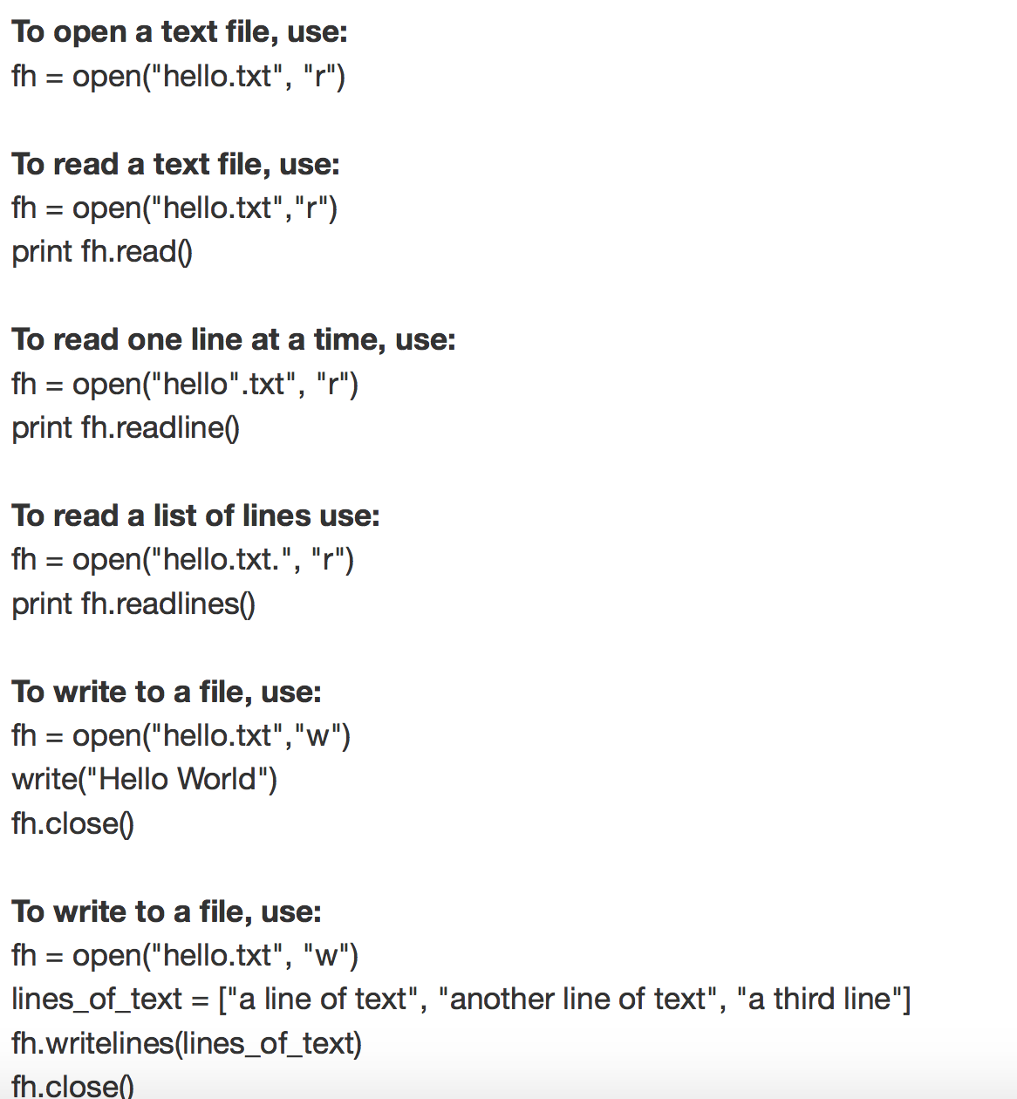
File Handling
no module has to be imported.
built in object called file can be used.
A file can be opened in read, write and append modes.
After using a file, it must be closed, to free the system resources used by the file.
Syntax to open: open(“filename”,”mode”).
Modes are r,w,a. Default is r.

Slide 24
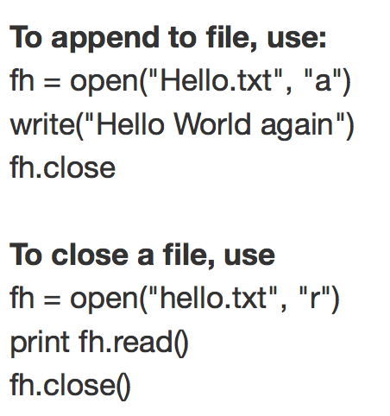

Slide 25
Few Sites and books I found that’s easy and nice
https://learnpythonthehardway.org/book/ex0.html
Pluralsight
Safari books
Python in a gist : https://www.stavros.io/tutorials/python/#

