Slide 1
KL UNIVERSITY
Design and Simulation of a Digital
Access Verification System
Using Flip-Flops & Shift Registers
BATCH 13
Presented by: Tanish (2620080073) • Vrithika (2620080089) • Sujeet (2620090014) • Prakash (2620080060) • Meghana (2620080049)
CO2 — Sequential Logic Circuits

Slide 2
Agenda
Introduction to Sequential Access Systems
CO2 Recap — Latches & Flip-Flops
1
2
SR Latch — Working & Truth Table
D Flip-Flop — Working & Truth Table
3
4
Shift-Register Concept for Code Entry
System Block Diagram
5
6
Circuit Diagram (Simulated in Logisim)
Applications, Advantages & Conclusion
7
8
Batch 13 | KL University
2

Slide 3
What is a Sequential Access Verification System?
A circuit that REMEMBERS each entered bit using flip-flops and, once the full CODE is in, grants or denies access — the same logic used in keypad locks, ID card readers and PIN checks.
1
2
3
Input
Store
Decide
User enters a binary code serially, 1 bit per clock pulse
D flip-flops shift in and remember each bit
AND gate decodes the 4-bit register → match / no match
Batch 13 | KL University
3

Slide 4
CO2 Recap — Sequential Building Blocks
SR
JK
T
D
SHIFT REG
Qn+1 = S + R'·Q
Qn+1 = J·Q' + K'·Q
Qn+1 = T ⊕ Q
Qn+1 = D
Qi ← Qi-1
Set or reset a bit (S = R = 1 invalid)
Like SR, but J = K = 1 toggles output
Toggles on each clock pulse when T = 1
Output copies D on the clock edge
Bits move one place on each clock pulse
This project focuses on the D flip-flop and shift register — the blocks that store the entered code bit by bit.
Batch 13 | KL University
4

Slide 5
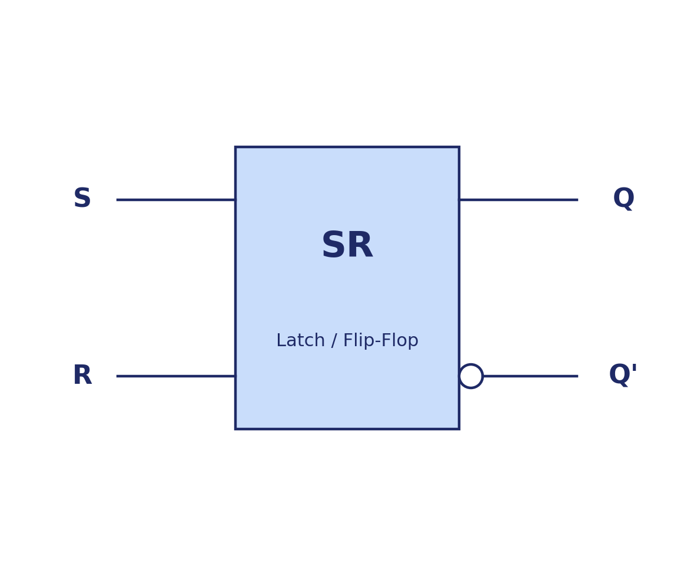
SR Latch / Flip-Flop
S | R | Qn+1
0 | 0 | Q
0 | 1 | 0
1 | 0 | 1
1 | 1 | X
Boolean Expression: Qn+1 = S + R'·Q
In access verification, the SR latch is a 1-bit memory: S = 1 sets the ‘code accepted’ flag, R = 1 clears it, and S = R = 1 is an invalid (forbidden) input.
Batch 13 | KL University
5

Slide 6
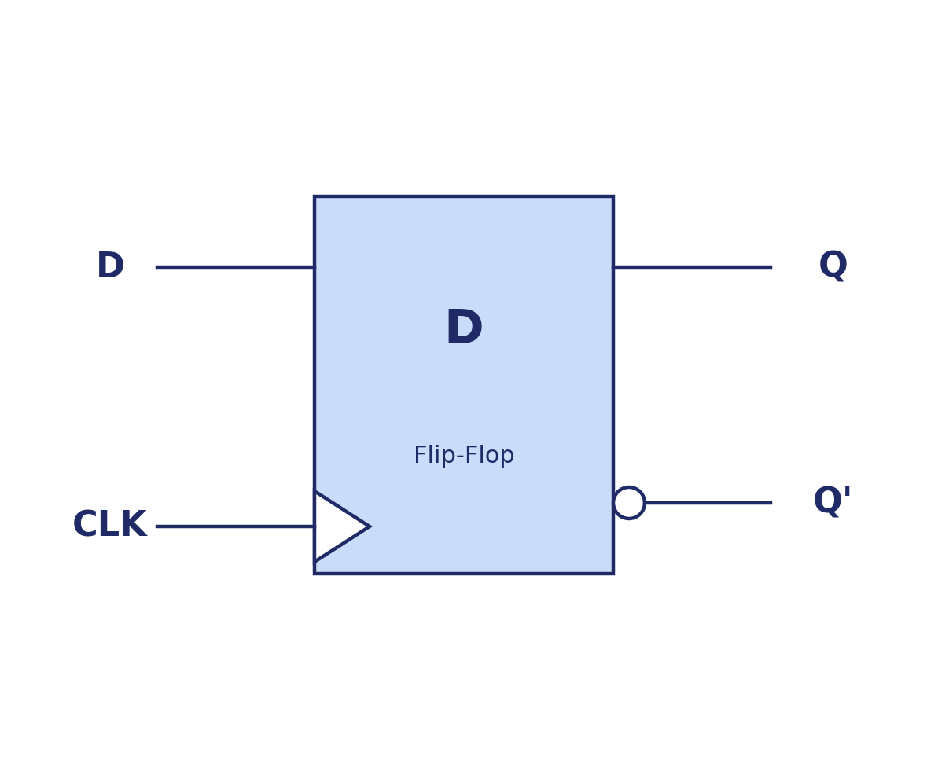
D Flip-Flop
CLK | D | Qn+1
↑ | 0 | 0
↑ | 1 | 1
0 | X | Q
1 | X | Q
Boolean Expression: Qn+1 = D
The D flip-flop copies D to Q on every rising clock edge. Chained together, D flip-flops form the shift register that captures the entered code bit by bit.
Batch 13 | KL University
6

Slide 7
Shift-Register Concept for Code Entry
Each bit of the entered code is shifted into a chain of D flip-flops on every clock pulse; after 4 pulses the register holds the full code.
Entered Code (Din)
1 0 1 1
Register (Q3–Q0):
1 0 1 1
4 clock pulses →
Stored Code
1 0 1 1
AND-decode the register contents → if the result = 1, the register holds the stored code → ACCESS GRANTED.
If even ONE bit differs, the AND output = 0 → ACCESS DENIED.
Batch 13 | KL University
7

Slide 8
System Block Diagram
Keypad / Switches
(Serial Data In)
Clock Generator
(Timing Pulses)
Shift Register
(4 D flip-flops)
AND Decoder
(final decision)
LED / Buzzer
Output
Serial data and clock pulses drive the flip-flop shift register; the AND decoder’s decision drives a visible/audible output.
Batch 13 | KL University
8

Slide 9
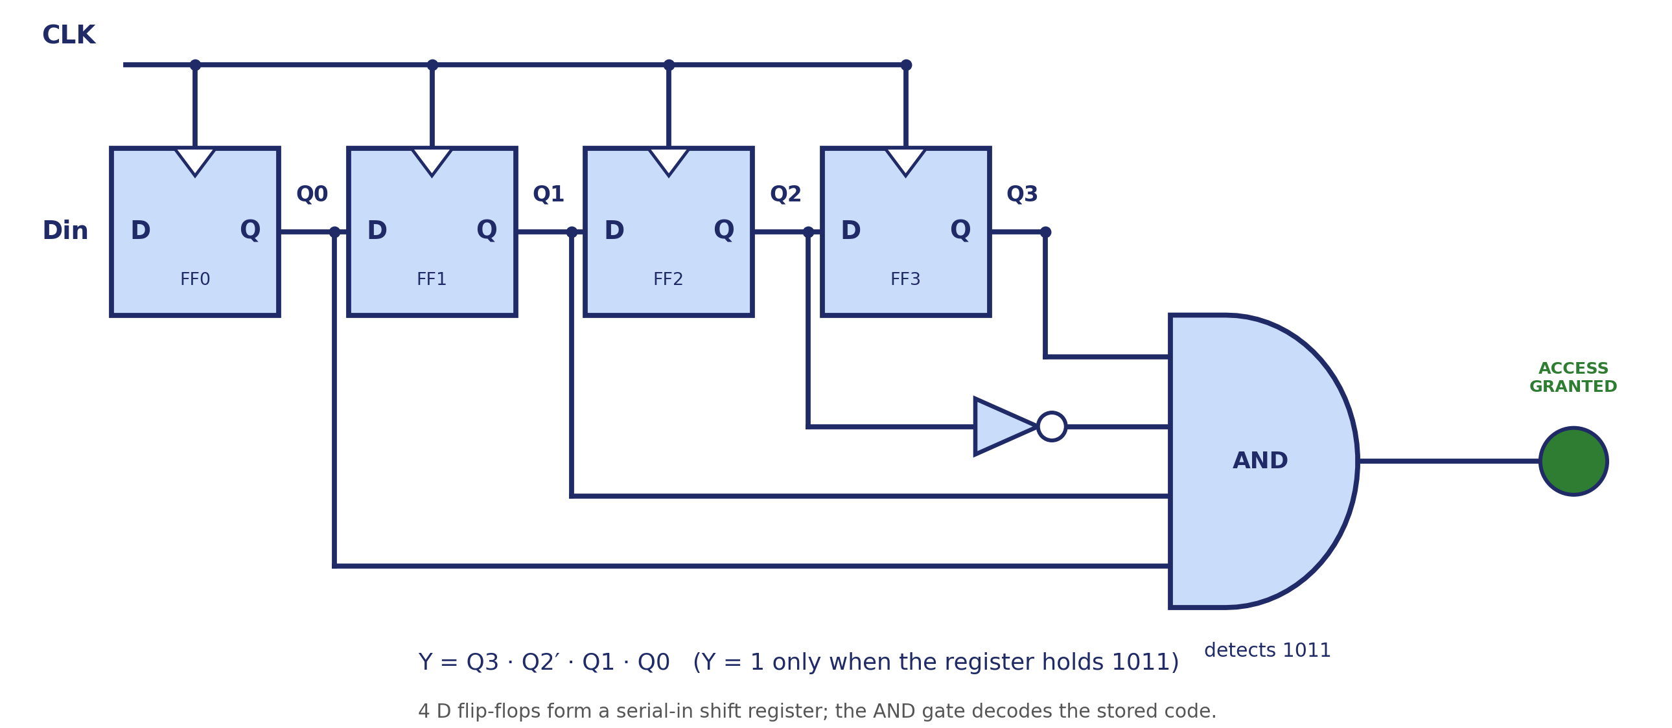
Circuit Diagram — Simulated in Logisim
Batch 13 | KL University
9

Slide 10
Worked Example — 4-clock Code Entry
Case 1: Correct Code (1011) Entered
Case 2: Wrong Code (1111) Entered
Clock | Din | Q3 Q2 Q1 Q0 | AND Output
1 | 1 | 0 0 0 1 | 0
2 | 0 | 0 0 1 0 | 0
3 | 1 | 0 1 0 1 | 0
4 | 1 | 1 0 1 1 | 1
Clock | Din | Q3 Q2 Q1 Q0 | AND Output
1 | 1 | 0 0 0 1 | 0
2 | 1 | 0 0 1 1 | 0
3 | 1 | 0 1 1 1 | 0
4 | 1 | 1 1 1 1 | 0
AND = 1 → ACCESS GRANTED
AND = 0 → ACCESS DENIED
Batch 13 | KL University
10

Slide 11
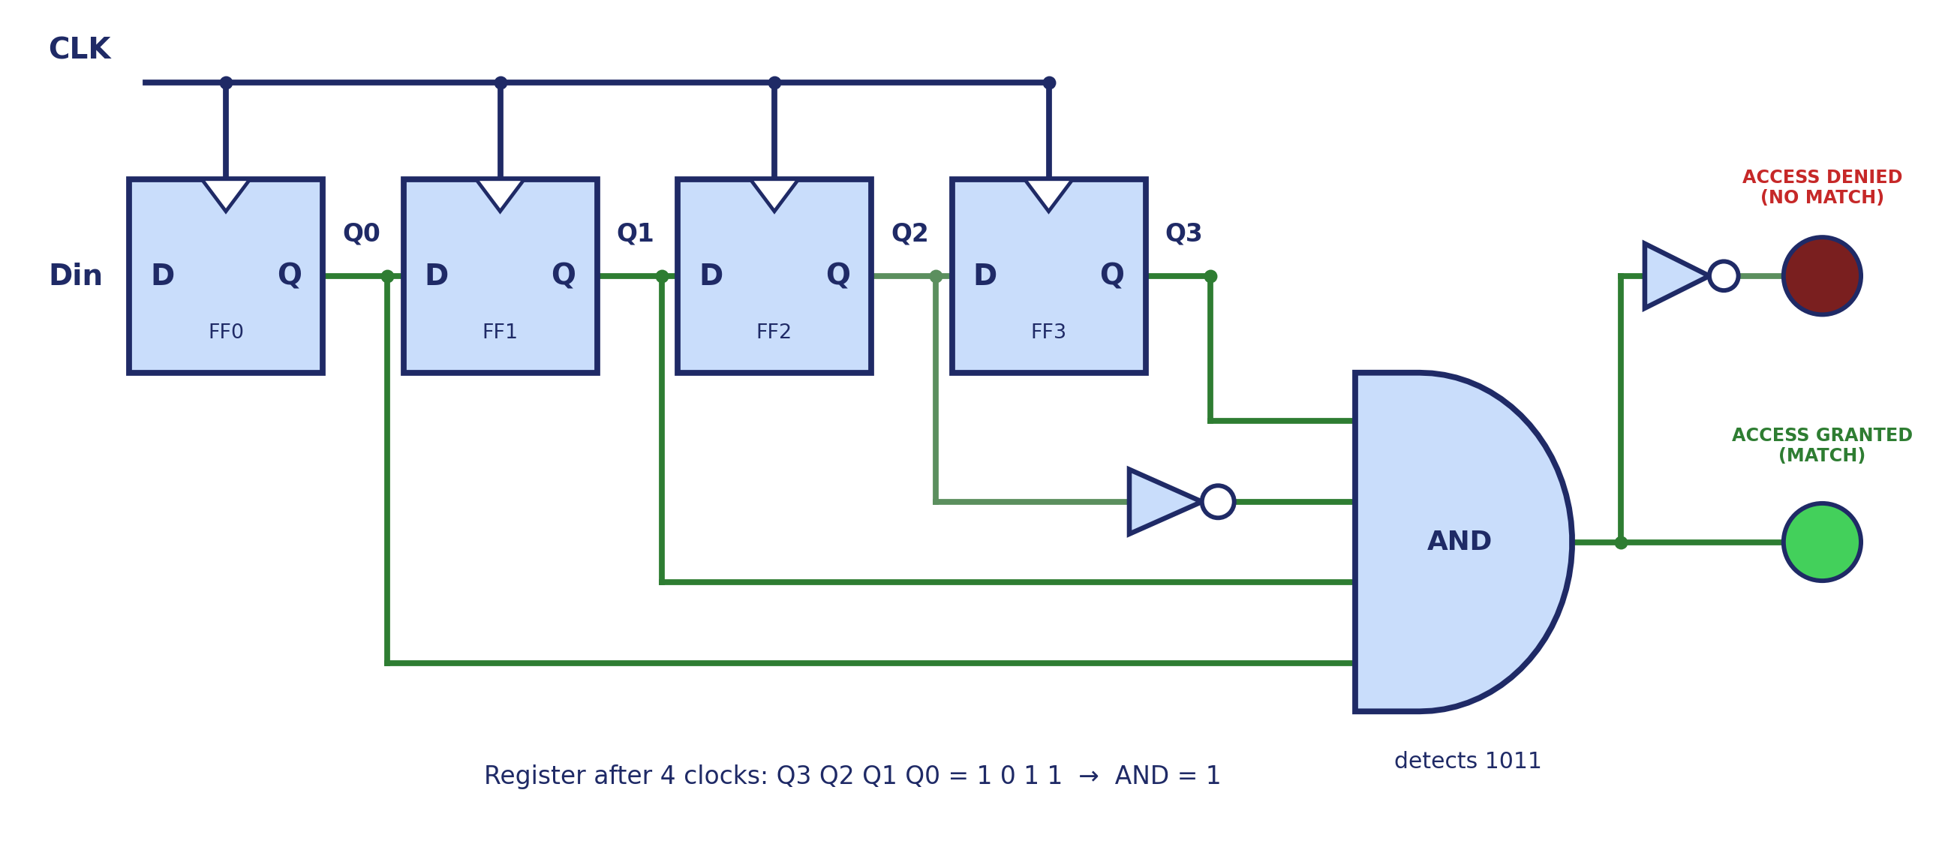

Slide 12
Applications
Sequential keypad locks & door entry systems
Registers & memory cells in microprocessors
1
2
Counters & frequency dividers
Serial data transfer (UART / SPI shift registers)
3
4
Traffic-light & vending-machine controllers (FSM)
Digital clocks, timers & event sequencers
5
6
Batch 13 | KL University
11

Slide 13
Advantages & Limitations
Advantages
Limitations
Remembers past inputs (stores state)
Clocked operation gives predictable timing
Easy to scale to more bits (8, 16...)
Reusable blocks: registers, counters, FSMs
Easy to simulate and test in Logisim
Fixed code is hardwired / not easily changed
No encryption — code is compared in plain bits
Needs a clean clock — setup / hold timing
Must be reset after every attempt
Batch 13 | KL University
12

Slide 14
Conclusion
1
Flip-flops store one bit each, giving the circuit the memory that purely combinational logic lacks.
2
Chaining D flip-flops forms a shift register that captures the entered code serially, one bit per clock pulse.
3
Decoding the register with a single AND gate gives one clean Grant / Deny signal.
4
The design was verified using truth tables and simulated successfully in Logisim.
Batch 13 | KL University
13

Slide 15
KL UNIVERSITY
Presented By — Batch 13
T
V
S
P
M
Tanish | 2620080073
Vrithika | 2620080089
Sujeat | 2620090014
Prakash | 2620080060
Meghana | 2620080049
Thank You
Sequential Access Verification System Using Flip-Flops & Shift Registers | CO2
github.com/tanishsharma73/KLH-FED-2026-SESSION13-BATCH-13

