Slide 1

Walmart sales analysis (q1 2019)
Yahya Khan and
Sai Ponnuru

Slide 2


Agenda
What have the sales trends been this quarter?
How do the 3 branches differ
What actions (eg promotions) should the company take based of the sales data?

Slide 3
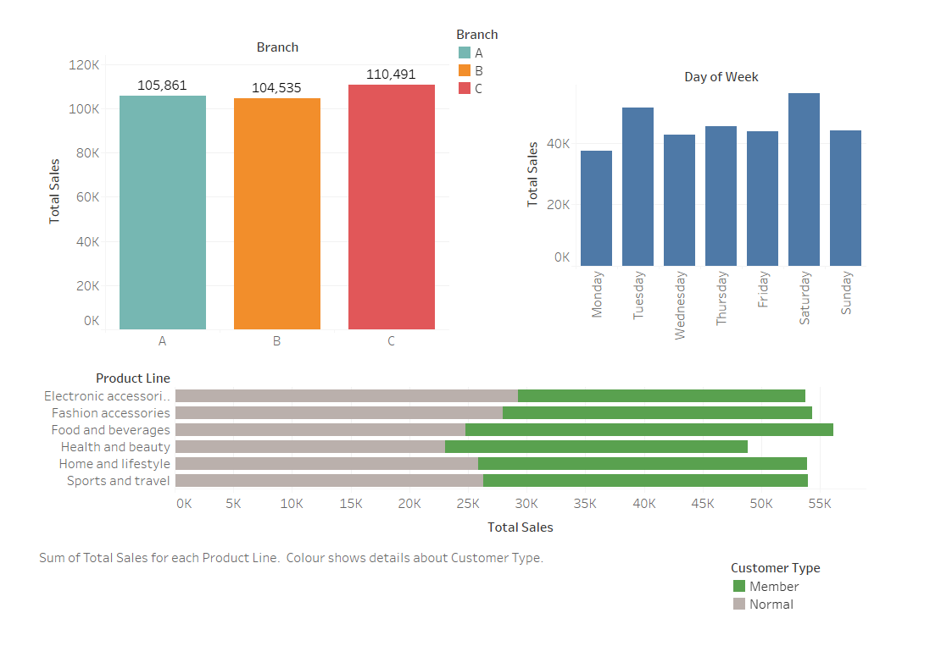
Overall DATA

Slide 4
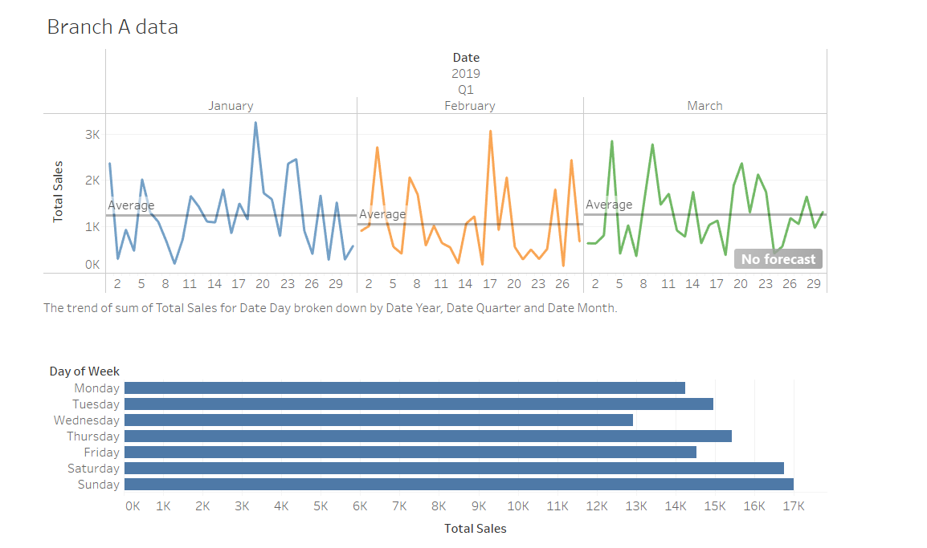
Branch A

Slide 5
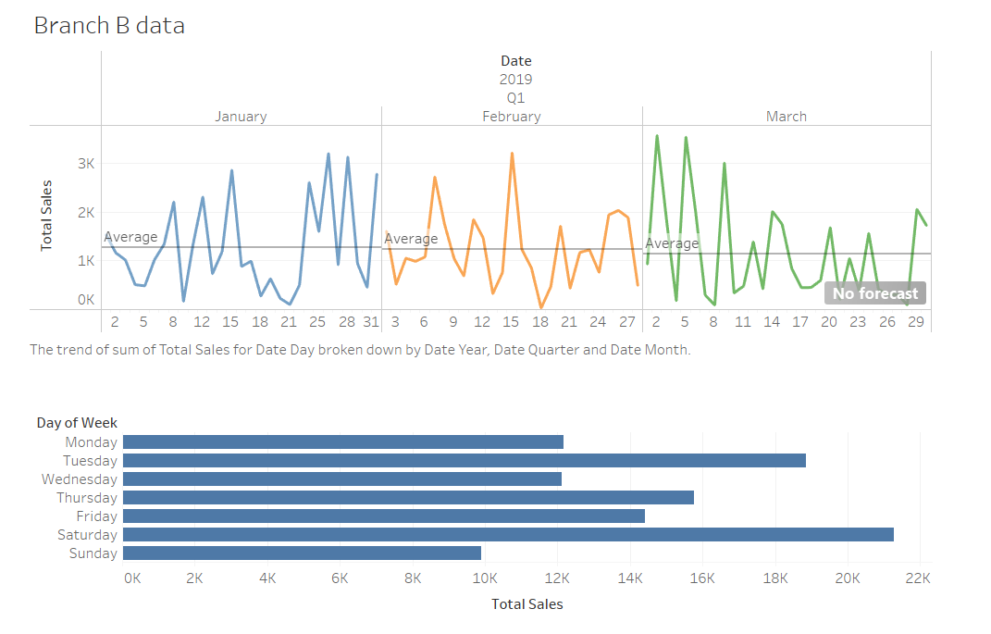
Branch B

Slide 6

Branch c

Slide 7




Summary
January is the best performing month of Q1 for all branches
February is the worth performing month of Q1 for all branches
Naypyitaw generates the greatest revenue
Branch C had the greatest sales quantity and highest average transaction amount by a fair distance
Branch A predominantly generates sales during work hours, B and C are after work hours
Weekends are best for sales
Ratings tend to be better on lower-priced products and worse on higher-priced products, although above and below-average ratings are quite evenly distributed across price.
Cash is the most commonly used method and has the highest average transaction amount but can’t generate amounts as high as credit card or Ewallet transactions.

Slide 8

suggestions
Could change product mix so that cheaper products become more critical given our findings on ratings and price.
Must remove and improve products sold in both low and high price categories. Could offer improved customer service to resolve any issues customers have with the products. Also could take surveys to see what customers have issues with and use as source to adapt business strategy.
Try to develop an effective marketing strategy for weekdays eg. offers and loyalty schemes. Particularly for branches B and C, who generate sales after work hours, so must find ways to attract these higher-income customers.
The marketing strategy for February needs to be reviewed internally.

Slide 9

Thank you
Yahya Khan:
y.khanwgsb10@gmail.com
Sai Ponnuru:
saiponnuru4@gmail.com

