Slide 1



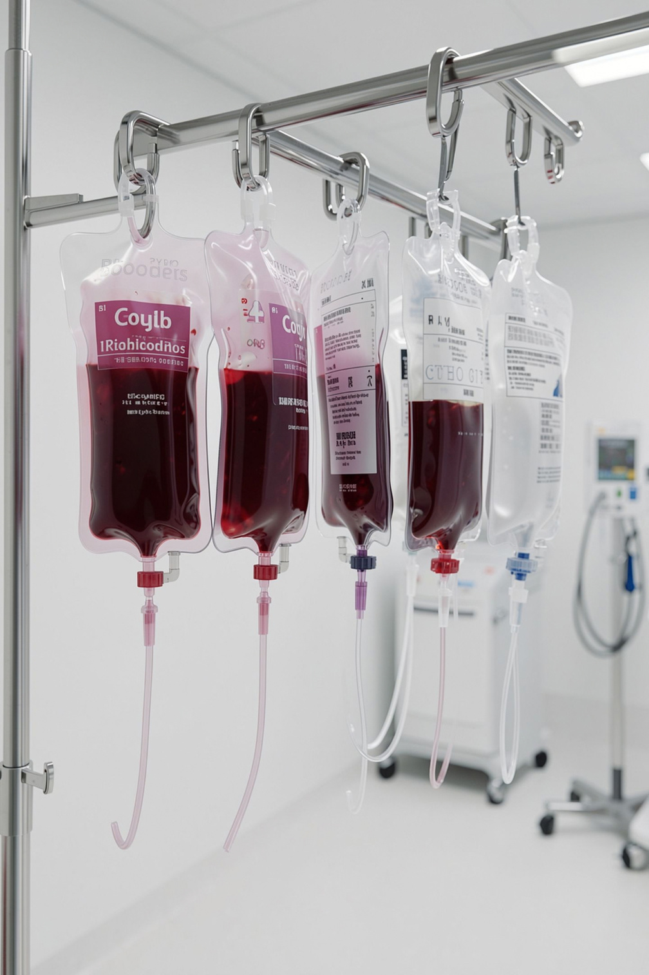
JAVA HEALTHCARE SOLUTION
Blood Bank Inventory & Donor Matcher
Streamlining blood donor records, real-time inventory tracking, and automated compatibility matching using core Java architecture.
Primary Stack
Target Domain
Java SE Platform
Healthcare Tech

Slide 2

Context & Vision
Transforming Manual Operations to Digital Precision
The Operational Challenge
Paper-based blood management creates critical delays, inventory miscounts, and risky manual compatibility errors.
The Automated Solution
Unified Java system automating donor registration, real-time stock balances, and instant patient matching algorithms.

Slide 3
PROJECT OVERVIEW
Abstract
The Blood Bank Inventory & Donor Matcher is a Java-based healthcare solution designed to digitize and simplify blood bank operations.
It maintains centralized donor records and tracks blood units by blood group.
The system allows staff to register donors, update inventory, and manage patient requests efficiently.
It applies ABO and Rh compatibility rules to identify suitable blood matches.
Automated stock deduction helps keep inventory information current after each issue.
Input validation and exception handling reduce errors during data entry and processing.
The project demonstrates object-oriented programming, collections, conditional logic, and exception handling in Java.
By integrating these functions, the system provides a practical and organized approach to blood bank management.
JAVA HEALTHCARE SOLUTION

Slide 4



Risk Assessment
Eliminating Core Vulnerabilities in Healthcare
Record Keeping
Slow Matching
Inventory Gaps
Transfusion Risk
Manual donor logs cause retrieval delays and lost health history.
Searching compatibility lists manually wastes life-saving emergency minutes.
Untracked shelf life leads to expired blood unit wastage.
Human error during ABO verification risks severe patient complications.

Slide 5

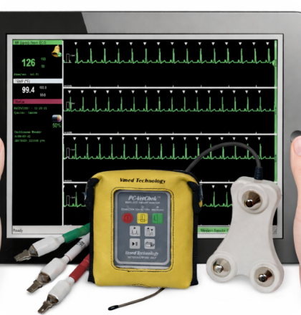
Strategic Objectives
System Design Goals
01
02
Centralized Donor Records
Live Stock Metrics
Instant query & updates across database records.
Automated unit subtractions upon issue.
03
04
Algorithmic Matching
Error Elimination
Automatic ABO/Rh compatibility filters.
Input validation and graceful error handling.

Slide 6
System Features
Six Integrated Functional Modules
Donor Management
Inventory Tracker
Patient Requests
Register, edit, and query donor blood groups.
Monitor available blood units by blood group.
Queue urgent requests with volume requirements.

Slide 7

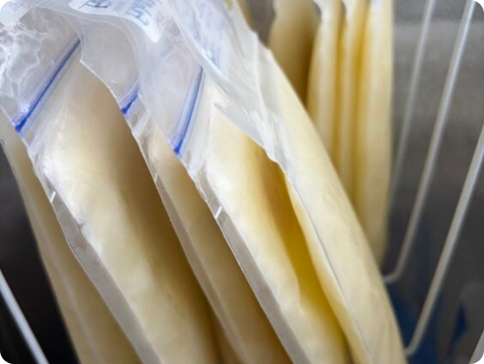
Cold-Chain Control
Precision Blood Unit Inventory Management
A+
High-Demand Stock Sync
Real-time addition of new intake bags.
O-
Universal Donor Safety
Alerts on critical universal supply thresholds.
AB
Automated Stock Deduction
Instant unit deduction on patient fulfillment.

Slide 8
Technical Stack
Built On Core Java Architecture
OOP Principles
Data Storage
Business Logic
Robustness
Classes & Objects
Collections API
Matching Algorithms
Exception Handling
Encapsulated models for Donor, Patient, and Blood Inventory objects.
Dynamic ArrayList structures for rapid lookup and record storage.
Conditional logic evaluating antigen and Rh compatibility rules.
Try-catch blocks preventing application crashes during invalid entry.

Slide 9
Execution Pipeline
End-to-End Operational Workflow
1
2
3
4
Donor Intake
Stock Increment
Patient Request
Match & Issue
Capture blood group & health eligibility.
Update inventory count for donated group.
Input requested blood type and volume.
Verify compatibility and issue blood units.

Slide 10
Measured Outcomes
Operational Performance & Value
100%
< 3 sec
0%
Digital Record Accuracy
Donor Compatibility Lookup
Manual Transfusion Matching Errors
Safeguards against critical blood shortages
Practical demo for Java OOP concepts

Slide 11

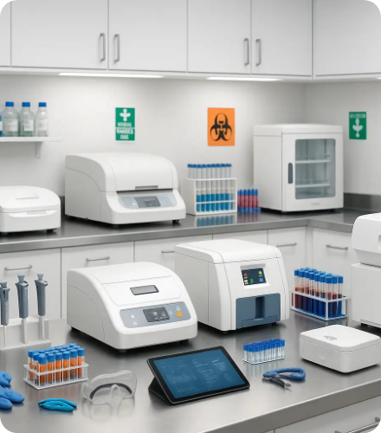
CONCLUSION
Empowering Healthcare Through Technology
Combining donor management, inventory control, and compatibility logic into one unified, accessible Java system to save lives.
"Core Java fundamentals applied directly to solve real-world healthcare challenges."

Slide 12





Image Sources
https://image.made-in-china.com/202f0j00DCeindMGLZpR/Wego-Medical-450ml-Single-Cpda-1-Blood-Collection-Transfusion-Bag-with-CE-Certificate.webp
Source: foosin.en.made-in-china.com
https://media.istockphoto.com/id/1371704715/photo/sample-test-tubes-with-multicolor-lids-a-rack-in-laboratory.jpg?s=612x612&w=0&k=20&c=rKOk5_J1HHCB1cIb3KtERgnrhOQQ-k5yv4uiDar_Nxg=
Source: www.istockphoto.com
https://www.vmedtechnology.com/wp-content/uploads/2023/09/VC_withands_FINAL-e1768603514128.png
Source: www.vmedtechnology.com
https://thedailyscan.providencehealthcare.org/wp-content/uploads/2026/05/Milk_1-564x752.jpeg
Source: thedailyscan.providencehealthcare.org
https://cdn.shopify.com/s/files/1/0691/6866/0573/files/clinical-laboratory-equipment-overview-modern-diagnostics-setup.webp?v=1764886189
Source: labequipmentdirect.com

