Slide 1
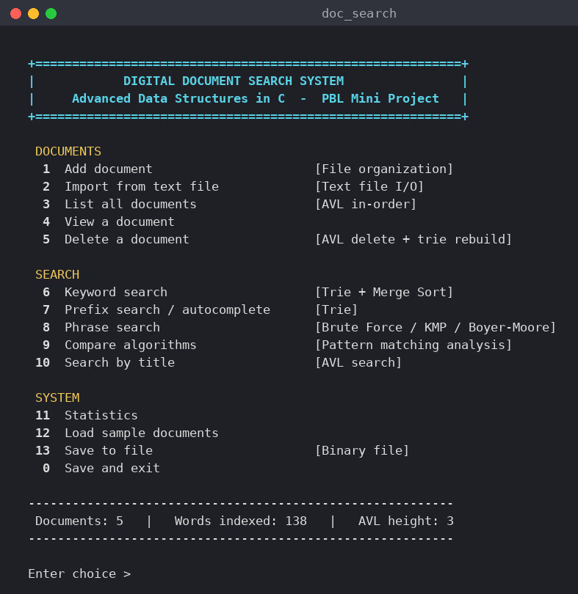
(PBL Mini Project Presentation)
Digital Document Search System
Searching documents with a trie, an AVL tree, KMP / Boyer-Moore and merge sort, written in C.
1. K. Akshaya - 26R15A6604
2. P. Shanmuka Sai Prabhath - 26R15A6605
3. R. Malavika - 26R15A6606
4. V. Chaithanya - 26R15A6607
Course Instructor: Dr. H. Venkata Ramana Rao,
Associate Professor, Dept. of CSE (AI&ML)
Geethanjali College of Engineering and Technology (UGC Autonomous)
Course Name: Advanced Data Structures
Department of CSE-AIML | A.Y. 2026-27
1
Notes:
Introduce the team and the project. The program is a menu-driven document search engine in C. It uses a standard trie, an AVL tree, three string-matching algorithms and merge sort. The screenshot on the right is the real main menu of the program.

Slide 2
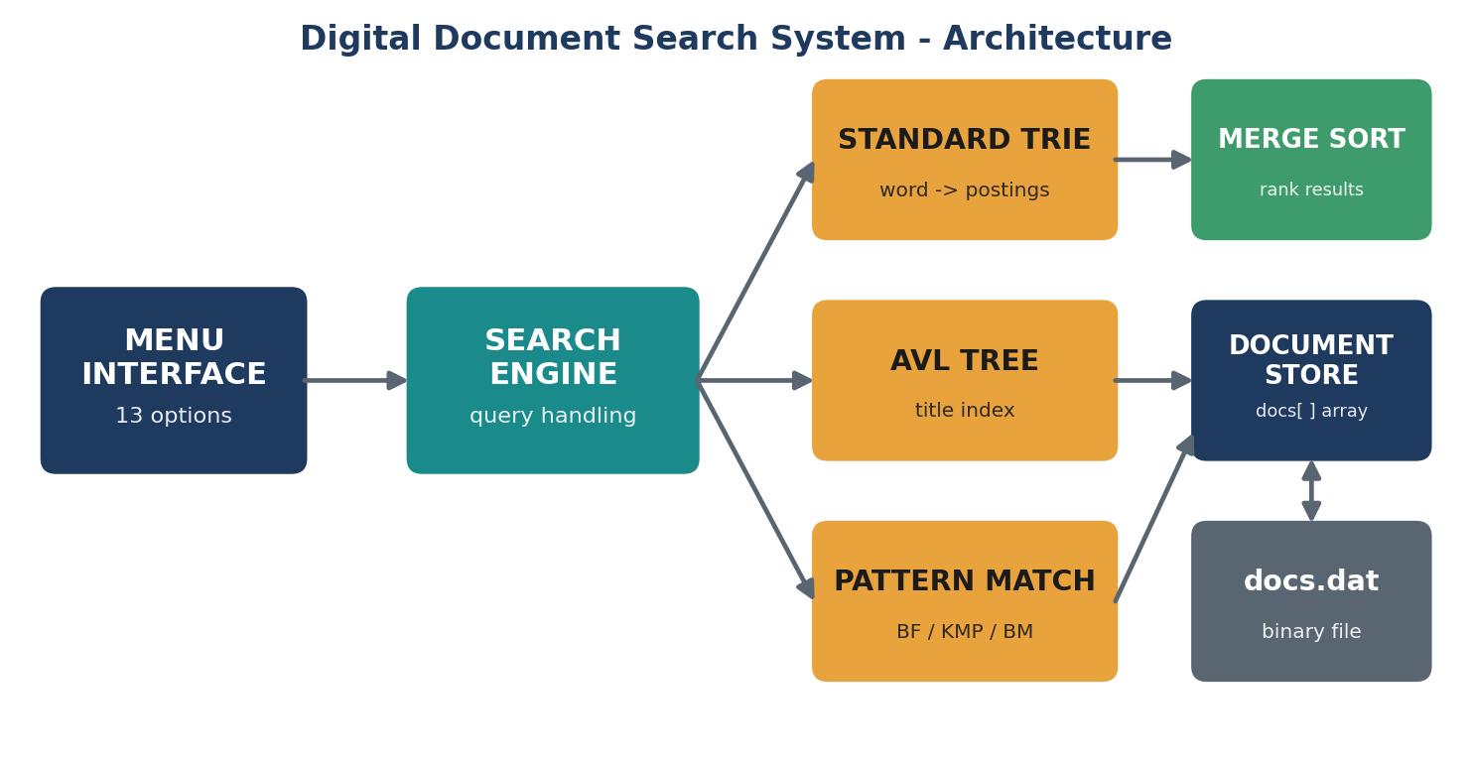
How the system fits together
Every document is indexed twice: by title (AVL) and by word (trie).
Notes:
Walk through the diagram left to right. The menu sends a query to the search engine. The engine picks the trie for words and prefixes, the AVL tree for titles, or a pattern matcher for exact phrases. Keyword results are ranked by merge sort. Documents are kept in memory and saved to docs.dat.

Slide 3
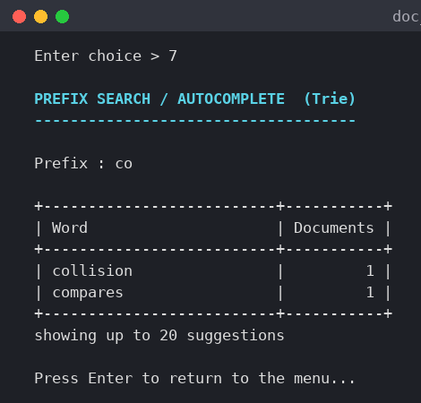
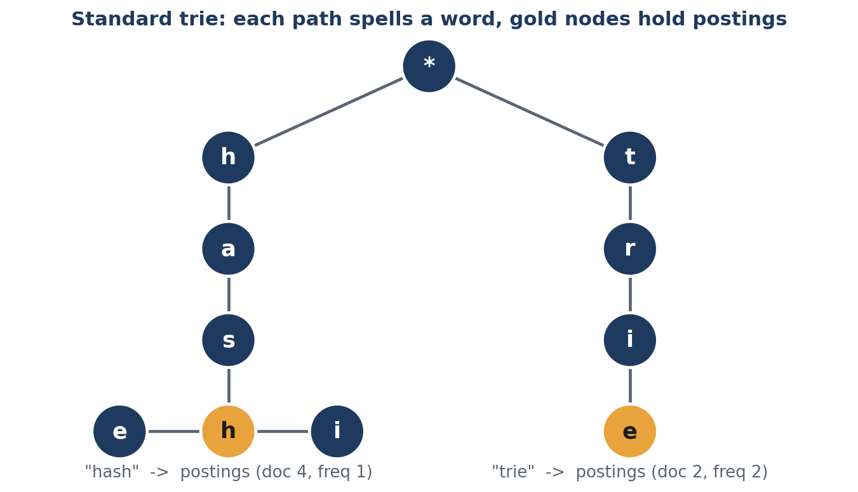
Standard trie: word to documents
Each path spells a word; gold nodes hold the list of documents. Prefix search is one walk down.
Notes:
A trie node has 36 children for a to z and 0 to 9. Inserting a word takes time proportional to its length. The gold node keeps a posting list with document ID and frequency. For prefix search we walk to the prefix node and collect the words below it. The screenshot shows the prefix co returning collision and compares.

Slide 4
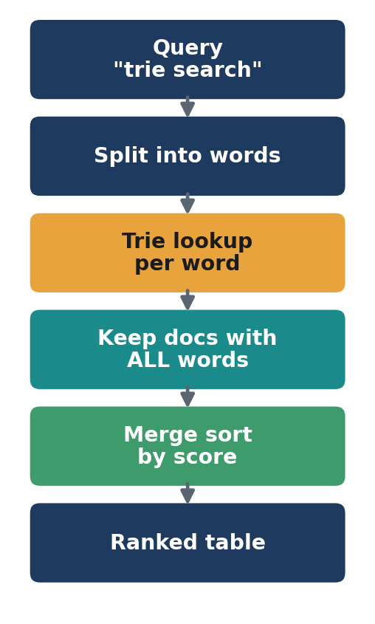
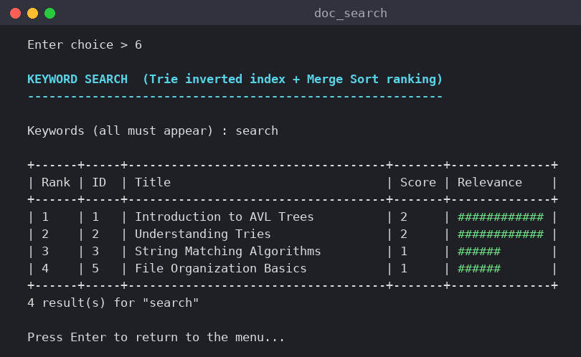
Keyword search with ranking
All words must match; the score is the total frequency; merge sort orders the table.
Notes:
The query is split into words. Each word is looked up in the trie. A document must appear in every posting list. We add up the frequencies to get a relevance score and sort with merge sort, which is stable and O(k log k). The screenshot shows the query search with four ranked results.

Slide 5
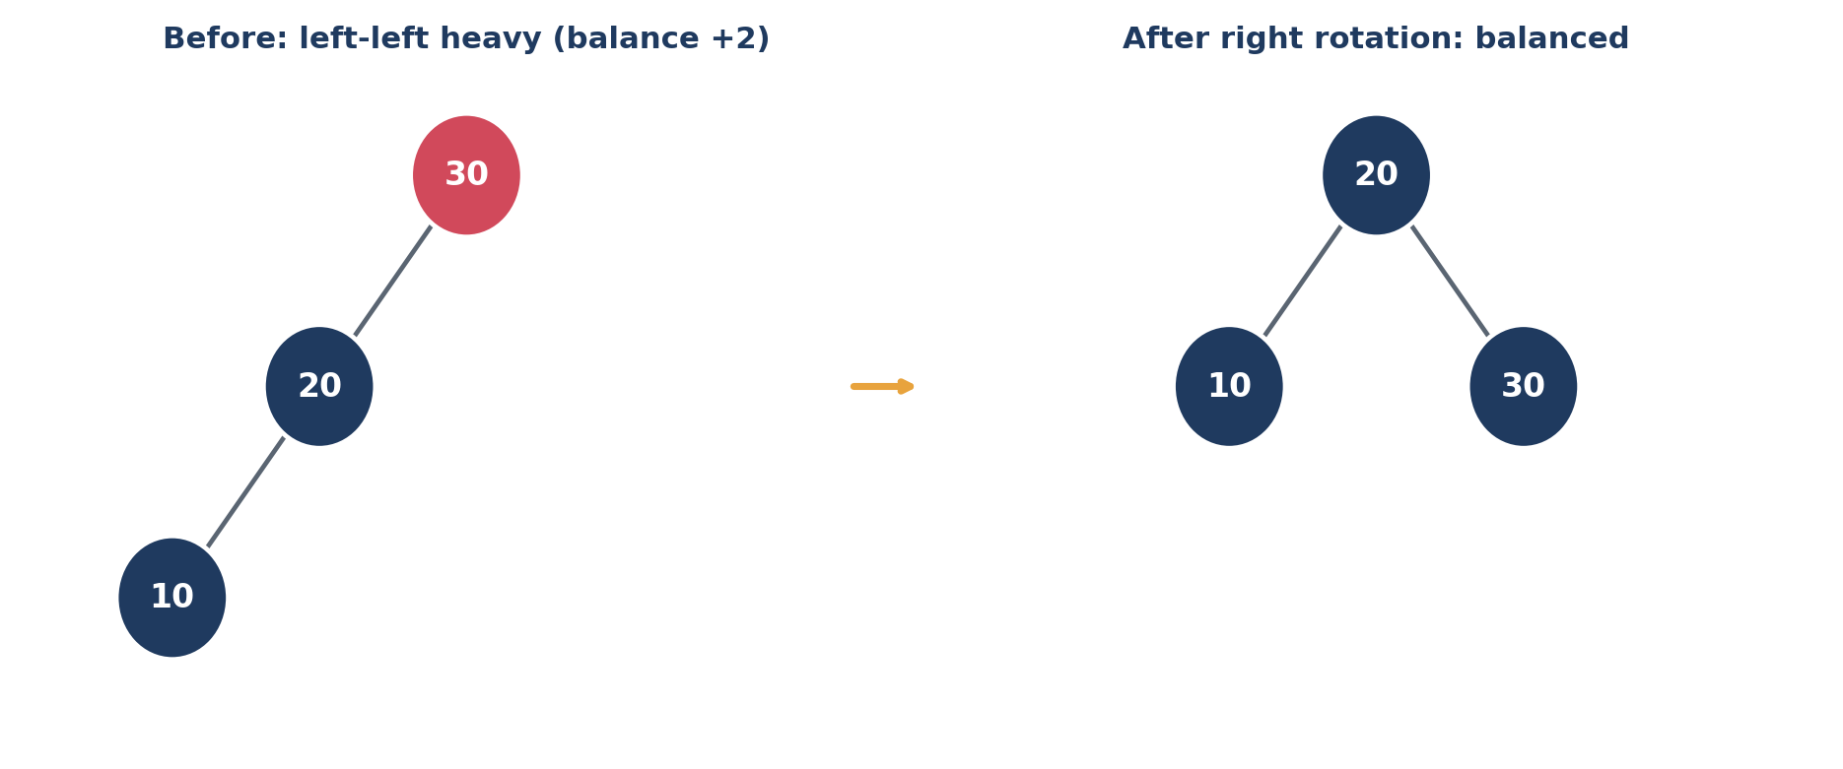
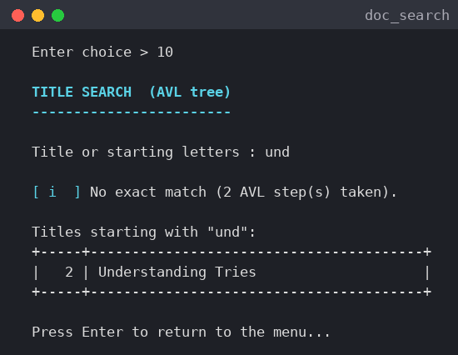
AVL tree: titles always balanced
A rotation restores balance after an insert; in-order traversal lists titles sorted.
Notes:
Titles are kept in an AVL tree. After every insert or delete the balance factor of each node is checked and one of four rotations is applied. The tree height stays about log n even if titles arrive in sorted order. Title search reports how many steps it took. In the sample data five titles give a tree of height 3.

Slide 6
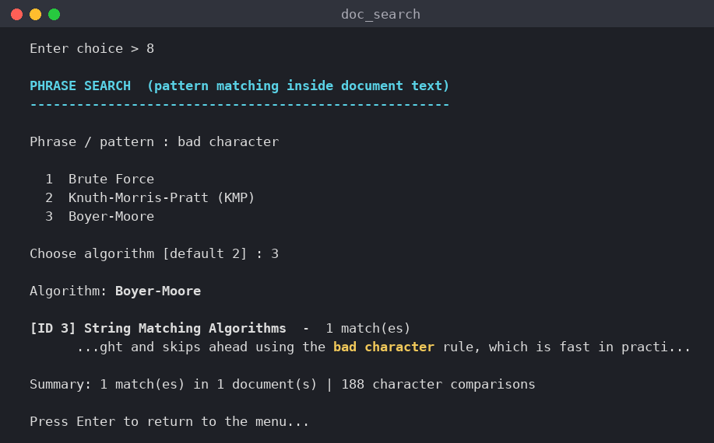
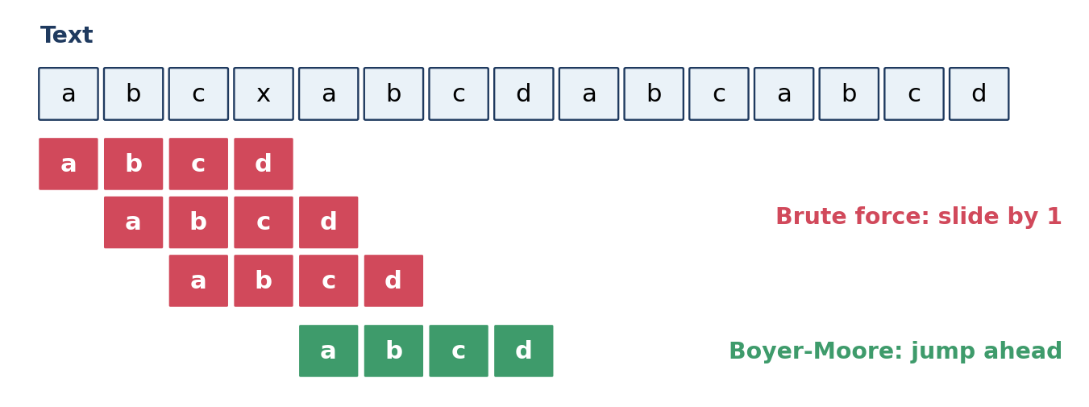
Pattern matching inside documents
Brute force slides by one; Boyer-Moore compares from the right and jumps ahead.
Notes:
For exact phrase search the user chooses brute force, KMP or Boyer-Moore. Brute force tries every position. KMP uses a prefix table so it never re-reads text. Boyer-Moore compares from the right and uses the bad-character rule to skip characters. The matched phrase is highlighted in the output.

Slide 7
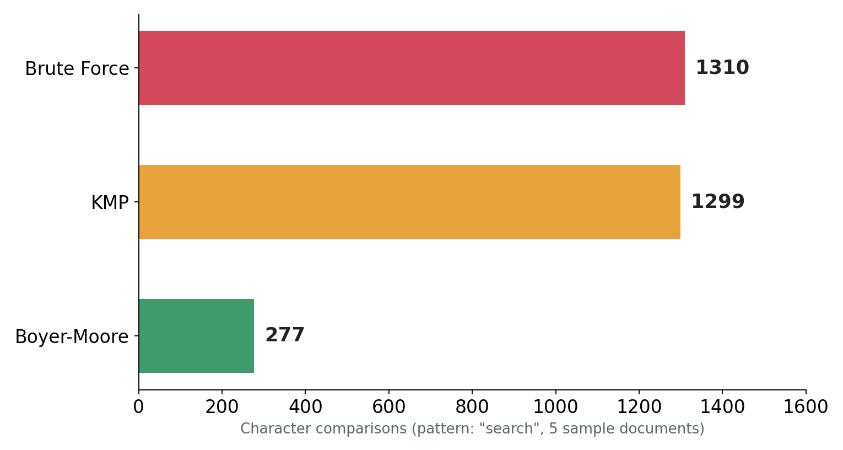
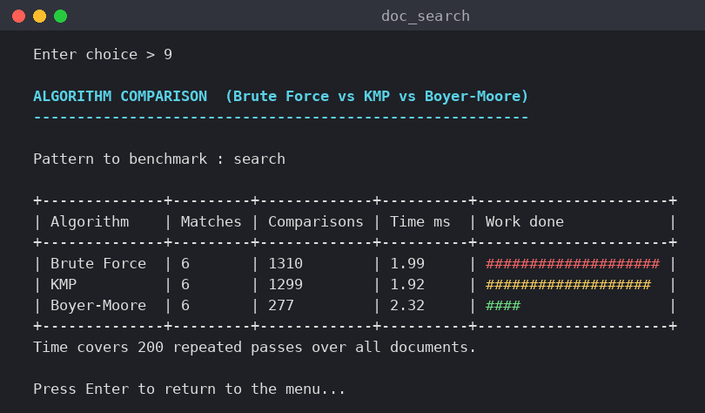
Boyer-Moore does the least work
Pattern "search" over 5 sample documents: 6 matches for every algorithm.
Notes:
We counted character comparisons. For the pattern search brute force needs 1310, KMP 1299 and Boyer-Moore only 277. Run time on such a tiny corpus is about two milliseconds for 200 passes and is dominated by copying text to lower case, so we only claim the reduction in comparisons.

Slide 8
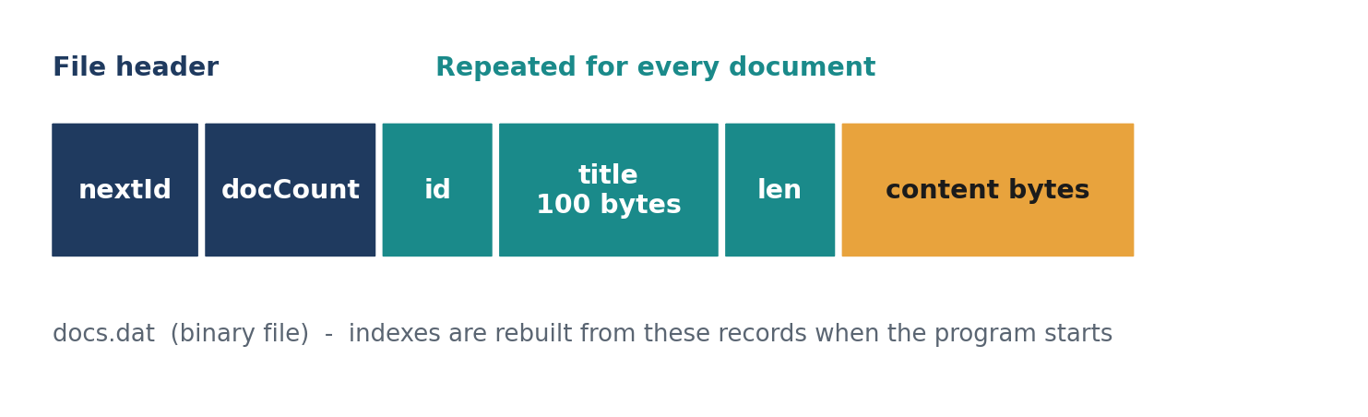
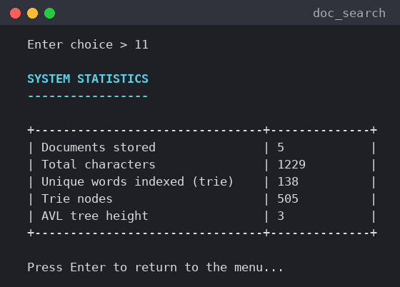
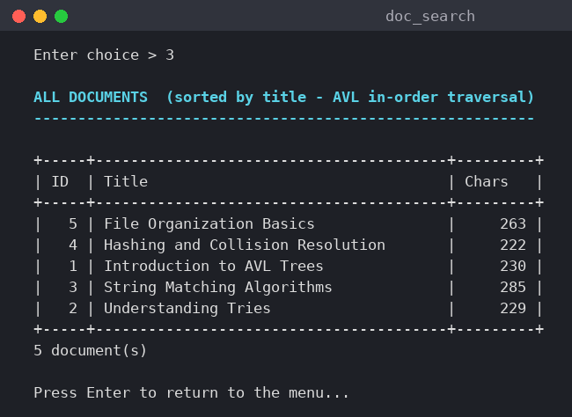
Files: documents survive restarts
Binary records in docs.dat; the trie and AVL tree are rebuilt when the program starts.
Notes:
Documents are saved in a binary file: a small header with the next ID and the count, then for every document its ID, a fixed 100 byte title, the length and the content bytes. Only raw documents are stored, so the indexes are always consistent with the file. The statistics screen shows the size of the rebuilt structures.

Slide 9
What we built
Trie + AVL + 3 matchers + merge sort
Menu-driven C, saves to a binary file
Next: B+ tree index, stemming, TF-IDF
Thank you - Questions?
9
Notes:
Summarise: four advanced data structures and algorithms working together in one C program. Mention possible extensions and invite questions.

