Slide 1

Human Activity Recognition
Kirtiraj Khandekar - kik26
Sai Pradeep Peri - sap187
Nikunj Goel - nig54
Notes:
Intro Slide

Slide 2


Human Activity Recognition(HAR)
Human activity recognition(HAR) through sensors.
Sensors – Inertial, Physiological, Image and Audio
Computational discovery of human activity from sensor data.
APPLICATIONS:- • Surveillance Systems • Patient Monitoring Systems • Assisted Living, Elderly Care • Sports play analysis • Content based video search

Slide 3
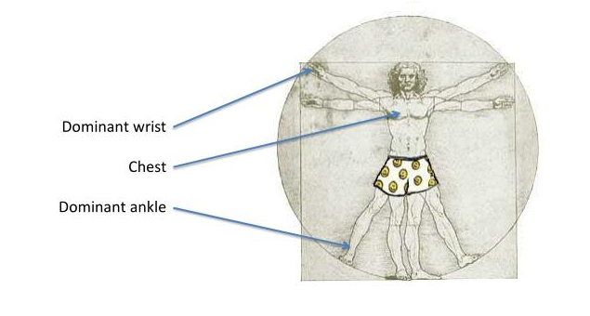
Data Description Origin and Source?
3 Colibri wireless inertial measurement units (IMU)
HR monitoring using BM-CS5SR
Data collected from 9 participants
10 hours of data collected each
12 compulsory activities, list of optional activities, total 18
Data source - http://archive.ics.uci.edu/ml/datasets/PAMAP2+Physical+Activity+Monitoring

Slide 4
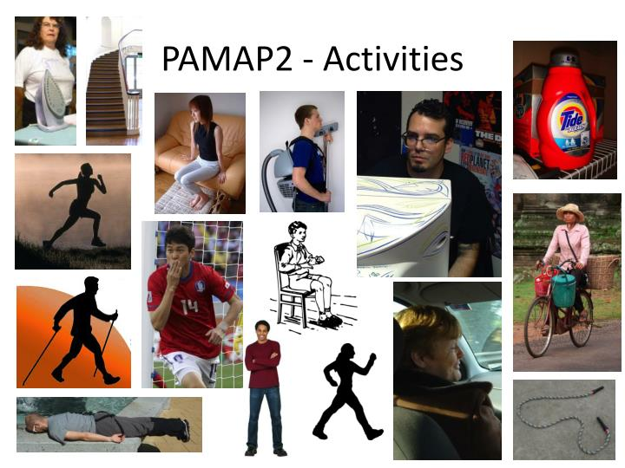
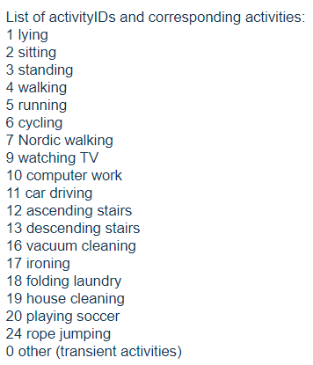

Slide 5
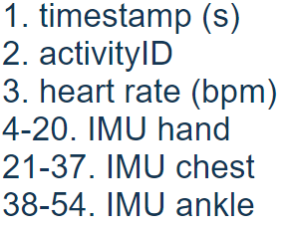
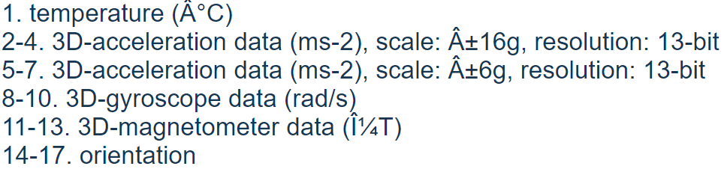
Data Description Origin & Source
1 data file per subject
Each data file has 54 columns
IMU sensor data has 17 columns

Slide 6
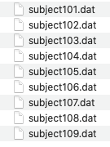
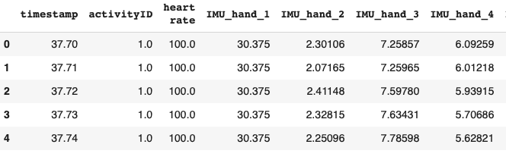
Data Exploration
9 .DAT files of all 9 participants
Appended all the files into 1 single data frame.
Removed all NAN’s because there was data drop due to wireless sensors.
Removed Activity 0 because of transient activity (activity between 2 activities)
Removed Orientation Column which are 4 per IMU as they do not provide valid data.

Slide 7
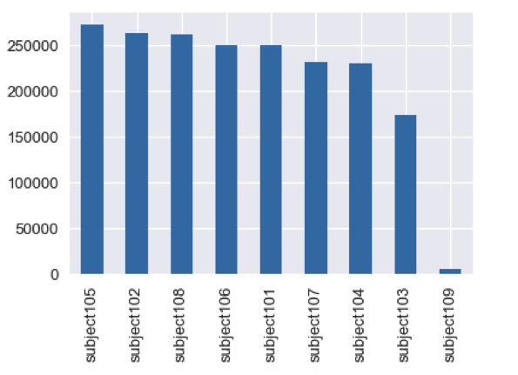
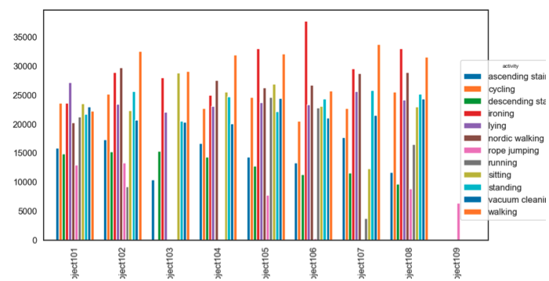
Number and Kind of activities performed by subjects
Subject 9 has least activities so Discarding subject 9.

Slide 8
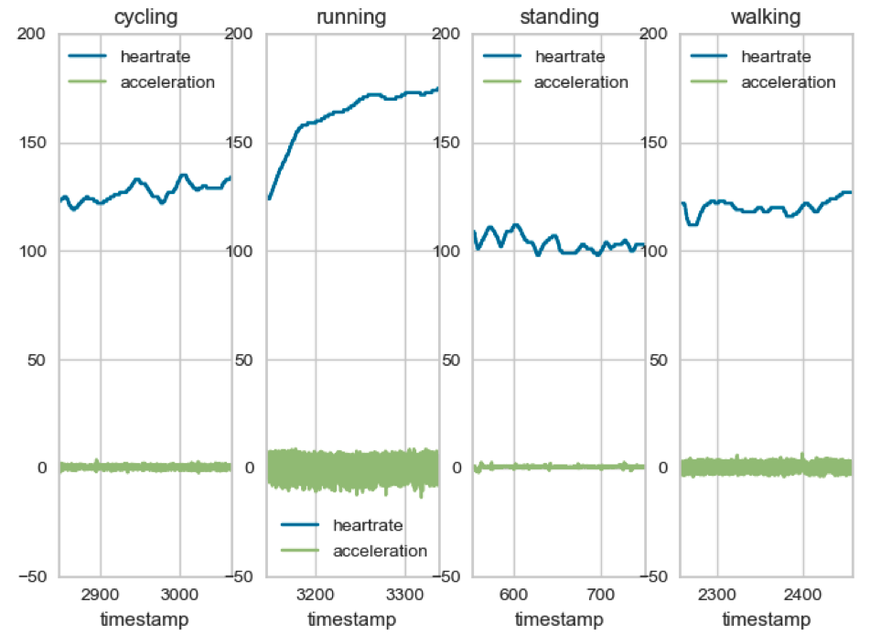
Raw acceleration (from chest IMU) and heat rate data from dataset of four activities
Notes:
raw acceleration (from chest IMU) and heart rate (in bpm) and we can see how they vary with four different activities (standing, cycling, running and walking)

Slide 9
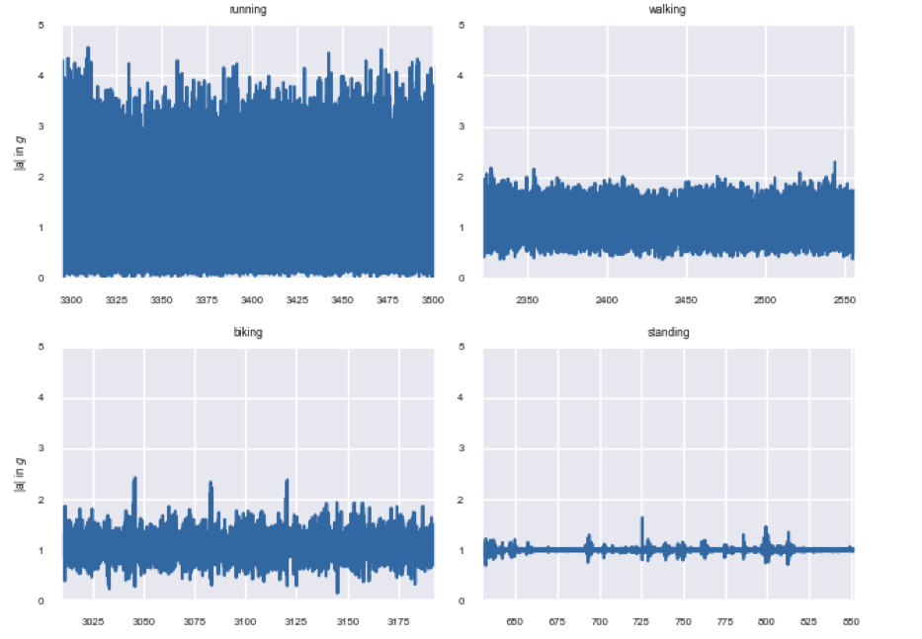
Absolute acceleration of four activities (running, walking, cycling/biking, standing)
Notes:
First features we explore is absolute acceleration, maximum and minimum acceleration and difference between max and min acceleration. We calculate absolute acceleration in order to get rid of the orientation. Absolute acceleration: |a| = q a 2 x + a 2 y + a 2 z where, |a| = absolute acceleration, a 2 x = IMU chest acceleration in x-axis, a 2 y = IMU chest acceleration in y-axis, a 2 z = IMU chest acceleration in z-axis

Slide 10
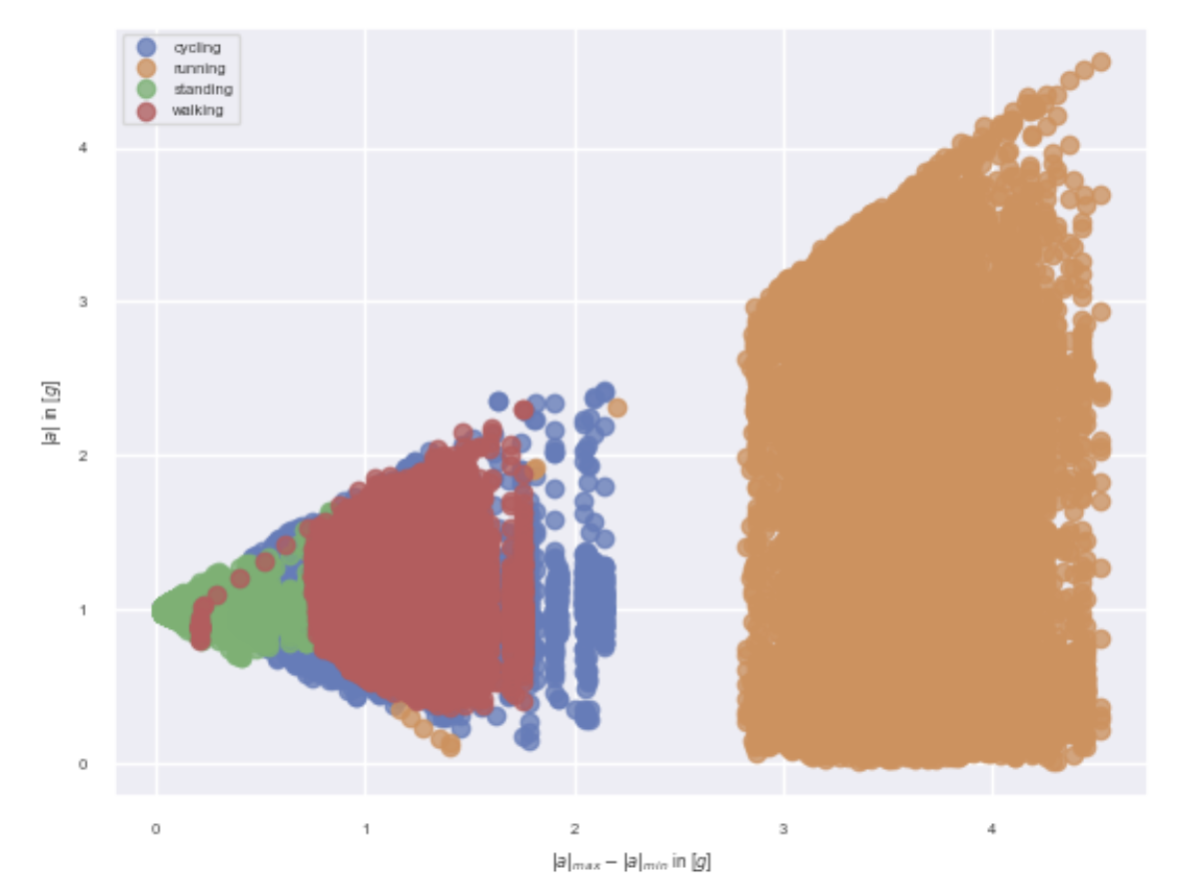
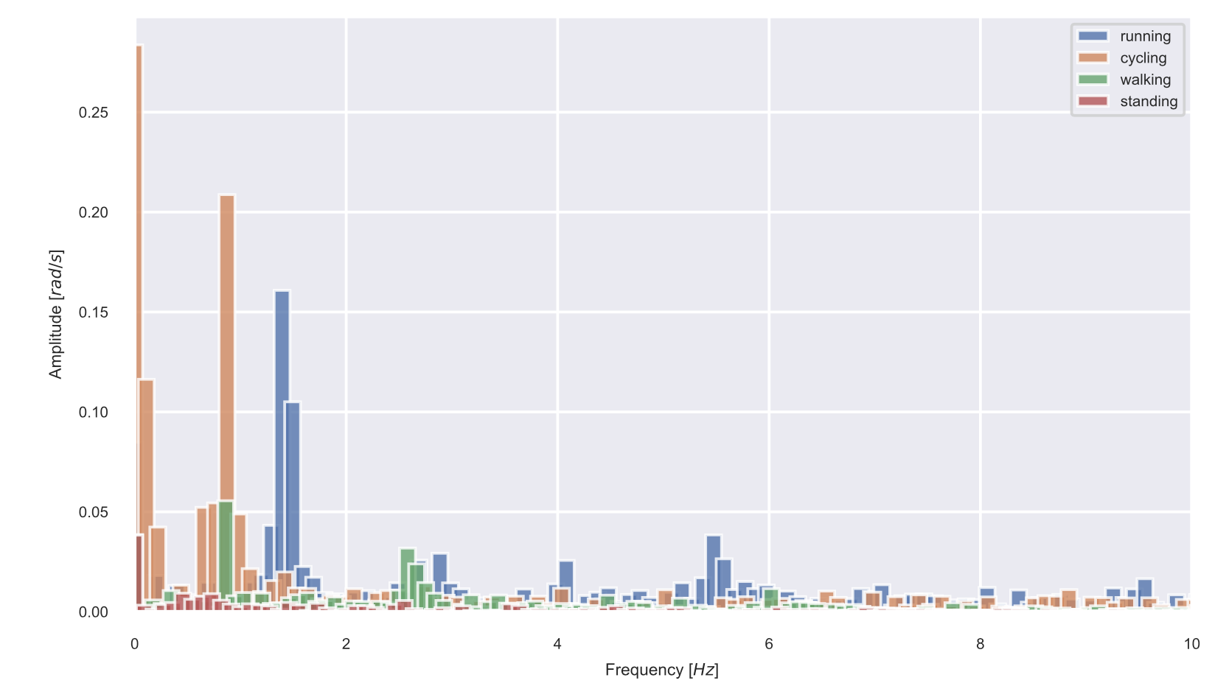
Plotting of absolute acceleration of four activities (running, walking, cycling/biking, standing) against difference in acceleration.
FFT amplitude of rotation rate of four activities (running, walking, cycling/biking, standing)
Notes:
difference of maximum and minimum absolute acceleration.
we will compute the discrete Fourier transform (DFT) over the signal for every window and dimension separately using the fast Fourier transform (FFT) algorithm

Slide 11
Original ID | Activity | After Cat Codes
17 | Ironing | 10
4 | Walking | 3
1 | Lying | 0
3 | Standing | 2
2 | Sitting | 1
7 | Nordic Walking | 6
16 | Vacuum Cleaning | 9
6 | Cycling | 5
12 | Ascending Stairs | 7
13 | Descending Stairs | 8
5 | Running | 4
24 | Rope Jumping | 11

Slide 12
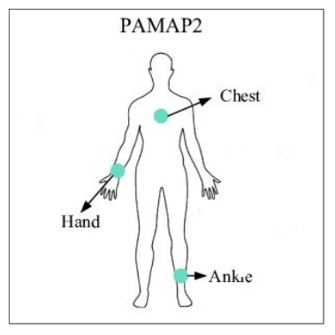
Problem Statement and Domain (Type of Problem)
The goals of this project in physical activity monitoring is to estimate the performed activities and to identify basic or recommended activities and postures.
The PAMAP dataset with different data processing methods and classification algorithms, will be used to create a benchmark of physical activity classification problems.
Walking ?
Running ?
Sleeping ?
Driving ?
…..
….

Slide 13
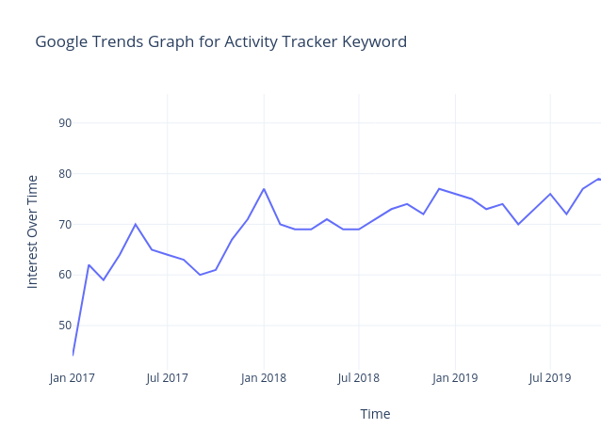
Why Problem is Interesting?
Healthcare and lifestyle – elderly assistance
Sports and fitness – provide feedback and motivation
Gaming – VR
Industrial – safety, daily analysis, training
Education – RFID tags
Robotics – interaction with objects and people

Slide 14
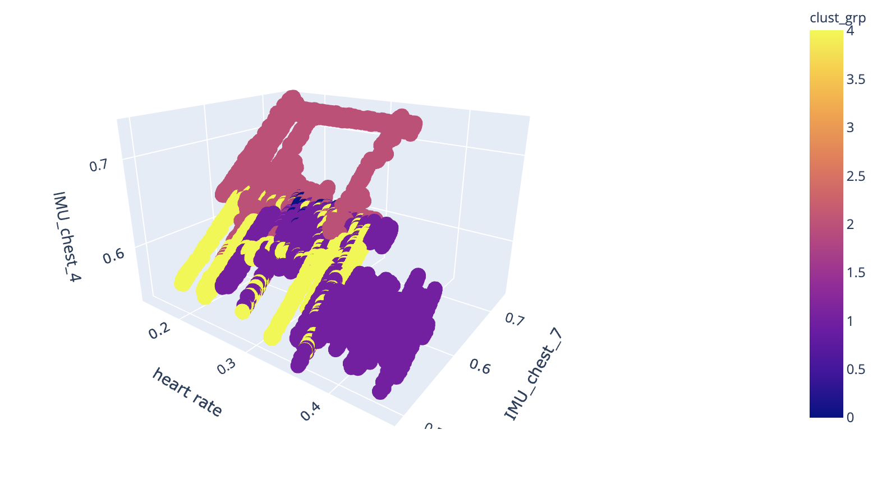
Hypothesis
5 Clusters after K Means Clustering on all the Features

Slide 15

Data Modeling :
We have used several different classifiers for comparing the performance. Below are listed some of the classifiers used
Simple Algorithms :- Logistic Regression
Bagging Algorithms :- Random Forests
Boosting Algorithms :- XGBoost, LightGBM
We split the dataset into training set and testing set. We use 70 percent data for training the classifier and 30 percent to test the model.
The parameters of each model require a certain amount of tuning and experimentation to optimize performance. Tuning for each of the models has been performed exclusively on the training data via 5-fold cross-validation, splitting the training data into disjoint training and validation sets, while the test data is held out solely for a final performance analysis.

Slide 16
Findings

Slide 17
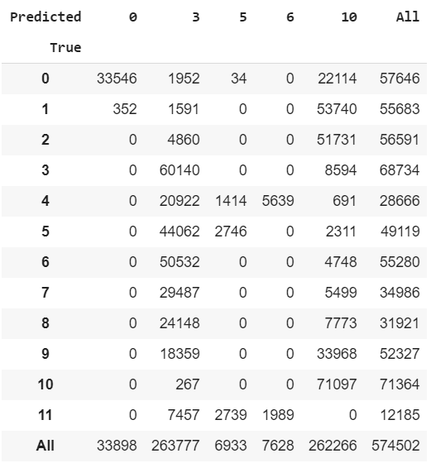
Logistic Regression :
AUC
Train - 0.8865027861335988
Test - 0.886487514654117

Slide 18
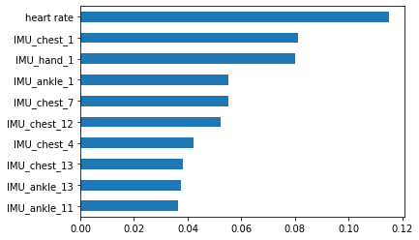
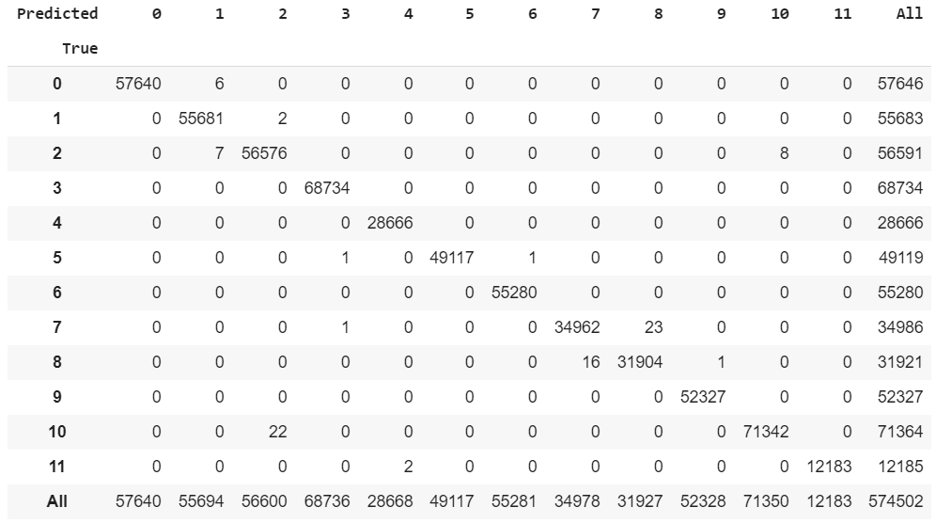
Random Forest :
AUC
Train – 1.0
Test - 0.9999998239125995

Slide 19
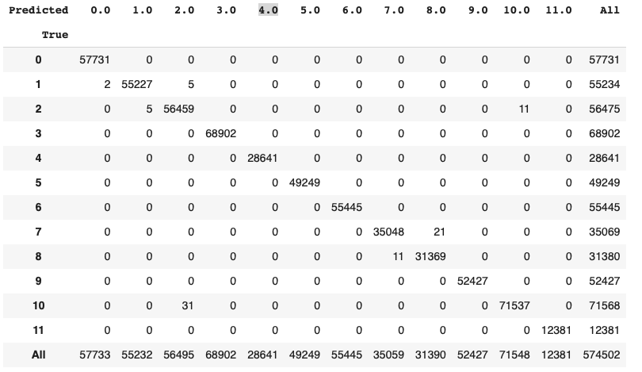
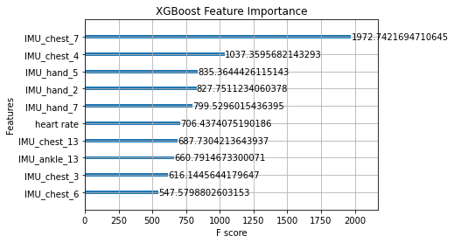
XGBoost :
AUC
Train - 0.9999999990347878
Test - 0.9999999657000426
Target column is Label Encoded

Slide 20
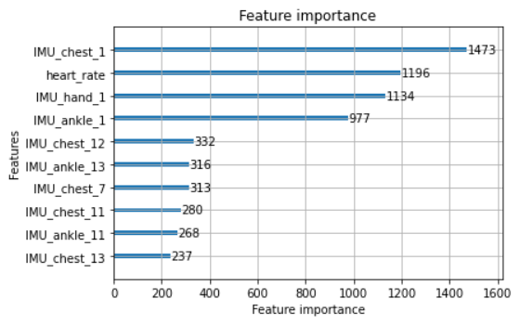
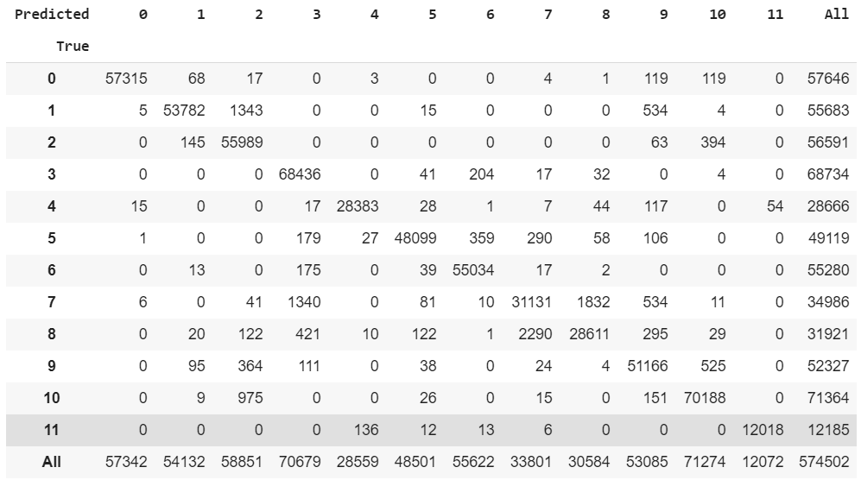
Light GBM :
AUC
Train - 0.999464900410993
Test - 0.9994545154702058

Slide 21
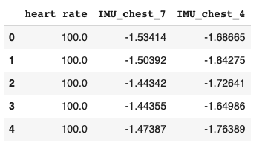
Confidence in the results
Model | Train AUC | Test AUC
Logistic Regression | 0.8865027861335988 | 0.886487514654117
Random Forest | 1.0 | 0.9999998239125995
Light GBM | 0.999464900410993 | 0.9994545154702058
XG Boost | 0.9999999990347878 | 0.9999999657000426
Testing XGBoost with limited Features :
AUC on Limited Features (XGBoost) Train : 0.9553235466050946
Test : 0.9528126807398868
Notes:
K MEANS – KNN --

Slide 22
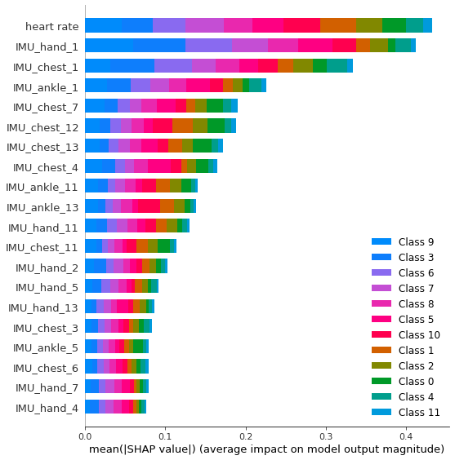
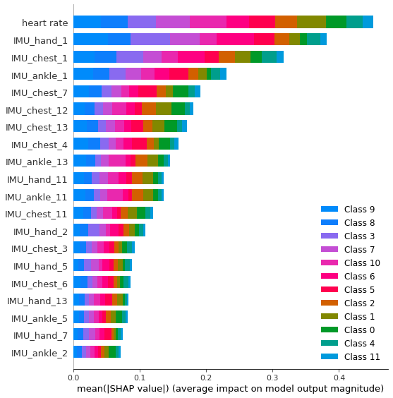
SHAP analysis for Random Forest model
Train set
Test set

Slide 23

Conclusion :
In this project, we have used PAMAP2 dataset which comprises of 9 subjects performing 18 activities over a period of 10 hours.
First, we pre-processed the raw data by removing unnecessary NAN values, removing the activity of Subject 9 and finally extracting necessary feature columns to use in the classification models.
Finally we performed classification on the transformed data and managed to achieve considerable AUC score. Logistic regression unsurprisingly performed the worst as it is a linear classifier. As expected, Tree base approaches improved test AUC.

Slide 24
Future Direction
The dataset provides input features that likely would not be present in real-world applications, like chest and ankle IMUs. We found we could get relatively good performance using just one of the IMU’s and heart rate, the type of data one might get from a smart watch.
In the future we would like to test these models using IMU’s in real time. In particular, we would want to see if a low-compute embedded device could perform classifications with NN’s or SVM’s in real time, in addition to computationally cheaper decision trees.
If we can manage to capture and recognize not only what activity has been performed but also how well it has been performed, then that could open new doors for various applications.
Major impact will be in sports and fitness field, where athletes or individuals could monitor how well they are training or performing.
It could also prove useful in health field with elderly living assistance and rehabilitation patients.

