Slide 1
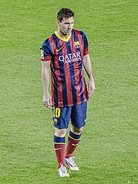
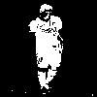
Image Segmentation Using Graph Cuts

Slide 2
Contents
Motivation
Construction of flow network
  Data Structure used for each
Algorithms implemented
  Edmond-Karp's
  Highest label Push-Relabel
Results
  Effect of number of nodes on running time

Slide 3
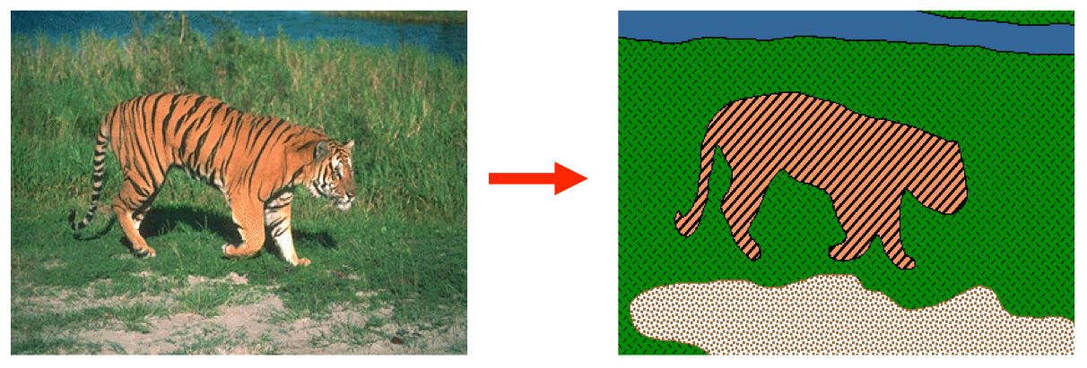
Motivation
Image segmentation is the process of partitioning an image into multiple segments
  So that the image becomes more meaningful and easier to analyze
A key problem in Robotics and Computer Vision
In this project, we focus on binary segmentation

Slide 4
Construction of flow network
Image segmentation can be thought of as min-cut problem
Each pixel – a node in the graph
Edges between the nodes show how similar two pixels are
Min-cut gives two partitions of the image such that the sum of weights of edges between the two partitions is minimized

Slide 5
Edmond - Karps
Construct the flow network
Initialize the flow f to be 0
Perform Breadth First Search in residual network to find any augmenting path
If augmenting path exists :
  Find the max flow f’ that can be sent through this path
  F = f + f’
  Update the residual network
Else :
  Find all the nodes reachable from source

Slide 6
Highest Label Push Prelabel

Slide 7
Results
Algorithm | Number of nodes | Total time | Number of iterations | Total number of iterations
Edmond Karp | 10 x 10

