Slide 1
Visualization of Social Media Sentiment Across Time
CSCE 5320 Scientific Data Visualization
LIKHITHA GADE
HARICHANDANA MUKKAMALA
CHIRAJEEVI UPPALA
REDDY KRISHNA REDDY YEDDULA

Slide 2
Introduction
Project Title: Analyzing Social Media Sentiment: Trends in Public Opinion Over Time
Domain: Social Media Sentiment Visualization
Objective: To track public sentiment on Twitter and identify trends over time.
Focus Case Study: Tesla Cybertruck window-breaking incident.

Slide 3
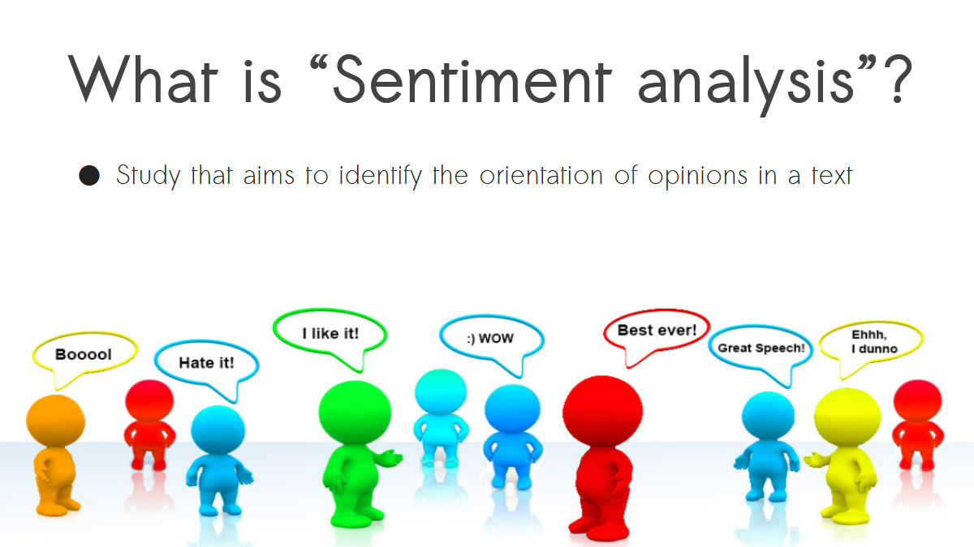

Slide 4
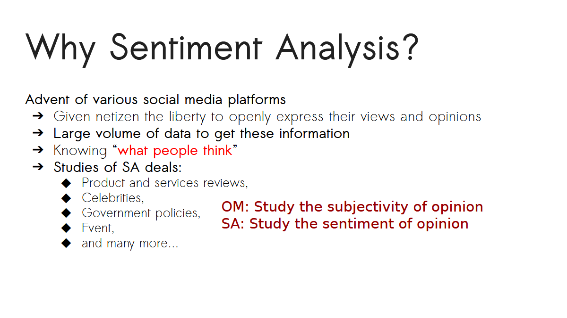

Slide 5
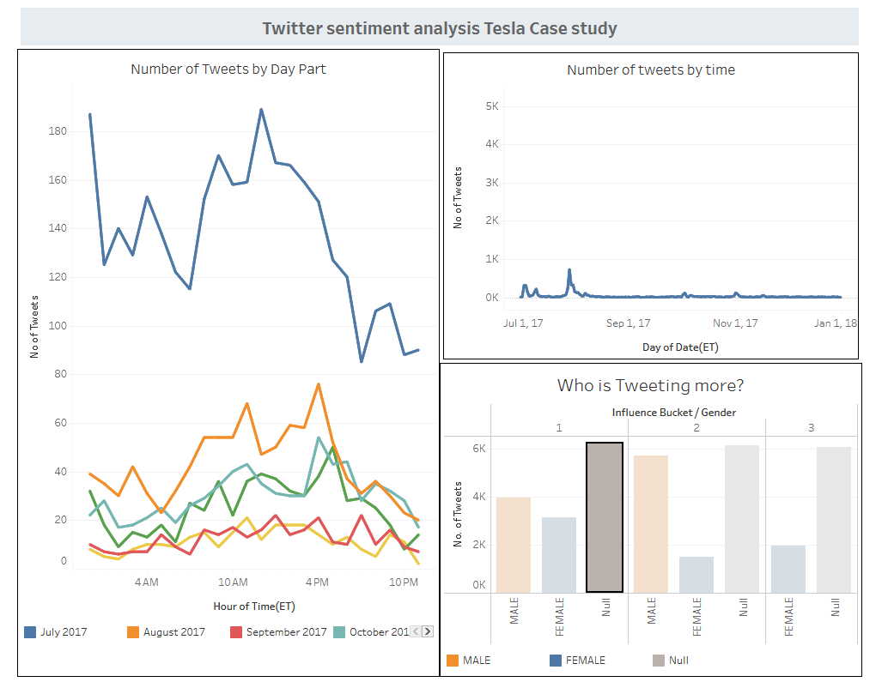
Implementation with Tableau
Why Tableau?
Tableau was chosen for its user-friendly interface, fast drag-and-drop analytics, and seamless dashboard publishing. It allowed us to quickly visualize patterns in sentiment data and share insights interactively.
What We Did:
Imported preprocessed tweet data (.CSV)
Used calculated fields to extract:
Sentiment scores
Hashtag and keyword frequency
Retweet and quote trends
Built multiple dashboards:
Overall Sentiment Overview
Trend Over Time
Most Influential Tweets
RT/QT/Hashtag Usage Patterns
Benefits:
Intuitive filtering and sorting
Highlighted correlations across different variables
Easily embedded into the webpage for seamless exploration

Slide 6
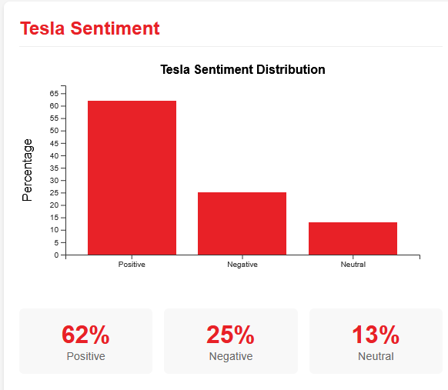
Implementation with D3.js
Why D3.js?
D3.js offers low-level, customizable control over visuals, allowing us to build dynamic, interactive, and animated visualizations embedded directly into the project website.
What We Did:
Used D3 to build:
Interactive Line Charts to show sentiment change over time
Bubble Graphs to show influence vs retweet count
Hover-enabled Bar Charts for hashtag frequency
Made it fully interactive with tooltip effects, transitions, and filters
Integrated within an HTML page using JavaScript and custom CSS
Benefits:
Real-time interactivity
Custom animations for storytelling
Deep integration with web technologies

Slide 7
Problem Statement
Social media significantly impacts public opinion and brand identity.
Viral events can influence brand reputation positively or negatively.
Example: Cybertruck event started with negative sentiment but increased engagement.

Slide 8
Key Questions:
How did sentiment change before, during, and after the event?
What keywords and hashtags were most used?
Did the viral moment help Tesla's brand in the long run?
Role of memes in sentiment transformation.

Slide 9
Methodology
Workflow: Data Collection: Twitter sentiment dataset (Kaggle, UCI)
Visualization & Insights: Tableau, Plotly,D3Js, Matplotlib, Seaborn
Understanding and implementing visualizations
Interpretation & Conclusion

Slide 10
Data Abstraction
Dataset Details:
Structured CSV format
Train Dataset: 31,962 records, 3 columns (id, label, tweet)
Test Dataset: 17,187 records, 2 columns (id, tweet)
Data Source: Kaggle, UCI Machine Learning Repository

Slide 11
Data Transformation & PreprocessingCleaning
Removing special characters, emojis, URLs
Filtering: Retaining only English tweets
Handling Missing Values: Removing nulls, imputing missing timestamps
Outlier Removal: Filtering very short/duplicate tweets

Slide 12
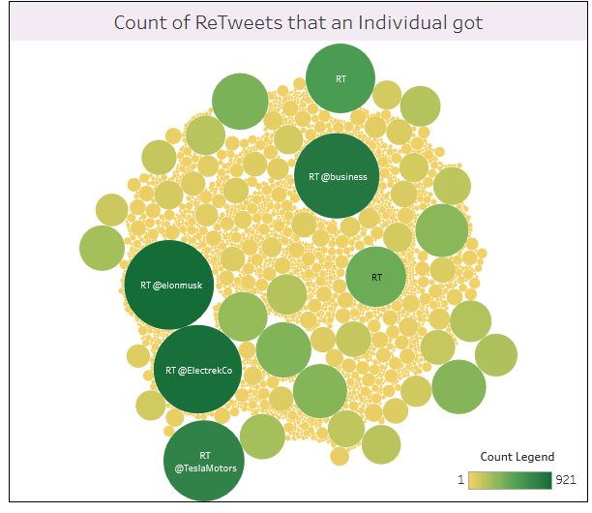
Task Abstraction
Targets:
Identify tweet volume spikes
Analyze positive/negative ratios
Find most influential tweets/users

Slide 13
Tools and Implementation
Exploration : Python + Pandas + Jupyter Notebook for text processing
Visualization: Tableau, D3.js, Plotly
Integration: Webpage using HTML/CSS + Tableau embeds

Slide 14



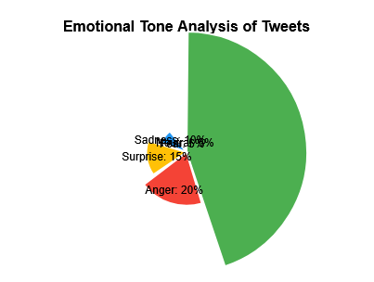
Key Visualizations
Visuals to include:
Overall sentiment distribution
Most influential tweets
Keyword usage (RT/QT/Hashtag)
Emotion frequency

Slide 15
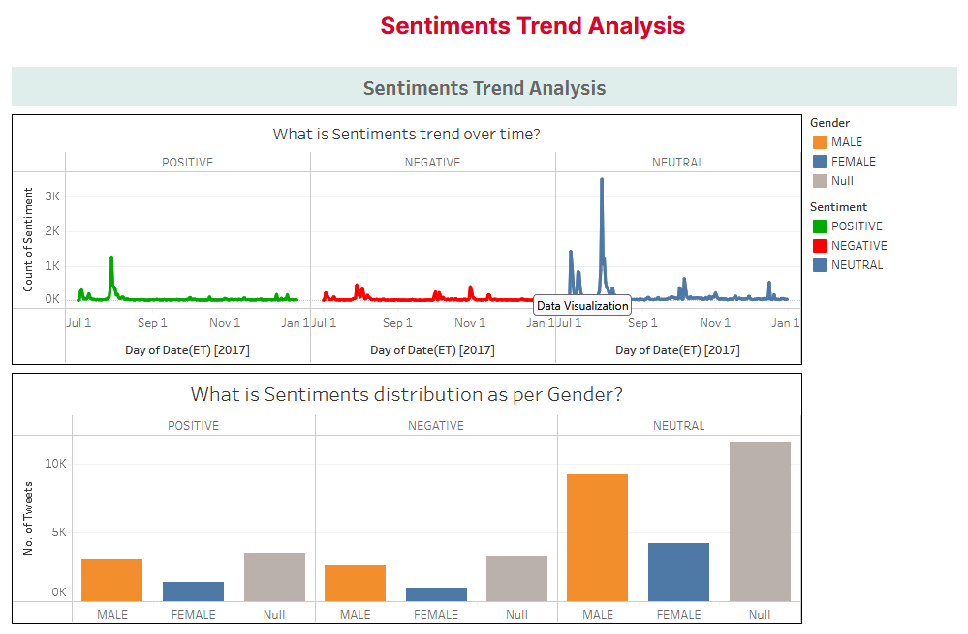
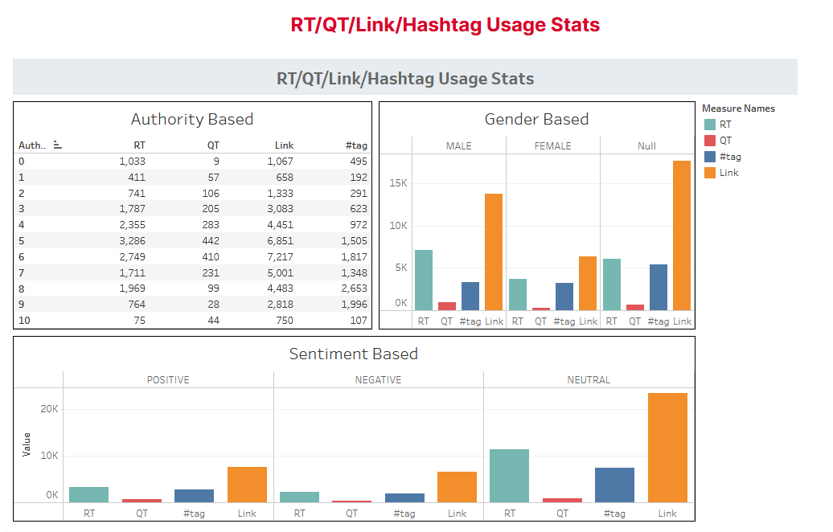
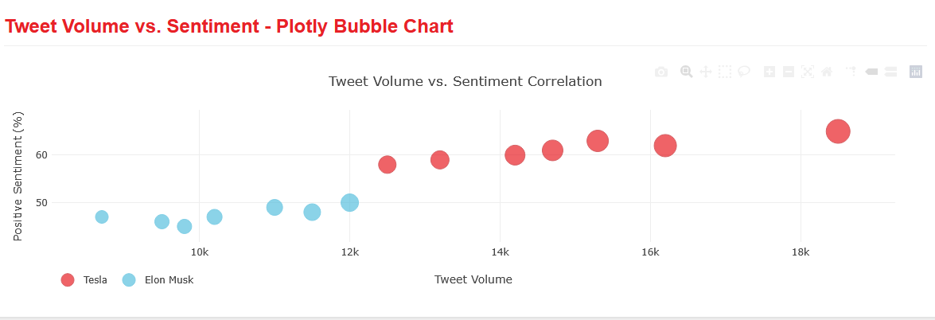
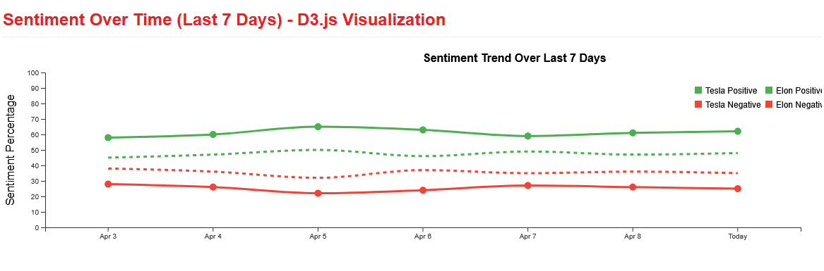
Visuals to include:
Sentiment Analysis and Usage Stats
Trend Analysis
Tweet Volume
Sentiment Overtime

Slide 16
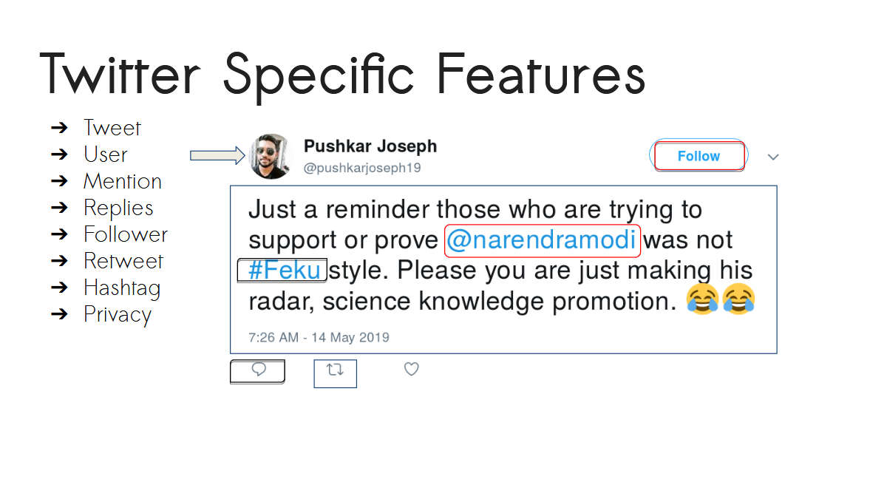

Slide 17
Case Study - Tesla Cybertruck Incident
What Happened?
Cybertruck’s armored glass broke during a live demo.
Initial reaction: Negative sentiment dominated Twitter.
Raw Sentiment Data Classification:
Negative Tweets: Backlash, disappointment, criticism
Neutral Tweets: News reports, general discussion
Positive Tweets: Humor, support for Tesla, memes

Slide 18
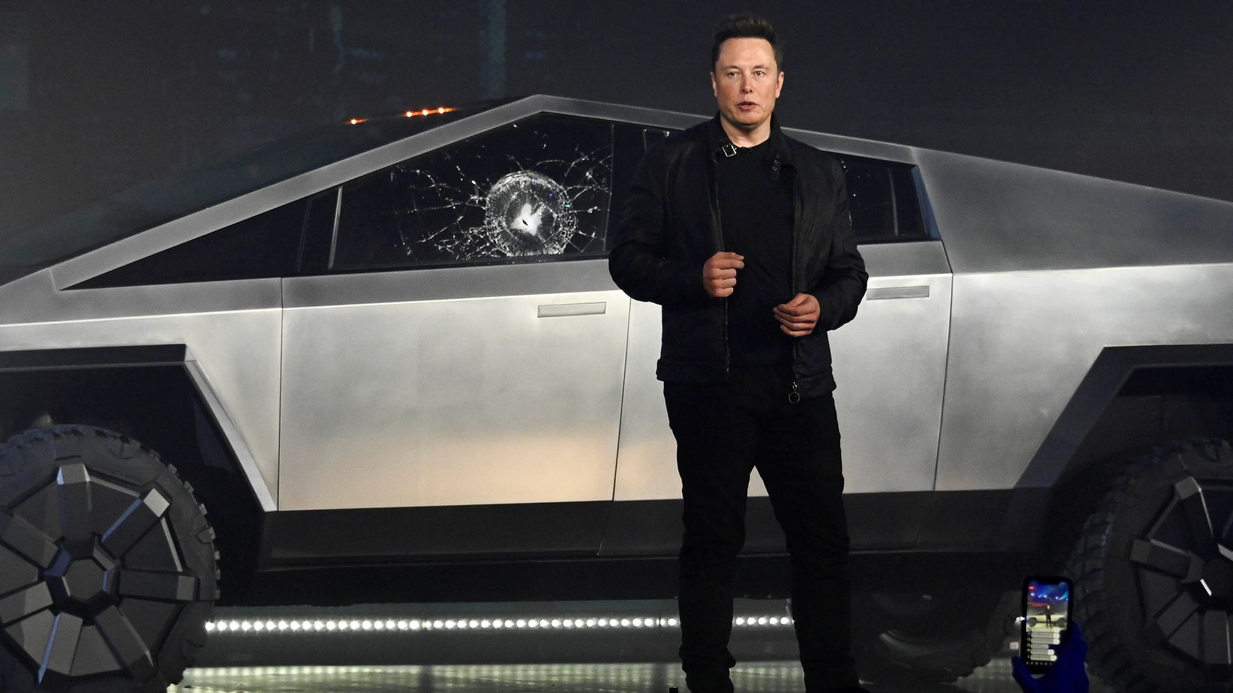
Elon Musk Reaction

Slide 19
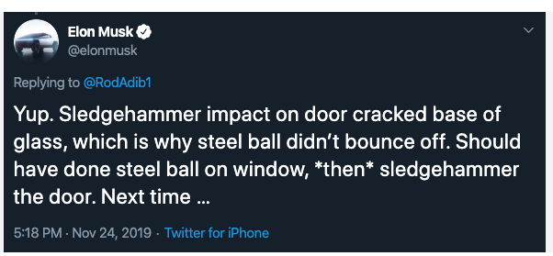
Sentiment Trends Over Time
Initial Reaction (Event Day):
Spike in negative words (“fail,” “embarrassing”).
High engagement in meme culture.
Turning Point (Following Days):
Elon Musk’s humor shifted perception.
Memes boosted Cybertruck’s visibility.
Long-Term Impact:
Increased pre-orders despite initial backlash.
Positive sentiment scores improved over weeks.

Slide 20
Key Insights & Conclusion
Viral incidents don’t always harm a brand—strategic response matters.
Social media sentiment can shift over time with humor & engagement.
Memes played a significant role in making Cybertruck a cultural icon.
Sentiment analysis can be applied to future PR crises and viral events.

Slide 21
Future Scope & Enhancements
Deep Learning Integration: Using BERT for better accuracy.
More Data Sources: Expanding beyond Twitter (Reddit, Facebook).
Real-Time Sentiment Tracking: Developing a live sentiment dashboard.

Slide 22
Responsibility Breakdown:
Team Member | Role & Responsibilities
Likhitha Gade | Tableau Dashboard Creation (3+ visualizations)
Harichandana Mukkamala | D3.js Visualizations and HTML
Chiranjeevi Uppala | Data visualization (Tableau and embedding the Tableau to Webpage)
Reddy Krishna Reddy Yeddula | Documentation,D3Js,Data Handling and final project presentation

Slide 23


Slide 24
Thank You!
LIKHITHA GADE
HARICHANDANA MUKKAMALA
CHIRAJEEVI UPPALA
REDDY KRISHNA REDDY YEDDULA

