Slide 1

Forty Minutes Into The Set
Building a reliable social-sentiment early-warning system for Kestrel Festival
Tailwyndz Propel Lateral Drive 2026 — Assessment 4
Sai Pranathi

Slide 2

More posts did not mean better signals.
Raw volume = noise
Irrelevant mentions
Social volume alone creates distortion, not signal.
Brand ambiguity distorts the picture before analysis begins.
Automated traffic
Short spikes ≠ incidents
Bots inflate both volume and apparent sentiment.
Genuine incidents may generate too little social activity to register.
"I would rather be told nothing than be told something wrong."

Slide 3
The challenge was not just sentiment. It was data quality.
1.2M
75K
Total posts
Unique authors
1,206,715 raw records ingested
7.28%
4+
Automated
Timestamp formats
Bot-flagged share of total volume
Requiring normalisation before any analysis
36K
46K
Late arrivals
Unmatched IDs
36,201 out-of-order records
46,863 author IDs with no profile match
Before measuring sentiment, we had to decide what data was trustworthy.

Slide 4
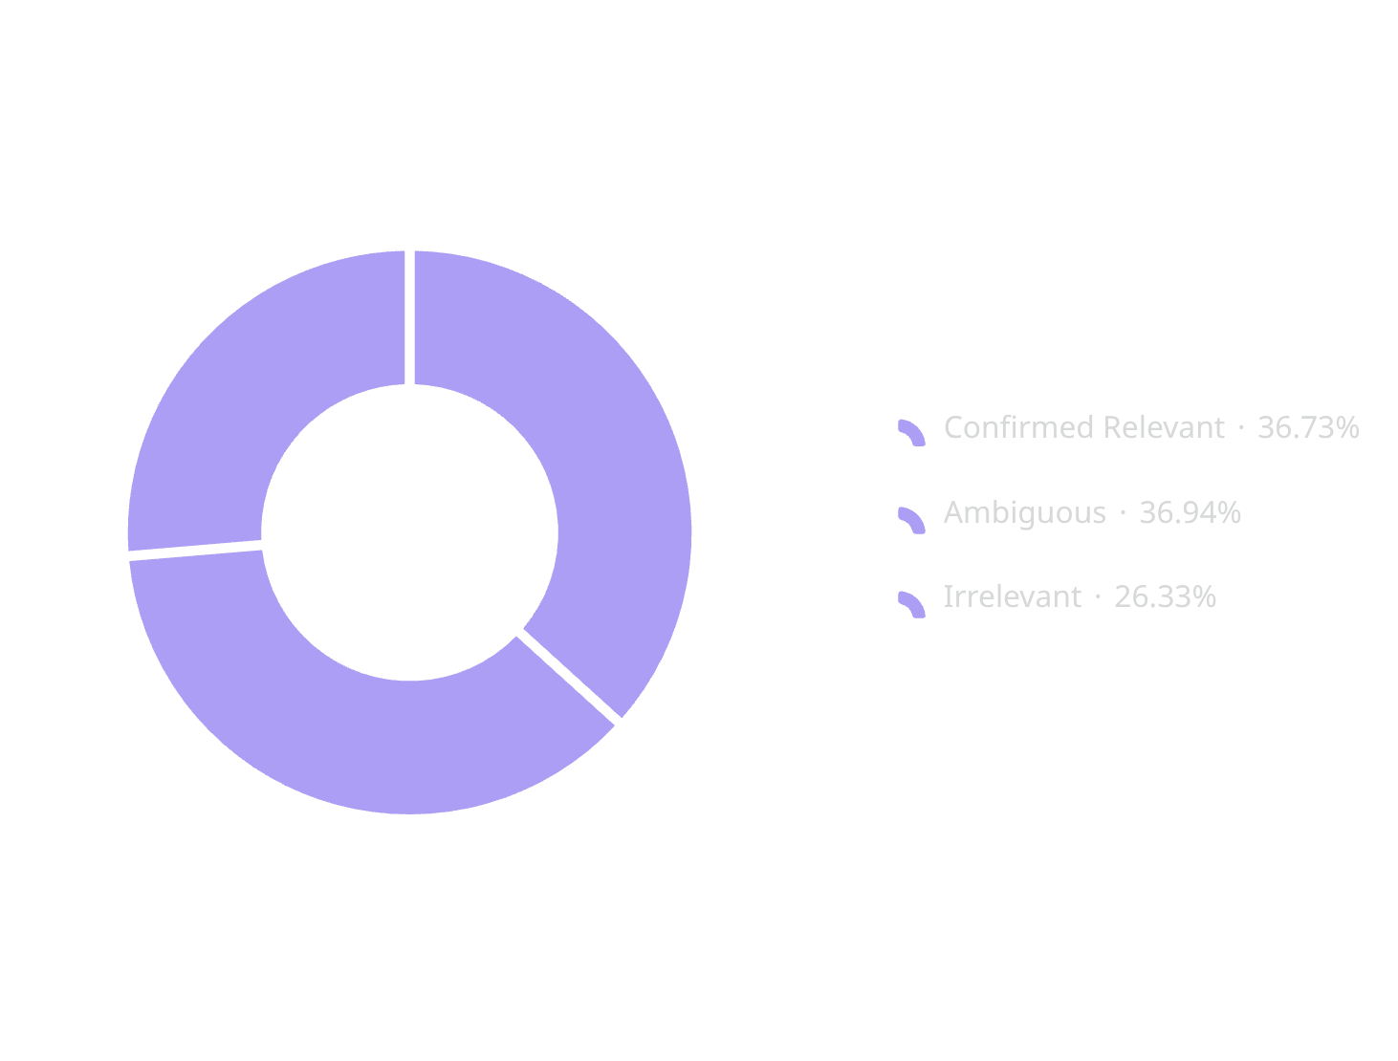
Kestrel is not always Kestrel.
The brand name is intentionally ambiguous — it can refer to a bird, a car, a surname, or dozens of other things.
Every Kestrel mention cannot be treated as event sentiment.
325,831
119,675
120,365
85,791
Total Kestrel mentions
Confirmed relevant
Ambiguous
Irrelevant

Slide 5


Bot traffic can manufacture the signal.
97.0%
94.2%
Precision
Recall
0.632%
Error rate
Bot detector performance
Final detection signals
87,868 true automated posts in dataset
85,344 predicted automated by detector
Promotional / spam language
Negative amplification language
a monitoring / summary language

Slide 6

Sentiment is harder than positive vs negative.
Real event language requires nuance
"not bad at all actually" → positive
"great, another delay 🙄" → negative
"this is sick" → positive
"यह बहुत अच्छा है" → positive
Coverage: English · Hindi/Devanagari · Hinglish · Portuguese/German · emojis · negation · sarcasm patterns
Hindi negation remains a known weak area.
203K
134K
69K
Positive
Neutral
Negative
203,161 posts
134,520 posts
69,546 posts

Slide 7
The dead ends were useful.
Three approaches were tested and rejected based on measured error, not intuition.
Method | Precision | Recall | Verdict
High activity / repetition | 6.4% | 40.7% | Too many false positives
Profile / activity metadata | 7.3% | 8.1% | Weak standalone separation
Coordinated repeated text | 8.1% | 99.7% | High recall, unusable precision
Scientific iteration — every rejected method narrowed the solution space.

Slide 8

Only trusted evidence reaches the alert layer.
Raw Posts
Relevance Filter
Data-Quality Audit
Volume is context. Sustained, relevant human sentiment is the signal.

Slide 9
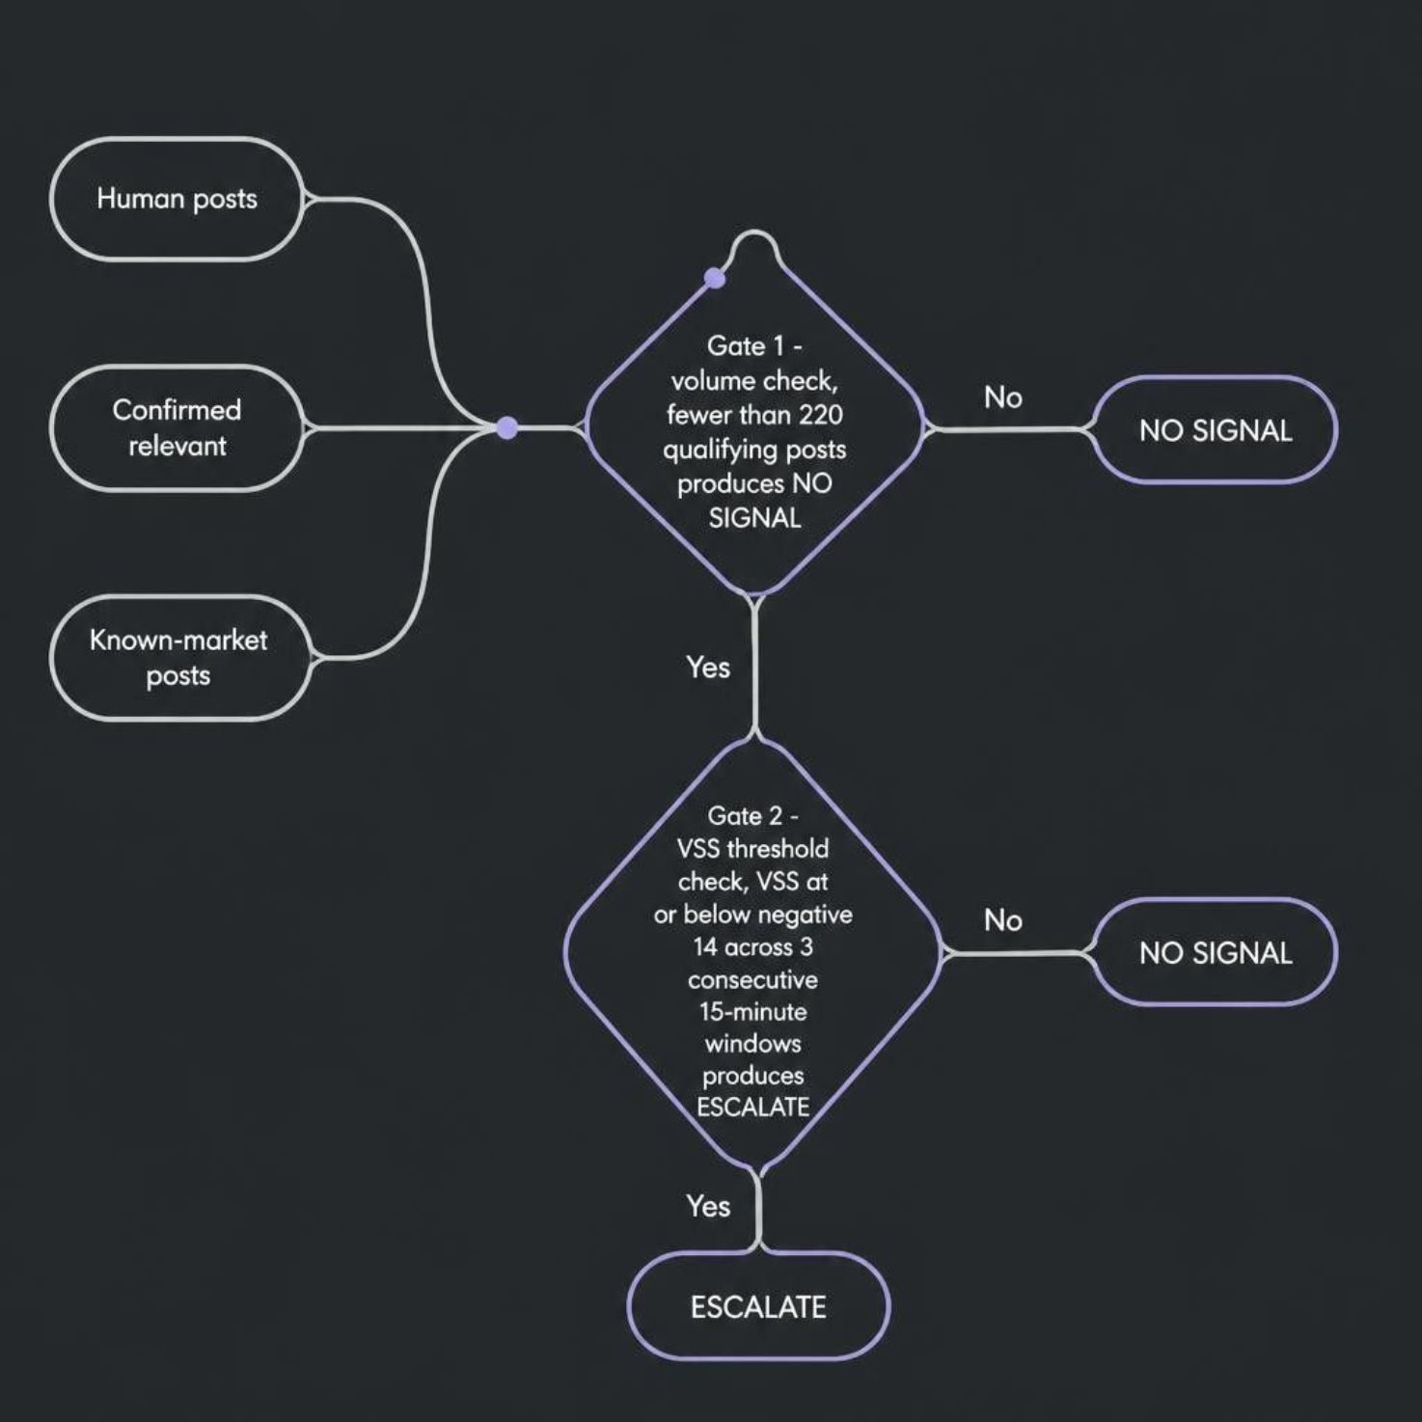
VSS asks: is sentiment unusually negative for this market?
The formula
VSS = Current 15-min net sentiment − 14-day same-market baseline
Net sentiment = % positive − % negative
Only human posts, confirmed relevant posts, and known-market posts qualify.
The decision gates
< 220 qualifying posts → NO SIGNAL
VSS ≤ −14 + 3 consecutive 15-min windows → ESCALATE
Raw volume alone never triggers an alert.

Slide 10
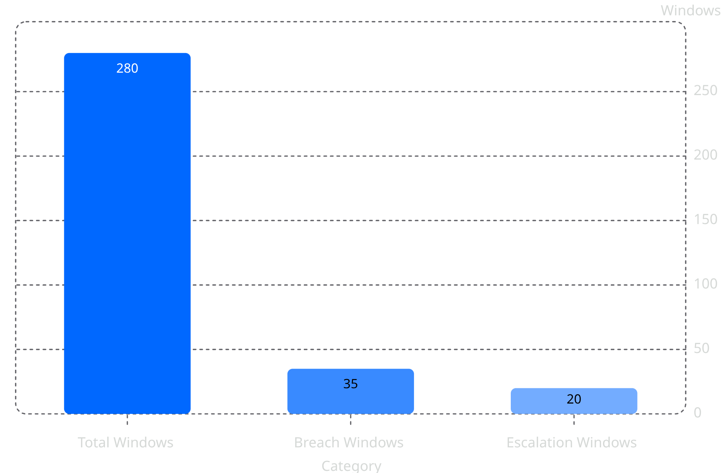

280 windows. 20 escalation windows.
280
35
20
Windows analyzed
Breach windows
Escalation windows
Every 15-minute window across the full event
VSS ≤ −14 recorded
3 consecutive breaches confirmed
Sponsor announcement detected with a 30-minute delay — the only confirmed incident in the review window.
The logic suppresses isolated noise and requires sustained evidence before escalating.
Isolated spikes are expected. Consecutive breaches are the signal.

Slide 11

The system was selective — but too selective.
INCIDENT EVALUATION
Incident | Result | Detail
Queue crush | MISSED | —
Sound failure | MISSED | —
Sponsor announcement | DETECTED | +30 min lead time
Payment outage | MISSED | —
Positive decoy 1 | IGNORED | 0 false escalations
Positive decoy 2 | IGNORED | 0 false escalations
1 / 6
0
Planted incidents detected
False escalations on positive decoys
This is a realistic stress test that revealed blind spots — not a successful incident detector.

Slide 12
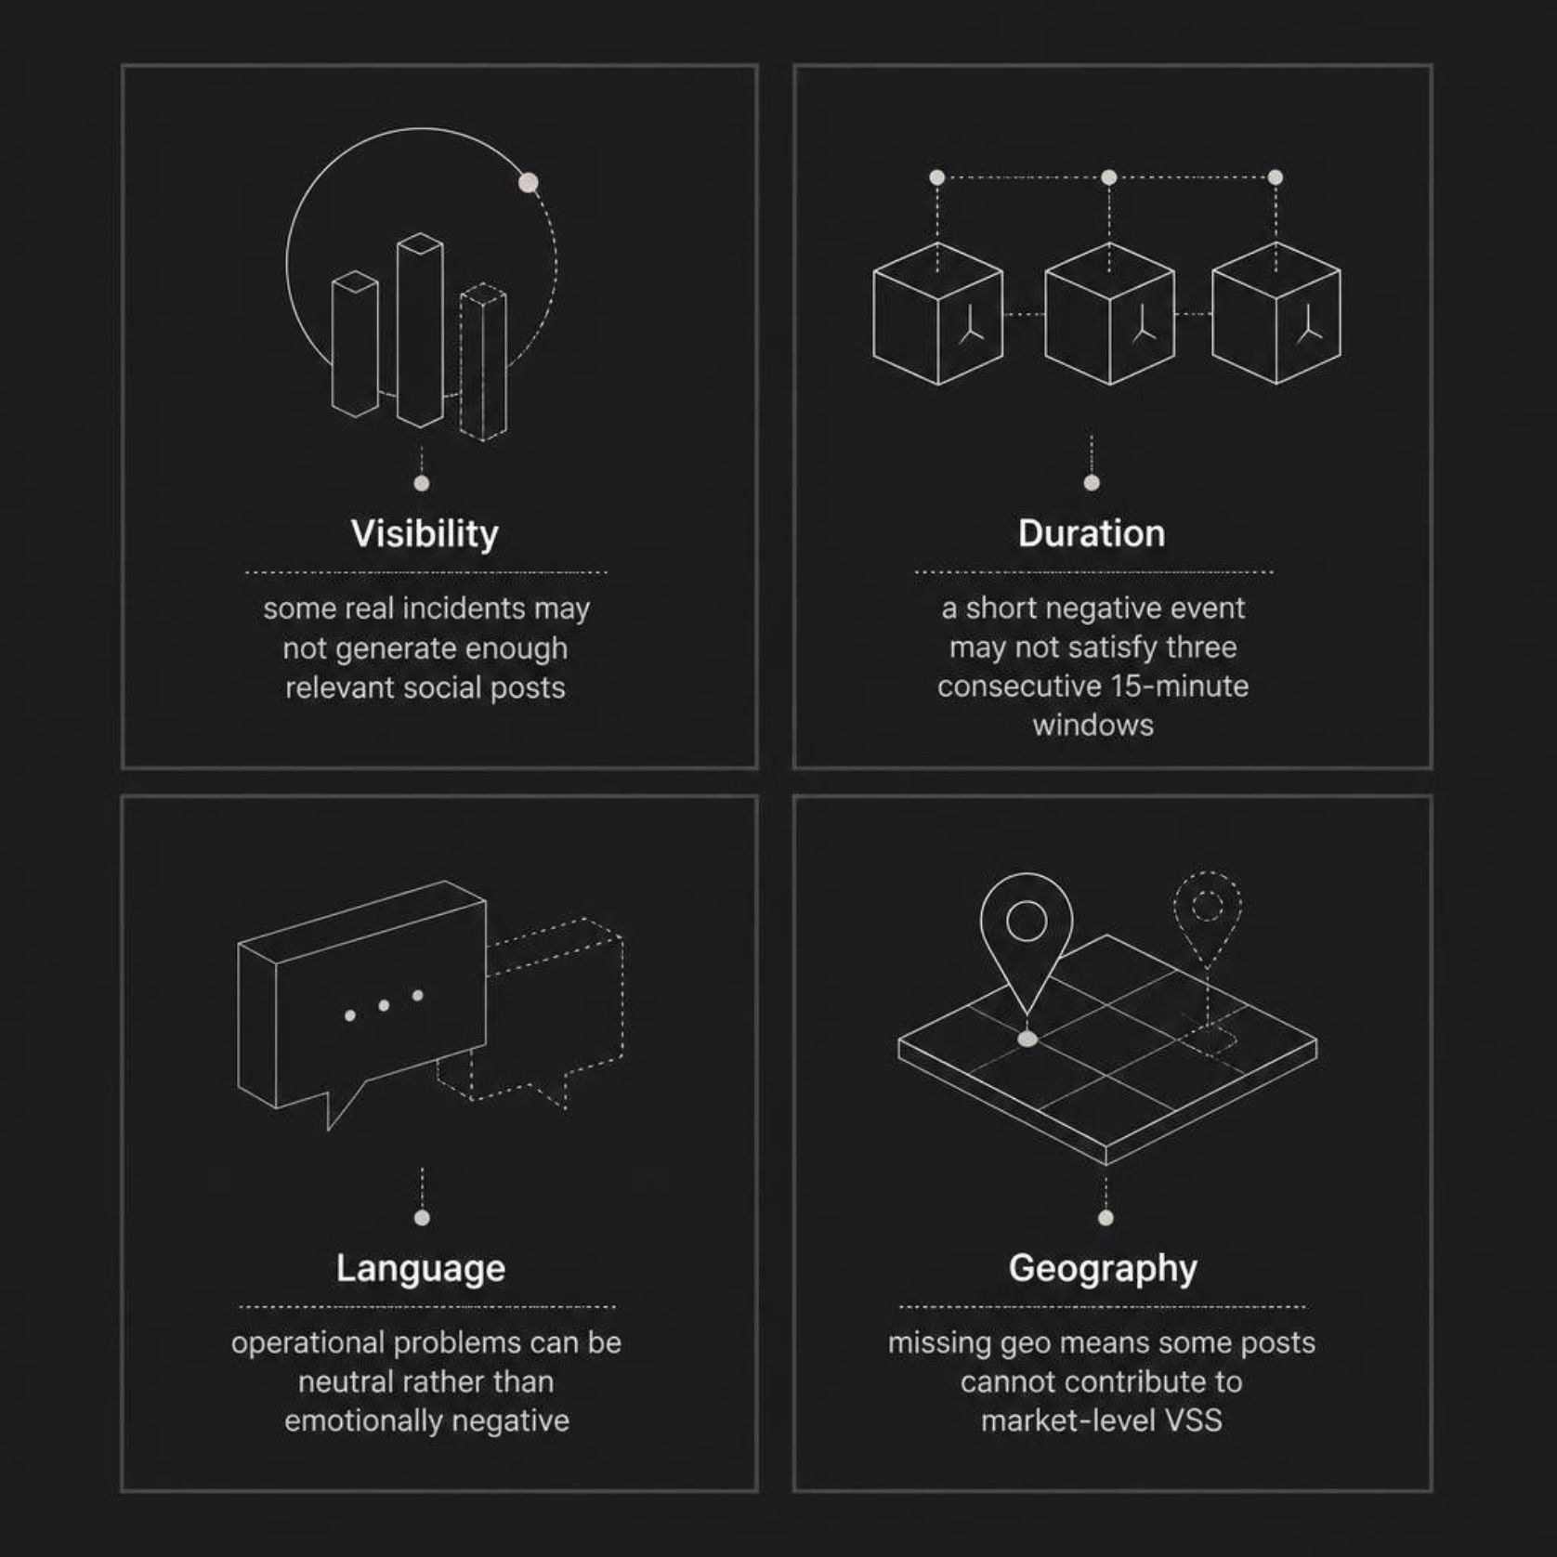

The misses are the most important result.
WHY DID WE MISS THREE REAL INCIDENTS?
Plausible failure modes
Each missed incident maps to at least one structural gap in how the system filters and scores incoming signals:
These are plausible failure modes supported by data and system design — not claimed as proven root causes for every miss.
Visibility
Duration
Language
Geography
Real incidents may not generate enough relevant social posts to cross qualifying thresholds.
Short negative events may not persist across three consecutive 15-minute breach windows.
Operational problems expressed neutrally produce no detectable negative sentiment signal.
Posts without usable location data cannot contribute to market-level VSS scoring.

Slide 13
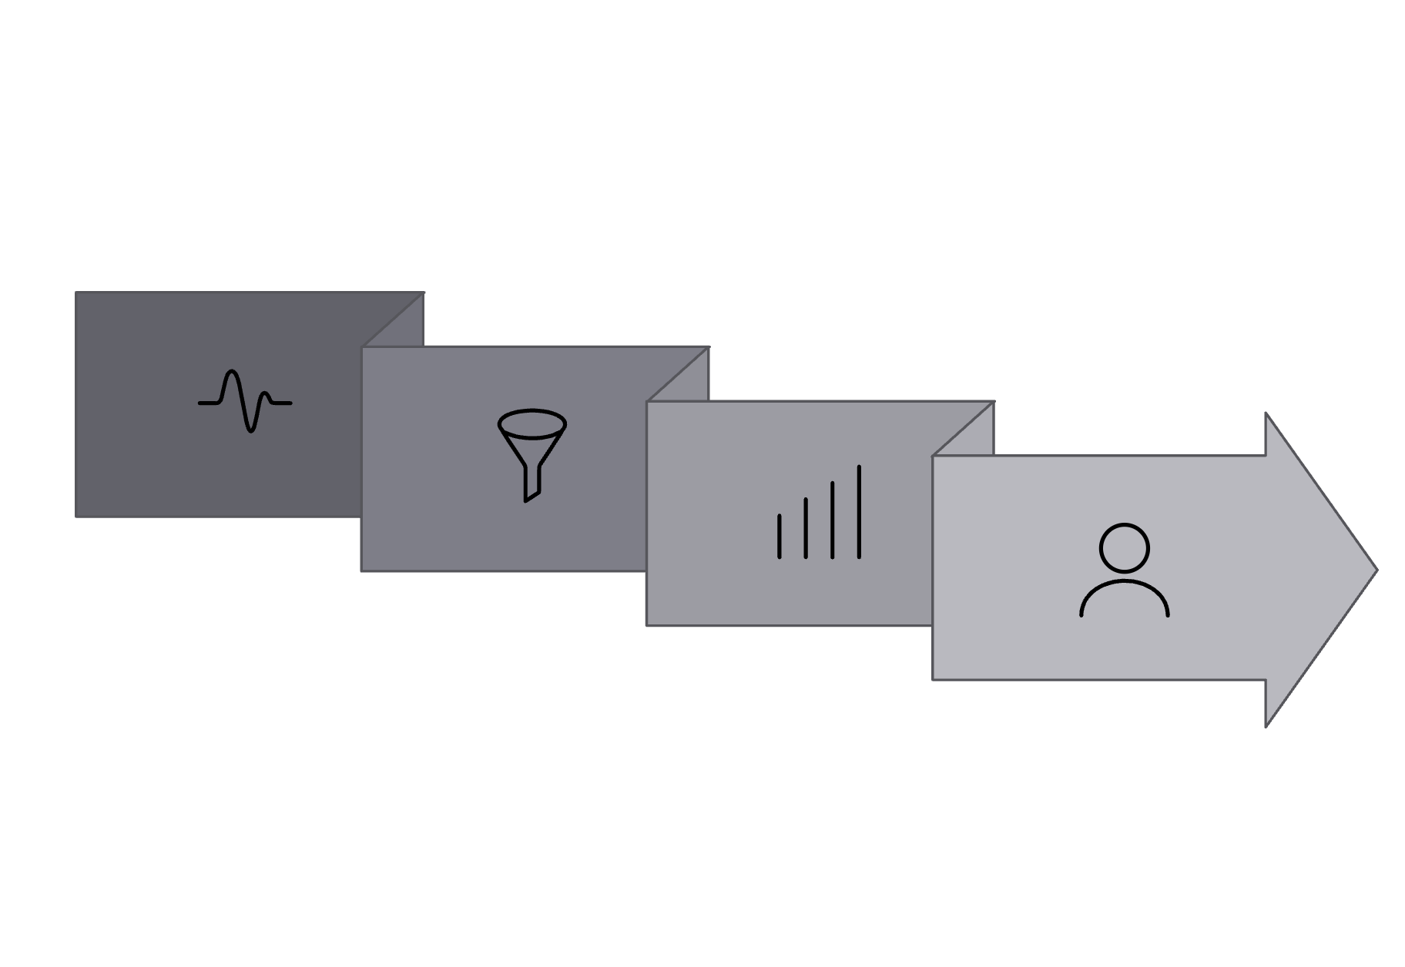

Watch sustained, relevant human sentiment.
WHAT THE COMMAND CENTRE SHOULD WATCH
Signal checklist
Sustained VSS ≤ −14
3 consecutive 15-minute breach windows
Adequate qualifying post volume
Relevant Kestrel / event posts only
Human-origin traffic confirmed
Market-level concentration present
Filter
Human Review
Noise
Prioritise alerts over raw volume. The system surfaces evidence — human review makes the call.
Sustained Signal
Use as an early-warning layer, not an autonomous incident diagnosis tool.

Slide 14

Not every spike deserves escalation.
SIGNAL DISCIPLINE FOR THE COMMAND CENTRE
IGNORE / DOWN-RANK
CANNOT RELIABLY SEE
Raw post-volume spikes without sentiment evidence
Incidents where affected people are not posting
Operational issues expressed in neutral language
Unrelated Kestrel mentions
Sentiment in posts without usable market data
Nuanced sarcasm and context outside rule-based coverage
Automated amplification signals
The system should know when it does not have enough evidence.
Isolated VSS breaches (single window only)
Windows below 220 qualifying posts
Positive sentiment spikes
Repeated text without strong supporting evidence

Slide 15




From noisy social volume to evidence-backed escalation.
FINAL TAKEAWAY
FILTER
TRUST
Remove irrelevant and automated traffic before any scoring begins.
Score sentiment with explicit limitations acknowledged.
COMPARE
ESCALATE
Measure against the same market's 14-day baseline — not absolute thresholds.
Act only on sustained, volume-backed negative shifts — not isolated spikes.
Better monitoring is not about generating more alerts. It is about knowing which signals deserve attention.
Thank you

