Slide 1


SBOM
Shrijee Bill Of Materials
The Optical Character Recognition Software, to automate the calculation Of Bill Of materials.

Slide 2
01
Overview Of New Structural Code.
Table Of Contents
02
Rules While Designing The Drawing.
03
Weekly Updates and Meetings.
04
Future Of The SBOM Project

Slide 3
01
Overview Of New Structural Code

Slide 4




File Name Stored
PDF To PNG
Drawing Details Class
Drawing Number
Sheet Number
Revision Number
Number of Beams
Image Division
Extract Drawing Details
Beam
Angle Cleats
Plates
Get The Text
Get The Text
Get The Text
Sent to Separate Modules Of code

Slide 5


Plate Details Class
Plate Thickness
Plate Dimensions
Plate Quantity
Plate Standard Weight = 7.85
Beam Details Class
Beam Section
Beam Length
Beam Quantity
Angle Cleat Details Class
Angle Cleat Section
Angle Cleat Length
Angle Cleat Quantity
MKD
1
2
3

Slide 6

1)
2)
3)
4)
5)
6)
7)

Slide 7
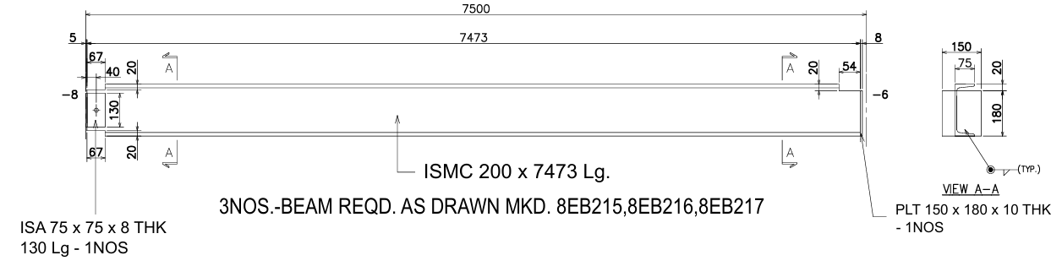

Slide 8
Solution
getSingleMKD()
getCommaSeperatedMKD()
getToKeywordMKD()
Replace MKD characters
Check If MKD
MKD text
Store in MKD list

Slide 9
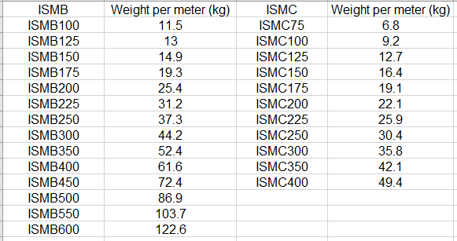
ISMB And ISMC Values
Standard Values Present in Sheet 2
New Feature
If later you want to change the section of the beam, the standard weight, weight, total weight would be automatically reflected in the bill of materials using excel formulas.

Slide 10
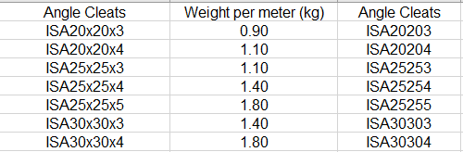
Angle Cleats
ISA 75x758 THK
ISA 7575x8 THK
ISA 75x75x8 THK

Slide 11
Plates
Plate Details Class
Plate Thickness
Plate Dimensions
Plate Quantity
Plate Standard Weight = 7.85
Get The Text
Formula Used To Calculate The Weight
=(VALUE(LEFT(F{$row}, FIND("THK", F{$row})-1)) * VALUE(LEFT(G{$row}, FIND("x", G{$row})-1)) * RIGHT(G{$row}, LEN(G{$row}) - FIND("x", G{$row})) * H{$row} * I{$row})/1000000

Slide 12

Multiple Files be Uploaded
Downloaded Excel Sheets can be retrieved directly from the Downloads Folder

Slide 13
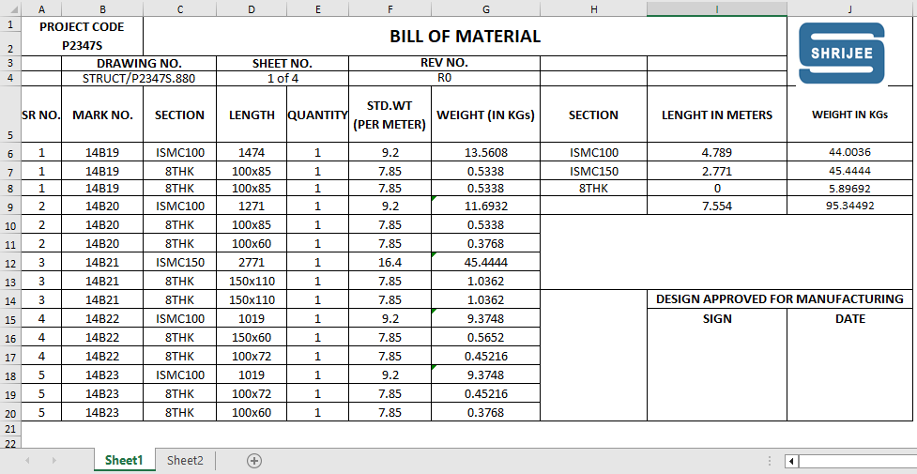
Inserting Data into Standard Excel Sheets

Slide 14
Excel Text Formatting
Alignment Of Inserted Data - Center
Font Name
Font Size
Borders styling to each cell
Merging particular Excel rows and columns
Dynamic Insertion Of text = “Design Approved For Manufacturing”, Sign and Date.
Written by our team in the code of the SBOM.

Slide 15
02
Rules While Designing The Drawing

Slide 16
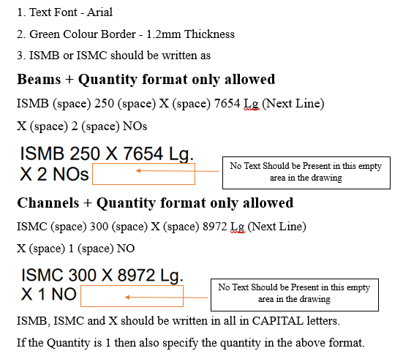
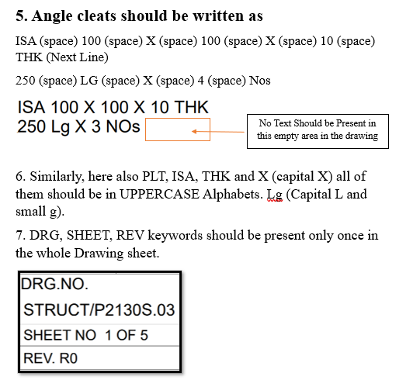
Rules For Drafting Binder Drawings

Slide 17
Thank You

