Slide 1

PBL PROJECT REVIEW
AgroSense
Smart Greenhouse Monitoring & Irrigation Management System
PROJECT GUIDE
Dr. Karumuri Sri Rama Murthy
Asst. Professor, Department of CSE
KLU Hyderabad, Hyderabad
TEAM NO: 20
2520040096
K. Prasanna
2520040118
A. Sai Pranay
Department of Computer Science & Engineering · KLU Hyderabad

Slide 2
Abstract
AgroSense is a web-based smart greenhouse monitoring and irrigation system.
It tracks soil moisture, temperature, humidity and light for three crop zones: Tomato, Capsicum and Lettuce.
ESP32 sensor nodes publish readings over MQTT to a Node.js server that stores data in PostgreSQL/TimescaleDB.
A rule engine raises warning and critical alerts when soil moisture falls below crop-specific limits.
Automatic irrigation switches pumps ON/OFF, with manual override for the grower.
A React dashboard shows live values, trends and alerts; a built-in simulator allows demonstration without hardware.
3
Crop zones
4
Sensor parameters
5 s
Dashboard refresh

Slide 3
Technologies Used
FRONT-END
BACK-END / MIDDLEWARE
DATABASE
React 18 (JSX components)
Vite 5 build tool
Recharts (live & trend charts)
Socket.IO client
Custom responsive CSS
Node.js 18+ with Express 4
MQTT client + Eclipse Mosquitto broker
Socket.IO (WebSocket) & SSE alert stream
CORS, JSON parser, logger, rate limiter
dotenv configuration
PostgreSQL (pg driver)
TimescaleDB hypertable for readings
Tables: zones, readings, alerts
In-memory store fallback for demo
IoT hardware: ESP32 · capacitive soil-moisture probe · DHT22 · LDR · relay + pump (Arduino C++) Deployment: Docker Compose · Render (API) · Vercel (web)

Slide 4
Problem Description
1
Manual monitoring
Growers check soil and climate by hand, so problems are noticed late.
OUR SOLUTION
AgroSense continuously monitors every crop zone, alerts the grower when conditions go out of range and automates irrigation using per-crop thresholds.
2
Water wastage
Fixed-schedule watering over-irrigates or under-irrigates crops with different needs.
3
No early warning
Heat stress or dry soil is found only after crop damage has started.
4
No data history
Without stored readings, trends cannot be analysed to improve yield.
Result: less water, healthier crops, less manual work.
5
Different crop needs
Tomato, capsicum and lettuce need different moisture thresholds.

Slide 5
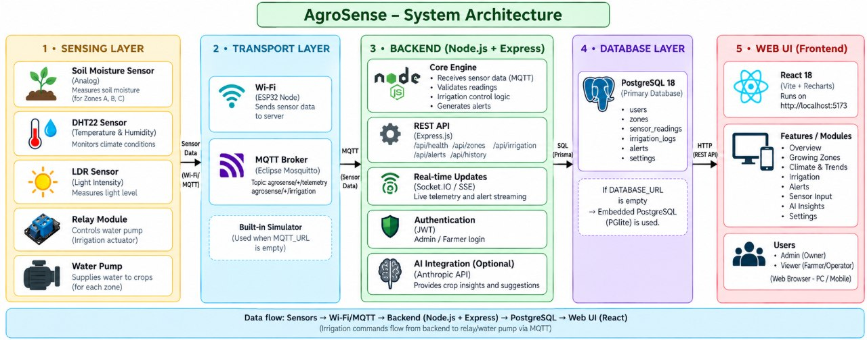
Architecture Diagram
Five-layer design: Sensing → Transport (MQTT) → Backend (Node.js) → Database (PostgreSQL/TimescaleDB) → React web UI.

Slide 6
Implementation Details – Modules
Firmware (ESP32)
Core engine (core.js)
Reads soil moisture (GPIO 34), DHT22 and LDR every 2 s; publishes JSON to agrosense/<zone>/telemetry; drives the relay from agrosense/<zone>/irrigation.
Validates each reading, stores it, broadcasts it and applies threshold rules. Alerts are de-duplicated for 90 s.
Simulator (simulator.js)
REST + real-time API
Generates 24 h of back-filled history and live readings every 2 s when no MQTT broker is configured.
Express routes for zones, history, alerts and irrigation control; Socket.IO pushes telemetry; SSE streams alerts.
Storage (store.js)
React dashboard
Saves readings and alerts to PostgreSQL/TimescaleDB; automatically falls back to memory.
Seven pages (Overview, Zones, Climate, Irrigation, Alerts, Live sensors, Settings), each opening in its own tab; refreshes every 3 s.

Slide 7
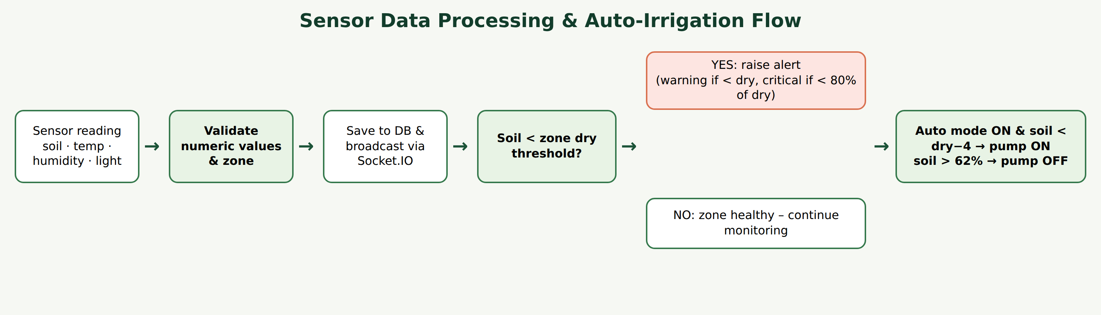
Implementation Details – Alert & Irrigation Logic
Zone | Crop | Dry threshold | Critical alert below | Pump ON below
A | Tomato | 32 % | 25.6 % | 28 %
B | Capsicum | 30 % | 24 % | 26 %
C | Lettuce | 38 % | 30.4 % | 34 %
Other rules
Air temperature > 34 °C → heat warning
Pump OFF automatically when soil > 62 %
Manual toggle switches auto mode off

Slide 8
Implementation Details – API & Database
REST API endpoints
Database schema
Method | Endpoint | Purpose
GET | /api/health | Status, uptime, store type
GET | /api/zones | Zones with latest reading & relay
GET | /api/history | Bucketed history (1–168 h)
GET | /api/alerts | Last 30 alerts
GET | /api/alerts/stream | SSE live alert feed
POST | /api/irrigation/:zone | Set pump on/off & auto mode
zones
id (PK) · name · crop · dry_threshold
readings (TimescaleDB hypertable)
time · zone (FK) · soil_moisture · temperature · humidity · light
alerts
id (PK) · time · zone · level · message
Index readings_zone_time (zone, time DESC) speeds up trend queries.

Slide 9
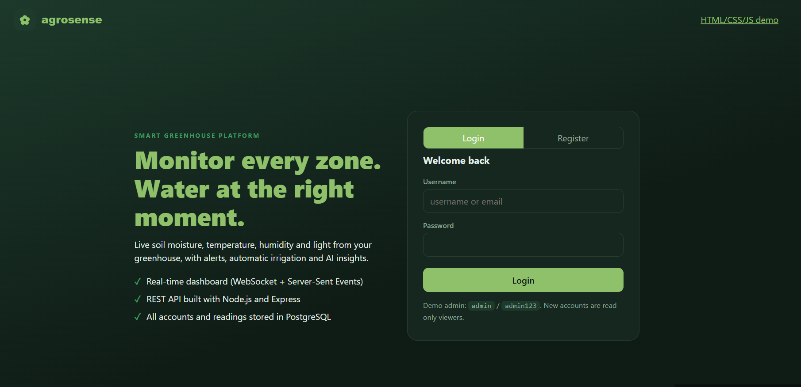
Output Screens – Register / Login
Overview: live averages of soil moisture, temperature, humidity and light, plus zone status cards
Notes:
Overview page of the AgroSense dashboard.

Slide 10
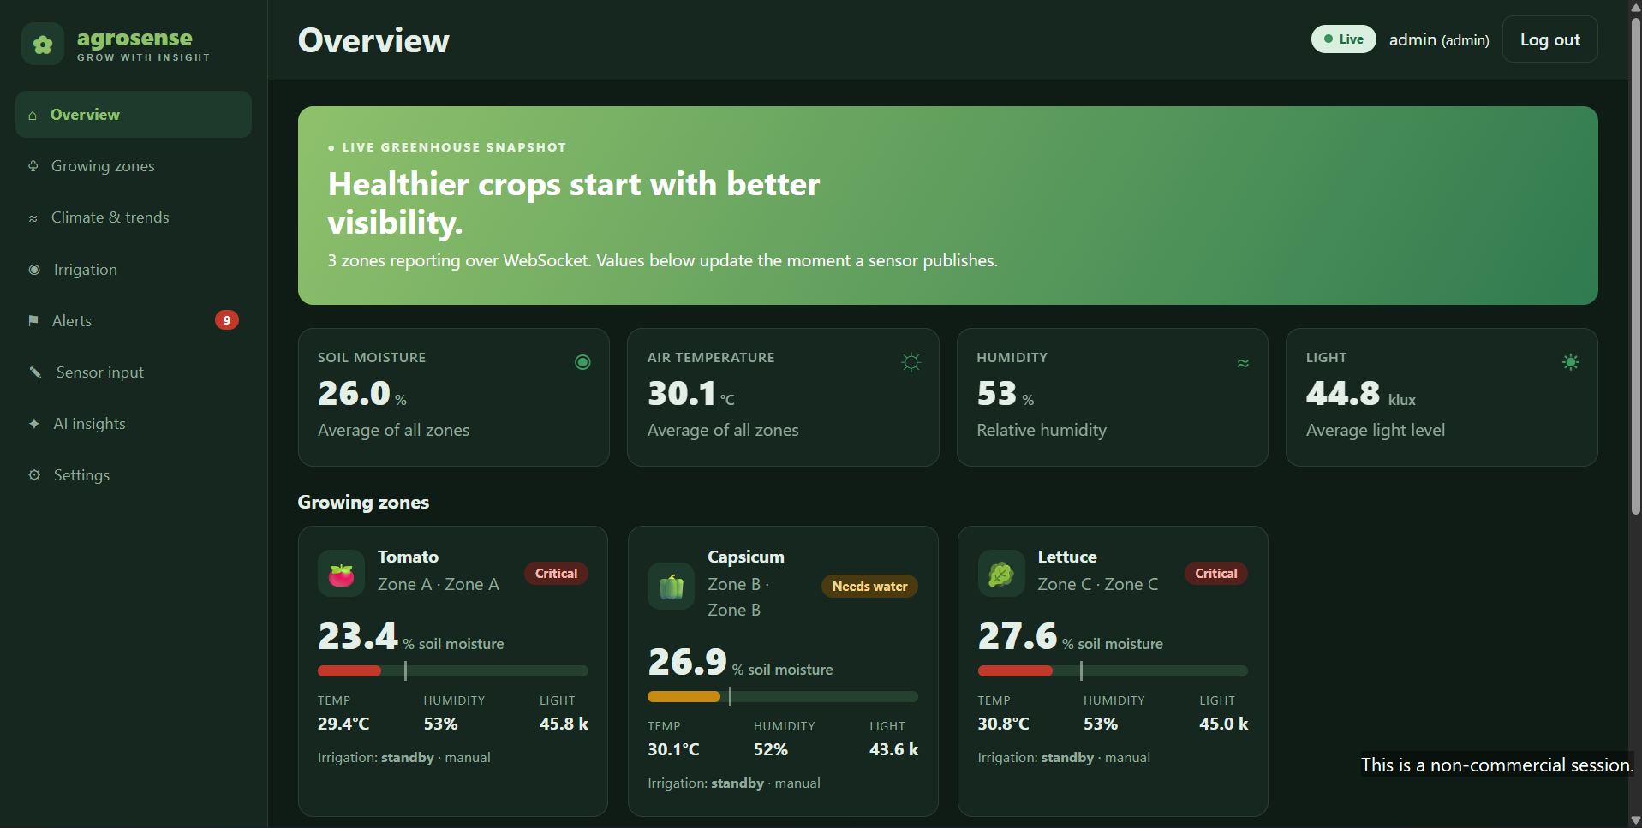
Output Screens – Overview Dashboard
Overview: live averages of soil moisture, temperature, humidity and light, plus zone status cards
Notes:
Overview page of the AgroSense dashboard.

Slide 11
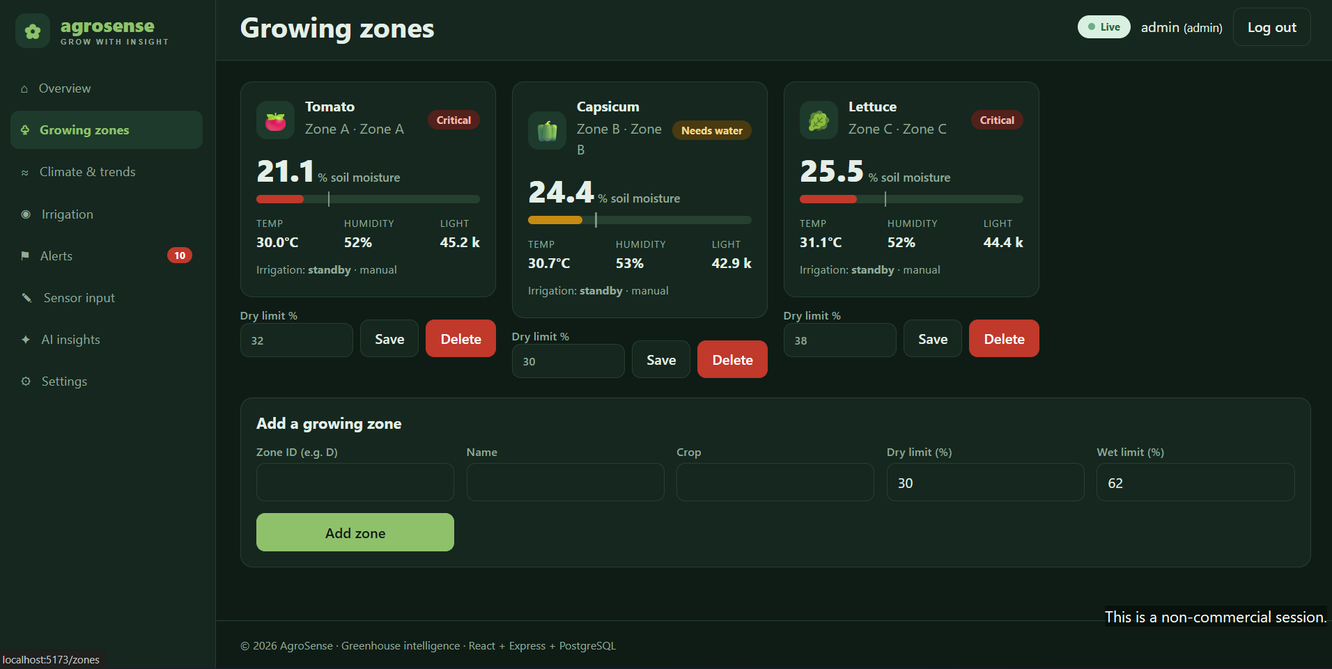
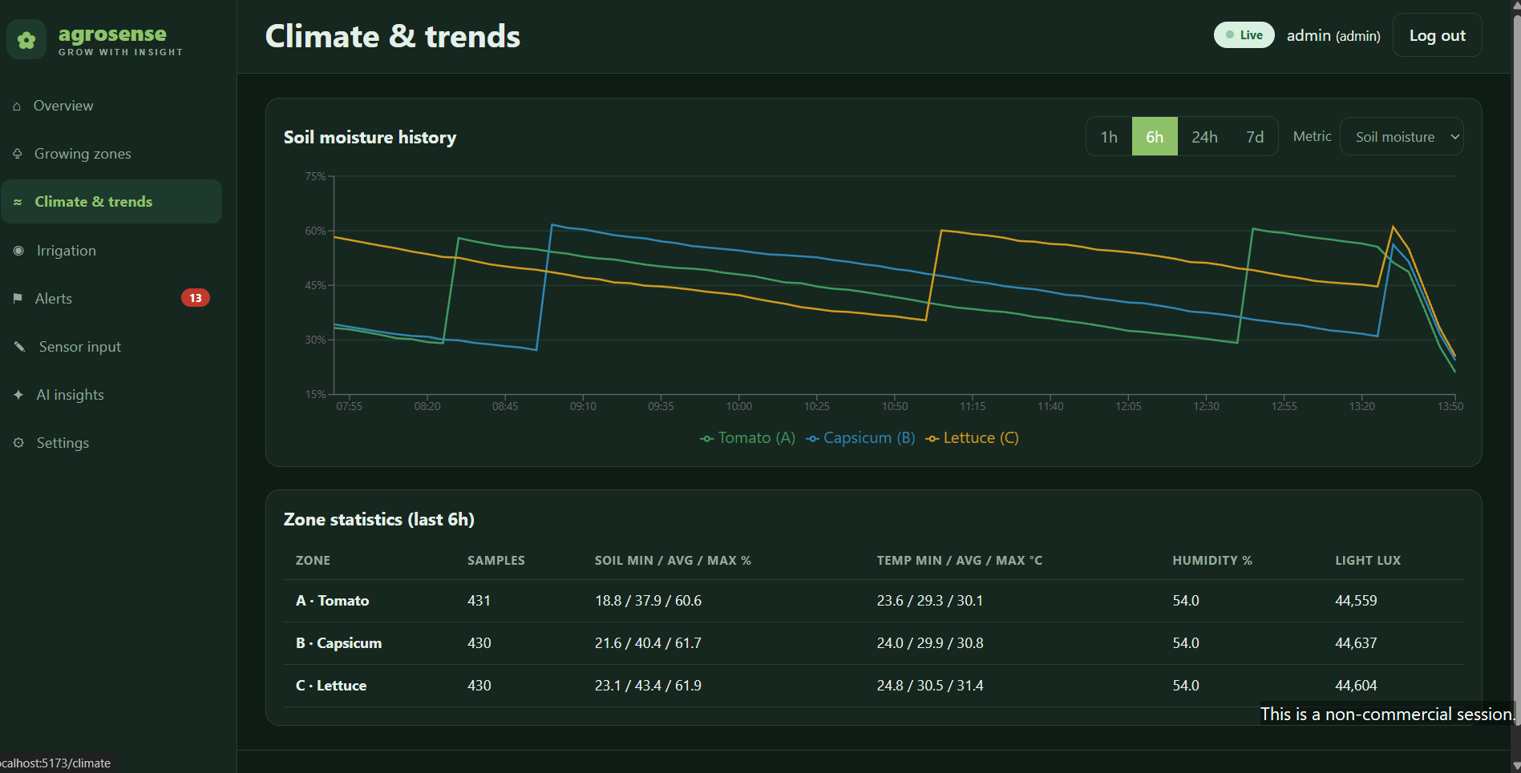
Output Screens – Growing Zones & Climate Trends
Growing zones – per-crop status
Climate & trends

Slide 12
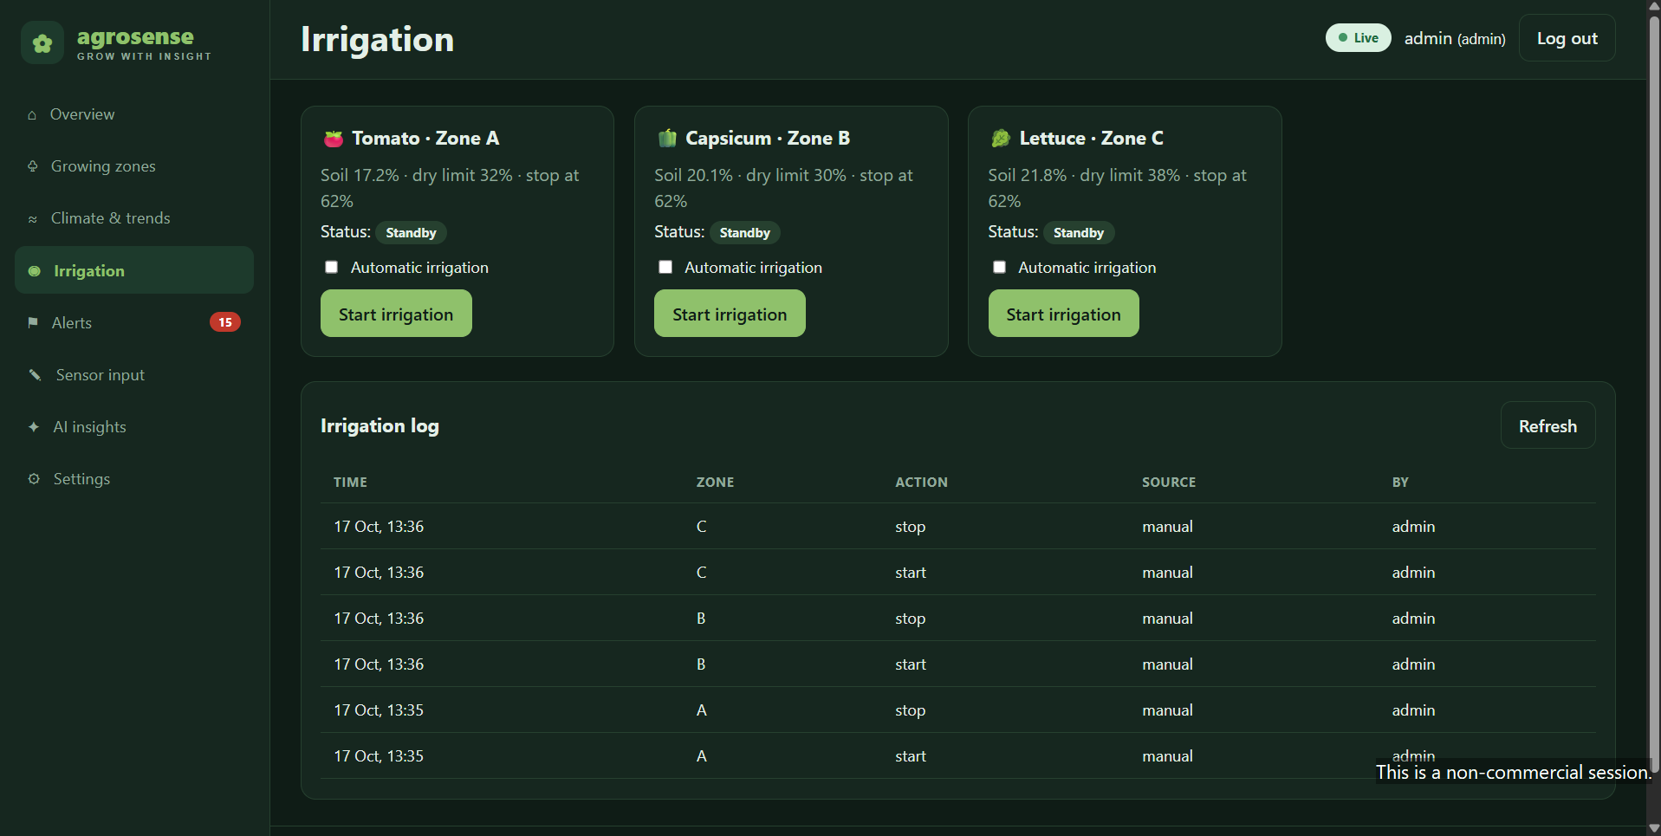
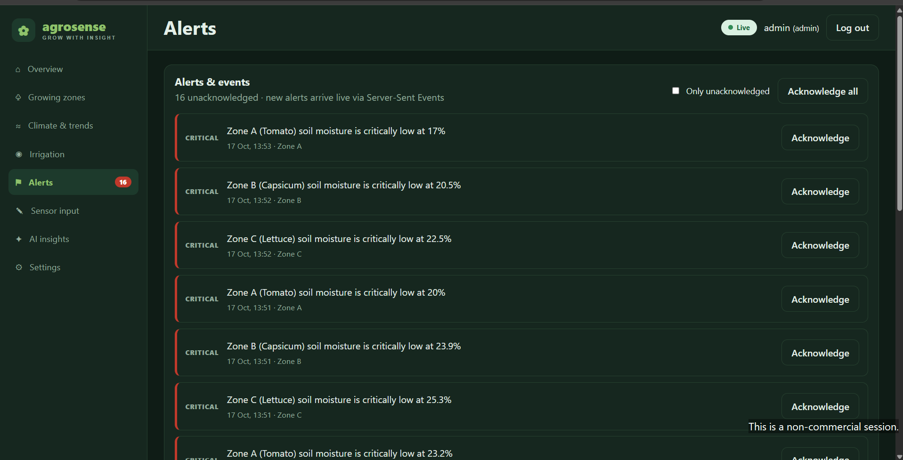
Output Screens – Irrigation Control & Alerts
Irrigation – manual & auto control
Alerts & events

Slide 13
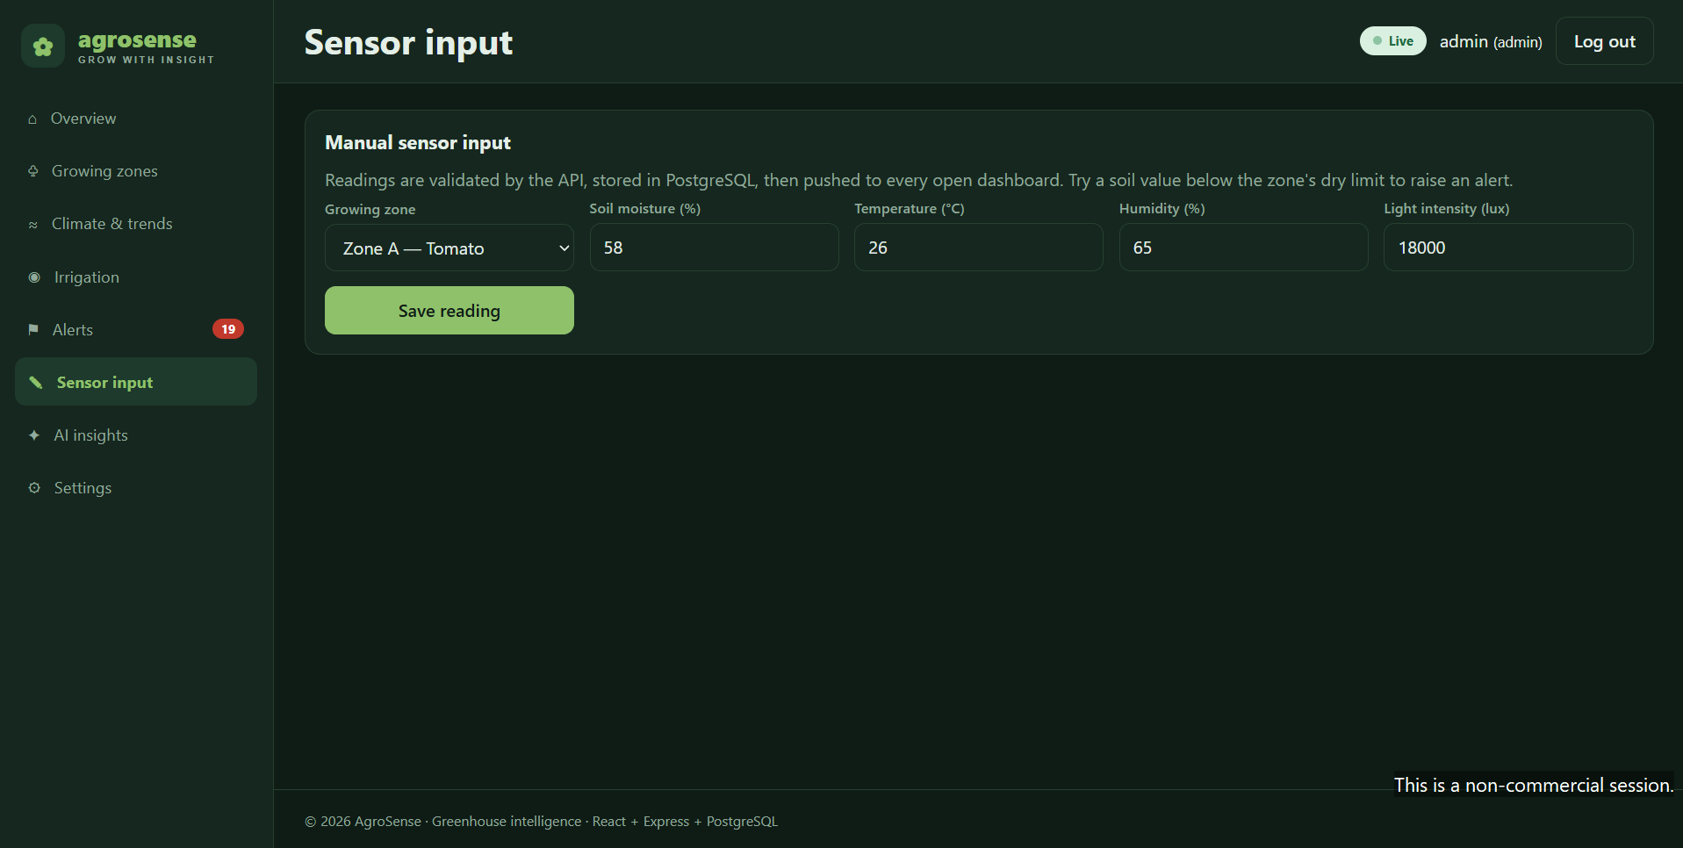
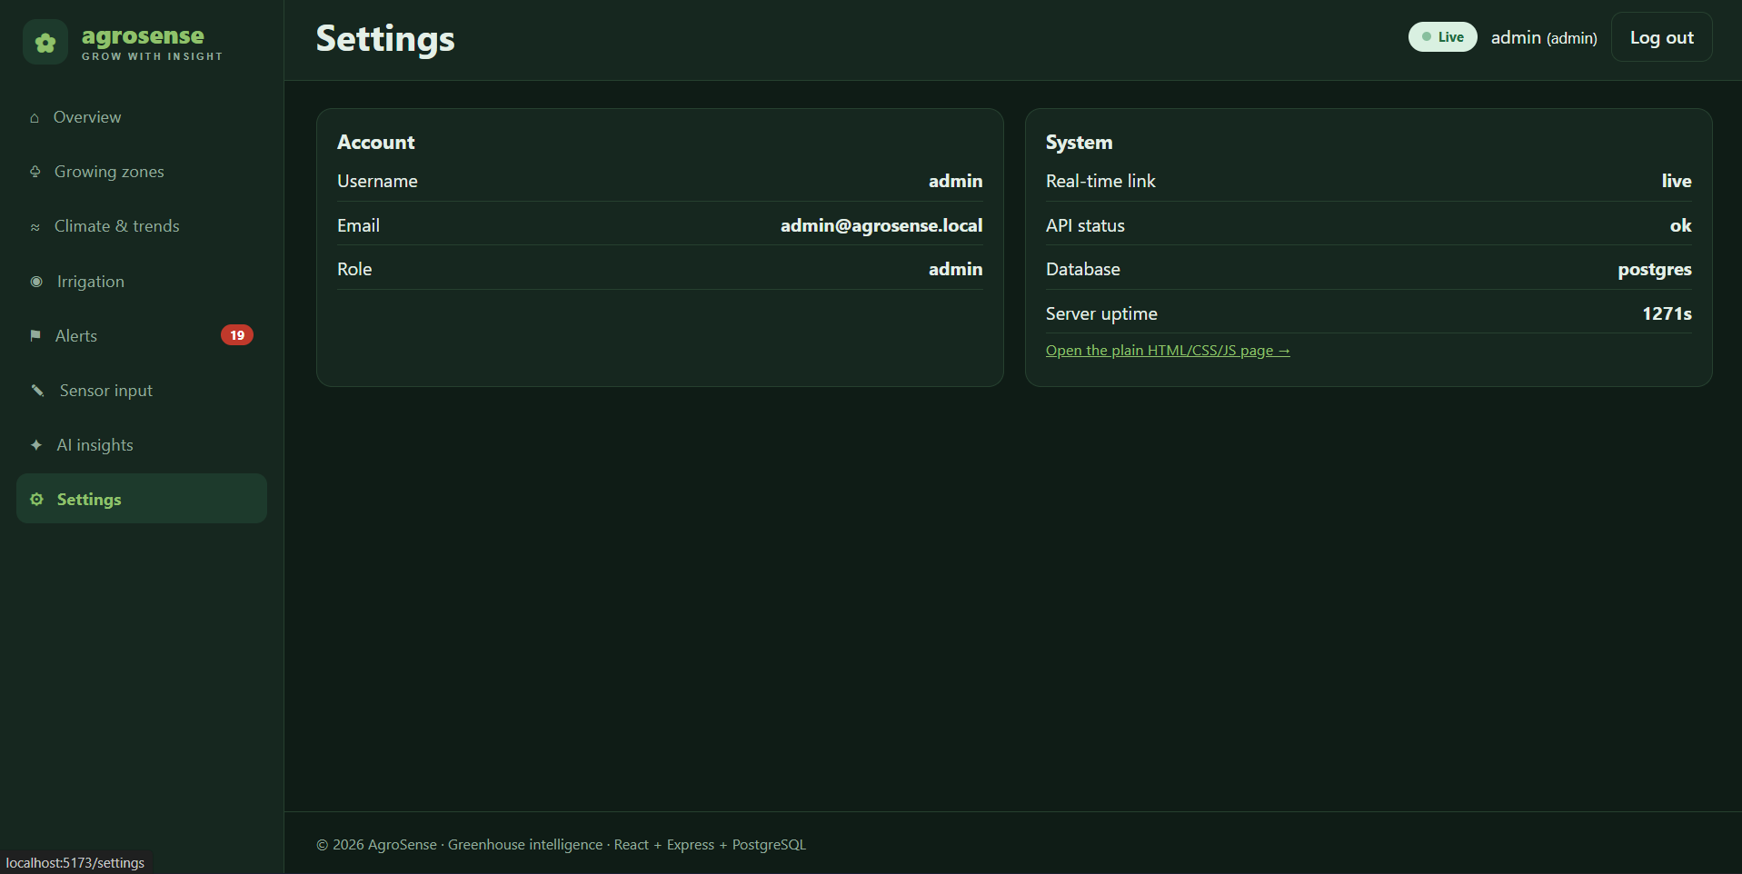
Output Screens – Live Sensors & Settings
Live sensor monitor (auto-refresh)
Workspace settings

Slide 14
Future Enhancements
1
2
3
Connect UI to live API
Predictive analytics
Notifications
Wire the React dashboard to the Socket.IO/REST backend and real ESP32 nodes.
ML models to forecast soil-moisture drop and recommend irrigation time.
SMS / WhatsApp / e-mail alerts and a mobile app for growers.
4
5
6
User accounts
More sensors & actuators
Solar & edge power
Authentication, roles and multi-greenhouse support.
pH, EC, CO₂, fans, vents, shade nets and fertigation control.
Solar-powered nodes with LoRa for large farms.

Slide 15
Thank You
AgroSense – grow with insight

