Slide 1

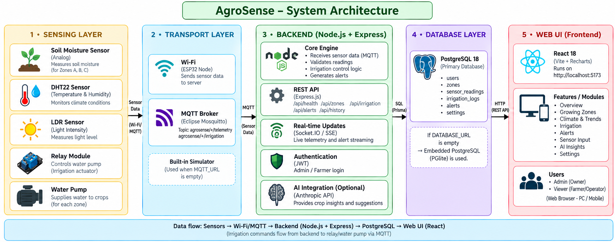
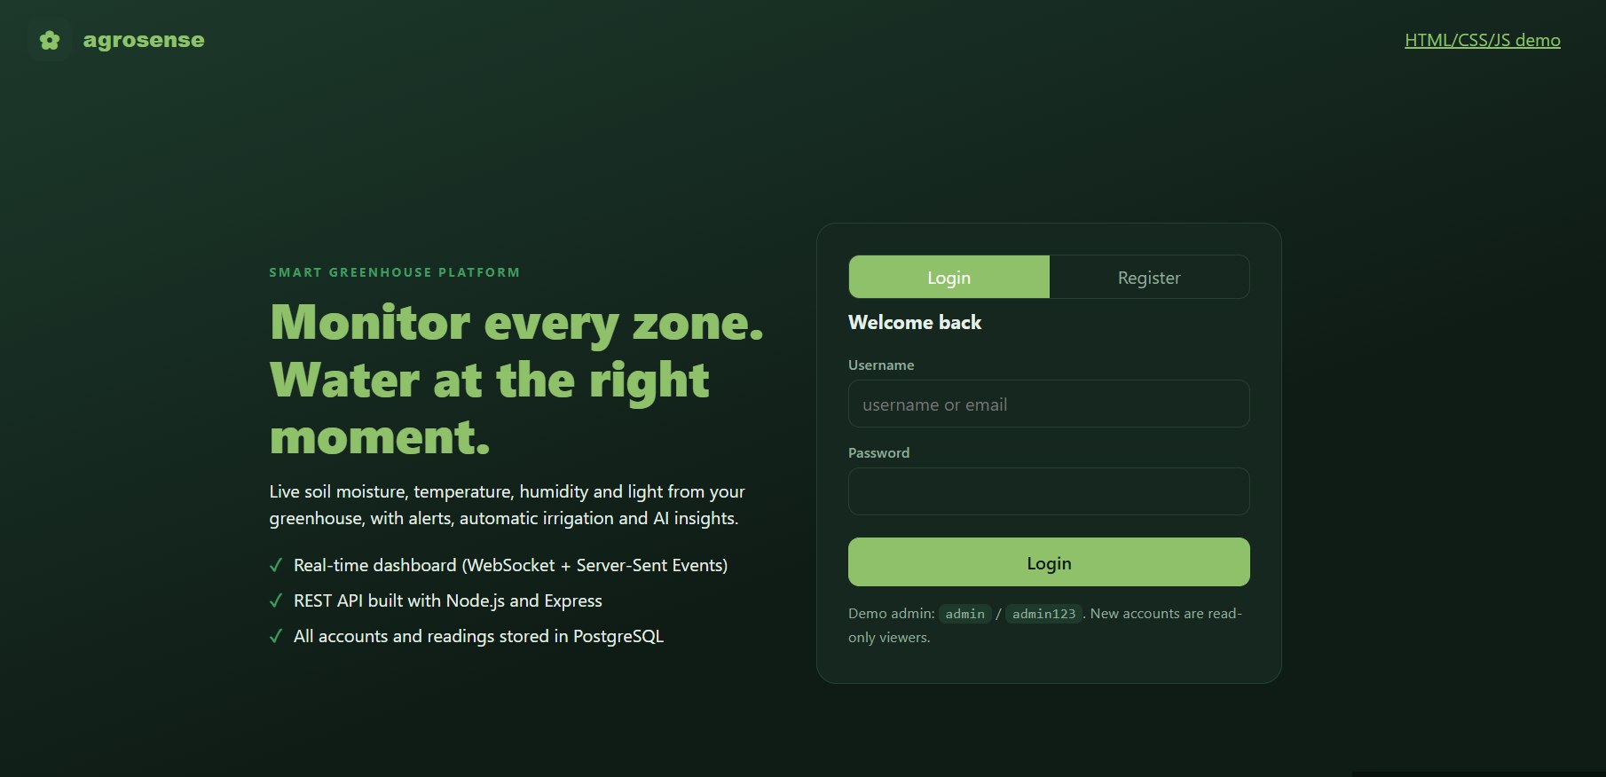
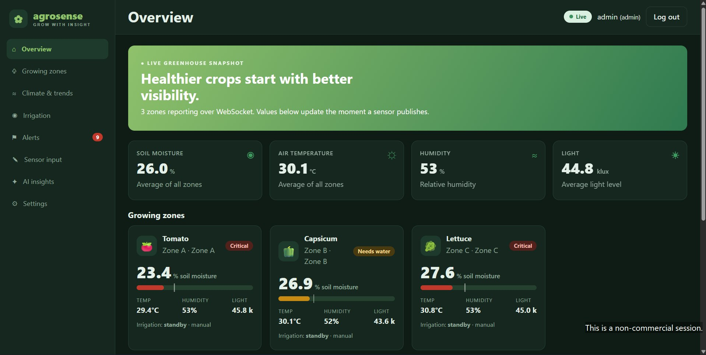
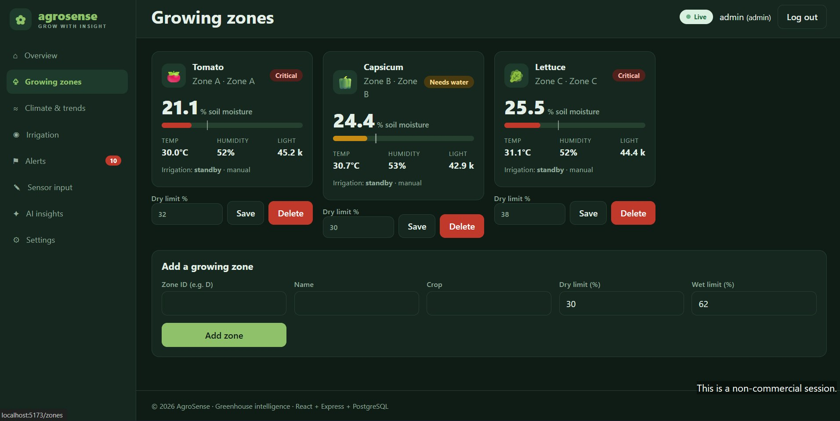
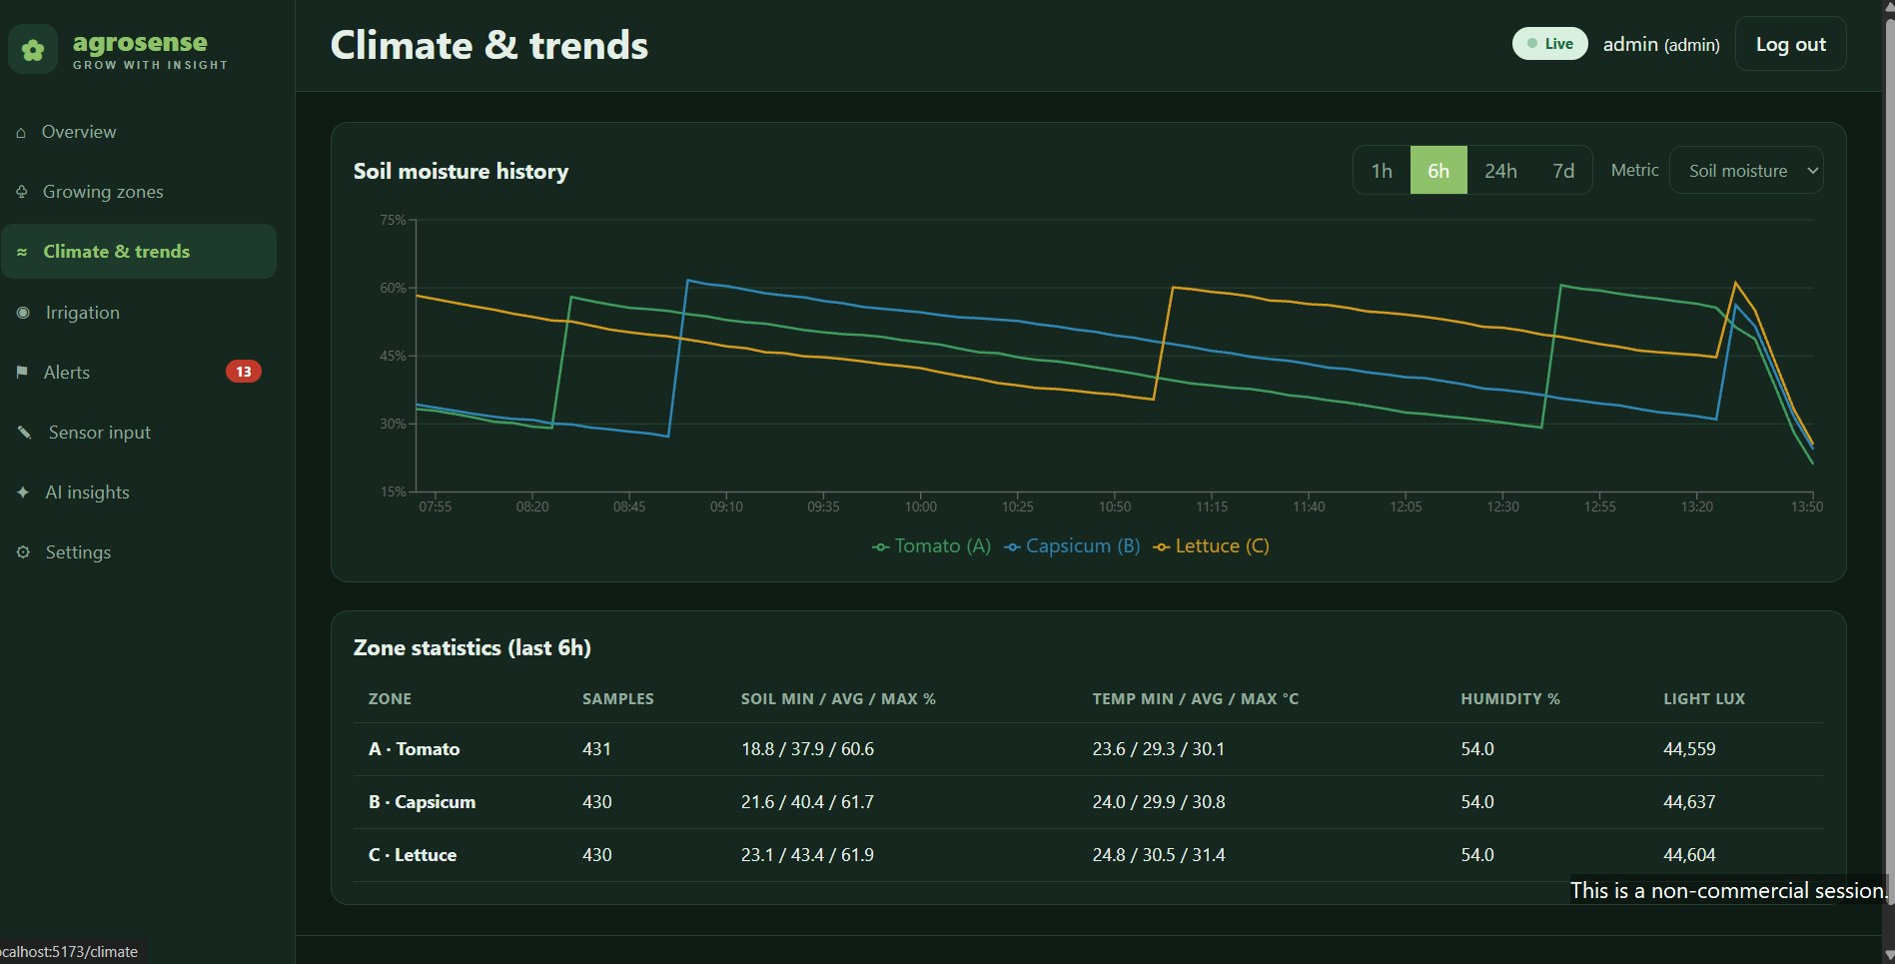
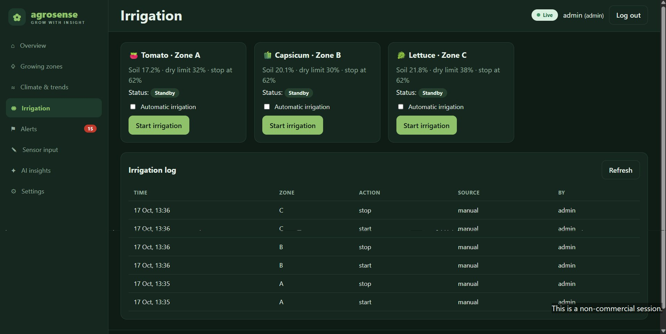
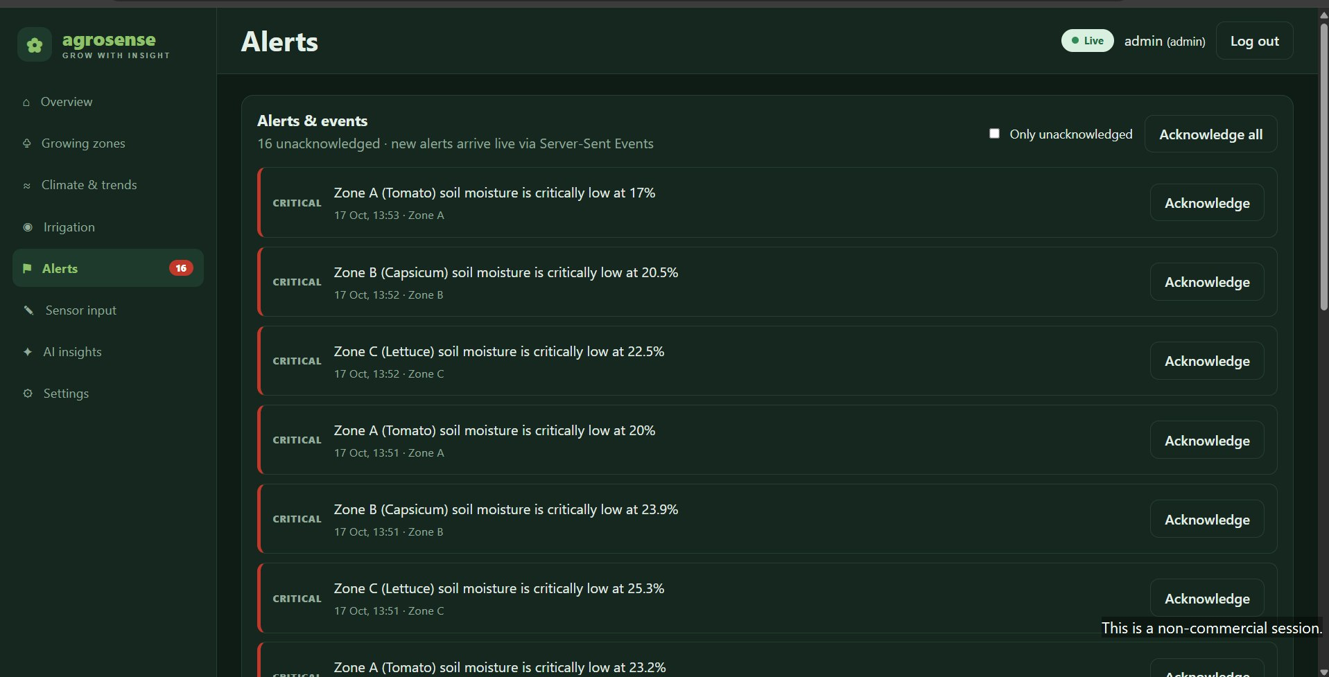
AgroSense
Smart Greenhouse Monitoring & Irrigation Management System
PBL Project · Team No: 1 · Department of CSE, KLU Hyderabad | Guide: Dr. Karumuri Sri Rama Murthy, Asst. Professor
1. PROJECT DESCRIPTION
AgroSense is a web-based smart greenhouse system that monitors soil moisture, temperature, humidity and light for three crop zones (Tomato, Capsicum, Lettuce) and automates irrigation.
ESP32 sensor nodes publish readings over MQTT to a Node.js server that stores data in PostgreSQL/TimescaleDB.
A rule engine raises warning/critical alerts when soil moisture falls below crop-specific thresholds.
Pumps switch ON/OFF automatically, with manual override.
A responsive React dashboard shows live values, trends and alerts; a built-in simulator works without hardware.
Frontend React 18 · Vite · Recharts
Backend Node.js · Express · Socket.IO
Database PostgreSQL · TimescaleDB
IoT ESP32 · DHT22 · MQTT
2. ARCHITECTURE DIAGRAM
Telemetry: sensor → MQTT → backend → database → web UI. Commands: dashboard → backend → MQTT → relay/pump.
3. TEAM DETAILS
K. Prasanna
A. Sai Pranay
PROJECT GUIDE
Dr. Karumuri Sri Rama Murthy
Asst. Professor, Dept. of CSE
KLU Hyderabad
TEAM NO: 20
2520040096
2520040118
4. OUTPUT SCREENS

