Slide 1

Trending Video Analysis

Slide 2
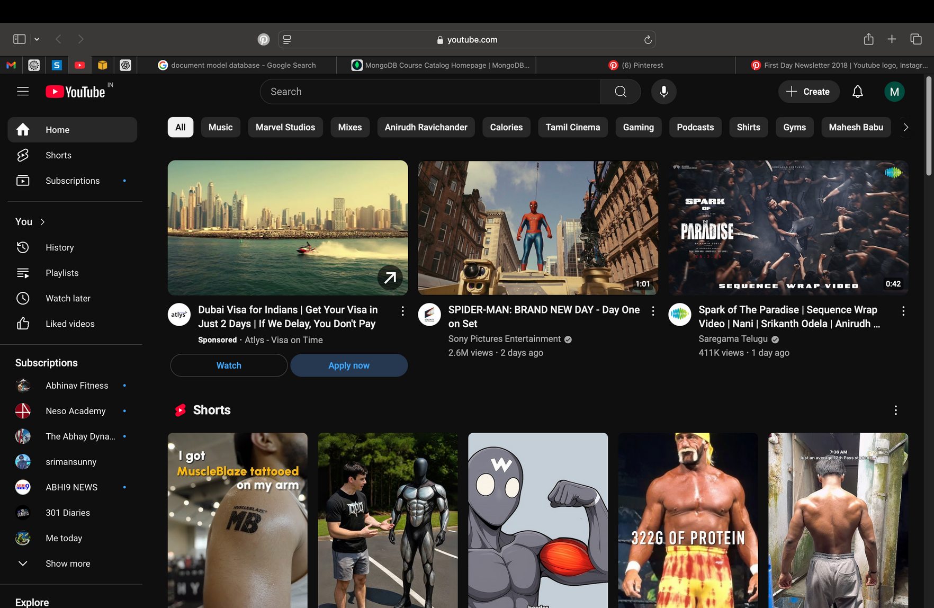
Introduction:
YouTube is one of the biggest platforms for videos, with millions of uploads daily.
The trending section highlights videos that are currently the most popular.

Slide 3
Objectives
Find out which types of videos appear most often in the trending list.
Study the role of views, likes, and comments in making a video trend.
Check if video category and upload timing affect popularity.

Slide 4
How I Did It ?!
Data Collection:
Collecting trending video data from YouTube using a dataset.
Data Cleaning:
Cleaning the data to remove duplicates and fix missing values.
Analysis:
Used charts and graphs to understand patterns in the data.

Slide 5
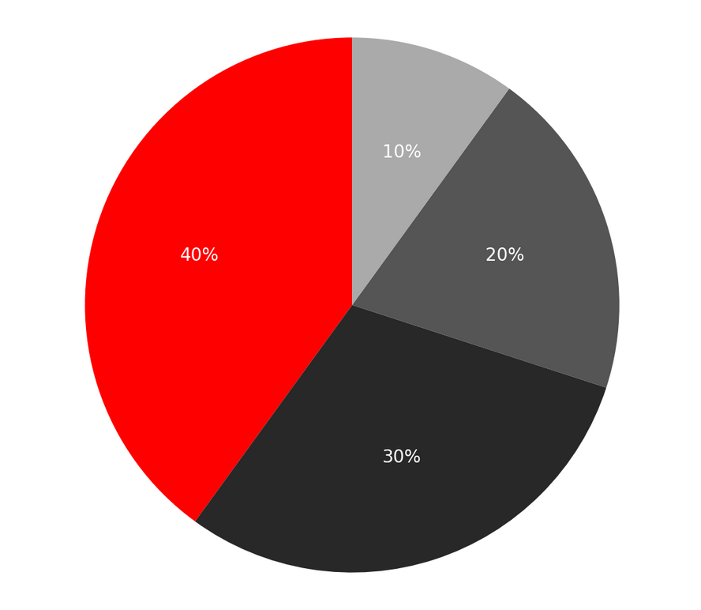
Key Observations:
Music, Entertainment, and News are the most common trending categories.
Videos with more likes and comments usually trend faster.
Posting videos at certain peak times helps them gain attention quickly.
Music – 40%
Entertainment – 30%
News – 20%
Others – 10%

Slide 6
Conclusion:
Trending videos are influenced by category, engagement, and timing.
These findings can help creators make better decisionsfor their content.
Trending content often follows current events, viral challenges, or memes.

