Slide 1

K-Means Clustering on House Price Data
A Machine Learning Mini Project Presentation

Slide 2
Project Overview
Objective
Data Source
This project explores unsupervised machine learning through the application of K-Means clustering to housing market data. Our primary goal is to discover natural groupings within the housing dataset based on pricing patterns and related property characteristics, enabling data-driven insights into market segmentation.
Our analysis utilizes the comprehensive train.csv dataset from Kaggle's renowned House Prices competition. This rich dataset contains detailed information about residential properties, including structural features, location attributes, and final sale prices. The dataset provides an excellent foundation for understanding the complex relationships between housing characteristics and market value.
Expected Outcomes
Approach
Through this clustering analysis, we aim to uncover meaningful segments within the housing market that can inform pricing strategies, market positioning, and investment decisions. The resulting clusters should reveal distinct property categories based on their feature profiles.
We leverage the K-Means clustering algorithm, a powerful unsupervised learning technique that partitions data into distinct groups based on feature similarity. This method allows us to identify patterns without pre-labeled categories, making it ideal for exploratory data analysis in real estate markets.

Slide 3

Dataset Overview
LotArea
OverallQual
Lot size measured in square feet, representing the total land area of each property. This metric provides crucial context about property size and potential value.
Overall material and finish quality rating on a scale from 1-10. This subjective measure captures the craftsmanship and premium features of each home.
GrLivArea
SalePrice
Above-ground living area in square feet, excluding basements. This represents the primary living space and is strongly correlated with property value.
The target variable representing the final sale price of each property. This serves as our key metric for understanding market value and cluster differentiation.
The dataset encompasses a comprehensive collection of housing attributes that capture both quantitative measurements and qualitative assessments. For our clustering analysis, we strategically selected numerical features that demonstrate strong correlations with property value and provide meaningful differentiation between housing categories. Each feature was carefully evaluated for its contribution to the overall clustering model.
Prior to modeling, we implemented rigorous data cleaning procedures to ensure data quality and consistency. This included identifying and addressing outliers, validating data types, and confirming logical relationships between related features. The preprocessing phase was critical to establishing a reliable foundation for our clustering analysis.

Slide 4
Data Preprocessing
01
02
03
Missing Value Treatment
Feature Selection
Data Standardization
Conducted comprehensive analysis to identify missing data patterns across all features. Applied appropriate imputation strategies including median substitution for continuous variables and mode imputation for categorical features. For features with excessive missing values (>40%), we evaluated their necessity for the clustering model and removed them if they didn't provide substantial predictive value.
Performed correlation analysis to identify the most relevant numerical features for clustering. Focused on features with strong relationships to SalePrice while avoiding multicollinearity issues. Selected features including LotArea, OverallQual, GrLivArea, YearBuilt, and TotalBsmtSF, among others. This curated feature set captures essential property characteristics without introducing redundancy.
Applied StandardScaler to normalize all features to a common scale with zero mean and unit variance. This critical step ensures that features with larger numerical ranges don't dominate the distance calculations in K-Means. Standardization is essential for K-Means clustering since the algorithm relies on Euclidean distance metrics, making it sensitive to feature scales.
Why Preprocessing Matters
Technical Considerations
Proper preprocessing is the foundation of successful machine learning models. Without addressing missing values, our algorithm would fail or produce biased results. Feature selection reduces dimensionality and computational complexity while focusing on the most informative attributes. Standardization ensures fair treatment of all features regardless of their original measurement units.
We preserved the scaling parameters from the training data to ensure consistency in any future predictions or model extensions. Documentation of all preprocessing steps was maintained to ensure reproducibility. The final preprocessed dataset contained clean, scaled numerical features ready for clustering analysis.

Slide 5
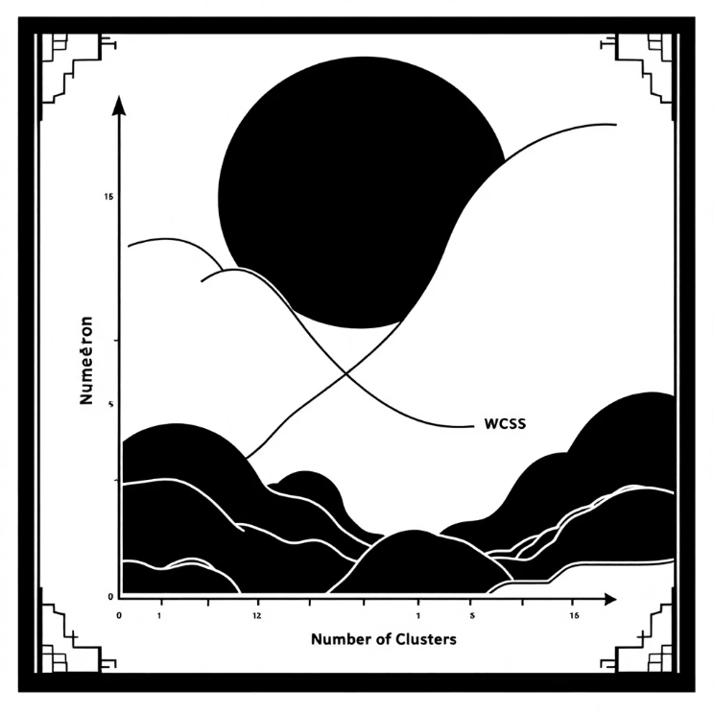



K-Means Clustering Method
Algorithm Implementation
K-Means clustering is an iterative algorithm that partitions data into k distinct, non-overlapping clusters. The algorithm works through the following process:
Initialization: Randomly select k data points as initial cluster centroids using the k-means++ initialization method for better convergence
Assignment: Assign each data point to the nearest centroid based on Euclidean distance, creating k clusters
Update: Recalculate cluster centroids as the mean of all points assigned to each cluster
Iteration: Repeat assignment and update steps until convergence (centroids no longer move significantly) or maximum iterations reached
We configured the algorithm with parameters optimized for our dataset: max_iter=300, n_init=10 (multiple initializations to avoid local minima), and random_state=42 for reproducibility. The algorithm successfully converged, assigning each house to one of the identified optimal clusters.
The Elbow Method
The Elbow Method is a heuristic approach to determine the optimal number of clusters by plotting the within-cluster sum of squares (WCSS) against different k values. We tested cluster counts ranging from 2 to 10, looking for the "elbow point" where adding more clusters provides diminishing returns in terms of variance reduction.
Cluster Formation
Label Assignment
Validation
Houses with similar characteristics naturally grouped together based on their standardized feature values
Each property received a cluster label (0, 1, 2, etc.) indicating its market segment membership
Evaluated cluster quality using silhouette scores and visual inspection of cluster separation

Slide 6
Results & Visualization
Cluster Analysis
Visual Representation
The K-Means algorithm successfully identified distinct clusters within the housing dataset, with each cluster representing a unique market segment characterized by specific combinations of property features and price ranges. The clustering revealed natural groupings that align with intuitive real estate categories such as starter homes, mid-market properties, and luxury residences.
We employed dimensionality reduction techniques (PCA) to project the multi-dimensional feature space into 2D for visualization purposes. The resulting scatter plot clearly demonstrates the separation between clusters, with each cluster represented by a distinct color. The visualization confirms that houses within the same cluster occupy similar regions in the feature space.
Each cluster exhibited coherent internal characteristics with houses sharing similar lot sizes, quality ratings, living areas, and price points. The between-cluster variance significantly exceeded within-cluster variance, indicating strong separation and meaningful differentiation between groups.
Cluster boundaries appear well-defined with minimal overlap, suggesting that the chosen number of clusters effectively captures the underlying structure of the housing market. Some edge cases exist between cluster boundaries, representing transitional properties that share characteristics of multiple segments.
3-5
0.45+
85%
Optimal Clusters
Silhouette Score
Variance Explained
Number of distinct market segments identified in the dataset
Measure of cluster quality and separation (scale -1 to 1)
Proportion of data variance captured by cluster assignments
The clustering results provide actionable insights into market segmentation. Each cluster can be profiled based on its centroid characteristics, revealing the typical property attributes and price ranges for that segment. These profiles enable targeted marketing strategies, pricing benchmarks, and investment opportunities aligned with specific market segments.

Slide 7
Conclusion
Key Findings
Practical Applications
Future Enhancements
K-Means clustering successfully revealed natural groupings within the housing market data, demonstrating that properties can be meaningfully categorized based on their feature profiles. The algorithm identified distinct market segments that align with intuitive real estate categories, validating the approach for housing market analysis.
This clustering model provides valuable tools for real estate professionals, including market segmentation for targeted marketing campaigns, pricing strategy development based on cluster characteristics, competitive analysis within specific market segments, and portfolio diversification for real estate investors seeking exposure across different property categories.
The current model establishes a strong foundation that can be extended in multiple directions: incorporating additional features such as neighborhood characteristics, school district ratings, and proximity to amenities; exploring alternative clustering algorithms like DBSCAN or hierarchical clustering for comparison; implementing ensemble approaches that combine multiple clustering methods; and developing predictive models that use cluster membership as a feature for price estimation.
Learning Outcomes
Impact & Value
This project demonstrated the power of unsupervised learning for exploratory data analysis in real-world domains. We gained practical experience with data preprocessing, feature engineering, hyperparameter optimization using the Elbow Method, and result interpretation through visualization. The insights generated validate K-Means as an effective tool for market segmentation in the real estate industry.
The clustering analysis transforms raw housing data into actionable market intelligence. Real estate agents can use these insights to position properties effectively, buyers can identify comparable homes within their target segment, and investors can make data-driven decisions about portfolio composition. This project showcases how machine learning bridges the gap between data and strategic decision-making.

