Slide 1


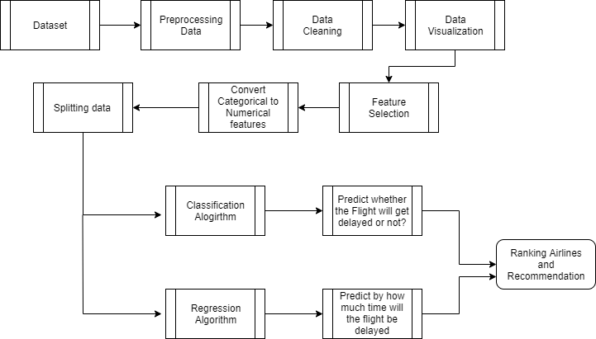
PREDICT FLIGHT DELAYS USING
SUPERVISED MACHINE LEARNING TECHNIQUE
Contact:
St. Joseph's College of Engineering
OMR, Semmanchery,
Chennai 600119
Guided By:
Mr. S. Vinu, M.E., (Ph.D.)

