Slide 1

Predict Flight Delays using Supervised Machine Learning Technique
Project Guide: Mr.S.Vinu M.E.,(Ph.D)
Assistant Professor
Department of Computer Science and Engineering
Presented By:
Saiprasaad K (312317104146)
Rohith Vigneshwar D (312317104143)

Slide 2
Abstract
In this project, we analyzed the various factors responsible for flight delays and applied machine learning models to predict whether a given flight would be delayed or not. Also with certain features we can predict how far the delay is going to be using some regression techniques like Random Forest Regression and Decision Tree Regression.
We also added a recommendation feature in which given a source and destination, we would list flights which are recommended to travel. Also we can know the percentage of Delay and Not delayed of a particular journey by entering Source , Destination and the name of Airlines.

Slide 3
Project Objectives
1. Given certain features, we would predict that whether a flight would be delayed or not.
2. Also we can predict, how far the delay would be in minutes.
3. We can also predict the percentage of delayed and non-delayed by giving the source, Destination and name of the Airlines.
4. Another feature was added to rank airlines and to recommend which airlines to prefer for a journey.

Slide 4
Existing System
The existing system deals with Time series forecasting of data which sees the data year wise and country wise. The existing system uses a approach of articulation point which is assumed to be having the greatest delay. And using arima modelling, the system has seen the change in the delay over years, concluding the delay of which airport is the delay most likely to occur in the country.
Disadvantages:
The existing system deals with year-wise timeseries forecasting and uses the approach of clustered networks, where the delay is forecasted only by airport wise. They are harder to explain and to interpret coefficients requires stationary series with constant autocorrelation

Slide 5
Proposed System
In the proposed system, we use classification algorithms like KNN Classification, XGB Classifier , Random Forest Classifier and Decision Tree Classifier to predict whether the flight would be delayed or not. Out of these algorithms XGB Classifier gives best accuracy using this algorithm we can predict whether the flight arriving in the destination will have delay or not. Also regression techniques are performed to predict arrival delays of how much delay is to occur. A feature of ranking and recommendation are also added for better travel.
Advantages:
Takes several features into account
Has predictions which helps both for airline management system and passengers
Recommendations are added to suggest flights for their journey

Slide 6
EXISTING SYSTEM | PROPOSED SYSTEM
Deals with Time-Series forecasting of data only by year | Deals with supervised machine learning solution involving various parameters
Uses a approach of articulation point which is assumed to be having the greatest delay. | No such approach of articulation point.
Country wise forecasting. | Origin , Destination and Airlines wise forecasting
Works only on small datasets | Works also on large datasets
Just shows the trend of delay over years. | Shows delayed or not , along with how much delay is to occur.
No recommendations of flights for journey is made. | Flights are ranked with score based on their delays and speed , recommendations are done.
Do not show the ratio of flights delayed and non delayed. | With the predicted value a pie chart is represented to know how far the flight is to get delayed.

Slide 7
Literature Survey
S No | Title | Name of the authors | Advantages | Disadvantages
1 | The Traffic Flow Management Rerouting Problem in Air Traffic Control: A Dynamic Network Flow Approach | Dimitris Bertsimas, Sarah Stock Patterson | Lagrangian Generation Algorithm is used which can quickly generate many non-integral solutions for the problem | Used randomized rounding heuristic Approach which provides a solution to air traffic congestion but fails to give a Optimum solution.
2 | Systemic delay propagation in the US airport network | Pablo Fleurquin, Jose´ J. Ramasco & Victor M. Eguiluz | The model offers the possibility of evaluating the effects of interventions in the system before their real implementation. | The analysis did not suit for all the possible cases as it takes into account only certain parameters

Slide 8
S No | Title | Name of the authors | Advantages | Disadvantages
3 | The architecture of complex weighted networks | A. Barrat, M. Barthe´lemy, R. Pastor-Satorras, and A. Vespignani | The analysis provide a better description of the hierarchies and organizational principles at the basis of the architecture of weighted networks. | In this, the impact of a local hazard/fault/disturbance can easily spread out to the whole system due to domino effect, cascading effect, and/or ripple effect and eventually evolves into a large-scale disaster
4 | A Light Statistical Method of Air Traffic Delays Prediction | Stanislav Tarasevych, Ivan Ostroumov | Statistical methods make it practical to measure the reliability of results. | Statistical data is often secondary data which means that is can be easily be misinterpreted. If sufficient care is not exercised in collecting, analyzing and interpreting the data, statistical results might be misleading

Slide 9
System Requirements
Hardware Requirements:
a) Processor -I3,I5,I7
b) RAM -4GB
c) Hard Disk -250GB
Software Requirements:
a) Python version 3.6 and above
b) Google colab software or Jupyter Notebook
Packages
Pandas
Numpy
Matplotlib
Xgboost
Sklearn
Flask

Slide 10
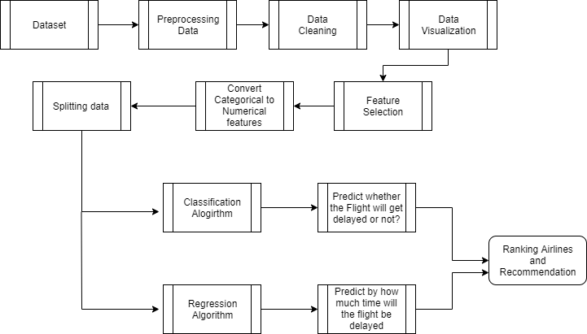
System Design
Architecture Diagram

Slide 11

Flow Chart Diagram

Slide 12
System Design
This project deals with predicting the flight delays using supervised machine learning techniques. The dataset which is obtained from Kaggle is first being imported and preprocessed. The processed data is cleaned to handle missing values and is visually represented in the form of graphs, charts and heatmaps.
The data with selected features is now fit into classification and regression algorithm for training. The trained data is then tested to get accuracy of models of both classification and regression techniques .The model with best accuracy is used for prediction. The model is further used to get recommendation to fly from a origin to destination, where airlines which is most preferable is represented as output.
Also one can see the ratio of delayed to not-delayed given their origin, destination along with airlines.

Slide 13
Modules
Exploring And Analyzing Data
Feature Selection And Label Encoding
Predicting Flight Delays
Ranking And Recommendation Of Flights
Deploying Using Django

Slide 14
Exploring And Analyzing Data
Importing Dataset:
The dataset was located from Kaggle, this dataset was collected from U.S department of transportation. The dataset tracks the performance of domestic flights within the united states.
Data Preprocessing
Handling missing values – The dataset contains small percentage of missing values for certain columns like Departure delay, taxi out and so on. These rows containing missing values are dropped as they make up a very small portion of the dataset

Slide 15
Exploratory Data Analysis:
Exploratory Data Analysis (EDA) is done to uncover relationships between different variables. A correlation matrix is drawn to measure how strong a relationship is between two variables, using which variables in strong relation to predicting delay is analyzed.
Visualizing Through Graphs
Several graphs and charts are drawn to present the data in a pictorial or graphical format and to analyze data visually. The data in a graphical format allows them to identify new trends and patterns easily. Fig 1 shows the scatter plot of airlines to no of minutes delayed. Overall proportion or percentage of airline companies in the dataset is represented as pie chart in Fig 2

Slide 16
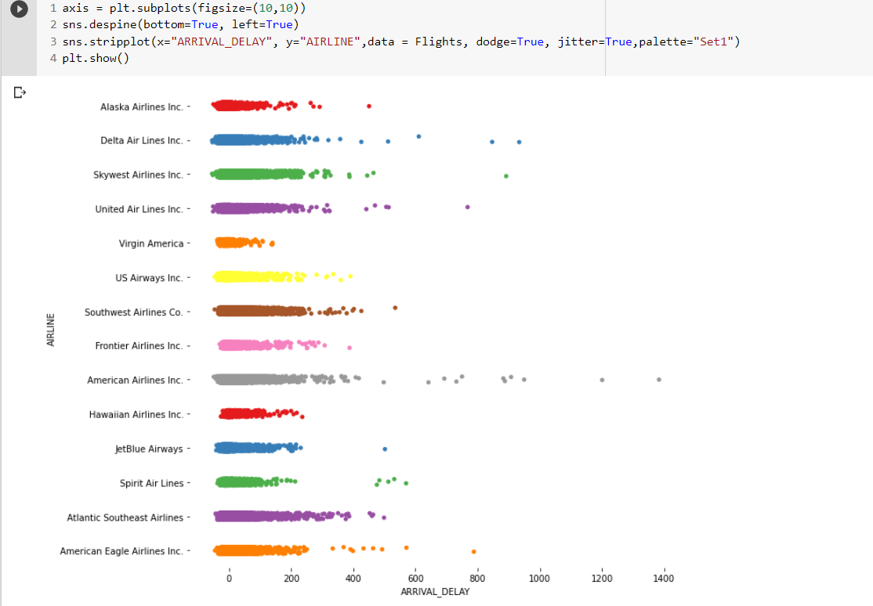
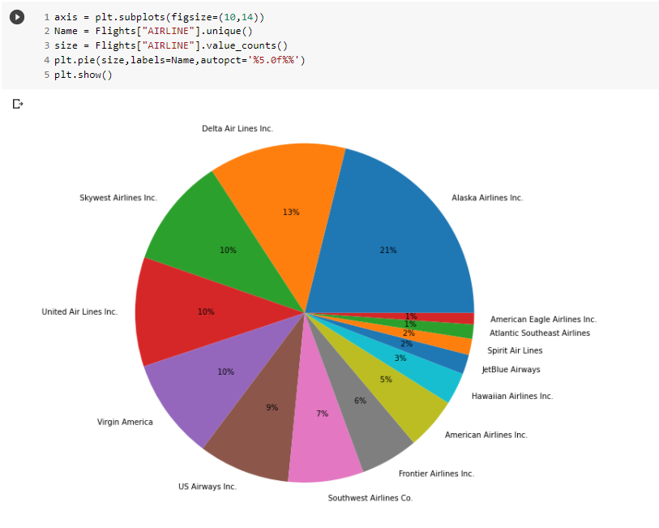
Fig 1 Scatter Plot
Fig 2 Pie Chart

Slide 17
Feature Selection And Label Encoding
Feature Selection :
The goal of this step is to find best set of features that allows one to build useful models of studied phenomena. So here certain features like Airline, Origin Airport, Destination Airport, Distance, Departure Delay, Scheduled Time, Airtime, Taxi Out are selected for prediction of flight delay
Label Encoding
Prediction can be done only when values in the data are in numbers. There are some categorial features which are to converted into number format. This step is called Label Encoding

Slide 18
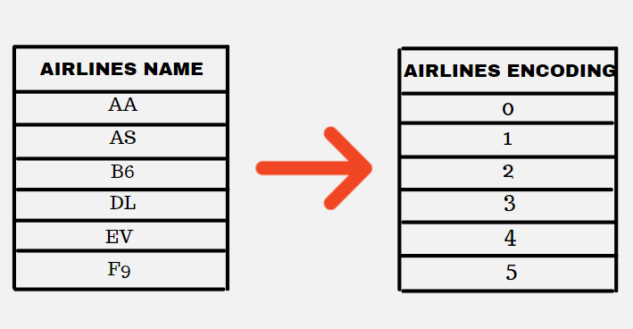
Table 1 Label Encoding
For Example, in this Table 1 the airlines name which is in the form of a string is being label encoded into number format which are then used for training

Slide 19
Predicting Flight Delays
We have several methods of prediction which some user can get the result of flight delay and by prediction with some more extra features the airline management can get the flight delayed prediction result.
Several algorithms like KNN, Decision Tree , Random Forest and XGBoost out of which XGBoost turns to have the best accuracy among all. Boosting is a sequential technique which works on the principle of an ensemble. It combines a set of weak learners and delivers improved prediction accuracy. At any instant t, the model outcomes are weighed based on the outcomes of previous instant t-1.

Slide 20
Predicting Whether or not Flight is Delayed
In this module, the primary aim is to predict flight is delayed (1) or not delayed (0) using features like origin, destination , airlines name, distance, airtime, departure-delay, taxi-out, scheduled time.
As these features are know only by the flight management system, this is useful for the airline management system to know how far these features can be altered to avoid delays.
Classification algorithm is used to predict this delayed or not-delayed status.

Slide 21
Predicting percentage of delay and non-delayed Percentage
In this module, the aim is to predict proportion of flight delayed and not delayed only by getting details of the origin, destination , airlines name.
The origin airport name, destination airport name and airlines name are got as input from the user, based on which other features are extracted from the dataset and finally the user gets a pie-chart of percentage of delayed to non delayed status.
This prediction also uses the XGBoost Classification model for prediction of flight delay.

Slide 22
Predicting delay value in minutes
In this module, the aim is to predict by how many minutes the flight will be delayed . This can be beneficial to airline management since they have all the features needed to prediction.
This uses regression techniques which explains the changes in criterions in relation to changes in select predictors.
Using XGBoost regression technique ,with the help of selected features delay of how much minutes the flight is going to get delayed is predicted.

Slide 23
Ranking and Recommendation
Users more often face a problem which is choosing the airlines for their journey. This To rank and recommend flights to the user we use certain features like flight delay, cancelled to operated ratio , speed which is calculated from airtime and distance.
For a origin and destination , the airways are grouped by their company and for each airline company the score is calculated accordingly. Then the airlines are sorted according to their scores and recommendations are given to the user, based on which the user can select the airlines to book for his journey.

Slide 24
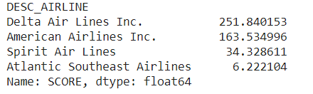
In this Table 2 the source given by user gives origin airport as Hartsfield–Jackson Atlanta International Airport and destination airport as Dallas/Fort Worth International Airport, so for the given source and destination the score is calculated and is displayed for the users in descending order of the scores for his comfortness
Table 2 Recommendations

Slide 25
Deployment using Django
A webpage using Django is created for user and airline transport system to get delays of flights and recommendations .In flight delay prediction page, user enters the source airport, destination airport and airlines name, so the percentage of delayed to not-delayed is returned to the user as a pie-chart to get an understanding about delays.
In another page the airline transport system can get the minutes of delay of airline giving details which are needed to predict the delays. Finally in another page of the website the user gives his source and destination of the journey by which he can get recommendations of the flights which he can prefer to fly for his journey.

Slide 26
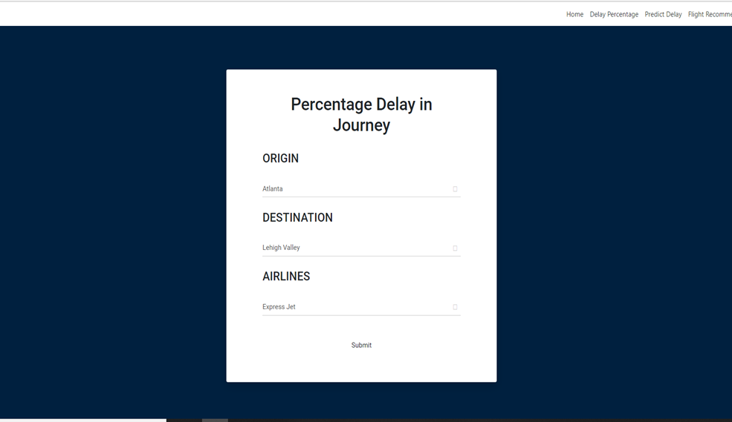
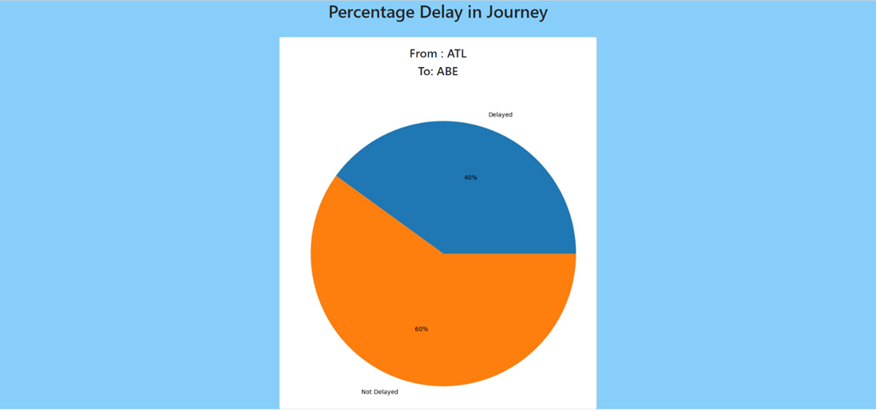
Sample Screenshots
Delay and Non Delay Percentage Result Webpage

Slide 27
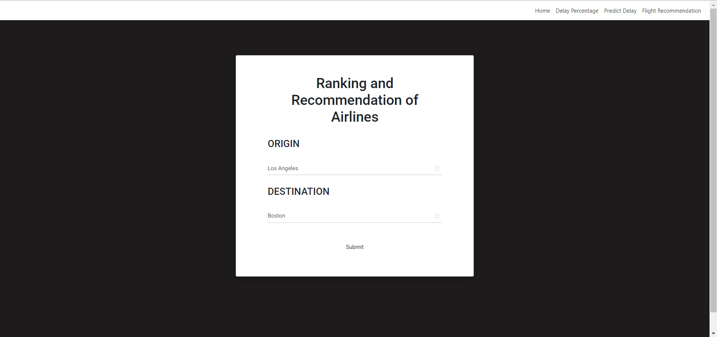
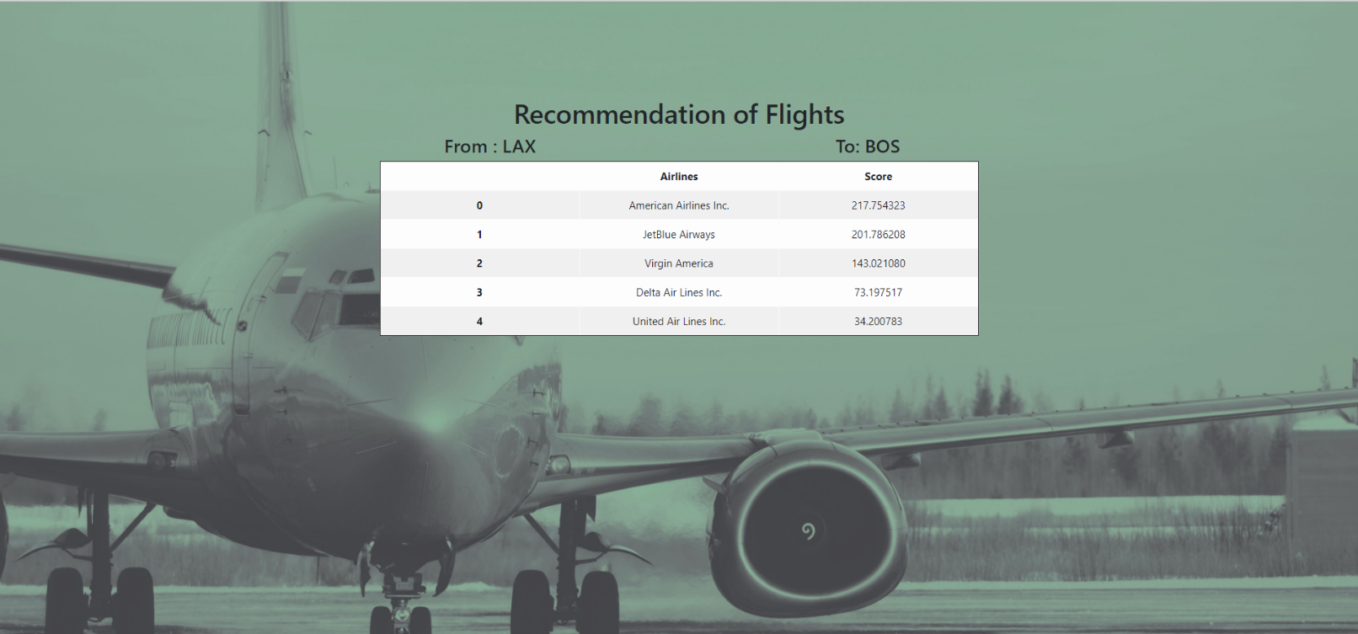
Sample Screenshots
Ranking and Recommendation Webpage

Slide 28
REFERENCE
1. J.E. Aronson, “A Survey Of Dynamic Network Flows,”Ann. Opns. Res. 20, 1–66
2. A. Barrat, M. Barthe´Lemy, R. Pastor-Satorras, And A. Vespignani,“The Architecture Of Complex Weighted Networks”, Pnas March 16, 2004 101 (11) 3747-3752;
3. Dimitris Bertsimas , Sarah Stock Patterson “The Traffic Flow Management Rerouting Problem In Air Traffic Control: A Dynamic Network Flow Approach” Https://Pubsonline.Informs.Org/Doi/Abs/10.1287/Trsc.34.3.239.12300
4. L. R. Ford And D. R. Fulkerson, Flows In Networks, Princeton University Press, Princeton, New Jersey, 1958.
5. L. Macdonald, “Collaborative Decision Making In Aviation,” J. Air Traffic Control 40, 12–17 (1998).

Slide 29
6. Pablo Fleurquin , Jose Javier Ramasco And Víctor M. Eguíluz,“ Systemic Delay Propagation In The Us Airport Network” , 10.1038/Srep01159
7. Stanislav Tarasevych; Ivan Ostroumov, “A Light Statistical Method Of Air Traffic Delays Prediction,”. 2020 Ieee 2nd International Conference On System Analysis & Intelligent Computing (Saic)
8. Shuai Li , Yuelei Xu, Mingming Zhu, Shiping Ma, And Hong Tang, “Remote Sensing Airport Detection Based On End-To-End Deep Transferable Convolutional Neural Networks”,Ieee Geoscience And Remote Sensing Letters ( Volume: 16, Issue: 10, Oct. 2019)
9. P. Vranas, D. Bertsimas, And A. R. Odoni, “Dynamic Ground-Holding Policies For A Network Of Airports,” Transp. Sci. 28, 275–291 (1994b)
10. P. Vranas, D. Bertsimas, And A. R. Odoni, “The Multiairport Ground-Holding Problem In Air Traffic Control,” Opns. Res. 42, 249–261 (1994a).

Slide 30
Thank You

