Slide 1

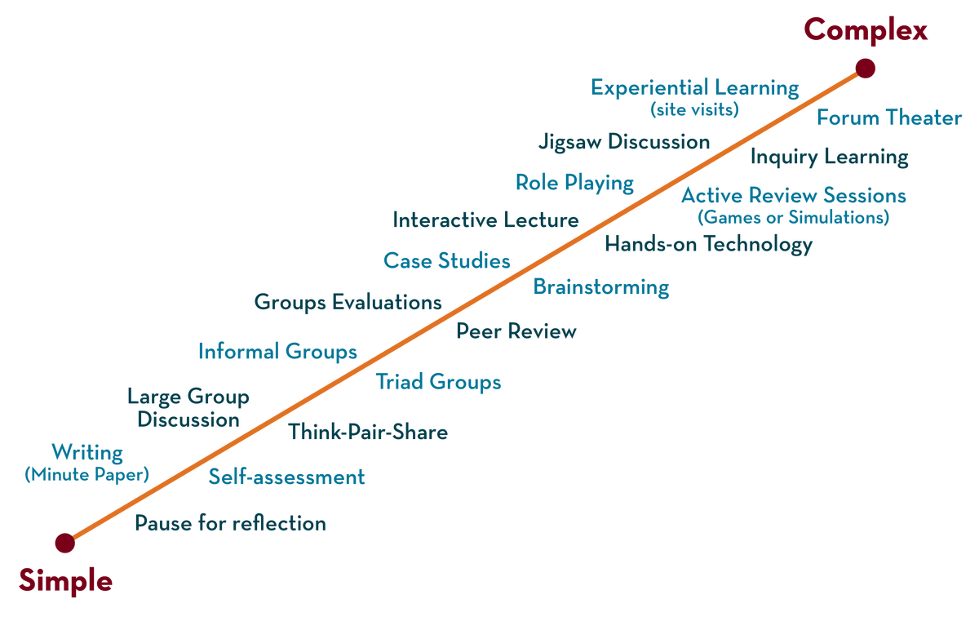
Department of CSE
Deep Learning
20CS3269AA
Topic:
Bias Variance tradeoff,
L2 Regularization
Session - 1

Slide 2



AIM OF THE SESSION
To familiarize students with the basic concept of Bias, Variance and Early stopping
INSTRUCTIONAL OBJECTIVES
This Session is designed to:
Demonstrate between Bias and variaance
Describe the decomposition of error rate in Bias and Variance
List out the regularization methods
Describe the L2 regularization
LEARNING OUTCOMES
At the end of this session, you should be able to:
Define bias, variance, L2 regularization
Describe Error rate in bias variance tradeoff
Summarize types of regularization

Slide 3
SESSION INTRODUCTION
Bias Variance tradeoff
In simple terms,
Bias = A simple model that under-fits the data
conversely…
Variance = A complex model that over-fits the data

Slide 4
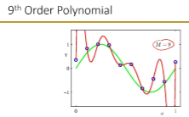
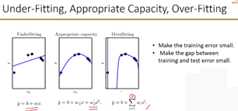
SESSION DESCRIPTION

Slide 5
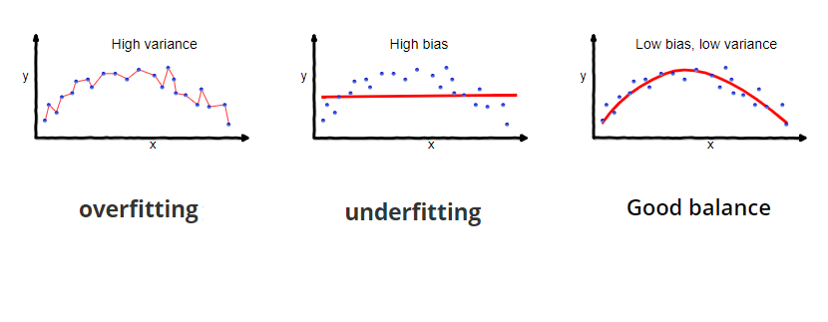
SESSION DESCRIPTION (Cont..)

Slide 6
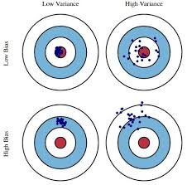
EXAMPLES

Slide 7
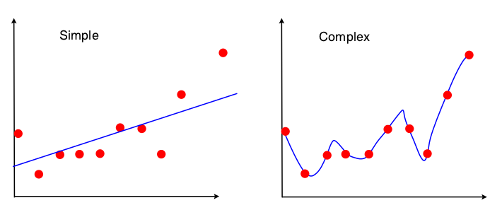
SESSION DESCRIPTION (Cont..)

Slide 8
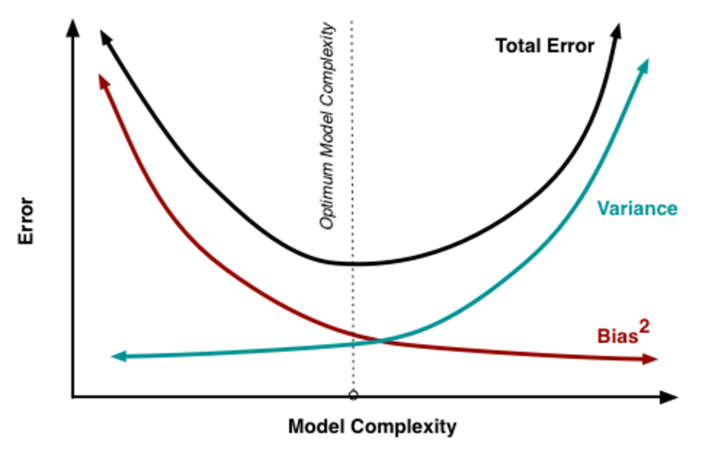
SESSION DESCRIPTION (Cont..)
ACTIVITIES/ CASE STUDIES/ IMPORTANT FACTS RELATED TO THE SESSION

Slide 9

Regularization
More generally, to regularize a model, a penalty is added to the Cost function. This is called a Regularizer:Ω(w)
Hence, the Cost function becomes J(w) = MSE_{train} + λ * Ω(w)
In case of weight decay, this penalty is represented by
In essence, in the weight decay example, linear functions with smaller weights were preferred. This was done by adding an extra term to minimize the Cost function.

Slide 10

Cost function = Loss (say, binary cross entropy) + Regularization term
this regularization term differs in L1 and L2.
In L2, we have:

Slide 11
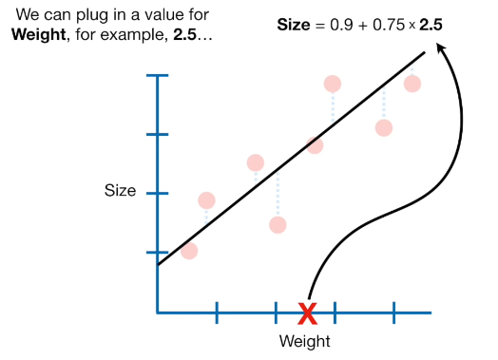
SESSION DESCRIPTION (Cont..)
L2 Regularization or Ridge Regularization
The L2 regularization is the most common type of all regularization techniques and is also commonly known as weight decay or Ride Regression.

Slide 12
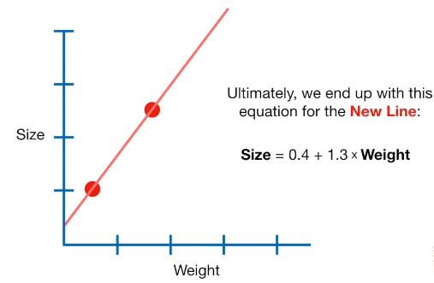
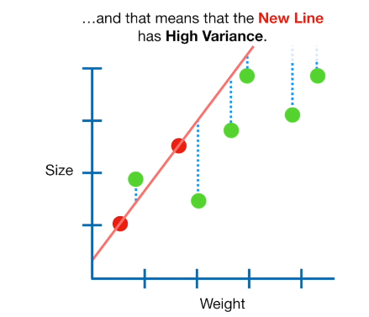
SESSION DESCRIPTION (Cont..)

Slide 13
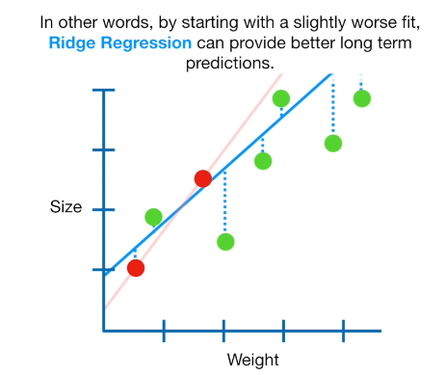
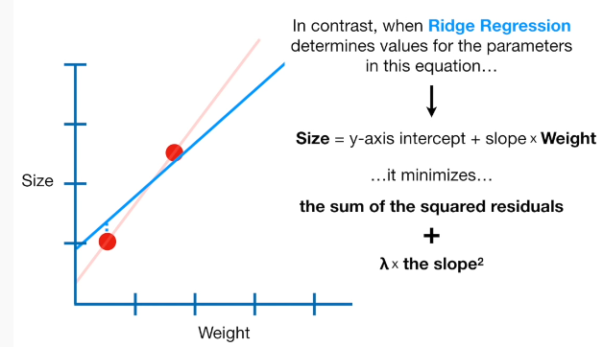
SESSION DESCRIPTION (Cont..)

Slide 14
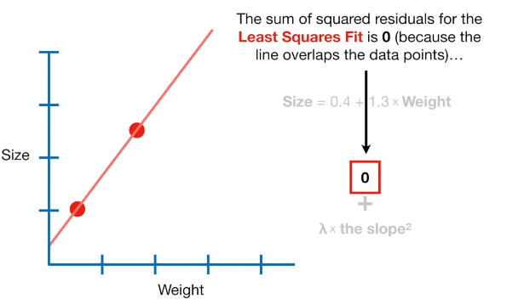
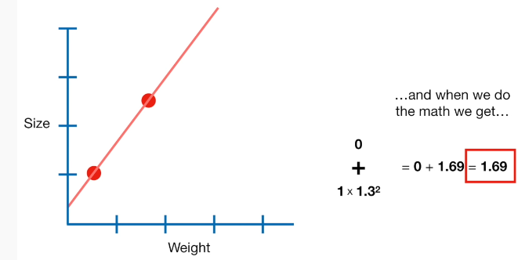
SESSION DESCRIPTION (Cont..)

Slide 15
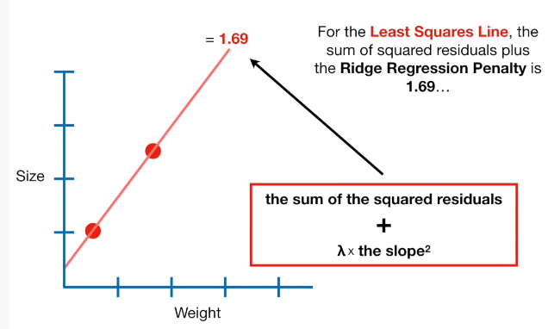
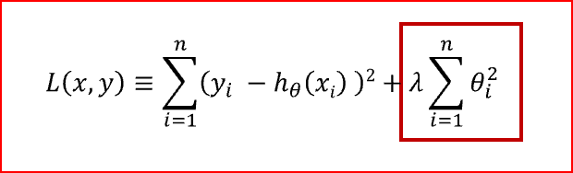
SESSION DESCRIPTION (Cont..)

Slide 16
SUMMARY
Suppose your deep learning model is performing very badly on a set of data because it is not generalizing to all your data points. This is when you say you model has high Bias. The phenomenon occurs when the model is under fit.
Suppose your deep learning model tries to account for all or mostly all points in a dataset successfully. If it then performs poorly when run on other test data sets, it is said to have high variance. Variance therefore occurs when the model is overfit.
Traditional methods like cross-validation and stepwise regression to perform feature selection and handle overfitting work well with a small set of features but L1 and L2 regularization methods are a great alternative when you’re dealing with a large set of features

Slide 17
TERMINAL QUESTIONS
1. Describe Bias, Variance tradeoff
2. List out different forms of regularization
3. Analyze expected squared error in bias, variance trade-off and how it can be decomposed
4. Summarize the concept of L2 regularization

Slide 18
REFERENCES FOR FURTHER LEARNING OF THE SESSION
Reference Books:
1. Deep Learning with Python, Francois Chollet , Manning publications, 2018
2. Grokking Deep Learning ,Andrew Trask, Manning publications, 2019
3. Ian Goodfellow and Yoshua Bengio and Aaron Courville (2016) Deep Learning Book.
Sites and Web links:
https://towardsdatascience.com/bias-variance-and-regularization-f3a0eefe99af
2. https://builtin.com/data-science/l2-regularization
3. https://www.excelr.com/blog/data-science/regression/l1_and_l2_regularization#:~:text=Ridge%20Regression%20(L2%20Regularization)&text=The%20main%20algorithm%20behind%20this,independent%20variables%20are%20highly%20correlated).

Slide 19
THANK YOU

