Slide 1

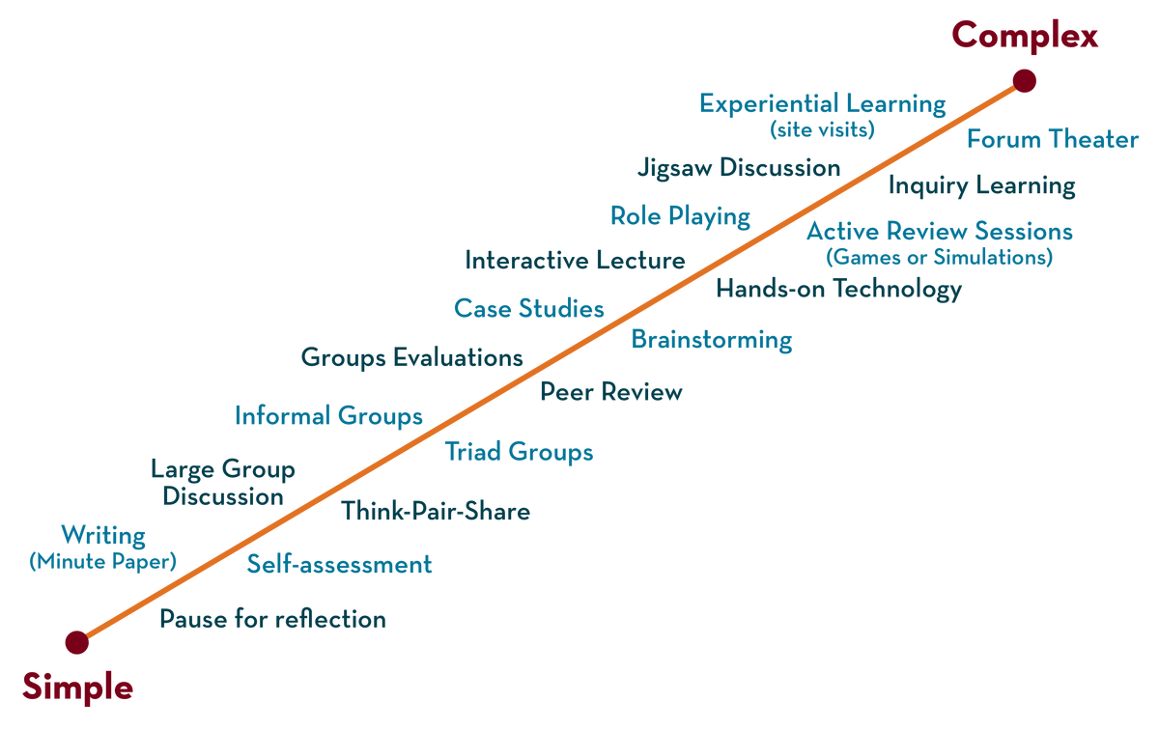
Department of CSE(H)
Deep Learning
20CS3269AA
Topic:
Data augmentaion
Session - 12

Slide 2



AIM OF THE SESSION
To familiarize students with the basic concept of Data Augmentation
INSTRUCTIONAL OBJECTIVES
This Session is designed to:
Demonstrate the concept of Data Augmentation
Describe the methods used for data augmentation
List out the applications of Data Augmentation
Describe the image augmentation techniques
LEARNING OUTCOMES
At the end of this session, you should be able to:
Define what Data augmentation is.
Describe how data augmentation can reduce overfitting of data
Summarize usage and applications of data augmentation

Slide 3
SESSION INTRODUCTION
The best way to make a machine learning model generalize better is to train it on more data.
in practice, the amount of data we have is limited
Overfitting is caused by having too few samples to learn from, rendering you unable to train a model that can generalize to new data.
Given infinite data, your model, would be exposed to every possible aspect of the data distribution at hand: you would never overfit.
One way to get around this problem is to create fake data and add it to the training set.
Notes:
<number>

Slide 4
SESSION DESCRIPTION
For some machine learning tasks, it is reasonably straightforward to create new fake data
Data augmentation takes the approach of generating more training data from existing training samples, by augmenting the samples via a number of random transformations that yield believable-looking images
The goal is that at training time, your model will never see the exact same picture twice.

Slide 5
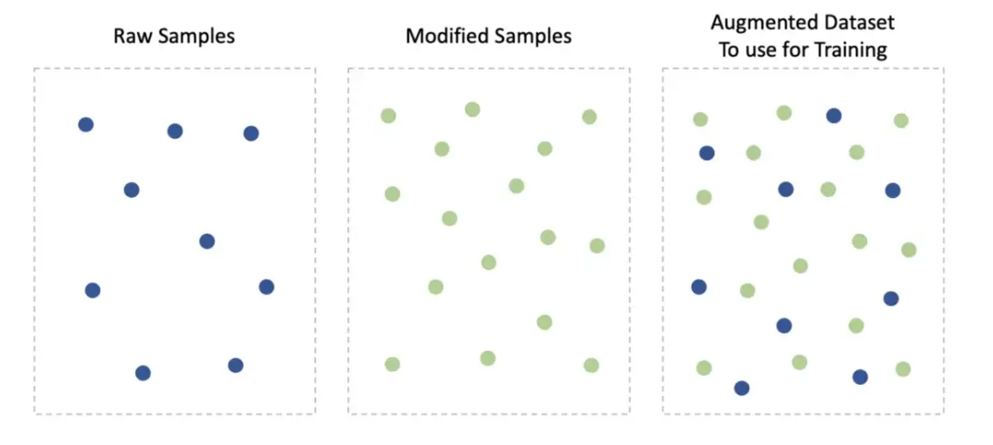
SESSION DESCRIPTION
Visualization of Data Augmentation technique

Slide 6
SESSION DESCRIPTION (Cont..)
This helps expose the model to more aspects of the data and generalize better.
Operations like translating the training images, rotating the image or scaling the image are effective for data augmentation
Applications:
Dataset augmentation has been a particularly effective technique for a specific classification problems like object recognition.

Slide 7
SESSION DESCRIPTION (Cont..)
Dataset augmentation is effective for speech recognition tasks as well
Injecting noise in the input to a neural network can also be seen as a form of data augmentation.
Data augmentation can also be used in other domains - time series analysis, audio processing.

Slide 8
ACTIVITIES/ CASE STUDIES/ IMPORTANT FACTS RELATED TO THE SESSION
Casestudy: Data augmentation for computer vision — Image Augmentation
Assume, you’d like to train a “Cat versus Dog?”
You’ve already collected 400 cat images and 400 dog images. 800 images probably are not enough to create high performing model.
so you want to use a Data Augmentation.
how to modify images to increase the dataset?

Slide 9
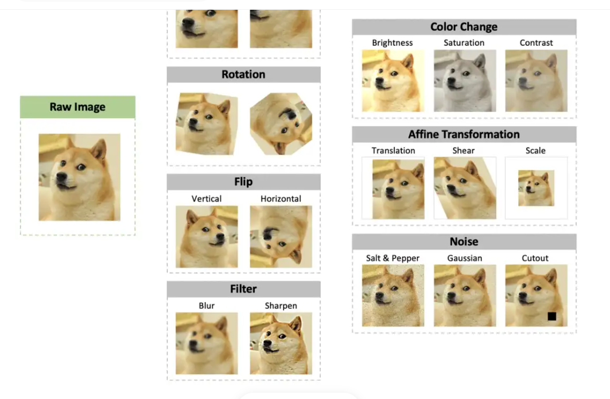
EXAMPLES
List of the most popular image augmentations:

Slide 10
EXAMPLES
Above list is not limited.
There are so many ways to change an image
Sometimes, after augmentation blank borders may appear. By default, the augmentation libraries fill blank pixels with white, black, or grey color. You may leave it as it is, or go further and:
Change the color to some other, for instance, blue.
Replicate pixels — duplicate pixels close to the border to fill blank space.
Reflect — mirror image part that is close to the border.
Wrap — copy pixels from another side of the image.

Slide 11
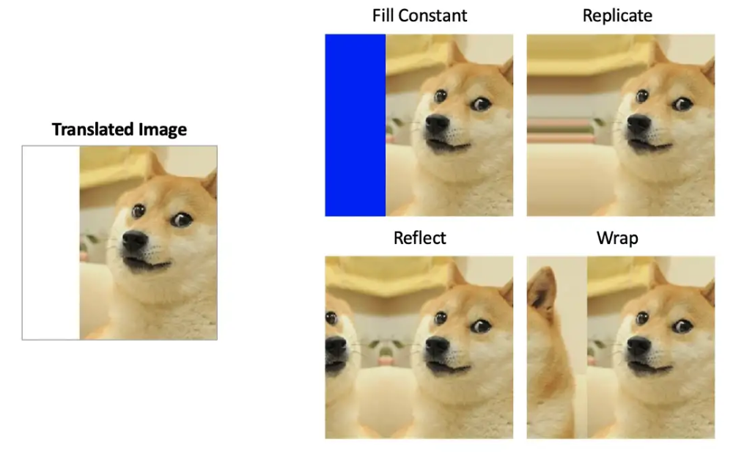
EXAMPLES

Slide 12
EXAMPLES
One must be careful not to apply transformations that would change the correct class.
Sometimes, depending on the dataset you use, some data augmentations may not only change images but also their labels.
For example:
1. optical character recognition tasks require recognizing the difference between ‘b’ and ‘d’ and the difference between ‘6’ and ‘9’, so horizontal flips and 180◦ rotations are not appropriate ways of augmenting datasets for these tasks.

Slide 13
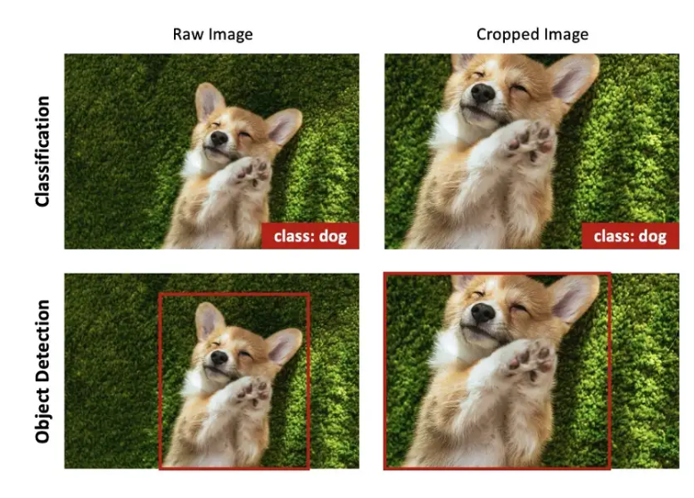
EXAMPLES
When training the “Cat versus Dog?” classifier, none of the augmentations would create a cat from a dog.
For instance, when cropping an image, part of the dog is still a dog.
However, if you are solving an object detection task, such as “Find a dog in the image”, the crop will change a location label (bounding box) of the original image.

Slide 14
SUMMARY
On a small dataset, overfitting will be the main issue. Data augmentation is a powerful way to fight overfitting when you’re working with image data.
More data = better model.
Data Augmentation helps overcome the “not enough data” issue, prevents overfitting, and makes the model perform better on previously unseen samples.
And no additional efforts are needed — to collect data or label data, which sometimes may be costly or unfeasible
Data augmentation is used in many domains — Natural Language processing, Time series Analysis, Audio Processing, Computer Vision

Slide 15
SELF-ASSESSMENT QUESTIONS
Data Augmentation is used for solving problem of __________________.
overfitting
underfitting
bais
variance
How to choose augmentation for specific task?
Business need
Domain expertise
Common sense
Can use any technique

Slide 16
TERMINAL QUESTIONS
1. Describe data augmentation and its applications.
2. List out image augmentation techniques.
3. Analyze data augmentation techniques for Natural Language Processing.
4. Summarize various data augmentation methods

Slide 17
REFERENCES FOR FURTHER LEARNING OF THE SESSION
Reference Books:
1. Ian Good fellow, Yoshua Bengio, Aaron Courville - Deep Learning (2017, MIT)
2. Deep Learning with Python, François Chollet
Sites and Web links:
1. https://towardsdatascience.com/complete-guide-to-data-augmentation-for-computer-vision-1abe4063ad07
2. https://towardsdatascience.com/data-augmentation-for-deep-learning-4fe21d1a4eb9

Slide 18
THANK YOU
Team – Course Name

